Slide 1
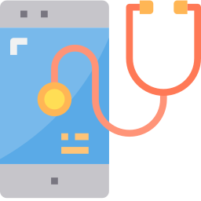
Selected Track
Health

Slide 2
Problem Statement
India is a hotbed of tech innovations and startups across the world. Tech-equipped medical devices and the development of top-notch technology for critical ailments such as heart diseases, diabetes, and cancer are already bringing laurels to Indian health-tech startups.
Create Solutions to deal with these two major challenges faced by the patients:
Enabling a patient-centered information exchange system.
Personal medical assistant.

Slide 3
OUR SOLUTION
MedDoc
One interface for all hospitals in India.
Patients registered with us can access all the hospitals and make appointments with doctors.
The hospitals can edit and structure the home page on our website.

Slide 4
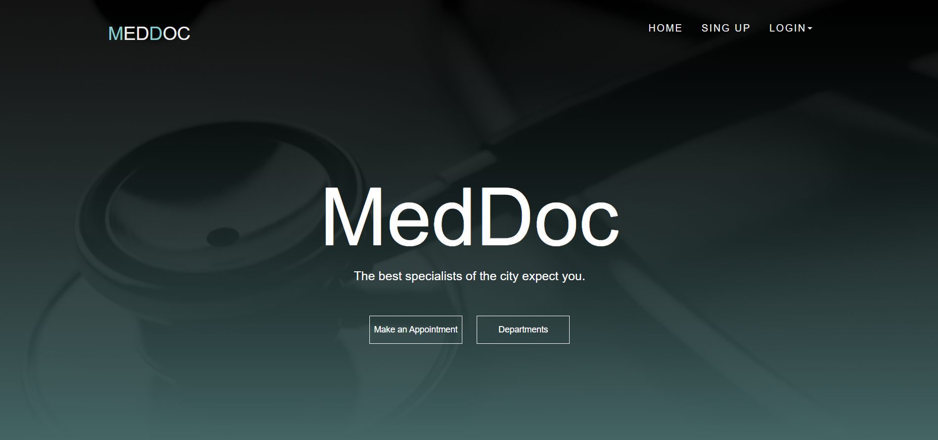

Slide 5
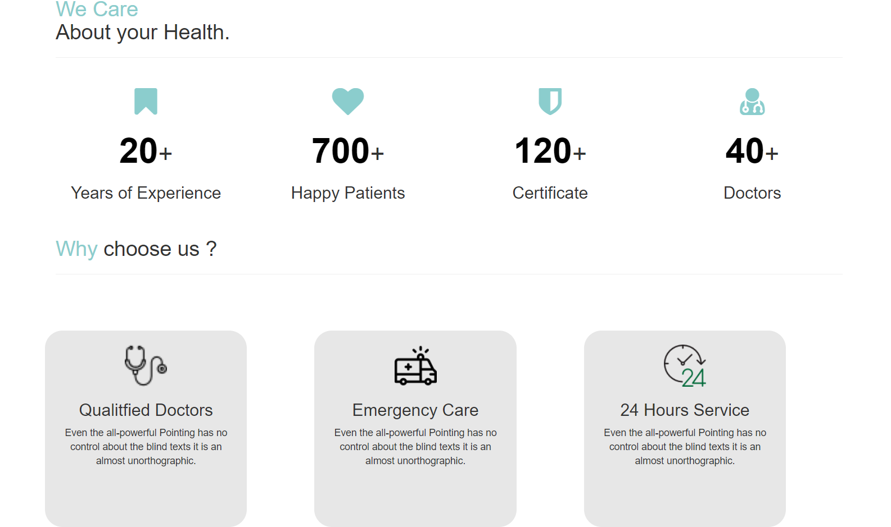

Slide 6
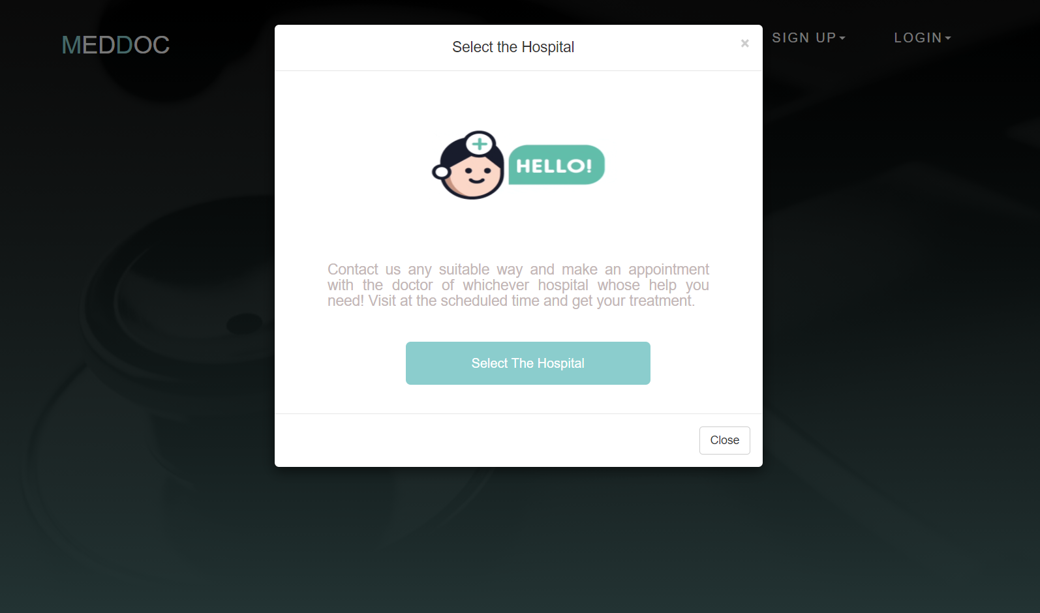

Slide 7
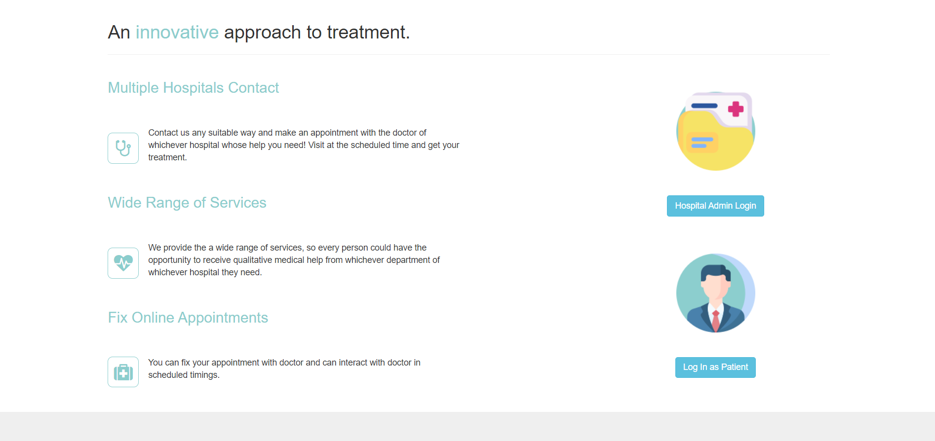

Slide 8

Simple interface to get the access to all the hospitals present in India virtually
You can virtually visit hospitals across India and get to know about the departments , lab test and qualifications and availability of a doctor of a particular hospital.

Slide 9

Book appointment according availability.
Every time you have to visit hospital , to get an appointment. With this website, you don’t need to visit the hospital. You simply go on the internet and book your appointment.
You can see availability of the doctor and book your appointment without messing up your schedule.

Slide 10
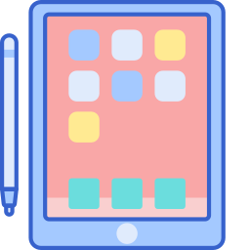
Reduce Paperwork
Paper documents can take up a significant amount of space, and the quantity of paper will increase day by day. Furthermore, documents will typically need to be stored close to hand so that they can be accessed as quickly as possible.
A patient can access his medical history through any device by just logging into his/her account on MedDoc , this would eliminate the need for carrying physical documents everywhere and thus, reduce the need of paperwork.

Slide 11

Does away with the existing
This system targets to provide complete solution for Hospital and Health Care Services.
This system can be used in Hospital , Clinic , Diagonistics or Pathology Labs for maintaining Patient Details and their test results.

Slide 12

Hospital admins can accordingly change the data
Hospital admins can change and delete data according to the hospital
They can update departments and about patients as well.

Slide 13
Future Prospects

Slide 14

View prescription
Do you require regular prescriptions for your health condition?
A legal and digitally signed prescription is generated for the patients by using MedDoc and can be provided to pharmacist and this could eliminate the false practises of using fake prescriptions by the people

Slide 15

Search Hospitals by location
One can search hospital in a particular location.
This means that anyone from any corner of the world can have access to your healthcare center’s information.

Slide 16

More Editable Hospitable Page
Hospitals admins can edit more information about hospitals , it’s doctors and departments.

Slide 17
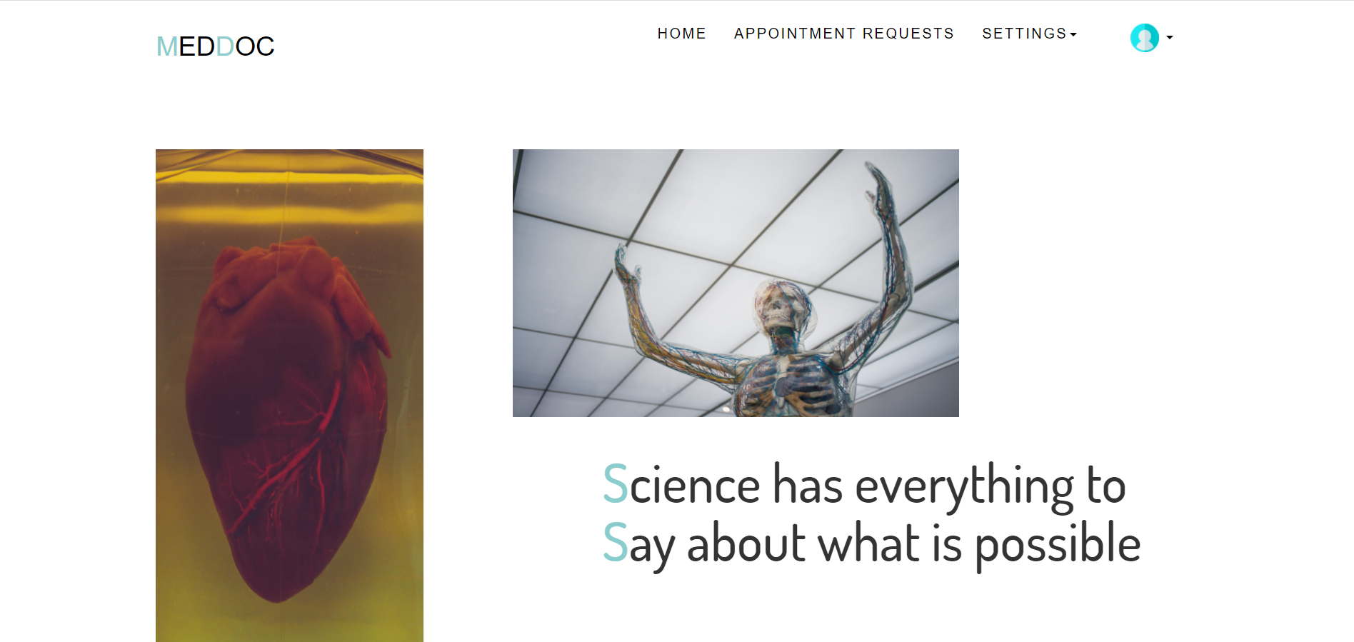

Slide 18
Video Link
https://drive.google.com/file/d/1TJy1Se_6PZxwMPhVA02VF0IGVVvU1OoE/view?usp=sharing

Slide 19
ABOUT TEAM
1. Aarchie Girdhar
Department : Computer Science
Batch : 2019
Roll Number : 1910990235
Email: aarchie0235.cse19@chitkara.edu.in
2. Divyanshi Bajpai
Department : Computer Science
Batch : 2019
Roll Number : 1910990278
Email: divyanshi0278.cse19@chitkara.edu.in
3. Paras Chaudhary
Department : Computer Science
Batch : 2019
Roll Number : 1910991638
Email: paras1638.cse19@chitkara.edu.in
4. Shaurya Kaushal
Department : Computer Science
Batch : 2019
Roll Number : 1910990237
Email: shaurya0237.cse19@chitkara.edu.in

