Slide 1
Bank of CLI
Aarej Syed

Slide 2
Project Overview
Bank of CLI’s Core Ledger is a prototype banking application that runs in the command terminal
The Core Ledger provides:
  Account registration and login
  Account balance checking
  Bank transactions: deposit, withdrawal, and transfer
  Bank transaction history
  System logging

Slide 3
Technology Stack
Java: Programming language
Maven: Build tool
PostgreSQL: Database language
JDBC: Database communication
Junit 5 and Mockito: Testing
SLF4J/Logback: Logging

Slide 4

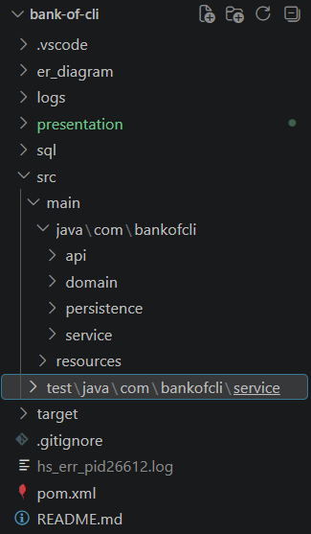
Project Structure
The application’s Java codebase is divided among four subdirectories:
  api/
  service/
  domain/
  persistence/
This establishes a multilayer software architecture where different layers have different responsibilities

Slide 5
Multilayer Architecture
API: Displays information to the user and handles user input
Service: Handles business logic; the “brain” of the application
Domain: Provides abstraction over database tables and records
Persistence: Talks to the database and “Translates” between Java and SQL

Slide 6
Object-Oriented Programming
And how the Bank of CLI Core Ledger applies it

Slide 7
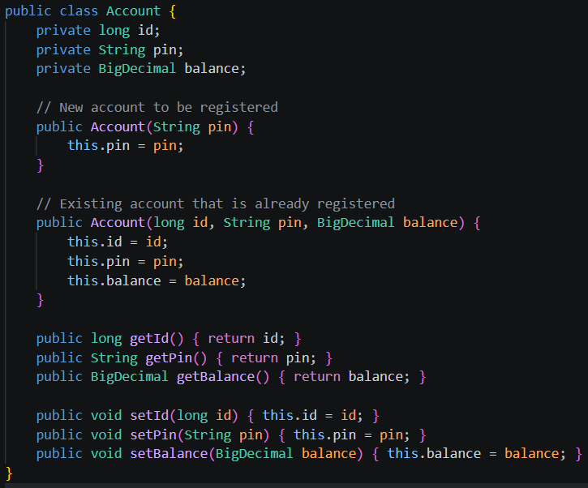
OOP: Encapsulation
Classes hide private members and expose them to the outside world through public getter and setter methods

Slide 8
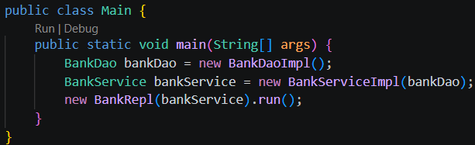
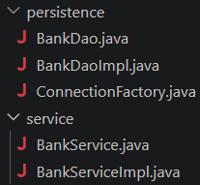
OOP: Abstraction
The service layer and the DAO (persistence layer) are not just concrete classes
Each has an interface and a concrete implementation
We access these objects through interfaces rather than directly through the concretion
This means we don’t need to concern ourselves with the implementation of these classes when using them

Slide 9
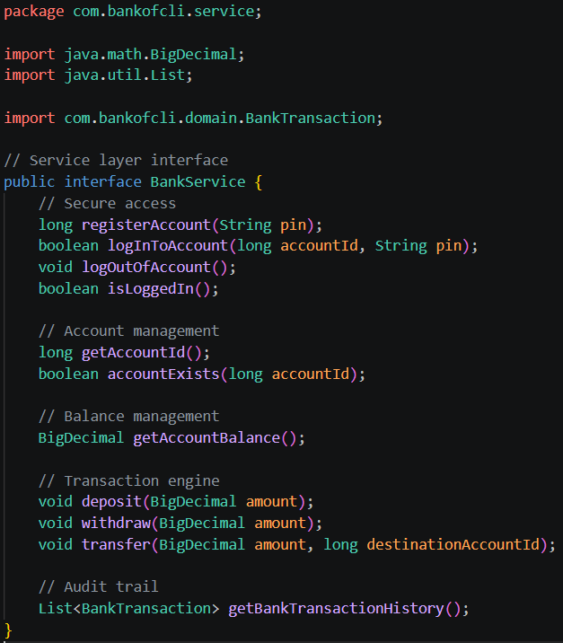
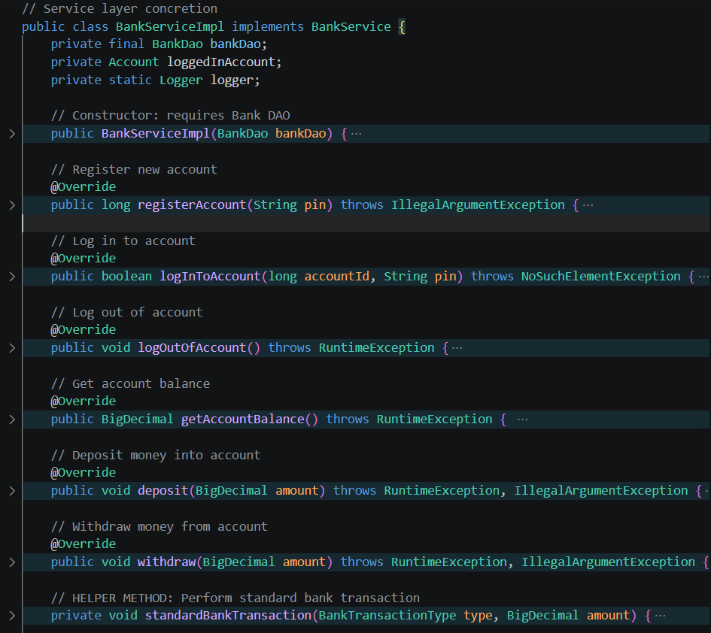
OOP: Abstraction (Continued)

Slide 10
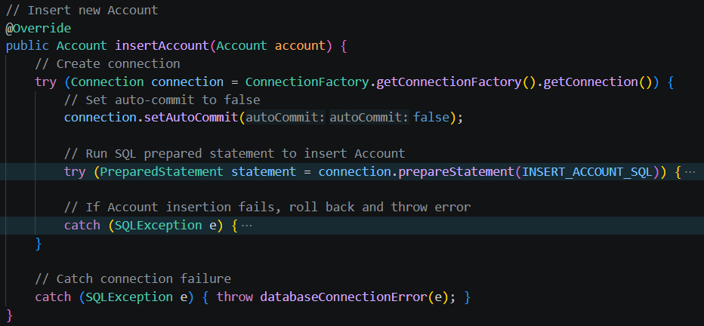
OOP: Polymorphism
The concretions of the service and persistence interfaces override the interface methods and provide their own functionality

Slide 11
Database Design
How the Core Ledger stores, manages, and represents data

Slide 12
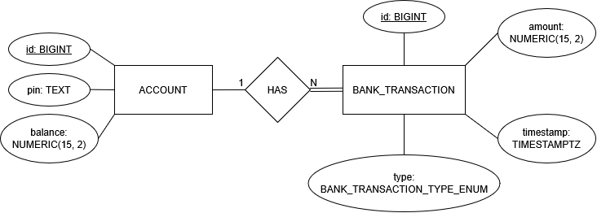
Database Design
Our database contains ACCOUNT and BANK_TRANSACTION tables
It also defines the custom enum type, BANK_TRANSACTION_TYPE_ENUM, with values ‘deposit’, ‘withdrawal’, ‘transfer_in’, and ‘transfer_out’
ACCOUNT and BANK_TRANSACTION have a 1:N relationship
ACCOUNTs do not need to have BANK_TRANSACTIONs, but BANK_TRANSACTIONs must be linked to accounts

Slide 13
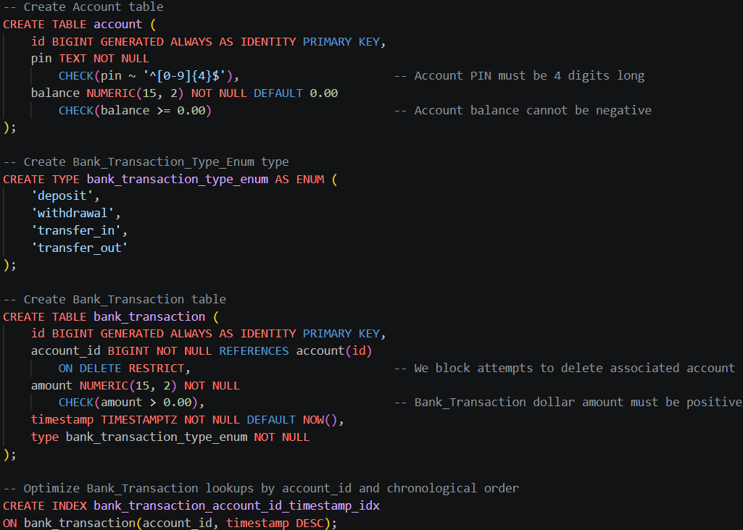
Database Design
Checks
  PIN must be a 4-digit string
  Balance cannot be negative
  Amount of money involved in a transaction must be positive
To preserve transaction history, we prevent account deletion if it has associated transactions
Indexing optimizes BANK_TRANSACTION lookups

Slide 14
Defensive Design
How the Core Ledger anticipates and protects against unexpected scenarios

Slide 15
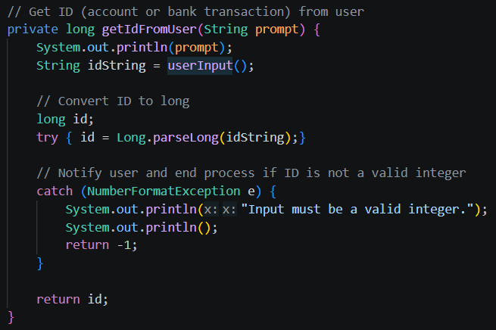
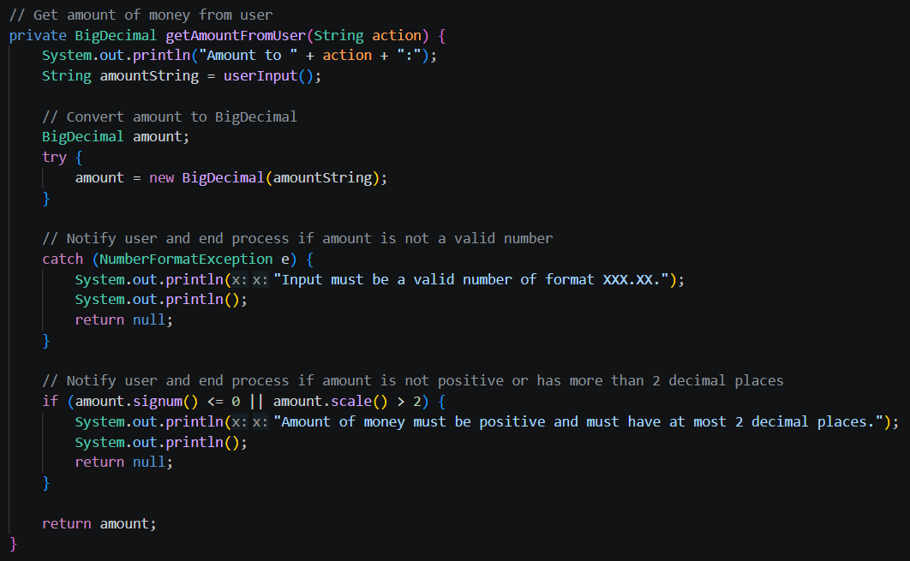
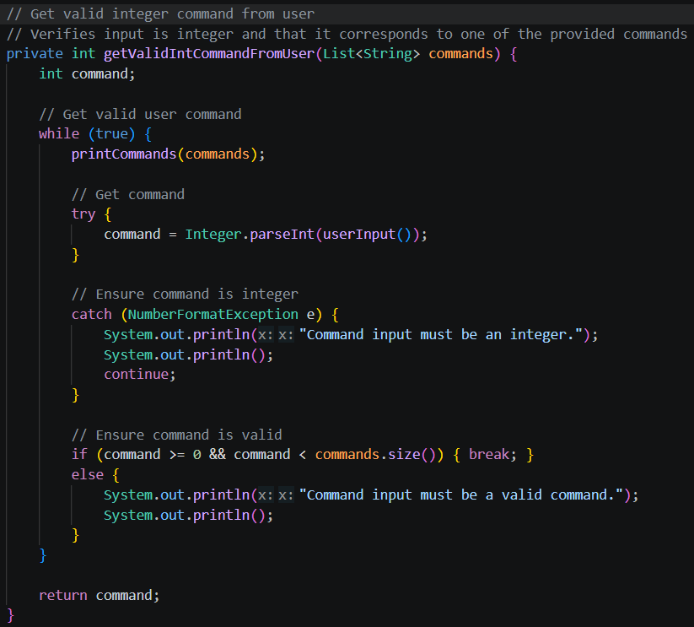
Defensive Design: Input Validation
The Core Ledger performs quick validations of user input:
Integer commands
Numeric input
`long`-type IDs

Slide 16
Defensive Design: Internal Rules
The Core Ledger also enforces internal rules after basic input validation, such as:
PIN validation
Verification of user log-in status
Nonexistent-account handling
Same-account transfer prevention
Overdraft prevention

Slide 17
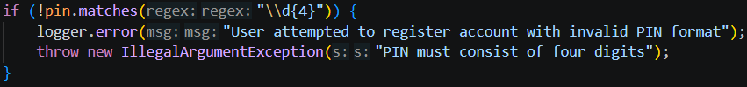
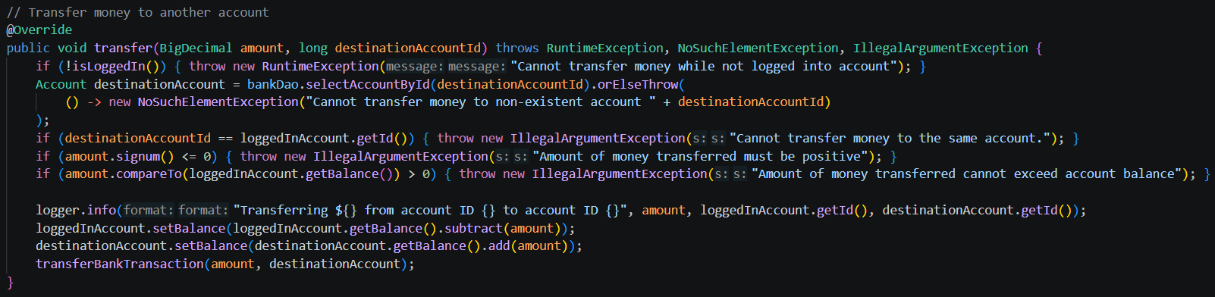
Defensive Design: Internal Rules (Continued)

Slide 18
Communicating with the Database

Slide 19
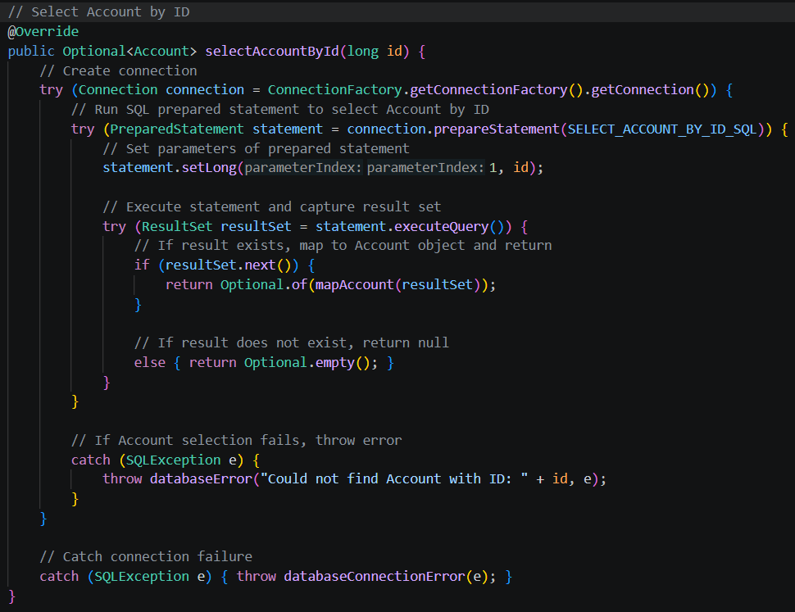
SecuritY
Core Ledger uses prepared statements when communicating with the database
By separating the data from the query itself, Core Ledger prevents SQL injections

Slide 20
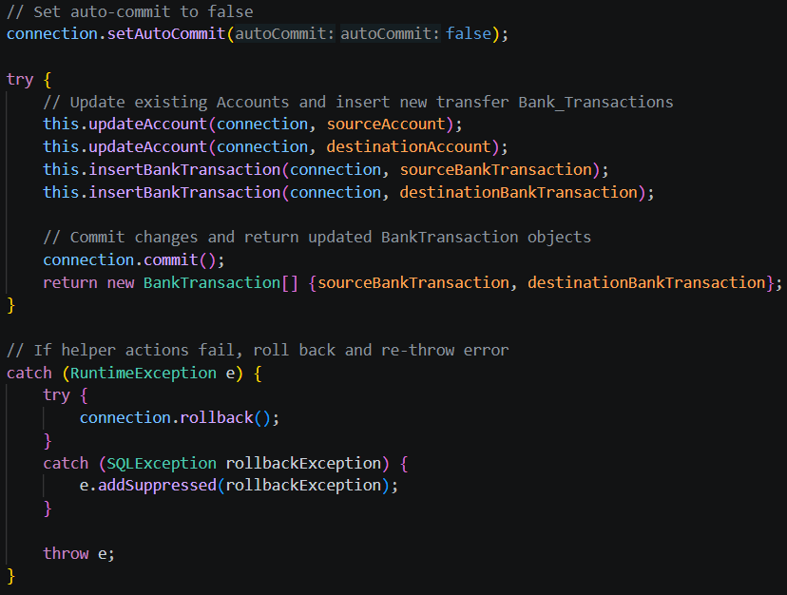
Database Transactions
Multi-step operations (e.g. bank transactions) are bundled into one database transaction
This ensures operation is atomic
Persistence layer commits a transaction if all steps were successful
If even one step fails, persistence layer rolls back commit

Slide 21
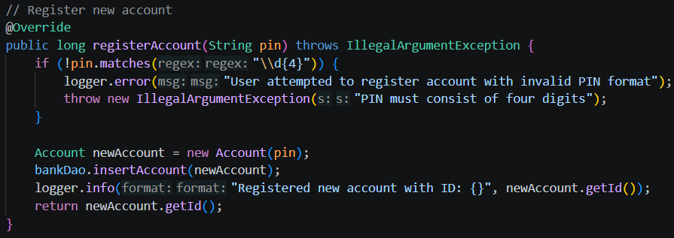
Logging and Errors
Core Ledger records application actions in a log file
When errors arise, the application displays a user-friendly description of the error

Slide 22
Testing
Core Ledger uses Junit 5 and Mockito for positive and negative tests, verifying both that a method works with valid input and that it properly handles invalid input
  Junit 5 enables unit tests and Mockito enables the mocking of objects
  This means we can use a mock DAO in unit tests without needing to test the database connection

Slide 23
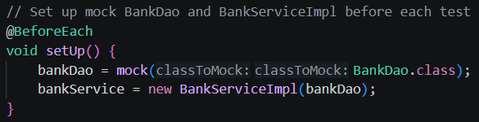
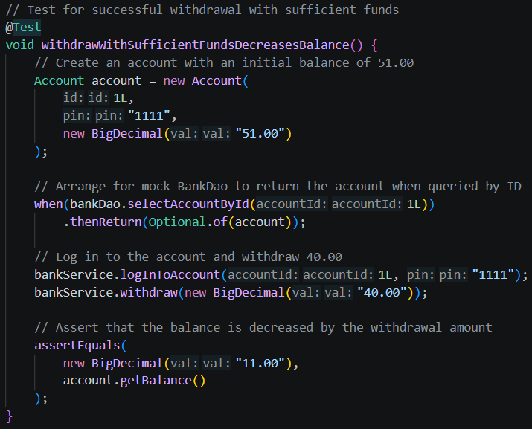
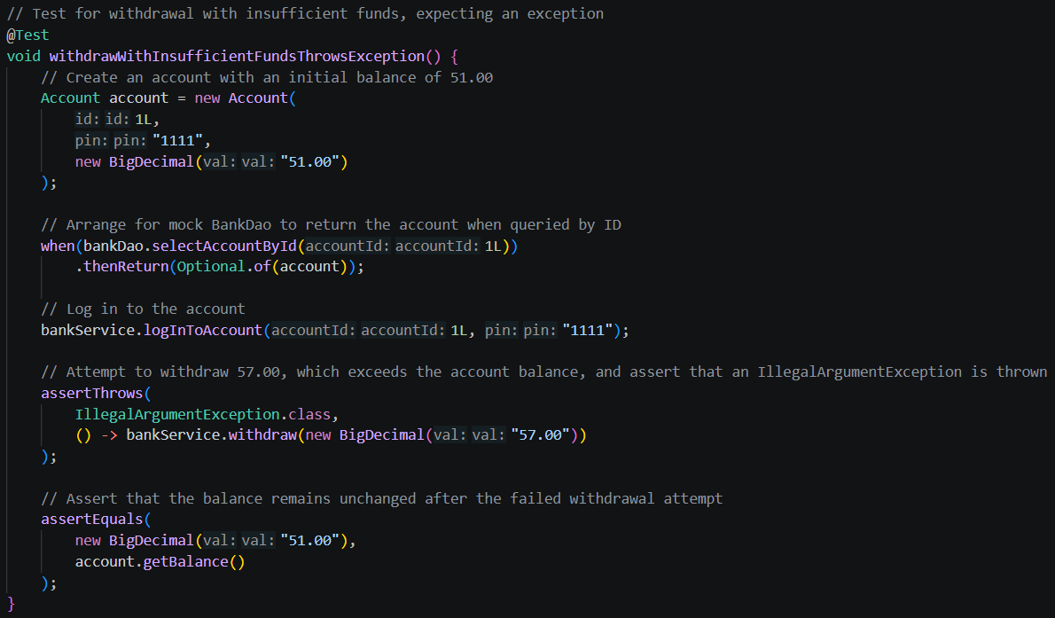
Testing (Continued)

Slide 24
Live Demonstration and Q&A

