Slide 1
Calling 470 races
How we forecast every House and Senate race of 2026, and why most of our picks are underdogs
Aaren Sun & Amun Reddy · Stanford Democracy Day, Model Citizens 2026

Slide 2
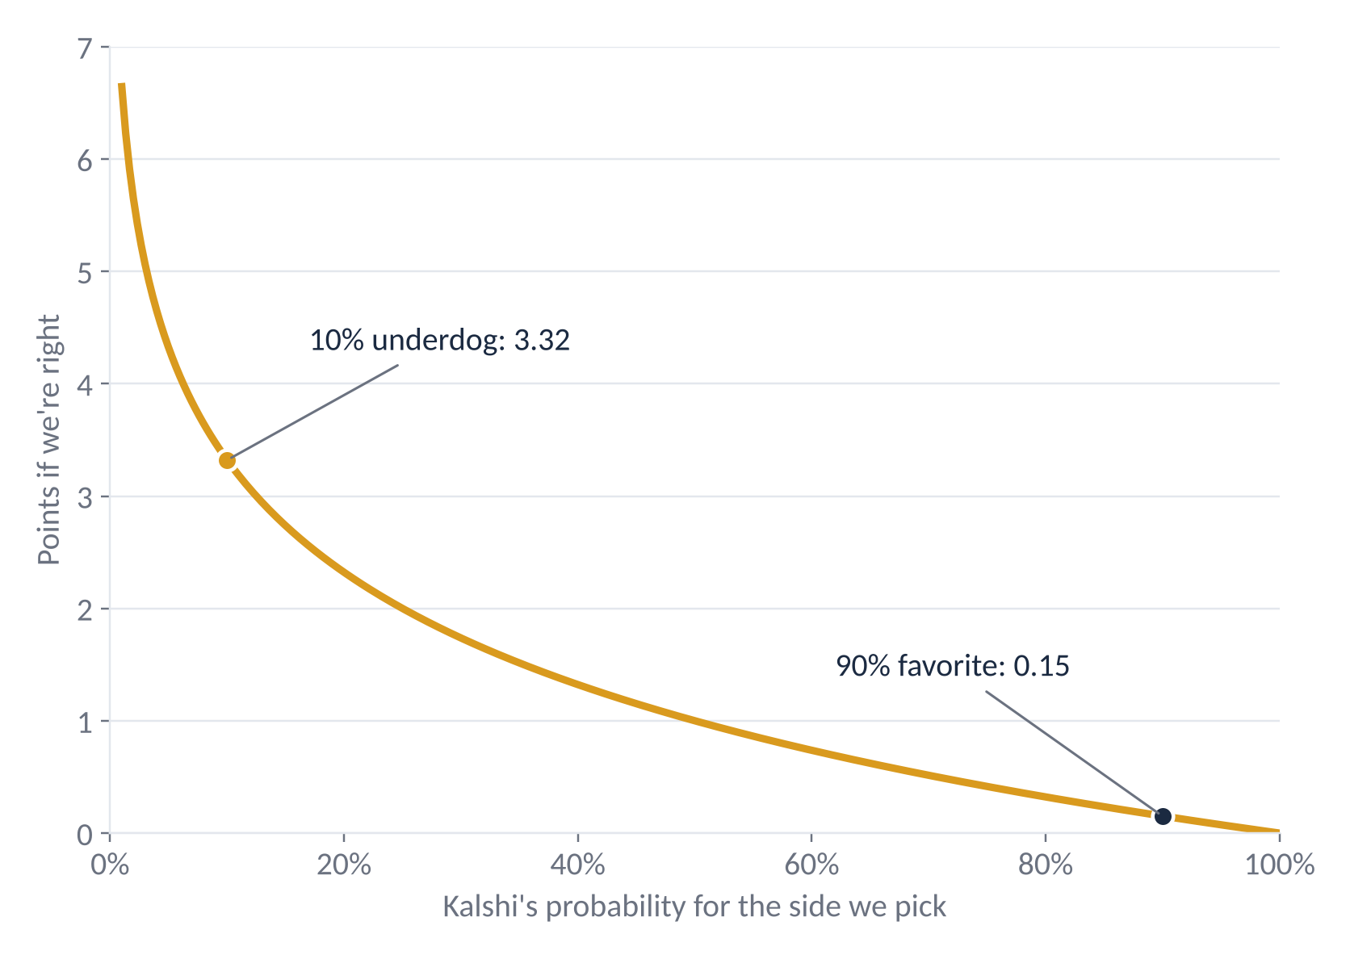
The scoring rule pays for upsets
A right pick earns −log₂(p), where p is the market's price for that side. A wrong pick earns 0.
0.15 pts
for calling a 90% favorite
3.32 pts
for calling a 10% underdog
So the best pick isn't always the likely winner.

Slide 3
Five steps from data to a pick
1
2
3
4
5
Inputs
Margin
Probability
Blend
Pick
→
→
→
→
District lean, national polling, incumbency, midterm year
Linear regression predicts the two-party vote margin
Margin turned into a win chance using our past errors
Mixed with Kalshi prices: 25% us, 75% market
Side with the most expected points
Trained on 3,235 contested House and Senate races from 2010 to 2024. Everything runs from one config file in our GitHub repo.

Slide 4
Four inputs, and what each one is worth
Partisan lean
0.88
Generic ballot
0.22
Cook PVI on that year's district lines. A district that votes 10 points more Democratic than the country for president gives the Democrat about 9 more points.
Final national House polling margin. Each point the country shifts moves a typical race by about a fifth of a point.
Incumbency
≈ 8 pts
Midterm penalty
≈ 4 pts
A sitting member running again adds about 8 points of margin for their party.
In midterm years the president's party loses about 4 points everywhere.
We also tried presidential approval. It added nothing once these four were in, so we dropped it.

Slide 5
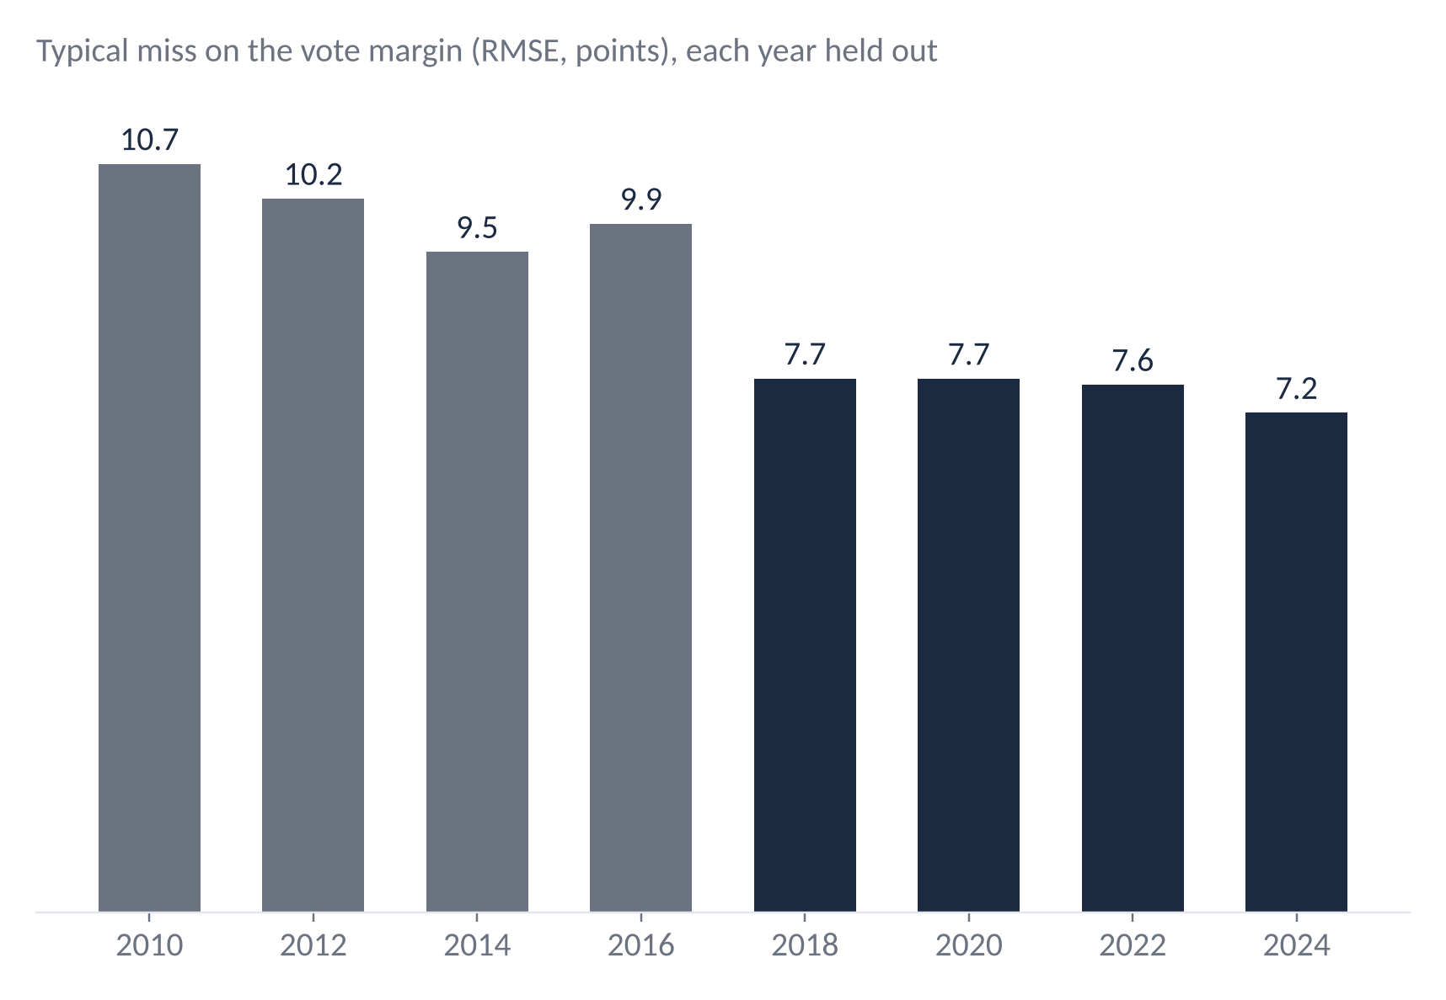
Tested on elections it never saw
For each year, we trained on every other year and predicted that one blind.
95%
of winners called correctly across 3,235 races
7.5 pts
typical miss since 2018, down from 10 earlier

Slide 6
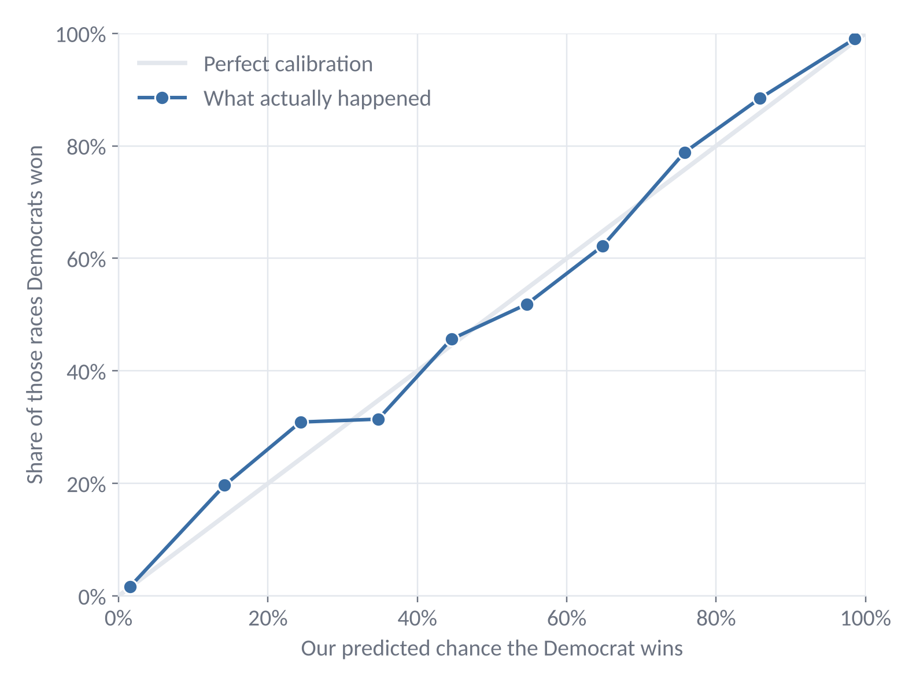
Our probabilities matched what happened
We grouped every held-out race by the chance we gave it. If the dots sit on the line, a 70% call really wins about 70% of the time.
Races we put at 70–80% went Democratic 79% of the time. At 80–90%, 88%.
Spread comes from a Student-t curve with separate House and Senate error sizes.

Slide 7
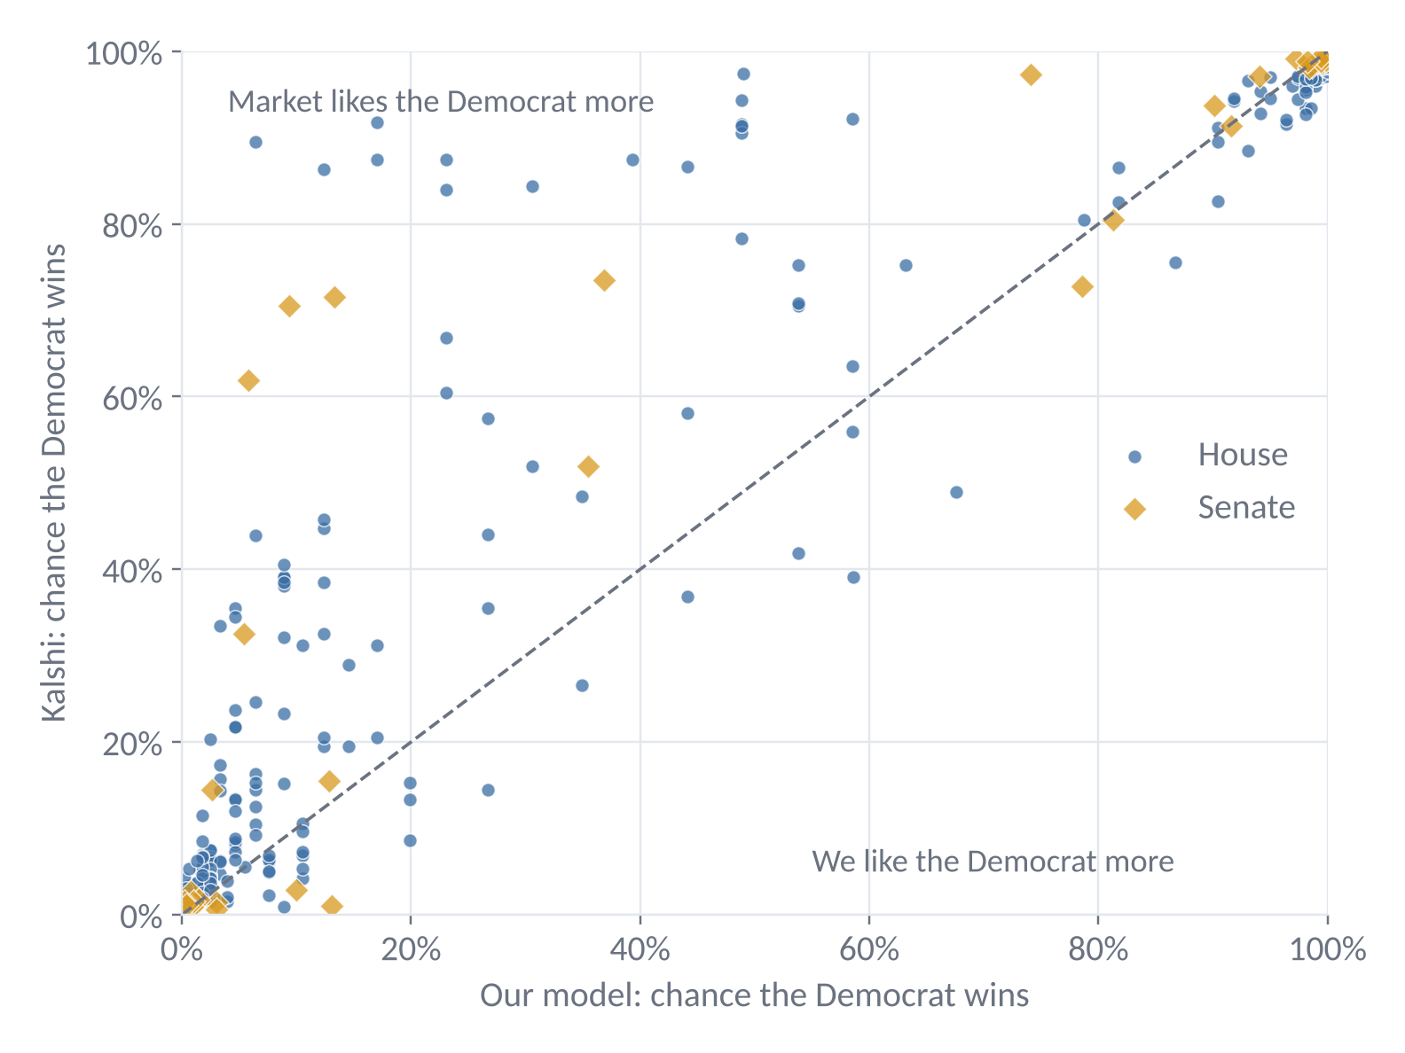
Where we disagree with the market
Each dot is one of the 450 contested races with a Kalshi market. Dots above the diagonal are races where traders like the Democrat more than we do.
Most disagreements sit there: Republican-held swing seats like TX-15, IA-01, OH-07 and PA-08, where our model leans Republican and the market leans Democratic.
The market sees polls and candidates we don't, so it gets 75% of the final say.

Slide 8
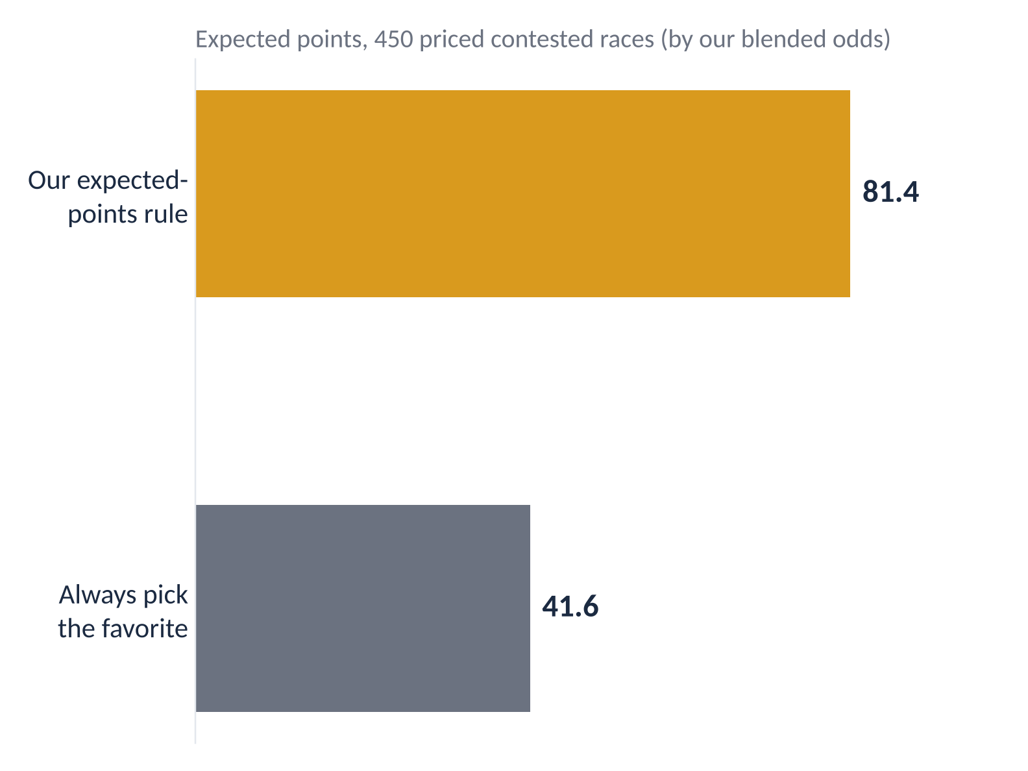
Our picks: mostly underdogs, on purpose
431 of 450
contested, priced races where we pick the market's underdog
We'll get most of these wrong. The few we get right pay 3 to 6 points each, which beats collecting fractions of a point on favorites.
The other 20 races are one-party contests or have no market, and there we take the obvious winner.

Slide 9
What we tried and left out
Kept
Dropped
Cook partisan lean
Generic-ballot polling
Incumbency
Midterm × president's party
Kalshi prices (Nov 2) as a 75% blend
Presidential approval: no gain over the generic ballot
Census demographics (ACS): almost no gain on 2018–2024
FEC fundraising: old totals include money raised after Election Day
Incumbents’ past overperformance: same, too little gain to trust

Slide 10
What could go wrong
1
We lean on the market
The 25/75 split is a judgment call. There's no history of race-level Kalshi prices to tune it on.
2
Races move together
One national surprise shifts every race at once, so our misses won't be independent.
3
New maps
Mid-decade redistricting in several states makes 2026 lean less certain than usual.
4
High variance
With so many underdog picks, a night where favorites sweep could leave us near zero.

Slide 11
Thanks
Code, data and README: github.com/AarenSunny/Election-Predictions-Model
Aaren Sun & Amun Reddy

