Slide 1




DODG‘HIT

Slide 2


PROJECT OVERVIEW .
. PRESENTATION
. GAME STRUCTURE​
. GAME DESIGN​
. ART DIRECTION​
. CHARACTERS​
. ENVIRONMENT

Slide 3
PROJECT OVERVIEW .

Slide 4
GAME STRUCTURE .
FPS
PC
Controller
FPS
Shooter
Fans
Unreal engine 5

Slide 5
GAME DESIGN . ​

Slide 6
ART DIRECTION​ . ​

Slide 7
CHARACTERS . ​

Slide 8
ENVIRONMENT . ​

Slide 9







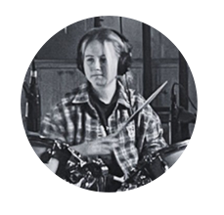
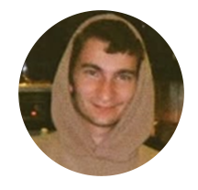

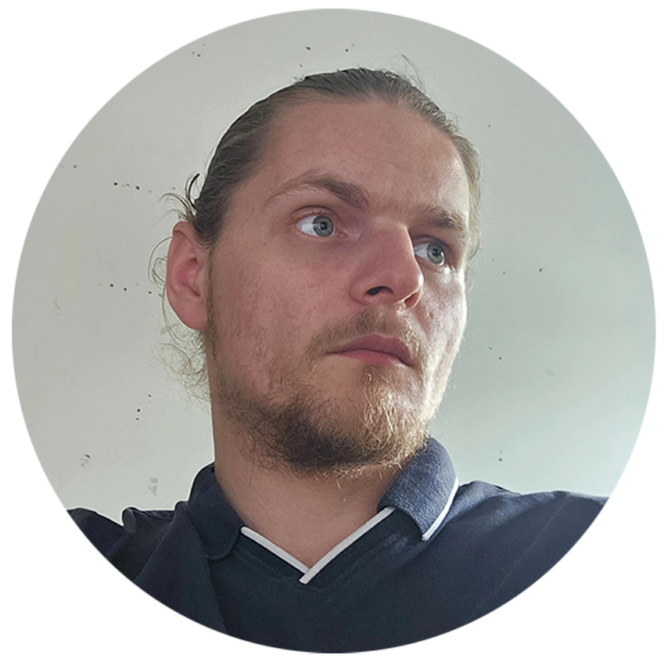
TEAM .
DASILVA
JALEO
DROUET
HUGO
FERNANDES
AUDREY
CHARACTER
ARTIST
ENVIRONMENT ARTIST
FERNANDES
AUDREY
FUHRMANN
VALENTINE
LEJEWSKI
MATTHEO
MOREAU
PAULIN
TRUFFER
NASTASIA
ANIMATOR
VFX
ARTIST
RIG
ARTIST
SOUND
DESIGNER

Slide 10
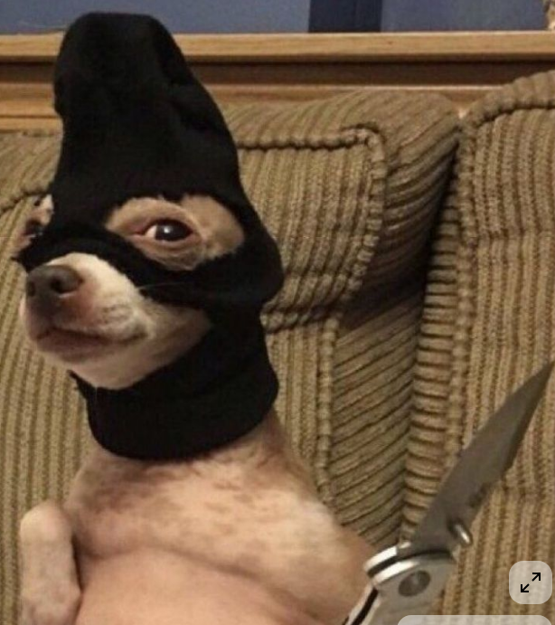
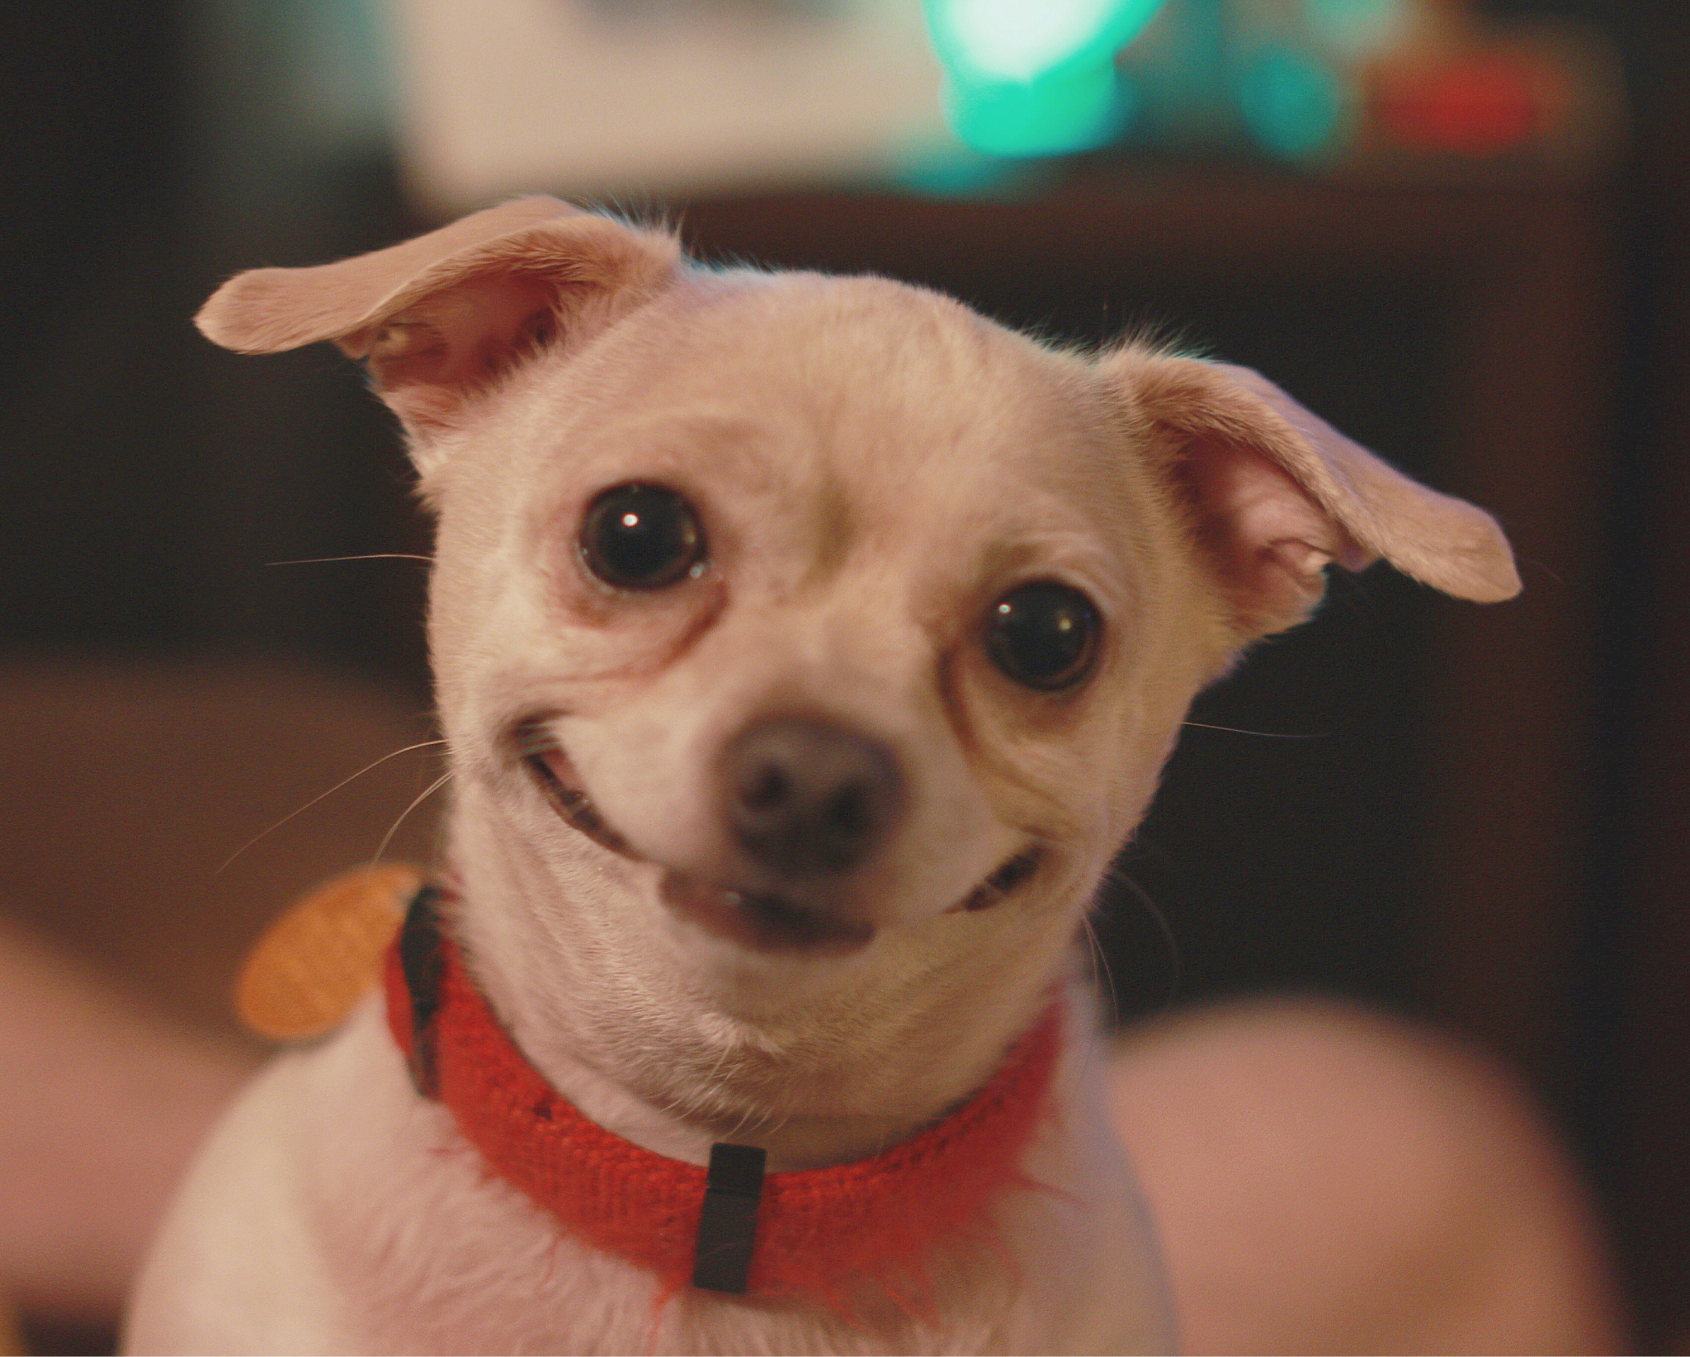
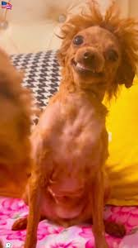
Merci de nous avoir écouté !

