Slide 1
Aaria model
Manual control with joystick

Slide 2
Opening the model
Download the model folder: AariaR2017a
https://bit.ly/2zgyQzU
https://github.com/AariaRobot/Joystick-Control
Open MATLAB R2017a
Open files
AariaJoystickR2017a.slx
AariaUI2017a.m
AariaJoystickR2017a.slx will open in a new window
Run AariaUI2017a.m to open the User Interface

Slide 3
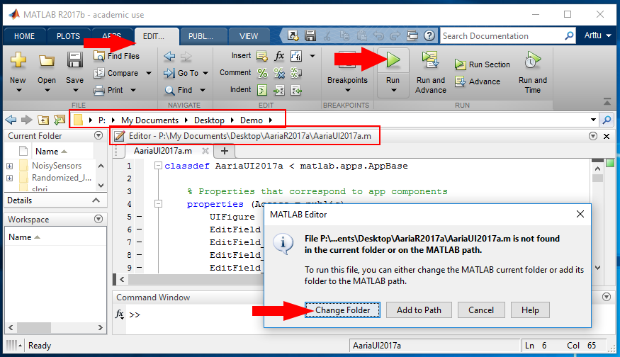

Slide 4
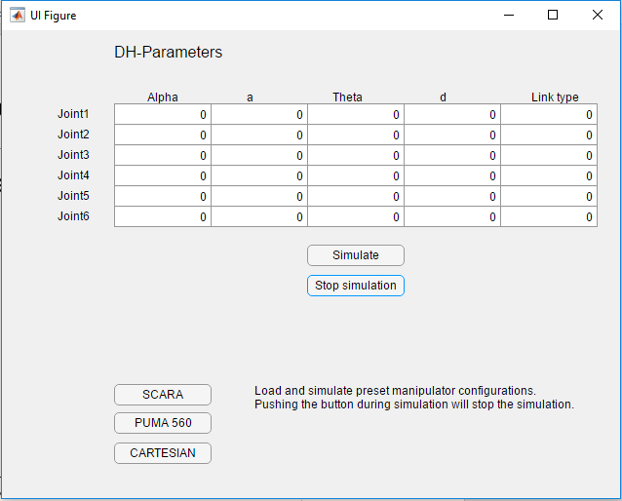

Slide 5
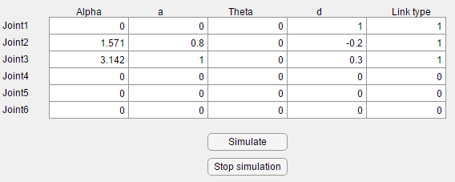
Input desired DH-parameters using the modified notation
Values must be numeric pi = 3.142, pi/2 = 1.571
Set the link types: 1 = revolute joint, 2 = prismatic joint, 0 = empty
Click “Simulate” button to begin simulation
Click “Stop simulation” to stop the simulation

Slide 6
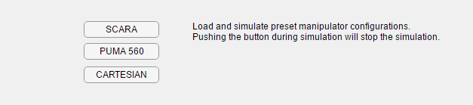
Alternatively, you can simulate a preset manipulator model by clicking one the buttons in the bottom left
The simulation can be stopped by clicking the “Stop simulation” button

Slide 7
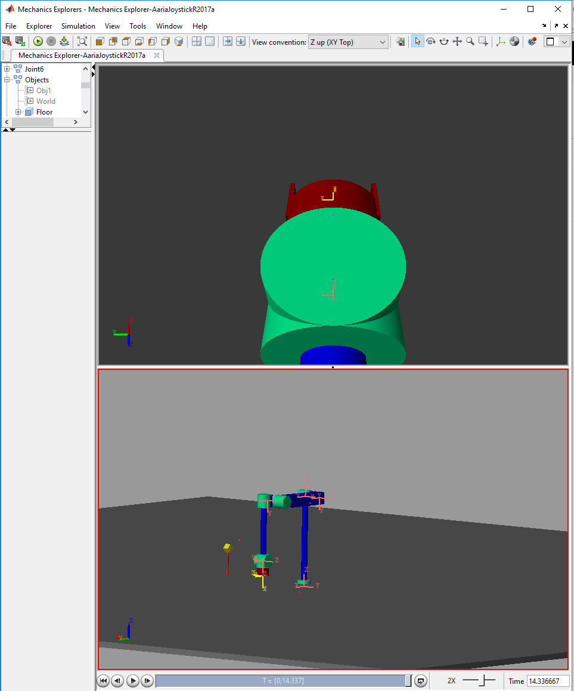
The simulation visualization will appear in a new window or a tab in MATLAB
Zoom the view with scroll wheel
Rotate the view by dragging with middle mouse button
Cursor location matters

Slide 8
Joystick controls
Joint 1: Left and Right
Joint 2: Front and Back
Joint 3: Twist Clockwise and Counterclockwise
Joint 4: Lever Up and Down
Joint 5: Buttons 3 and 4
Joint 6: Buttons 7 and 8
Grab: Trigger

Slide 9
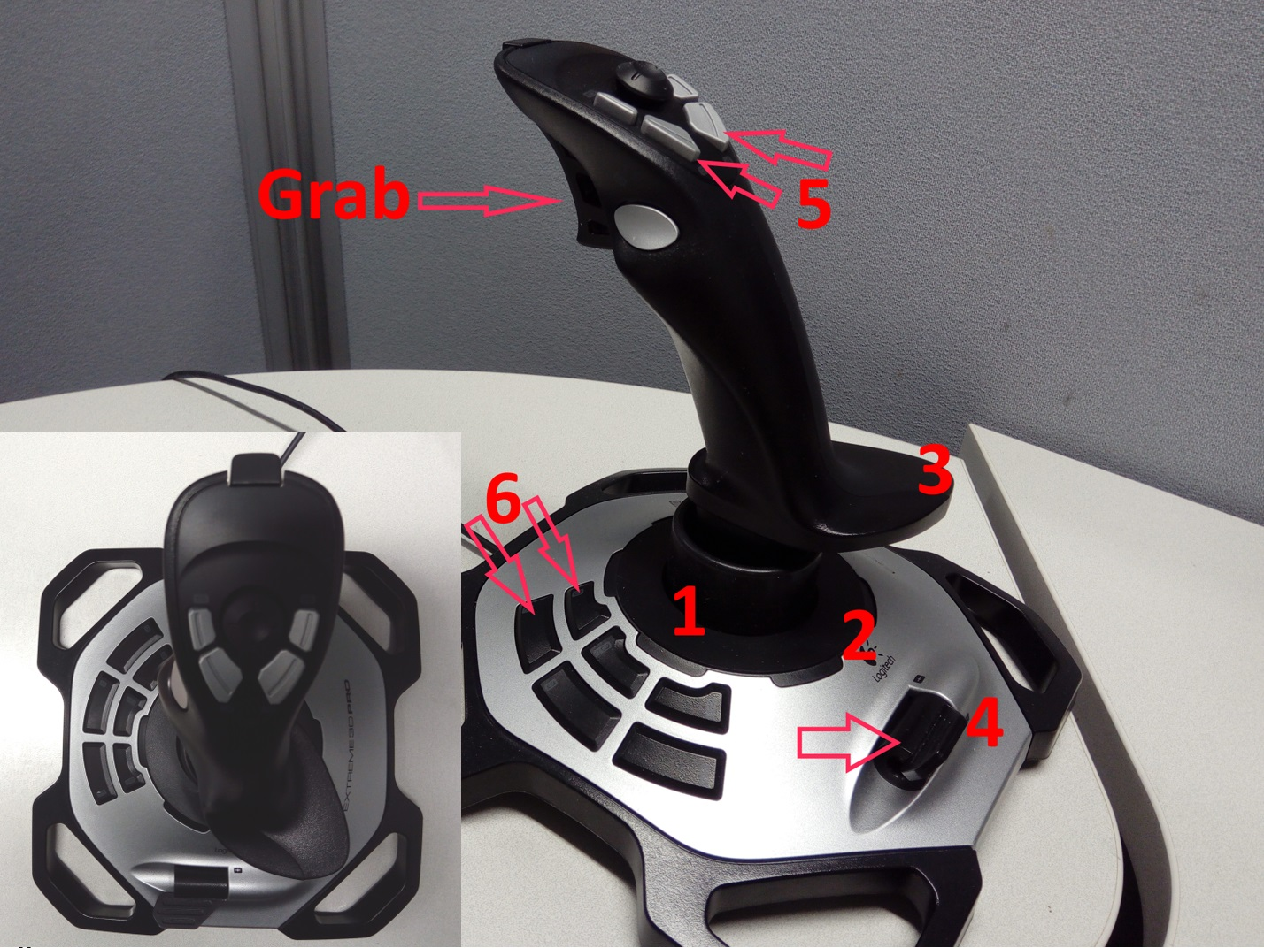

Slide 10


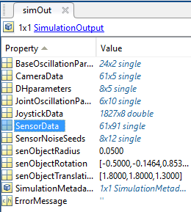
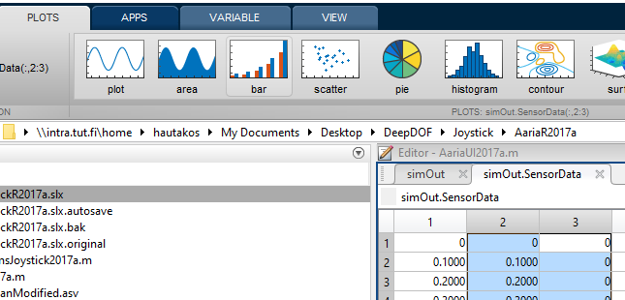
Plotting
0. plot(1,1) in command window
1. simOut in Workspace
2. SensorData
3. Paint columns and click
plot from the plots tab

Slide 11
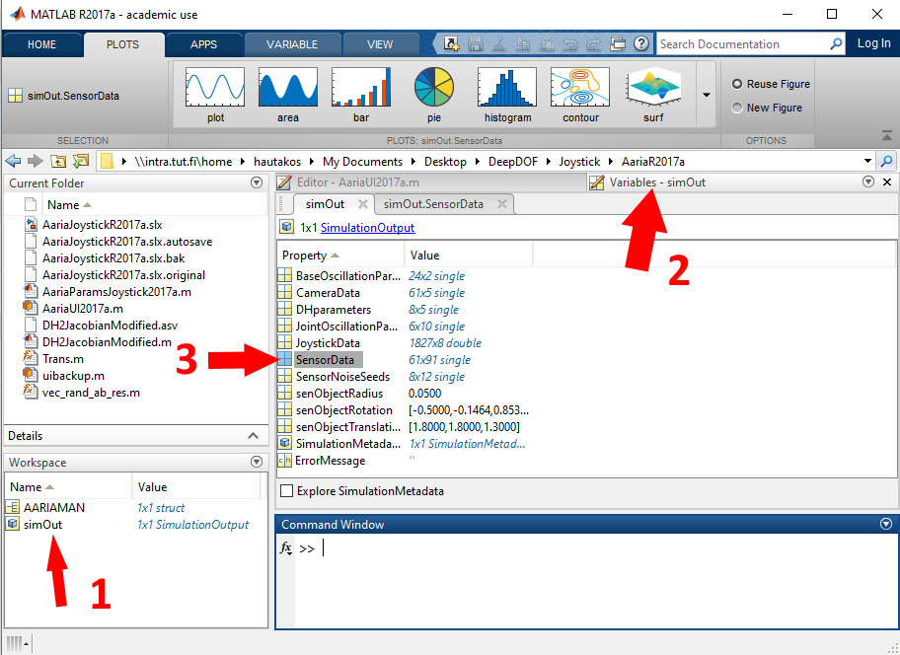

Slide 12
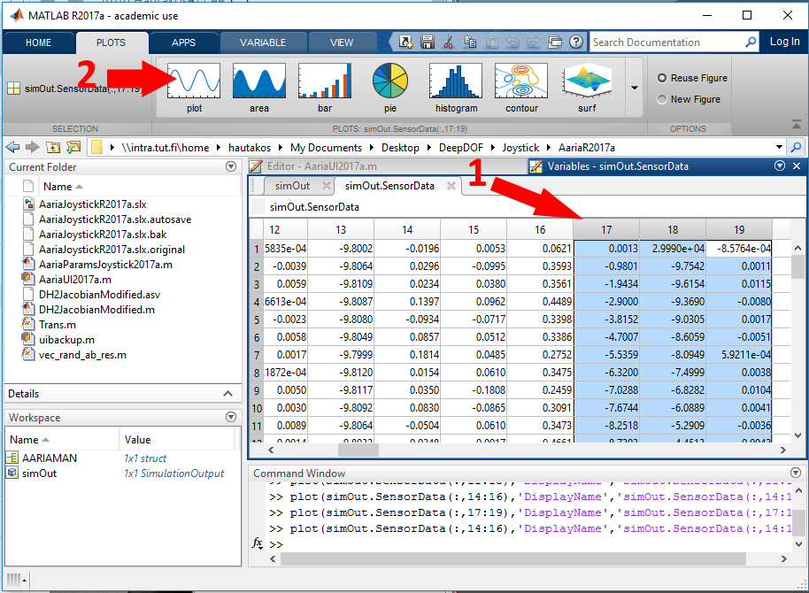

Slide 13
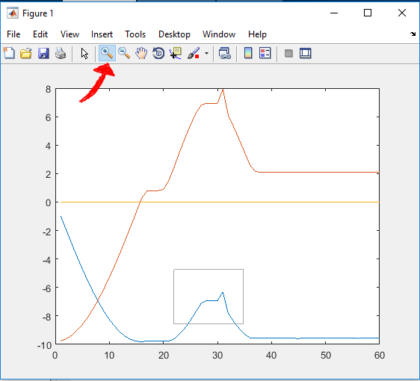
Select magnifying glass
Drag a box around the
part you want to zoom
Double click the graph
to return to normal view

Slide 14
The data
SensorData table column guide:
1 time,
2-7 joint values[radians or meters]
8-13 base sensor, [xyz angular velocity, xyz acceleration]
14-19 tool sensor, [xyz angular velocity, xyz acceleration]
20-31 link 1 sensors [xyz angular velocity, xyz acceleration] X 2
32-43, 44-55, 56-67, 68-79, 80-91
each link to 91 when using 2 sensor for each link
This info is written in AariaParams12J.m file on line 35

Slide 15
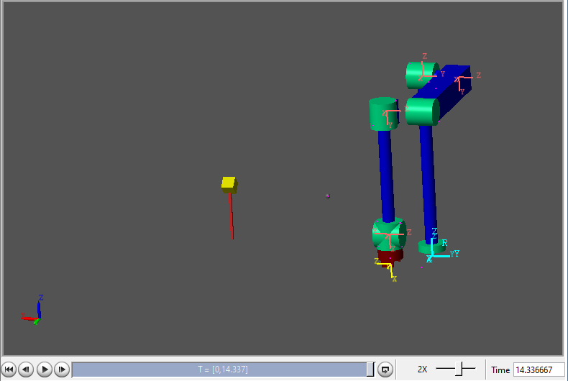
Try to grab the yellow box
The tool needs to be close enough and in the right orientation

Slide 16
Good Luck!

