Slide 1
KRR Project – P9 T20 Ontology Based Analytics
Aarib Ahmed Vahidy 22K-4004
Arham Hussain Khan 22K-4080
Partham Kumar Chawla 22K-4079

Slide 2
Problem Statement
In the field of cricket analytics, there is a growing need to analyse and interpret match data efficiently to extract meaningful insights, such as evaluating team performance and determining pivotal match moments.
This project aims to leverage semantic web technologies and RDF-based representations to build a cricket ontology. Using SPARQL queries, the project extracts insights such as the highest-scoring teams, best bowling performances, and key statistics, enabling better decision-making for teams, analysts, and enthusiasts.

Slide 3
Dataset
We were provided with two CSV files representing the two innings of cricket matches. Each file contains the following columns:
Index: A unique identifier for each row.
MatchId: A unique identifier for the match (e.g., 5_1).
Balls: Represents the ball in terms of overs and balls, formatted as over.ball (e.g., 0.1).
Runs: The number of runs scored on that particular ball.
Toss Winner: The team that won the toss for that match.
Batting Team: The team currently batting.
Bowling Team: The team currently bowling.
Player Out: Indicates whether a player was dismissed on that ball (1 for out, 0 for not out).
City: The city where the match took place.
Venue: The stadium or ground where the match was played.
An example row from the dataset is:
19,5_1,2.6,2,India,West Indies,India,0,Lauderhill,Central Broward Regional Park Stadium Turf Ground
Here, the row represents the following:
Over 2 ball number 6 in match 5_1 between toss winner and bowling team India and batting team West Indies.
2 runs were scored on this ball, no player was dismissed, and the match was held in Lauderhill at the Central Broward Regional Park Stadium Turf Ground.

Slide 4
Methodology Used
The two csv files were loaded as data-frames in pandas in python. The data was then pre-processed and evaluated using plots in order to visualise the data.
The cleaned data was then transformed into triple formats(subject-predicate-object) and then serialized into a Resource Description Framework (RDF) graph using the rdflib library.
A cricket ontology was created to represent the relationships between different entities, such as matches, teams, players, and venues.
Classes and properties in the ontology were carefully defined to capture the nuances of cricket match data.
The classes, relationships and instances were checked using SPARQL queries to better understand the graph structure that was created.

Slide 5
Results
Ontology Population:
The cricket ontology was successfully populated with instances derived from the dataset, representing key entities such as matches, teams, players, venues, and match events.
SPARQL Query Results:
SPARQL queries were executed successfully, yielding correct results for various insights, such as:
Determining the match winner for specific matches.
Identifying the team with the highest number of sixes.
Calculating the average run rate of teams.
Extracting many other key match and team insights.

Slide 6
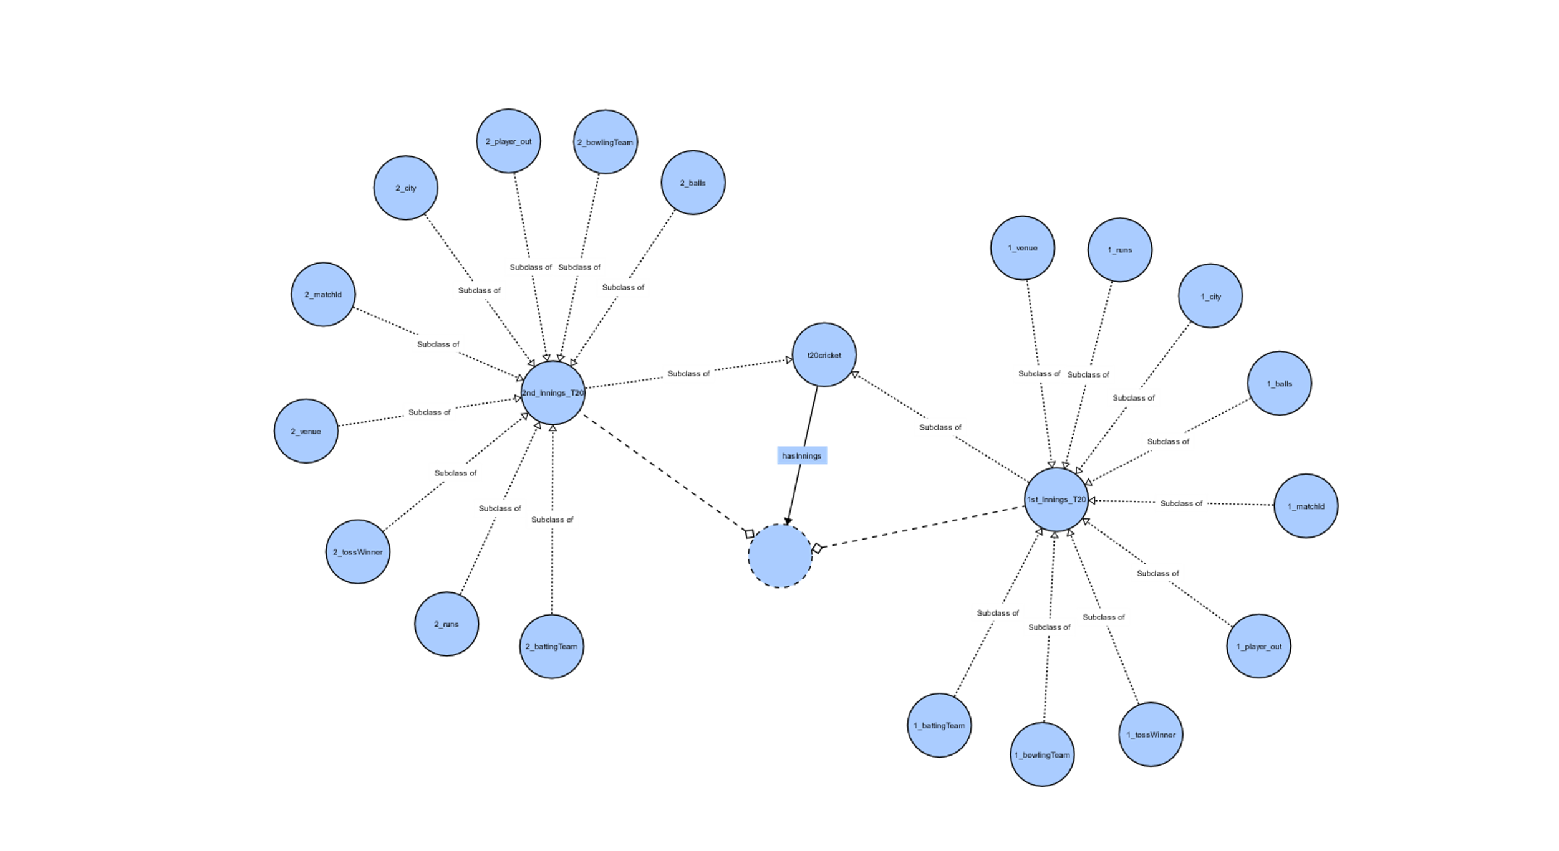

Slide 7
Conclusion
The project successfully utilized semantic web technologies to build a cricket ontology, enabling the extraction of valuable insights from cricket match data.
By transforming the dataset into an RDF graph and querying it with SPARQL, we were able to identify key match statistics, such as team performances, player dismissals, and match outcomes.
The use of an ontology allowed for flexible querying and better decision-making, making it easier to analyse complex match events. Moreover, the structure of the ontology can be extended to accommodate future datasets or additional cricket-related entities, ensuring scalability and adaptability for further analysis.

