Slide 1



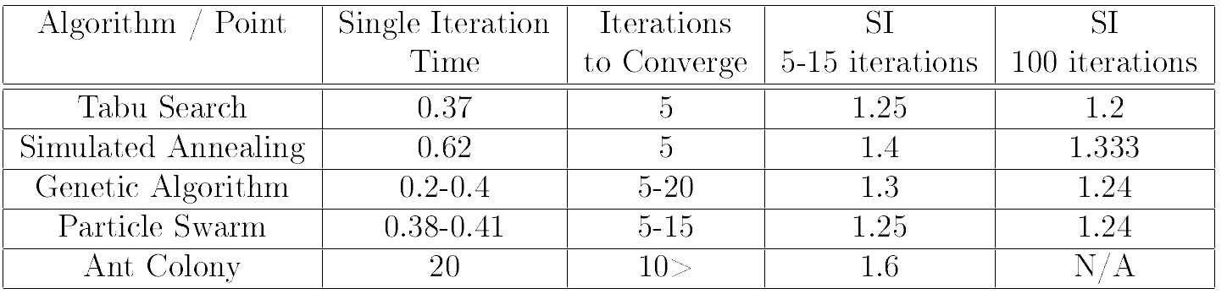
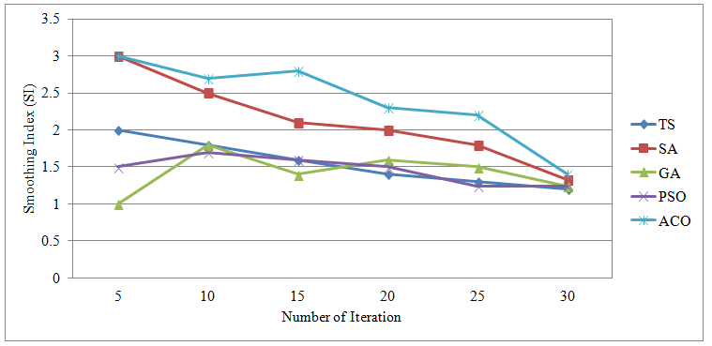
University of Waterloo
Department of Electrical and Computer Engineering
Spring 2014 – ECE457A Cooperative and Adaptive Algorithms
20. Wind Park Design Problem
Multiple Targets Clustering
Given a number of turbines, try to optimize the wind park layout that generate lowest cost/power ratio
Problem Formulation
Metaheuristics
Experimental Results
Problem formulation goes here…
Tabu Search
Experiment Setup
Simulated Annealing
Evaluation Metrics
Comparative Study
Genetic Algorithm
Problem Modeling
Problem modelling goes here…
PSO
ACO
Conclusion
Conclusions go here…
Chao Gao, Qi Feng Liu, _x0019_Yi Kun Song, Mai Wang, Hong Wen Zhu

