Slide 1


Bank Swallows on the Sacramento River
Nest colonially in holes dug into riverbanks in Spring
Migrate to South America in Winter
Listed as threatened in 1989 under endangered species act

Slide 2

Natural erosion forms vertical surfaces they can dig burrows in, but also destroys burrows
Notes:
Natural erosion of banks forms vertical surfaces they can dig burrows into, but also destroys burrows

Slide 3
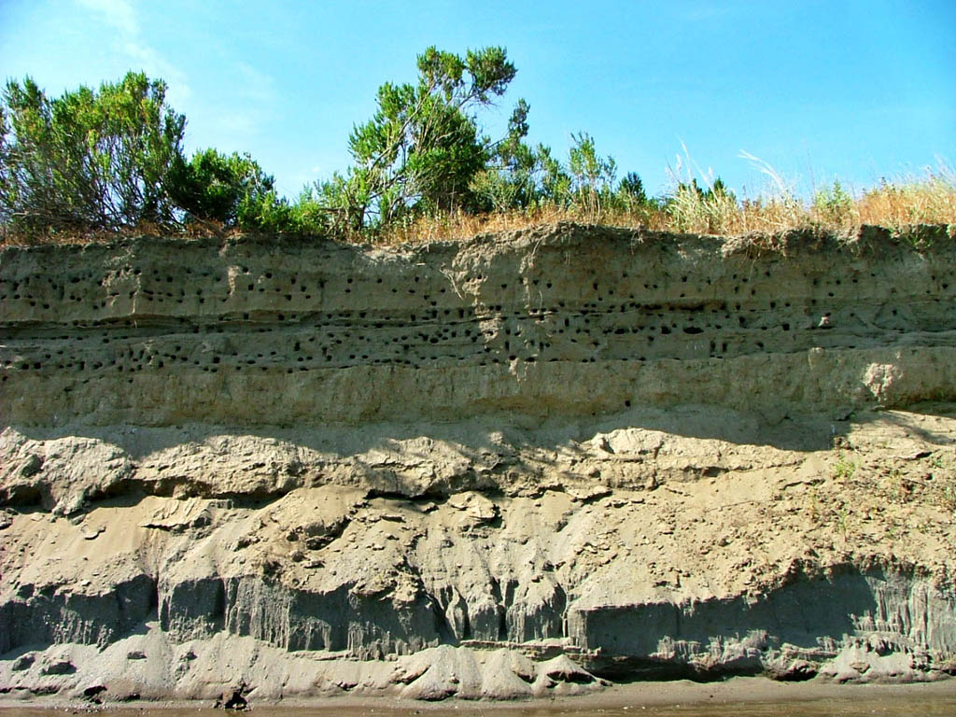

Slide 4
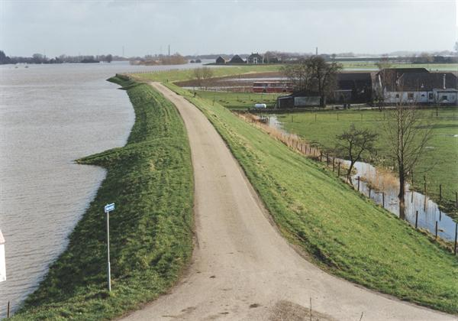
Riverbanks are modified to stabilize them for human use
Notes:
”riprapping” to stabilize banks for human use removes habitat

Slide 5

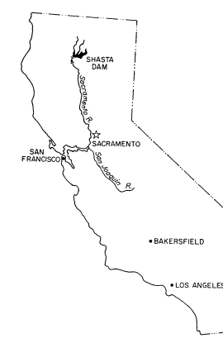
Erosion intensified by water releases from Shasta Dam

Slide 6


year | # occupied colonies | # that went "extinct" (were not occupied in the next year)
1986 | 53 | 19
1987 | 49 | 35
1988 | 30 | 11
1989 | 23 | 11
1990 | 30 | 12
1991 | 36 | 11
1996 | 42 | 32
1997 | 40 | 24
1998 | 38 | 34
1999 | 47 | 41
2000 | 33 | 16
2001 | 38 | 19
2002 | 44 | 35
Fit two models to these data:
A single extinction rate
Two extinction rates, one before conservation efforts and one after
Conservation Efforts Began →
Notes:
Think-pair-share. How would you go about fitting these models “manually” (like we did way back last week before we really learned about glms)? How would you go about fitting these with glm()?

Slide 7
Link Functions
Eric Scott

Slide 8
Link Functions
So far we’ve only used the “identity” link, which essentially means no link function.
But generally we will want to use the default link function for the distribution under which our data fall
For binomial data, the default link function is “logit”

Slide 9
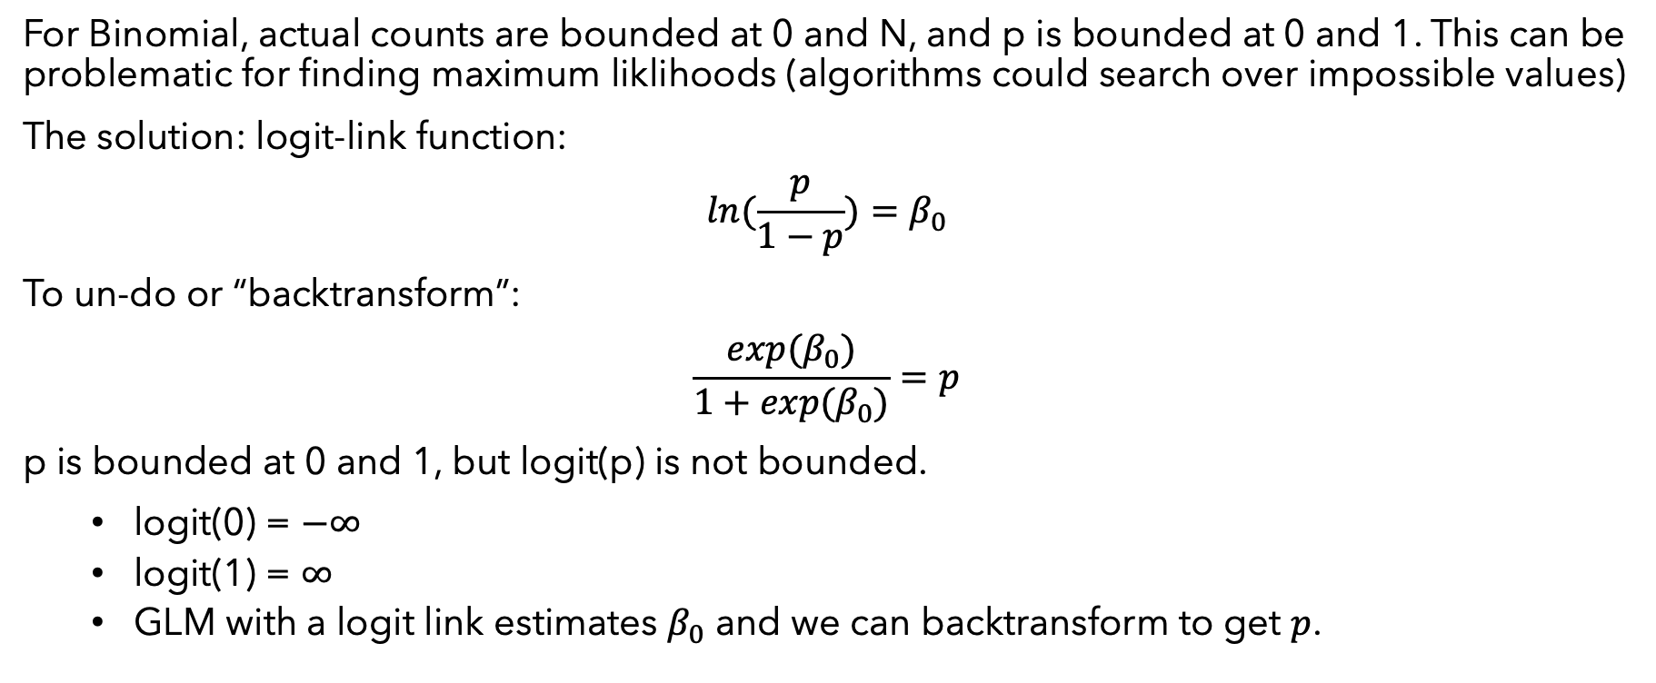
Logit Link?
For Binomial, actual counts are bounded at 0 and N, and p is bounded at 0 and 1. This can be problematic for finding maximum liklihoods (algorithms could search over impossible values)
The solution: logit-link function:
$$ln(\frac{p}{1−p})=β_{0}$$
To un-do or “backtransform”:
$$\frac{exp(β_{0})}{1+exp(β_{0})}=p$$
p is bounded at 0 and 1, but logit(p) is not bounded.
logit(0) = $−∞$
logit(1) = $∞$
GLM with a logit link estimates $β_{0}$ and we can backtransform to get $p$.
Notes:
NOTE: Some of the convergence errors I demonstrated earlier in the class can be easily fixed by changing the link function!

Slide 10
logit transformation in R
We can logit tranform a proportion “manually”
p <- 0.6 logit_p <- log(p/(1-p)) logit_p
## [1] 0.4054651
And backtransform…
exp(logit_p) / (1+ exp(logit_p))
## [1] 0.6
We can also do this with the logit distribution functions like so:
#logit transform qlogis(0.6)
## [1] 0.4054651
#inverse-logit back-transformation plogis(0.4054651)
## [1] 0.6

Slide 11
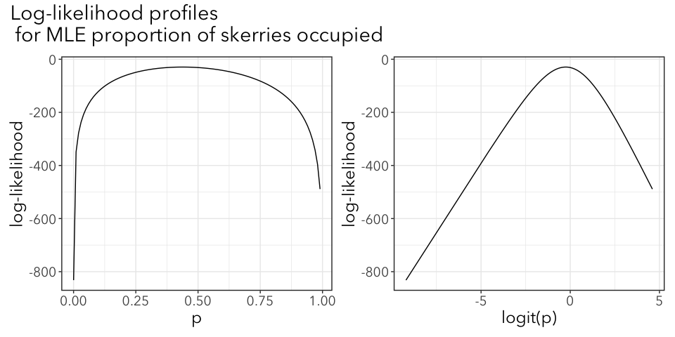
Why do logit link?
One simple reason is that the algorithm to find maximum likelihood has a difficult time with proportion data.
Because it might choose starting values that are impossible (not between 0 and 1)
Because convergence might not be as sharp

Slide 12
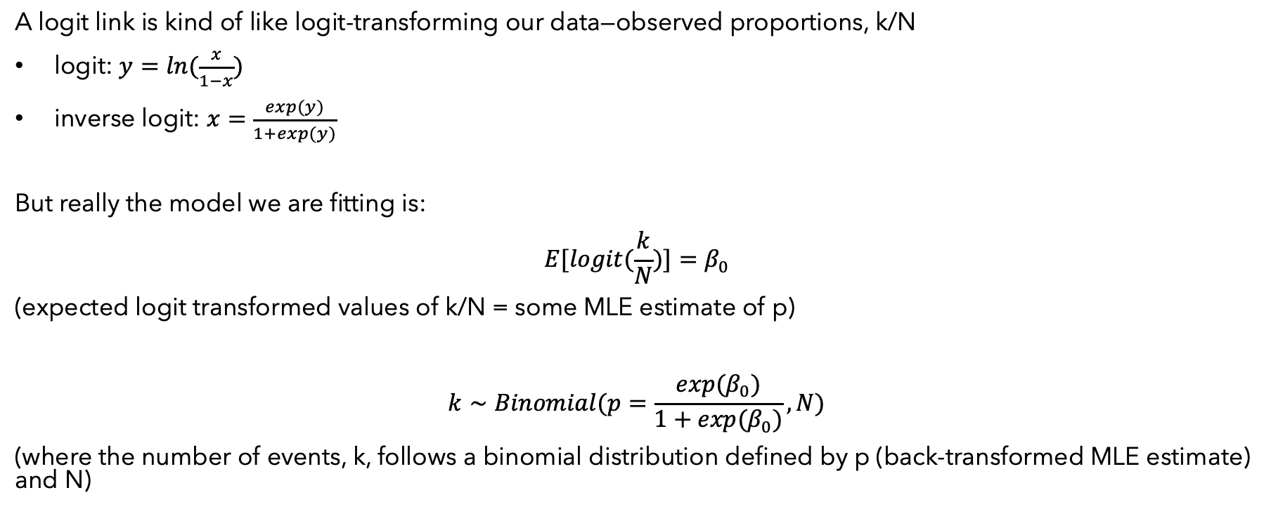
Kind of like transforming data
A logit link is kind of like logit-transforming our data—observed proportions, k/N
logit: $y=ln(\frac{x}{1−x})$
inverse logit: $x=\frac{exp(y)}{1+exp(y)}$
But really the model we are fitting is:
$$E[logit(\frac{k}{N})]=β_{0}$$
(expected logit transformed values of k/N = some MLE estimate of p)
$$k∼Binomial(p=\frac{exp(β_{0})}{1+exp(β_{0})},N)$$
(where the number of events, k, follows a binomial distribution defined by p (back-transformed MLE estimate) and N)

Slide 13
Benefits to link vs. transforming data
With a link function, we are essentially transforming the model not the data.
Allows us to keep more information about the data by using the binomial distribution rather than analyzing transformed proportion data (50/100 is different than 5/10).
Variance isn’t transformed and is still what you’d expect from a binomial process. This is an important assumption of a binomial GLM. If variance is very far from Np(1-p), then p-values may be unreliable.

Slide 14
Relationship between link function and transformation
Let’s re-fit the models from last time, but with the default logit link. For this example, I’m going to re-code year so it’s the number of years after 1972 so the intercept for model C makes more sense.
vole_dat <- vole_dat %>% mutate(year_post = year - 1972)

Slide 15
Model A, constant proportion
ma <- glm(cbind(with_voles, no_voles) ~ 1, family = binomial(link = "identity"), data = vole_dat) ma_logit <- glm(cbind(with_voles, no_voles) ~ 1, family = binomial(), data = vole_dat) #link = "logit" by default coef(ma) #proportion of skerries occupied
## (Intercept) ## 0.4375
coef(ma_logit) #proportion of skerries occupied, on a logit scale
## (Intercept) ## -0.2513144
exp(coef(ma_logit)) / (1 + exp(coef(ma_logit))) #backtransform "manually"
## (Intercept) ## 0.4375
plogis(coef(ma_logit)) #plogis() does the inverse logit function
## (Intercept) ## 0.4375
we can use inverse-logit to get coefficients back into proportions

Slide 16
Model B with logit link
#means parameterization (intercept removed) mb <- glm(cbind(with_voles, no_voles) ~ -1 + year_factor, family = binomial(link = "identity"), data = vole_dat) mb_logit <- glm(cbind(with_voles, no_voles) ~ -1 +year_factor, family = binomial(), data = vole_dat) coef(mb)
## year_factor1972 year_factor1973 year_factor1974 year_factor1975 year_factor1976 year_factor1977 ## 0.400 0.425 0.700 0.525 0.100 0.475
coef(mb_logit)
## year_factor1972 year_factor1973 year_factor1974 year_factor1975 year_factor1976 year_factor1977 ## -0.4054651 -0.3022809 0.8472979 0.1000835 -2.1972246 -0.1000835
plogis(coef(mb_logit))
## year_factor1972 year_factor1973 year_factor1974 year_factor1975 year_factor1976 year_factor1977 ## 0.400 0.425 0.700 0.525 0.100 0.475

Slide 17
Model C with logit link
mc <- glm(cbind(with_voles, no_voles) ~ year_post, family = binomial(link = "identity"), data = vole_dat) mc_logit <- glm(cbind(with_voles, no_voles) ~ year_post, family = binomial(), data = vole_dat) coef(mc)
## (Intercept) year_post ## 0.49313595 -0.02234586
coef(mc_logit)
## (Intercept) year_post ## -0.02707945 -0.09028784
plogis(coef(mc_logit))
## (Intercept) year_post ## 0.4932306 0.4774434
Uh-oh! Why didn’t that work? Because order of operations matters!

Slide 18
Order of operations matters
Recall that log(A + B) = log(A)log(B) NOT log(A) + log(B)
Believe that logit(A + B) is NOT logit(A) + logit(B)
Therefore, the order of operations matters when back-transforming results.
Do all your calculations using values on the link function scale
predicting values from a line
confidence interval calculations
effects of dummy variables (with effects parameterization, with intercept)
THEN back-transform the final results

Slide 19
Correct way:
mb_logit <- glm(cbind(with_voles, no_voles) ~ year_factor, family = binomial(), data = vole_dat) confint(mb_logit) %>% plogis()
## Waiting for profiling to be done...
## 2.5 % 97.5 % ## (Intercept) 0.25790251 0.5545323 ## year_factor1973 0.31226051 0.7310000 ## year_factor1974 0.58538266 0.9007839 ## year_factor1975 0.40711465 0.8027965 ## year_factor1976 0.04174099 0.3411912 ## year_factor1977 0.35908510 0.7686378

Slide 20
Correct way:
coef(mb_logit)
## (Intercept) year_factor1973 year_factor1974 year_factor1975 ## -0.4054651 0.1031842 1.2527630 0.5055486 ## year_factor1976 year_factor1977 ## -1.7917595 0.3053816
#you can only safely back-transform coefs from no-intercept models
predict(mb_logit) %>% plogis()
## 1 2 3 4 5 6 ## 0.400 0.425 0.700 0.525 0.100 0.475
#or predict(mb_logit, type = "response")
## 1 2 3 4 5 6 ## 0.400 0.425 0.700 0.525 0.100 0.475

Slide 21
Logit coefficients
coef(mb_logit)
## (Intercept) year_factor1973 year_factor1974 year_factor1975 ## -0.4054651 0.1031842 1.2527630 0.5055486 ## year_factor1976 year_factor1977 ## -1.7917595 0.3053816
FYI: The coefficients for the effects-parameterization of model B (intercept included) on a logit scale are log-odds ratios, something you might encounter in economics and sociology literature.
Ecologists are not typically comfortable thinking in log-odds ratios and usually prefer to use means parametrization (no intercept) and then back-transform coefficients to get proportions!

Slide 22
year | # occupied colonies | # that went "extinct" (were not occupied in the next year)
1986 | 53 | 19
1987 | 49 | 35
1988 | 30 | 11
1989 | 23 | 11
1990 | 30 | 12
1991 | 36 | 11
1996 | 42 | 32
1997 | 40 | 24
1998 | 38 | 34
1999 | 47 | 41
2000 | 33 | 16
2001 | 38 | 19
2002 | 44 | 35
Fit four models to these data:
A single extinction rate, link = ”identity”
A single extinction rate, link = “logit”
Two extinction rates, by ‘period’, link = “identity
Two extinction rates, by ‘period’, link = “logit”
Conservation Efforts Began →
Notes:
Inverse-logit transform the coefficients from the link=”logit” model to see them on a natural scale
Logit-transform the coefficients from the link = “identity” model to see them on a logit scale
#Compare likelihoods - should not be affected by link function here (in this case it is just a statistical tool for getting the model to fit)
#Compare coefficients for the second model - these WILL be affected by link
#Logit transform coefficients from identity model
#What about by year? Is there a trend?

