Slide 1
Variance and Overdispersion
Eric Scott

Slide 2
Last time
Before the first exam, we talked about 4 ways of modeling population growth with GLMs:
Exponential growth with observation error (log-link Poisson)
Exponential growth with process error (intercept only with offset of $N_{t−1}$)
Density dependent growth with observation error (log-link quadratic Poisson)
Density dependent growth with process error (Ricker model)

Slide 3
Interpreting parameters
wolves_sub <- wolves %>% filter(year >= 1995 & year <= 2005) m1 <- glm(num.wolves ~ year_post, family = poisson(link = "identity"), data = wolves_sub) coef(m1)
## (Intercept) year_post ## -1002.23754 82.79097
change in number of wolves/year
m1b <- glm(num.wolves ~ year_post, family = poisson(link = "log"), data = wolves_sub) exp(coef(m1b))
## (Intercept) year_post ## 10.674835 1.223248
$λ$ (population growth rate)
Fitting a line to data:
$E[Y_{i}]=β_{0}+β_{1}x_{1}$
$Y_{1}∼Poisson(λ)$ This is not the same $λ$ as population growth rate!

Slide 4
Link functions change the shape of the line
Similar to transforming data, but rather than transforming response variable from raw data, transforms expected values
Lee’s table

Slide 5
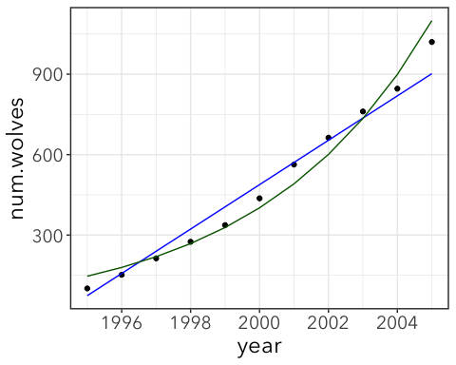

Slide 6
Model definition review
All models are defined by:
Equation for the expected value, or mean (e.g. $E[Y_{i}]=β_{0}+β_{1}x_{1}$)
Probability distribution for the distribution of events around this mean—the “errors” or residuals. (e.g. $Y_{1}∼Poisson(λ)$)
Assumptions about errors
When we use family = poisson, we are making an assumption that the errors (also called residuals) follow a Poisson distribution. Similarly, when we use family = binomial we are assuming that errors follow a binomial distribution.
If these assumptions are violated (errors don’t follow these distributions) then our p-values and parameter estimates may be unreliable.

Slide 7
Observation vs. Process error
Observation error models:
Assume all error due to sampling process
Error only effects current observed state of the population
Uses a formula to calculate a curve over time
Works with missing years of data
Process error models:
Assumes there is year-to-year variation in the true population size
“Error” feeds back to affect the future state of the population
Predicted counts are some function of count from previous time step
Makes sense when counts are exact (e.g. small or lab population)
Doesn’t work with missing data

Slide 8
End of recap…

Slide 9
Variance and mixture models

Slide 10
Variance
Variance is a measure of the spread of data calculated as the average of the squared differences from the mean.
Population variance:
$$σ^{2}=\frac{∑(x−μ)^{2}}{N}$$
Sample variance:
$$s^{2}=\frac{∑(x−\overline{x})^{2}}{n−1}$$

Slide 11
Poisson variance
For Poisson distributions, the expected variance is tied to the mean.
$μ=λ$
$σ^{2}=λ$

Slide 12
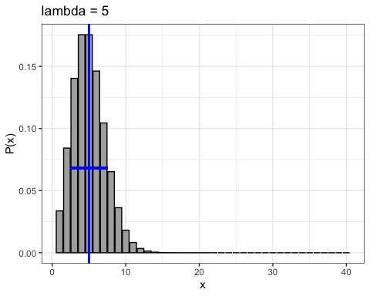

Slide 13
Sample variance
You can calculate the sample variance of your actual data with the var() function in R
x <- rpois(1000, 5) ggplot(tibble(x), aes(x)) + geom_bar()

Slide 14
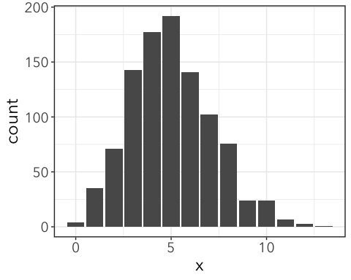

Slide 15
var(x)
## [1] 4.732156

Slide 16
Combined distributions
What if our data comes not from one population with a Poisson distribution, but two Poisson distributed populations with different means?
#simulated data that is combination of two poisson distributions. y1 <- rpois(500, 3) y2 <- rpois(500, 10) mean(c(y1, y2))
## [1] 6.504
var(c(y1, y2))
## [1] 18.6206
Now, there is more variation than we would predict from a simple Poisson process.

Slide 17
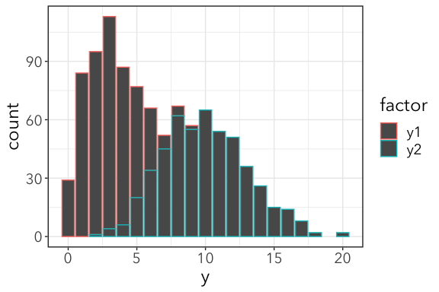

Slide 18
GLMs partition variance
If we fit a model that accounts for differences among levels of factor, we can account for the increased variance.
m <- glm(y ~ factor, family = poisson(link = "log"), data = data2)
To see this, we need to look at the residuals (AKA “errors”)

Slide 19
Working with Residuals
Residuals (aka “errors”) are the difference between the data points and the expected/fitted values from a model.
augmented <- data2 %>% mutate(fitted = predict(m, type = "response")) %>% mutate(residuals = y - fitted) head(augmented)
## # A tibble: 6 x 4 ## factor y fitted residuals ## <chr> <int> <dbl> <dbl> ## 1 y1 4 3.01 0.986 ## 2 y2 8 9.99 -1.99 ## 3 y1 4 3.01 0.986 ## 4 y2 5 9.99 -4.99 ## 5 y1 4 3.01 0.986 ## 6 y2 11 9.99 1.01

Slide 20
Checking residuals
Now that we’ve accounted for additional sources of variation (two samples from different Poisson distributions) let’s calculate variance of the residuals.
residuals(m, type = "response") %>% var()
## [1] 6.428312
mean(c(y1,y2))
## [1] 6.504
Much closer!
If we still had higher variation than expected after accounting for predictor variables, we would say this response variable is overdispersed. Less variation than expected = underdispersed

Slide 21
Deviance residuals
More commonly, deviance of a model is used to check for overdispersion.
Deviance is 2 time the log-likelihood ratio of our model compared to a saturated model—a model with a different parameter estimate for every row or datapoint. It’s kind off like asking how much worse our model is compared to one that perfectly predicts the data.
deviance(m)
## [1] 1085.06
Model deviance should be about the same as residual degrees of freedom.
deviance(m) / df.residual(m)
## [1] 1.087234
If greater than 1, overdispersion. If less than 1, underdispersion.
Formal test for overdispersion:
pchisq(deviance(m), df.residual(m), lower.tail = FALSE)
## [1] 0.02809645
p > 0.05, so not overdispersed

Slide 22
What if we can’t account for overdispersion?
What if departurs from the Poisson distribution are due to things we can’t account for? What consequences are there?
df2 <- tibble(y = c(rpois(20, 4), rpois(20, 50), rpois(20, 200)), #factor levels are random, don't correspond to three distributions factor = sample(c("A", "B", "C", "D"), 60, replace = TRUE)) head(df2)
## # A tibble: 6 x 2 ## y factor ## <int> <chr> ## 1 5 D ## 2 2 D ## 3 0 A ## 4 2 C ## 5 11 A ## 6 7 A
m2 <- glm(y~factor, family = poisson(), data = df2) deviance(m2) / df.residual(m2)
## [1] 93.41814
Overdispersed!

Slide 23
summary of m2
summary(m2)
## ## Call: ## glm(formula = y ~ factor, family = poisson(), data = df2) ## ## Deviance Residuals: ## Min 1Q Median 3Q Max ## -13.872 -10.100 -4.699 9.168 13.213 ## ## Coefficients: ## Estimate Std. Error z value Pr(>|z|) ## (Intercept) 4.36276 0.02590 168.461 < 2e-16 *** ## factorB 0.26057 0.03859 6.753 1.45e-11 *** ## factorC 0.21023 0.03913 5.372 7.77e-08 *** ## factorD -0.13722 0.03912 -3.507 0.000452 *** ## --- ## Signif. codes: 0 '***' 0.001 '**' 0.01 '*' 0.05 '.' 0.1 ' ' 1 ## ## (Dispersion parameter for poisson family taken to be 1) ## ## Null deviance: 5356.0 on 59 degrees of freedom ## Residual deviance: 5231.4 on 56 degrees of freedom ## AIC: 5558.2 ## ## Number of Fisher Scoring iterations: 6
The consequence is that now our p-values are unreliable. Just look, this meaningless factor gives a highly significant p-value! But don’t trust it!
m0 <- glm(y ~ 1, family = poisson(), data = df2) lmtest::lrtest(m0, m2)
## Likelihood ratio test ## ## Model 1: y ~ 1 ## Model 2: y ~ factor ## #Df LogLik Df Chisq Pr(>Chisq) ## 1 1 -2837.4 ## 2 4 -2775.1 3 124.54 < 2.2e-16 *** ## --- ## Signif. codes: 0 '***' 0.001 '**' 0.01 '*' 0.05 '.' 0.1 ' ' 1

Slide 24
Dealing with departures from Poisson assumptions

Slide 25
Northern flickers
library(pscl)
## Classes and Methods for R developed in the ## Political Science Computational Laboratory ## Department of Political Science ## Stanford University ## Simon Jackman ## hurdle and zeroinfl functions by Achim Zeileis
birds <- read_csv(here("data", "NE_flickers.csv"))
## Parsed with column specification: ## cols( ## Code = col_character(), ## Name = col_character(), ## Latitude = col_double(), ## Longitude = col_double(), ## hours = col_double(), ## Count = col_double() ## )
m2 <- zeroinfl(Count ~ 1, data = birds) m2
## ## Call: ## zeroinfl(formula = Count ~ 1, data = birds) ## ## Count model coefficients (poisson with log link): ## (Intercept) ## 3.175 ## ## Zero-inflation model coefficients (binomial with logit link): ## (Intercept) ## 1.125

Slide 26
summary
summary(m2)
## ## Call: ## zeroinfl(formula = Count ~ 1, data = birds) ## ## Pearson residuals: ## Min 1Q Median 3Q Max ## -0.5547 -0.5547 -0.5547 -0.5547 6.0678 ## ## Count model coefficients (poisson with log link): ## Estimate Std. Error z value Pr(>|z|) ## (Intercept) 3.17471 0.04089 77.64 <2e-16 *** ## ## Zero-inflation model coefficients (binomial with logit link): ## Estimate Std. Error z value Pr(>|z|) ## (Intercept) 1.1249 0.2302 4.887 1.02e-06 *** ## --- ## Signif. codes: 0 '***' 0.001 '**' 0.01 '*' 0.05 '.' 0.1 ' ' 1 ## ## Number of iterations in BFGS optimization: 11 ## Log-likelihood: -340.4 on 2 Df

Slide 27
ZiP with offset
m3 <- zeroinfl(Count ~ 1, offset = log(hours), data = birds) m3
## ## Call: ## zeroinfl(formula = Count ~ 1, data = birds, offset = log(hours)) ## ## Count model coefficients (poisson with log link): ## (Intercept) ## -1.583 ## ## Zero-inflation model coefficients (binomial with logit link): ## (Intercept) ## 1.123

Slide 28
summary
summary(m3)
## ## Call: ## zeroinfl(formula = Count ~ 1, data = birds, offset = log(hours)) ## ## Pearson residuals: ## Min 1Q Median 3Q Max ## -0.5612 -0.5469 -0.5362 -0.4854 6.4429 ## ## Count model coefficients (poisson with log link): ## Estimate Std. Error z value Pr(>|z|) ## (Intercept) -1.58304 0.04091 -38.69 <2e-16 *** ## ## Zero-inflation model coefficients (binomial with logit link): ## Estimate Std. Error z value Pr(>|z|) ## (Intercept) 1.1233 0.2303 4.878 1.07e-06 *** ## --- ## Signif. codes: 0 '***' 0.001 '**' 0.01 '*' 0.05 '.' 0.1 ' ' 1 ## ## Number of iterations in BFGS optimization: 9 ## Log-likelihood: -277.7 on 2 Df

