Slide 1
Likelihood and Bayes’ Theorem
Eric Scott

Slide 2
Short problem from the end of last class (…ppt)
Ignoring flowering (for now), explore the likelihood of different values of survival, given the 5-plant data set.
Calculate the likelihood of survival having each of the following values: 0.1, 0.2, 0.3, 0.4, 0.5, 0.6, 0.7, 0.8, 0.9.
Make a graph of the log-likelihood (y-axis) vs. value of survival (x-axis).
Repeat a & b for the 10-plant data set. How does the shape of the graph change?
What is the likelihood that survival is 0? Or 1? What happens to the log-likelihood at these values?

Slide 3
Likelihood calculations
For small dataset:
s <- seq(from = 0.1, to = 0.9, by = 0.1)#vector of possible values for s
# 4 survive, 1 doesn't survive. Math vectorized over all values of s orchid_sm_lik <- s^4 * (1 - s)
orchid_sm_lik
## [1] 0.00009 0.00128 0.00567 0.01536 0.03125 0.05184 0.07203 0.08192 0.06561

Slide 4
Likelihood calculations
For larger dataset:
orchid_lg_lik <- s^8 * (1-s)^2 orchid_lg_lik
## [1] 0.0000000081 0.0000016384 0.0000321489 0.0002359296 0.0009765625 ## [6] 0.0026873856 0.0051883209 0.0067108864 0.0043046721

Slide 5
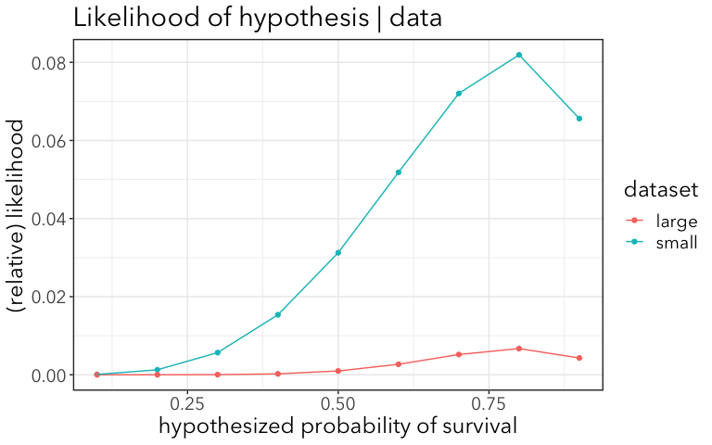
Plotting Likelihood Profiles

Slide 6
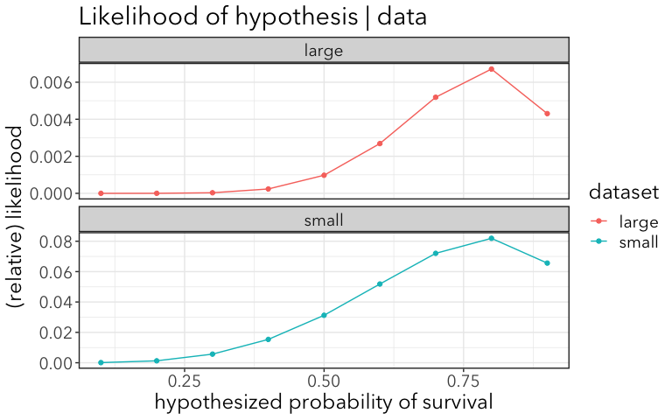
Plot both side by side

Slide 7
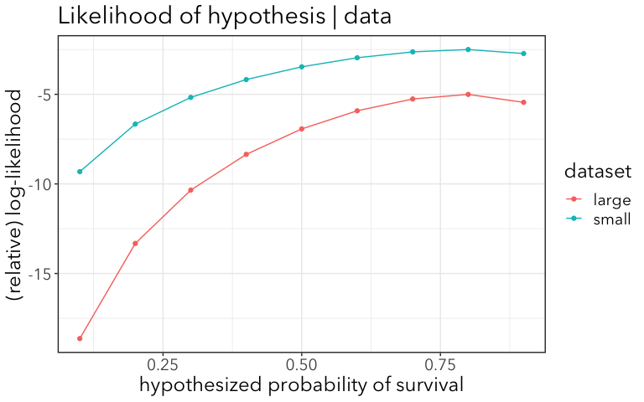
Plot log-likelihood

Slide 8
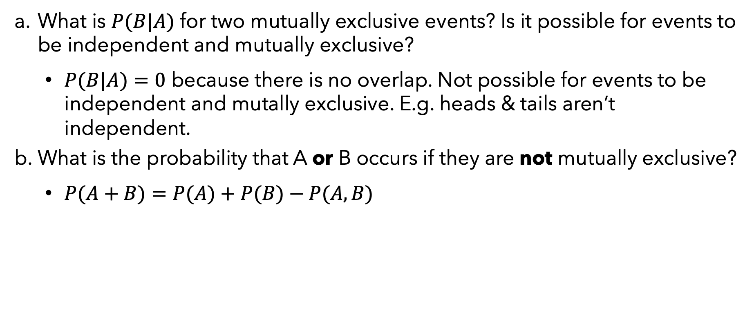
Question 2
What is $P(B|A)$ for two mutually exclusive events? Is it possible for events to be independent and mutually exclusive?
$P(B|A)=0$ because there is no overlap. Not possible for events to be independent and mutally exclusive. E.g. heads & tails aren’t independent.
What is the probability that A or B occurs if they are not mutually exclusive?
$P(A+B)=P(A)+P(B)−P(A,B)$

Slide 9
Homework 1
My homework…
Estimate occurrence of leafhoppers on a tea plant.
Sampled the second leaf from the top on haphazardly chosen shoots.
In reality, I counted the number of leafhoppers
In reality, I did this on multiple, randomly sampled plants

Slide 10
My Data
plant | count | presence
1 | 0 | FALSE
1 | 0 | FALSE
1 | 0 | FALSE
1 | 1 | TRUE
1 | 0 | FALSE
1 | 0 | FALSE
1 | 0 | FALSE
1 | 0 | FALSE
1 | 0 | FALSE
1 | 0 | FALSE
1 | 3 | TRUE
1 | 0 | FALSE
1 | 0 | FALSE
1 | 0 | FALSE
1 | 0 | FALSE

Slide 11
Calculate probability
plant | count | presence | trials | events | P(leafhopper) estimate
1 | 0 | FALSE | 1 | 0 | 0.0000000
1 | 0 | FALSE | 2 | 0 | 0.0000000
1 | 0 | FALSE | 3 | 0 | 0.0000000
1 | 1 | TRUE | 4 | 1 | 0.2500000
1 | 0 | FALSE | 5 | 1 | 0.2000000
1 | 0 | FALSE | 6 | 1 | 0.1666667
1 | 0 | FALSE | 7 | 1 | 0.1428571
1 | 0 | FALSE | 8 | 1 | 0.1250000
1 | 0 | FALSE | 9 | 1 | 0.1111111
1 | 0 | FALSE | 10 | 1 | 0.1000000
1 | 3 | TRUE | 11 | 2 | 0.1818182
1 | 0 | FALSE | 12 | 2 | 0.1666667
1 | 0 | FALSE | 13 | 2 | 0.1538462
1 | 0 | FALSE | 14 | 2 | 0.1428571
1 | 0 | FALSE | 15 | 2 | 0.1333333

Slide 12
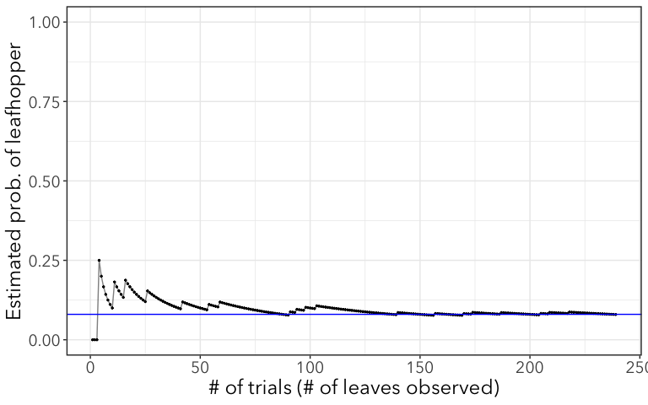

Slide 13
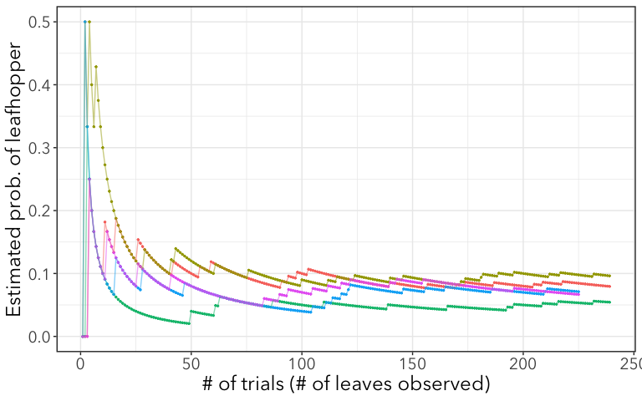

Slide 14
Exponents and logarithms (from previous notes)
review from last time

Slide 15
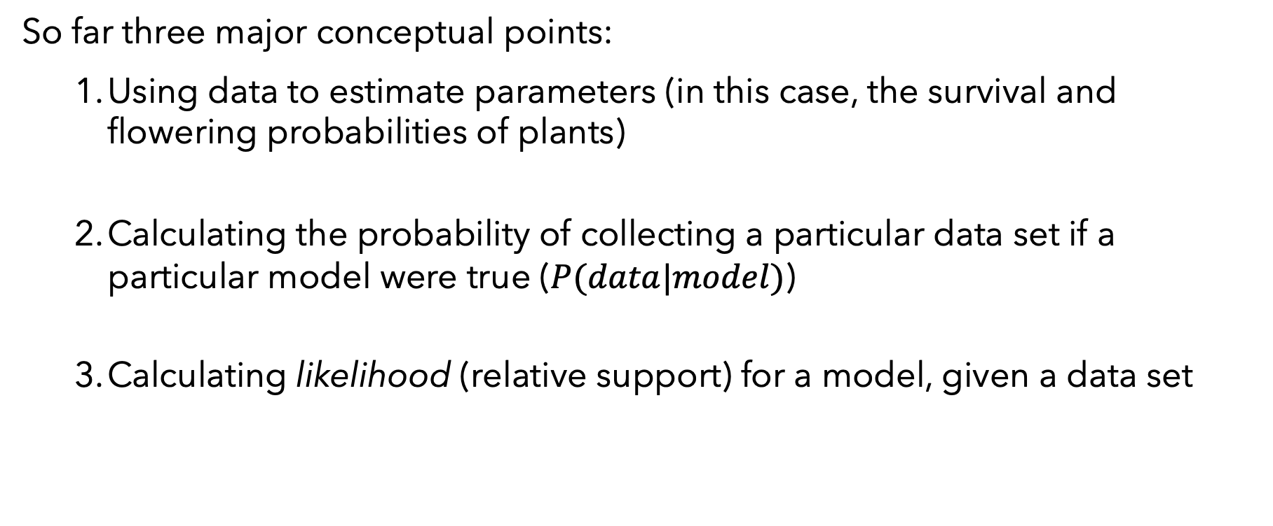
Review
So far three major conceptual points:
Using data to estimate parameters (in this case, the survival and flowering probabilities of plants)
Calculating the probability of collecting a particular data set if a particular model were true ($P(data|model)$)
Calculating likelihood (relative support) for a model, given a data set

Slide 16
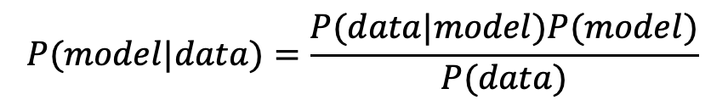
Intro to Bayes’ Theorem
Rev. Thomas Bayes (1702-1761) showed that we can convert the probability of seeing a particular dataset, given a model, into the probability of the model given the data:
[derivation on board]
$$P(model|data)=\frac{P(data|model)P(model)}{P(data)}$$

Slide 17
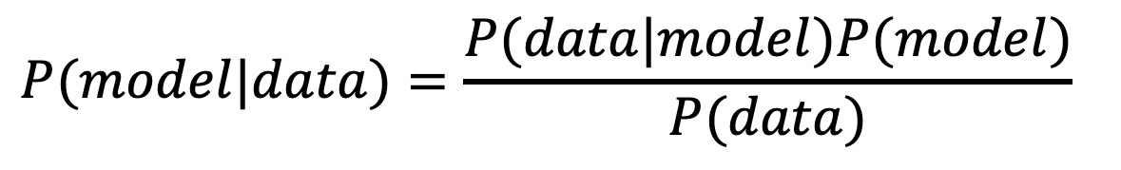
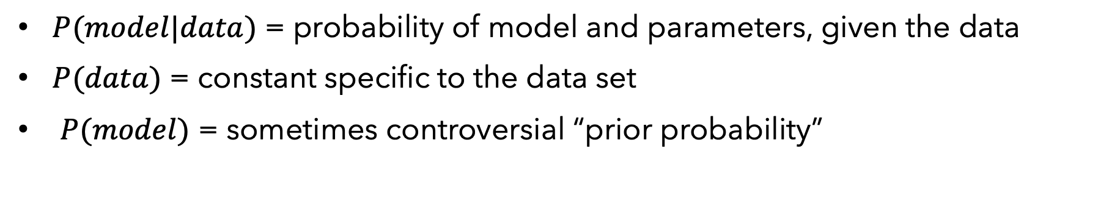
Bayes’ Theorem
$$P(model|data)=\frac{P(data|model)P(model)}{P(data)}$$
$P(model|data)$ = probability of model and parameters, given the data
$P(data)$ = constant specific to the data set
$P(model)$ = sometimes controversial “prior probability”

Slide 18
Simple intuitive example: testing for Lyme Disease
We have tests for Lyme disease, so why shouldn’t everyone get tested regularly?
true positive rate = 87%
false positive rate = 1%
But Lyme Disease is pretty rare in the US. According to the CDC, about 300,000 cases per year
300,000 / 300,000,000 = 0.001, or about 0.1% of population
Notes:
These numbers actually vary depending on the type of test (ELISA, Western Blot, PCR, etc.)

Slide 19
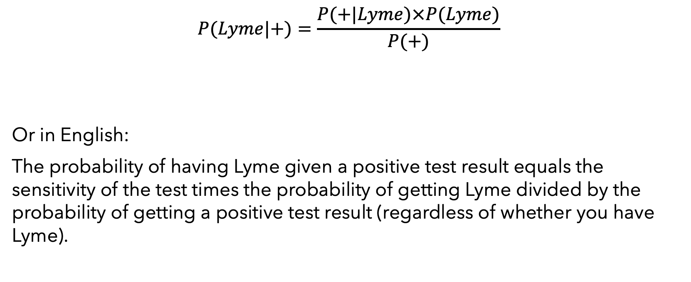
Use Bayes’ Theorem
$$P(Lyme|+)=\frac{P(+|Lyme)×P(Lyme)}{P(+)}$$
Or in English:
The probability of having Lyme given a positive test result equals the sensitivity of the test times the probability of getting Lyme divided by the probability of getting a positive test result (regardless of whether you have Lyme).
Notes:
::: You can also look at it like the probability of getting a true positive (this model) out of all the ways of getting a positive (both models) adjusted for the actual prevalence of Lyme (your prior belief of how likely it is that anyone would have Lyme). :::

Slide 20
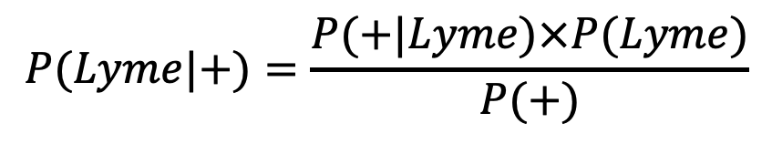
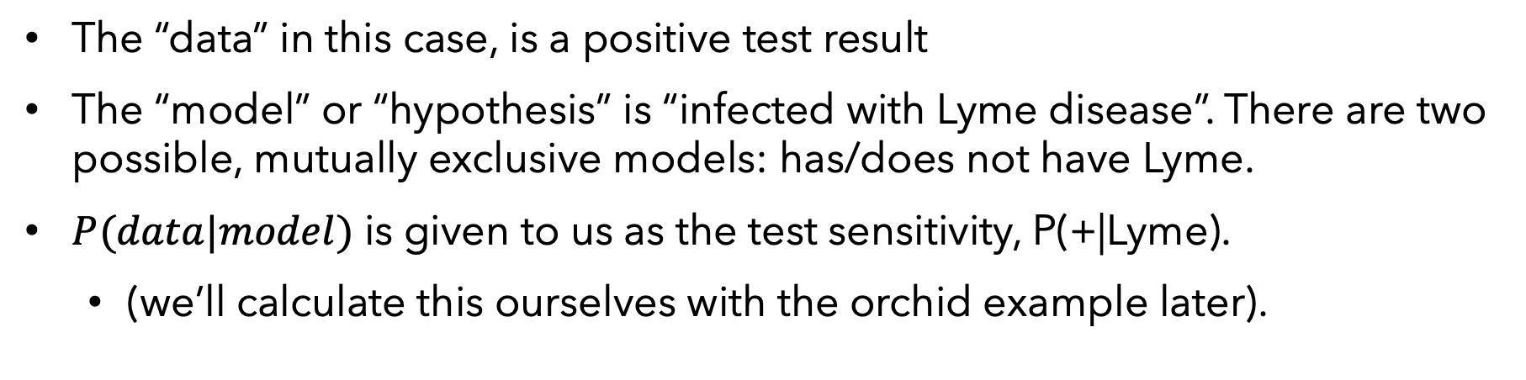
Defining the terms:
$$P(Lyme|+)=\frac{P(+|Lyme)×P(Lyme)}{P(+)}$$
The “data” in this case, is a positive test result
The “model” or “hypothesis” is “infected with Lyme disease”. There are two possible, mutually exclusive models: has/does not have Lyme.
$P(data|model)$ is given to us as the test sensitivity, P(+|Lyme).
(we’ll calculate this ourselves with the orchid example later).

Slide 21
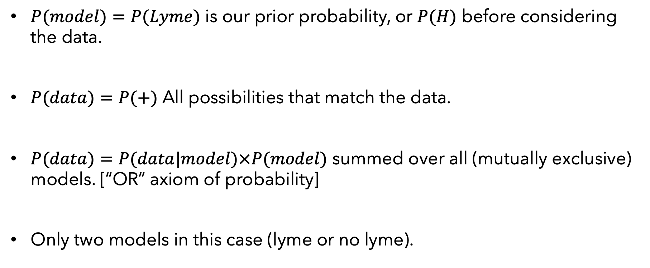
Defining the terms:
$P(model)=P(Lyme)$ is our prior probability, or $P(H)$ before considering the data.
$P(data)=P(+)$ All possibilities that match the data.
$P(data)=P(data|model)×P(model)$ summed over all (mutually exclusive) models. [“OR” axiom of probability]
Only two models in this case (lyme or no lyme).

Slide 22
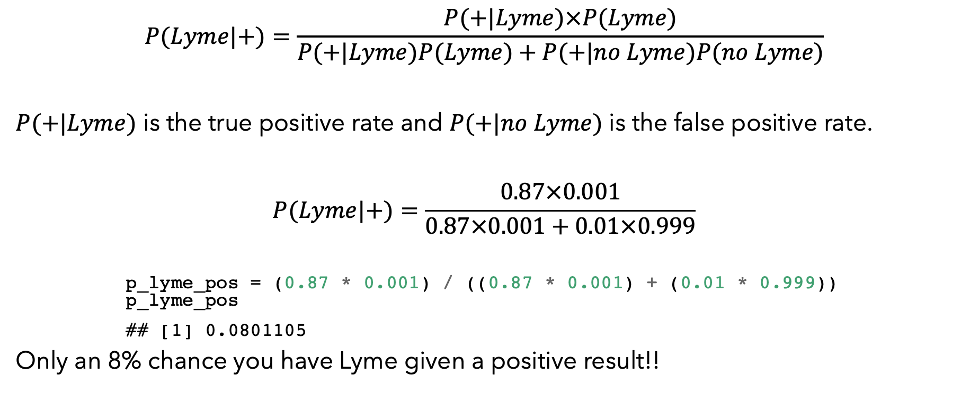
Calculations
$$P(Lyme|+)=\frac{P(+|Lyme)×P(Lyme)}{P(+|Lyme)P(Lyme)+P(+|no Lyme)P(no Lyme)}$$
$P(+|Lyme)$ is the true positive rate and $P(+|no Lyme)$ is the false positive rate.
$$P(Lyme|+)=\frac{0.87×0.001}{0.87×0.001+0.01×0.999}$$
p_lyme_pos = (0.87 * 0.001) / ((0.87 * 0.001) + (0.01 * 0.999)) p_lyme_pos
## [1] 0.0801105
Only an 8% chance you have Lyme given a positive result!!

Slide 23
What if we change our prior belief?
What would change if you knew the patient lived in Massachussetts?
Re-calculate with prior relevant to MA

Slide 24
P(Lyme|+) for MA
87,000 Lyme cases / 6.5 million = 0.013
(0.87 * 0.013) / ((0.87 * 0.013) + (0.1 * 0.987))
## [1] 0.1028088
What if they were in MA, bitten by a tick, AND had a bulls-eye rash?
(0.87 * 0.6) / ((0.87 * 0.6) + (0.1 * 0.4))
## [1] 0.9288256

Slide 25
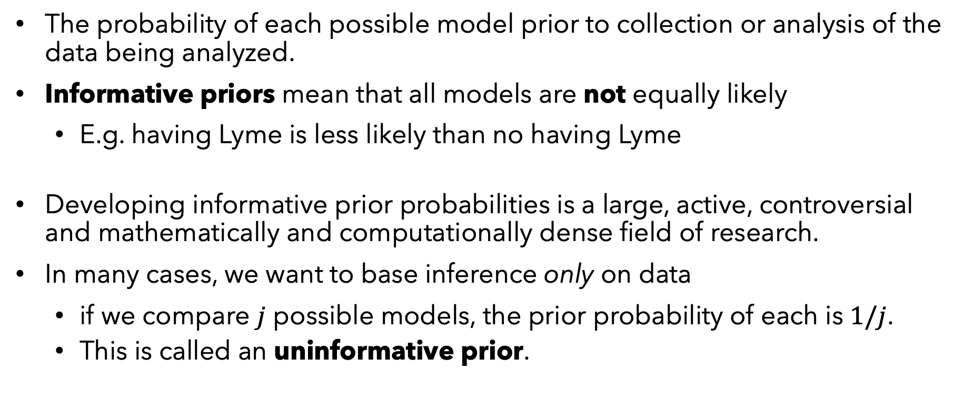
More on P(model), the “prior probability”
The probability of each possible model prior to collection or analysis of the data being analyzed.
Informative priors mean that all models are not equally likely
E.g. having Lyme is less likely than no having Lyme
Developing informative prior probabilities is a large, active, controversial and mathematically and computationally dense field of research.
In many cases, we want to base inference only on data
if we compare $j$ possible models, the prior probability of each is $1/j$.
This is called an uninformative prior.
Notes:
In the case of our lyme example, uninformative prior means the probability of Lyme is a coin toss.

Slide 26
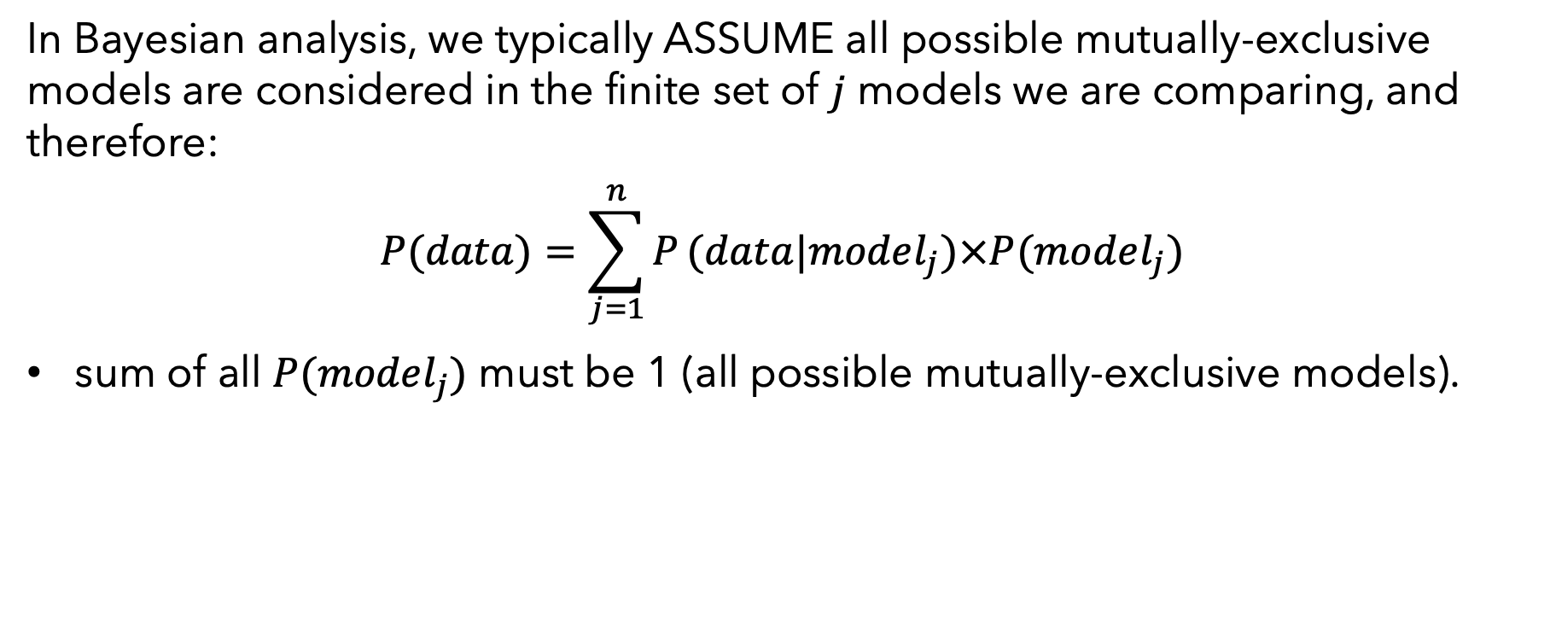
More on P(data)
In Bayesian analysis, we typically ASSUME all possible mutually-exclusive models are considered in the finite set of $j$ models we are comparing, and therefore:
$$P(data)=\sum_{j=1}^{n}{P}(data|model_{j})×P(model_{j})$$
sum of all $P(model_{j})$ must be 1 (all possible mutually-exclusive models).

Slide 27
More on P(model|data)
Also called “posterior probability”. The probability of the model after seeing the evidence (as opposed to “prior probability”)
Rather than looking for model with the highest likelihood, Bayesians look at posterior probabilities.

Slide 28
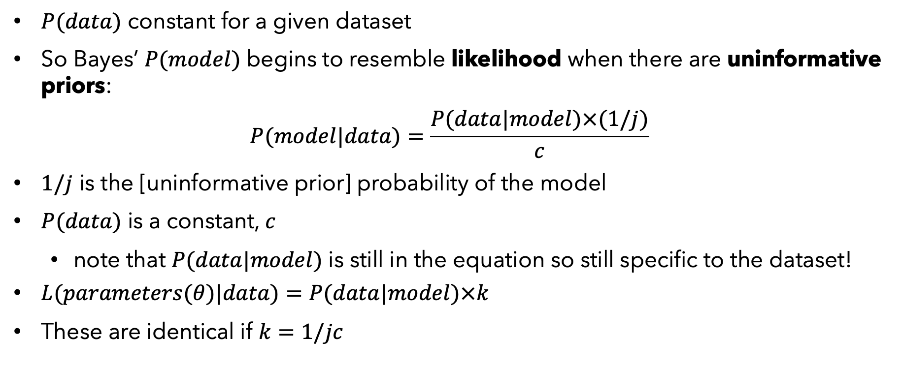
Comparing to Likelihood
$P(data)$ constant for a given dataset
So Bayes’ $P(model)$ begins to resemble likelihood when there are uninformative priors:
$$P(model|data)=\frac{P(data|model)×(1/j)}{c}$$
$1/j$ is the [uninformative prior] probability of the model
$P(data)$ is a constant, $c$
note that $P(data|model)$ is still in the equation so still specific to the dataset!
$L(parameters(θ)|data)=P(data|model)×k$
These are identical if $k=1/jc$

Slide 29
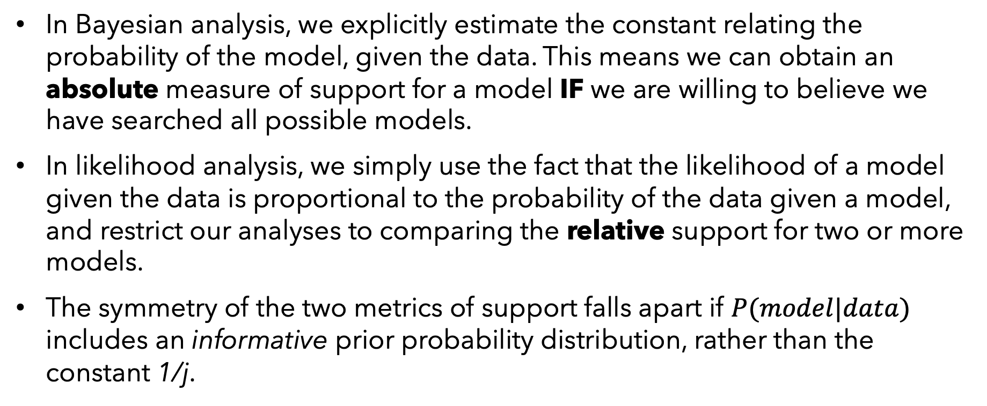
In other words:
In Bayesian analysis, we explicitly estimate the constant relating the probability of the model, given the data. This means we can obtain an absolute measure of support for a model IF we are willing to believe we have searched all possible models.
In likelihood analysis, we simply use the fact that the likelihood of a model given the data is proportional to the probability of the data given a model, and restrict our analyses to comparing the relative support for two or more models.
The symmetry of the two metrics of support falls apart if $P(model|data)$ includes an informative prior probability distribution, rather than the constant 1/j.

Slide 30
Graphical / geometric representation
Good video here: https://youtu.be/HZGCoVF3YvM

