Slide 1
Homework 4 Feedback
Can’t compare p-values of models to judge relative support
More about confidence intervals
They don’t have to be symmetrical (often aren’t with link functions), so report lower and upper not ±.
Error bars plotted on graphs aren’t always 95% CIs—need to specify in figure captions
Notes:
Put up drawing of p-value comparison. Show how ”linearly nested” makes sense to do LRT (stepwise), but how anything more complicated you might just want to do AIC.

Slide 2
Hacking GLMs to fit population growth models

Slide 3
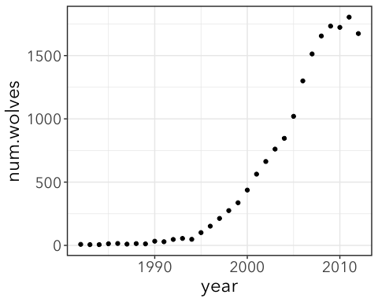

Grey Wolves in Yellowstone
By 1920s almost all grey wolves in the US were killed
This and other factors led to overgrazing by elk which altered riparian (near river) habitat and affected other organisms.
1974 Wolves listed as endangered
Recover plan in 1987
Reintroduced to Yellowstone National Park in 1995
2008–2012 de-listed (hunting allowed again)
Notes:
Reintroduced from Canada. Successfully controlled elk. Still controversial as some hunters worry that too many elk will be killed.

Slide 4
Grey Wolves
NRM = Northern Rocky Mountains
wolves <- read_csv(here("data", "NRMwolves.csv")) head(wolves)
## # A tibble: 6 x 7 ## year num.wolves MT.wolves WY.wolves ID.wolves OR.wolves WA.wolves ## <dbl> <dbl> <dbl> <dbl> <dbl> <dbl> <dbl> ## 1 1982 8 8 NA NA NA NA ## 2 1983 6 6 NA NA NA NA ## 3 1984 6 6 NA NA NA NA ## 4 1985 13 13 NA NA NA NA ## 5 1986 15 15 NA NA NA NA ## 6 1987 10 10 NA NA NA NA
wolves <- wolves %>% mutate(year_post = year - 1982, year = as.integer(year))

Slide 5
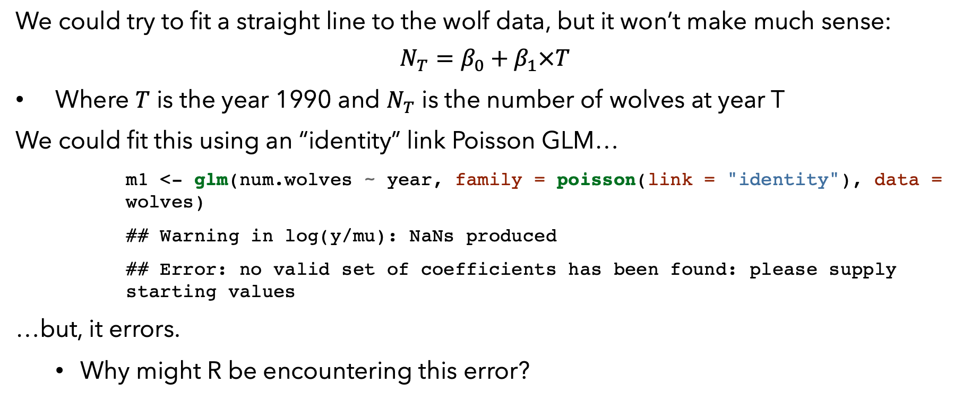
Linear vs. exponential growth
We could try to fit a straight line to the wolf data, but it won’t make much sense:
$$N_{T}=β_{0}+β_{1}×T$$
Where $T$ is the year 1990 and $N_{T}$ is the number of wolves at year T
We could fit this using an “identity” link Poisson GLM…
m1 <- glm(num.wolves ~ year, family = poisson(link = "identity"), data = wolves)
## Warning in log(y/mu): NaNs produced
## Error: no valid set of coefficients has been found: please supply starting values
…but, it errors.
Why might R be encountering this error?

Slide 6
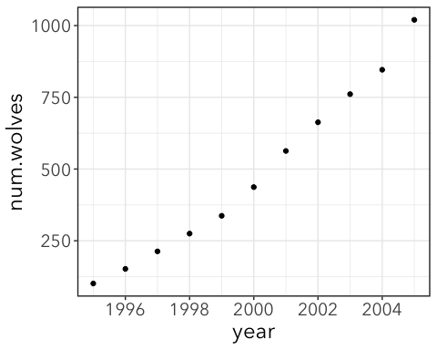
10 years of data
Let’s use a 10 year portion of this data from 1995–2005 that looks a little more reasonable as a line to demonstrate first.
wolves_sub <- wolves %>% filter(year >= 1995 & year <= 2005)

Slide 7
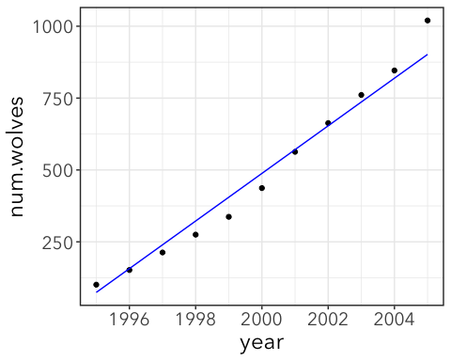
Use an identity link to fit a straight line
m1 <- glm(num.wolves ~ year_post, family = poisson(link = "identity"), data = wolves_sub) coef(m1)
## (Intercept) year_post ## -1002.23754 82.79097
Essentially impossible. Predicts -1002 wolves in 1982!

Slide 8
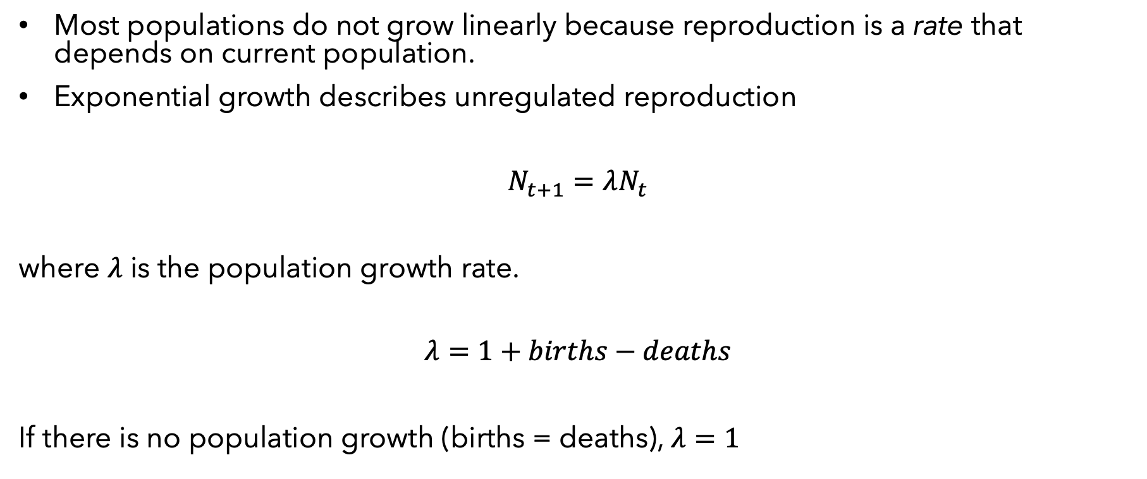
Exponential growth
Most populations do not grow linearly because reproduction is a rate that depends on current population.
Exponential growth describes unregulated reproduction
$$N_{t+1}=λN_{t}$$
where $λ$ is the population growth rate.
$$λ=1+births−deaths$$
If there is no population growth (births = deaths), $λ=1$

Slide 9
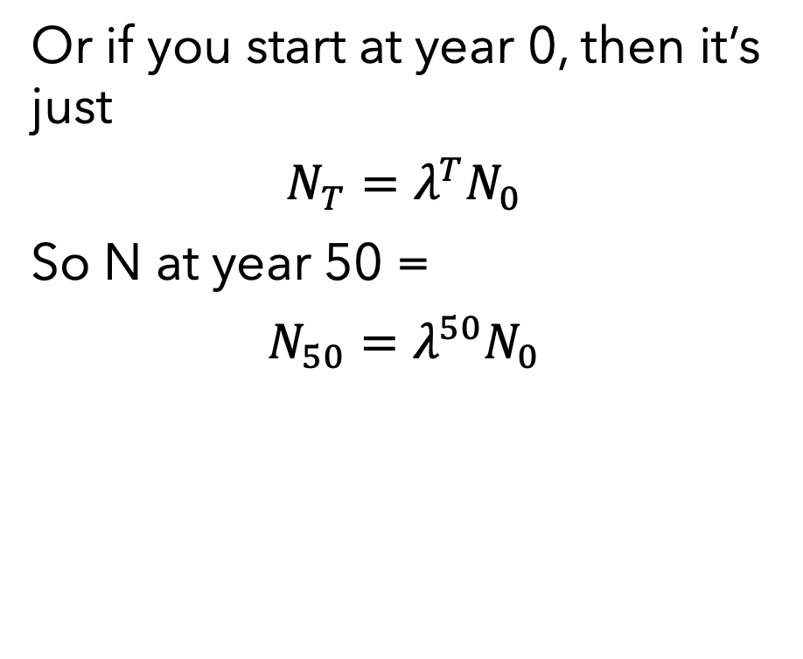
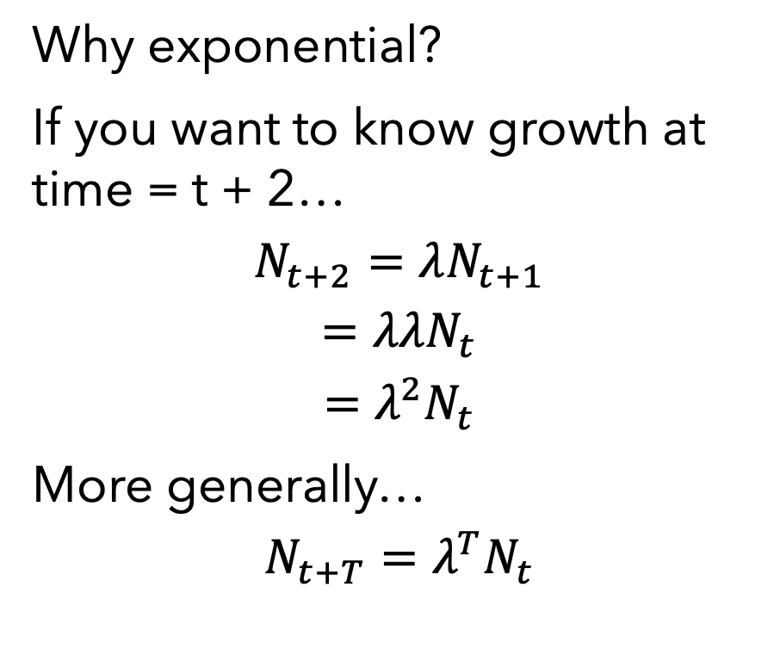
Exponential growth
Why exponential?
If you want to know growth at time = t + 2…
$$N_{t+2}=λN_{t+1}$$
$$=λλN_{t}$$
$$=λ^{2}N_{t}$$
More generally…
$$N_{t+T}=λ^{T}N_{t}$$
Or if you start at year 0, then it’s just
$$N_{T}=λ^{T}N_{0}$$
So N at year 50 =
$$N_{50}=λ^{50}N_{0}$$

Slide 10
Exponential growth
If lambda < 1
births = 0.05 deaths = 0.15 lambda = 1 + births - deaths N0 = 50 #population size at year 0 fake_pop <- tibble( year = 0:50, N = N0 * lambda ^ year ) ggplot(fake_pop, aes(x = year, y = N)) + geom_line() + labs(subtitle = paste("lambda =", lambda)) + ggplot(fake_pop, aes(x = year, y = log(N))) + geom_line()

Slide 11
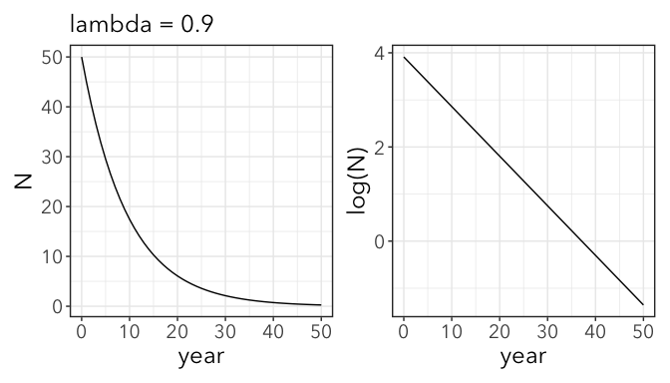
#the patchwork package allows you to make two-panel plots like this

Slide 12
Exponential growth
When lambda > 1
births = 0.15 deaths = 0.05 lambda = 1 + births - deaths N0 = 50 #population size at year 0 fake_pop <- tibble( year = 0:50, N = N0 * lambda ^ year ) ggplot(fake_pop, aes(x = year, y = N)) + geom_line() + labs(subtitle = paste("lambda =", lambda)) + ggplot(fake_pop, aes(x = year, y = log(N))) + geom_line()

Slide 13
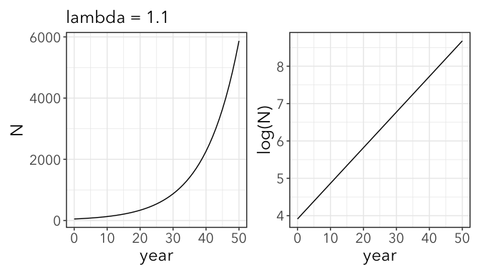

Slide 14
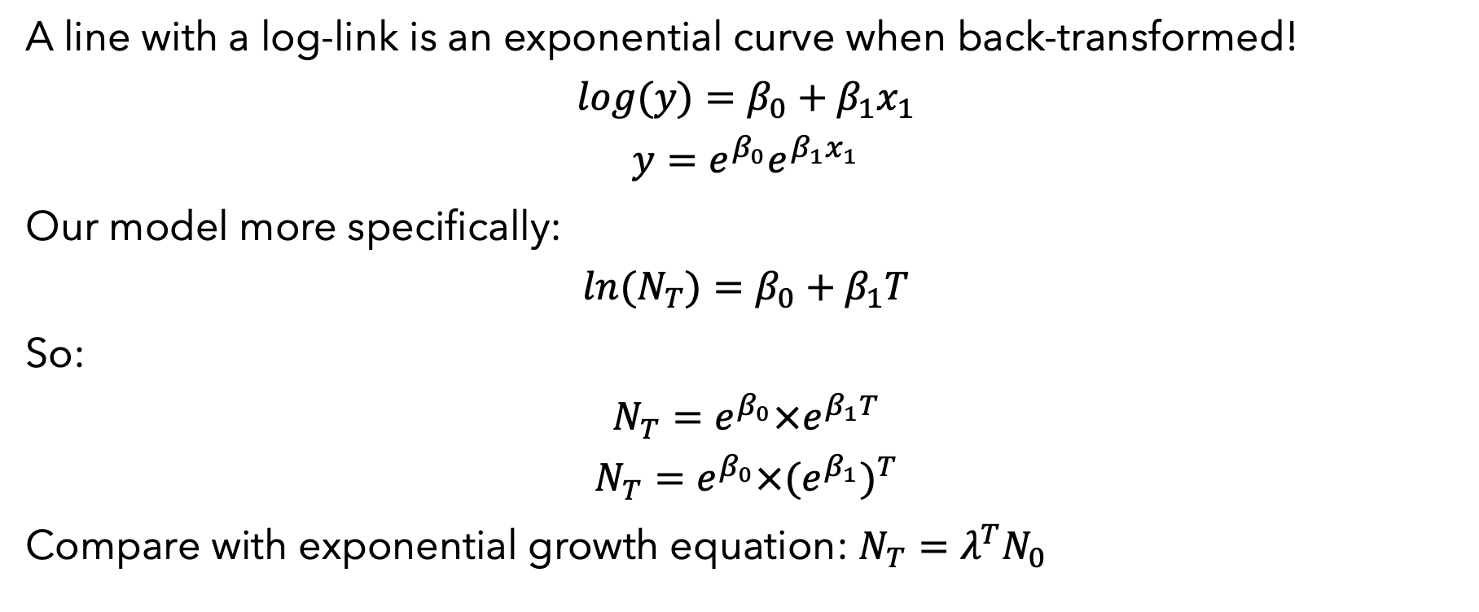
Use log-link instead
A line with a log-link is an exponential curve when back-transformed!
$$log(y)=β_{0}+β_{1}x_{1}$$
$$y=e^{β_{0}}e^{β_{1}x_{1}}$$
Our model more specifically:
$$ln(N_{T})=β_{0}+β_{1}T$$
So:
$$N_{T}=e^{β_{0}}×e^{β_{1}T}$$
$$N_{T}=e^{β_{0}}×(e^{β_{1}})^{T}$$
Compare with exponential growth equation: $N_{T}=λ^{T}N_{0}$

Slide 15
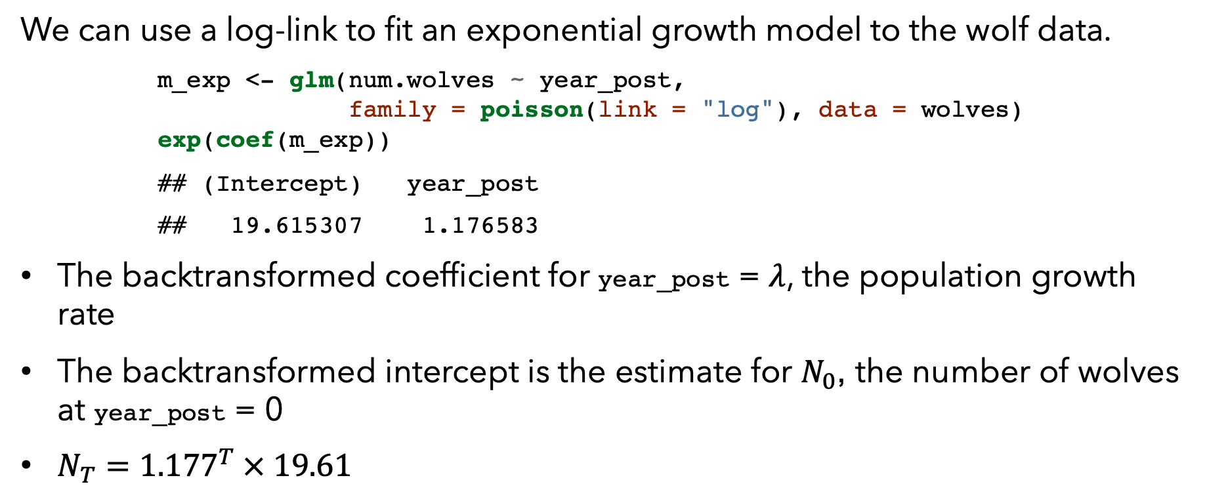
Hacking an exponential growth GLM
We can use a log-link to fit an exponential growth model to the wolf data.
m_exp <- glm(num.wolves ~ year_post, family = poisson(link = "log"), data = wolves) exp(coef(m_exp))
## (Intercept) year_post ## 19.615307 1.176583
The backtransformed coefficient for year_post = $λ$, the population growth rate
The backtransformed intercept is the estimate for $N_{0}$, the number of wolves at year_post = 0
$N_{T}={1.177}^{T} × 19.61$

Slide 16
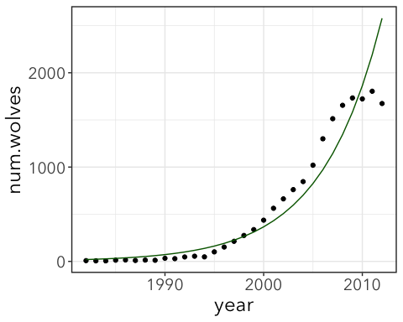
Hmm… doesn’t look quite right.

Slide 17
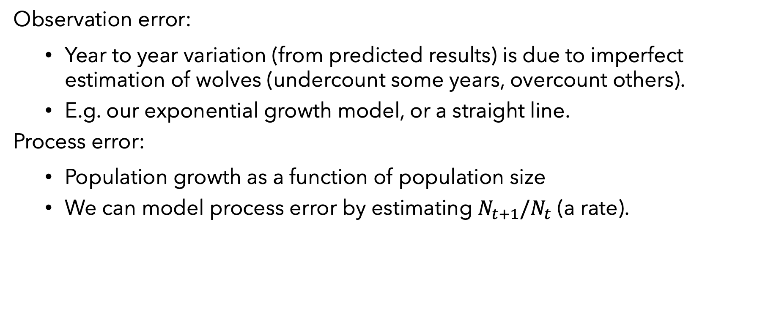
Observation error vs. process error
Observation error:
Year to year variation (from predicted results) is due to imperfect estimation of wolves (undercount some years, overcount others).
E.g. our exponential growth model, or a straight line.
Process error:
Population growth as a function of population size
We can model process error by estimating $N_{t+1}/N_{t}$ (a rate).

Slide 18

Process error using offset
We used offsets previously to estimate rates of bee visitation (bees/hour)
Here, we “hack” a glm to use offsets to fit a process error model. That is, we want to model a rate of increase relative to the previous year.
$$log(N_{t+1}/N_{t})=β_{0}$$
$$log(N_{t+1})=β_{0}+log(N_{t})$$
An offset!

Slide 19
Lagged data
We can create a column of the number of wolves in the previous year with the lag() function.
wolves2 <- wolves %>% mutate(num.prev = lag(num.wolves)) %>% select(year, year_post, num.wolves, num.prev) head(wolves2)
## # A tibble: 6 x 4 ## year year_post num.wolves num.prev ## <int> <dbl> <dbl> <dbl> ## 1 1982 0 8 NA ## 2 1983 1 6 8
We want to remove the first year, where we don’t have any data on the previous year’s number of wolves.
wolves2 <- wolves2 %>% filter(!is.na(num.prev)) head(wolves2)
## # A tibble: 6 x 4 ## year year_post num.wolves num.prev ## <int> <dbl> <dbl> <dbl> ## 1 1983 1 6 8 ## 2 1984 2 6 6
Notes:
is.na(x) returns TRUE if something is NA, but we want the opposite of that, so we negate it with !

Slide 20
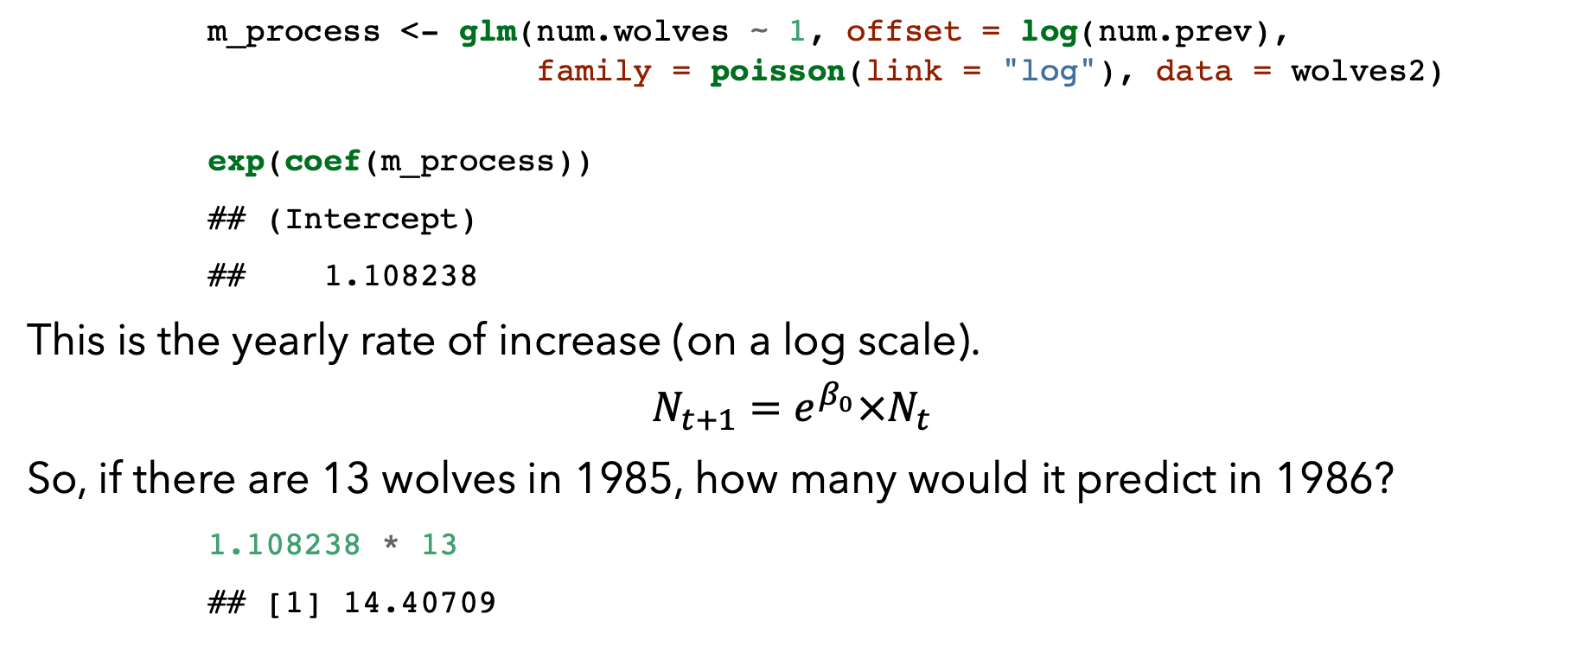
Hacking a process error GLM
m_process <- glm(num.wolves ~ 1, offset = log(num.prev), family = poisson(link = "log"), data = wolves2) exp(coef(m_process))
## (Intercept) ## 1.108238
This is the yearly rate of increase (on a log scale).
$$N_{t+1}=e^{β_{0}}×N_{t}$$
So, if there are 13 wolves in 1985, how many would it predict in 1986?
1.108238 * 13
## [1] 14.40709

Slide 21
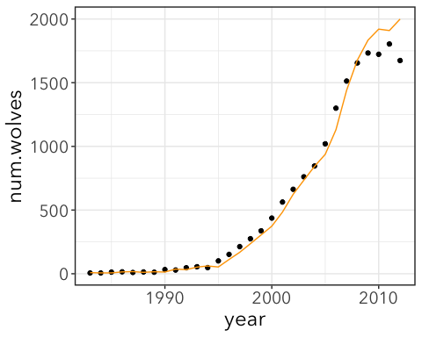
Notes:
Notice that this lags behind a bit since predicted growth (orange) is based on actual population size in previous year (black dots).

Slide 22
Density-dependent growth
Exponential growth isn’t realistic over the long term for most populations, even under favorable conditions.
Density dependent factors:
limited resources
faster disease spread
emigration
etc.
These things limit exponential growth to some carrying capacity (the maximum population size that can be sustained long term).
Carrying capacity = K

Slide 23
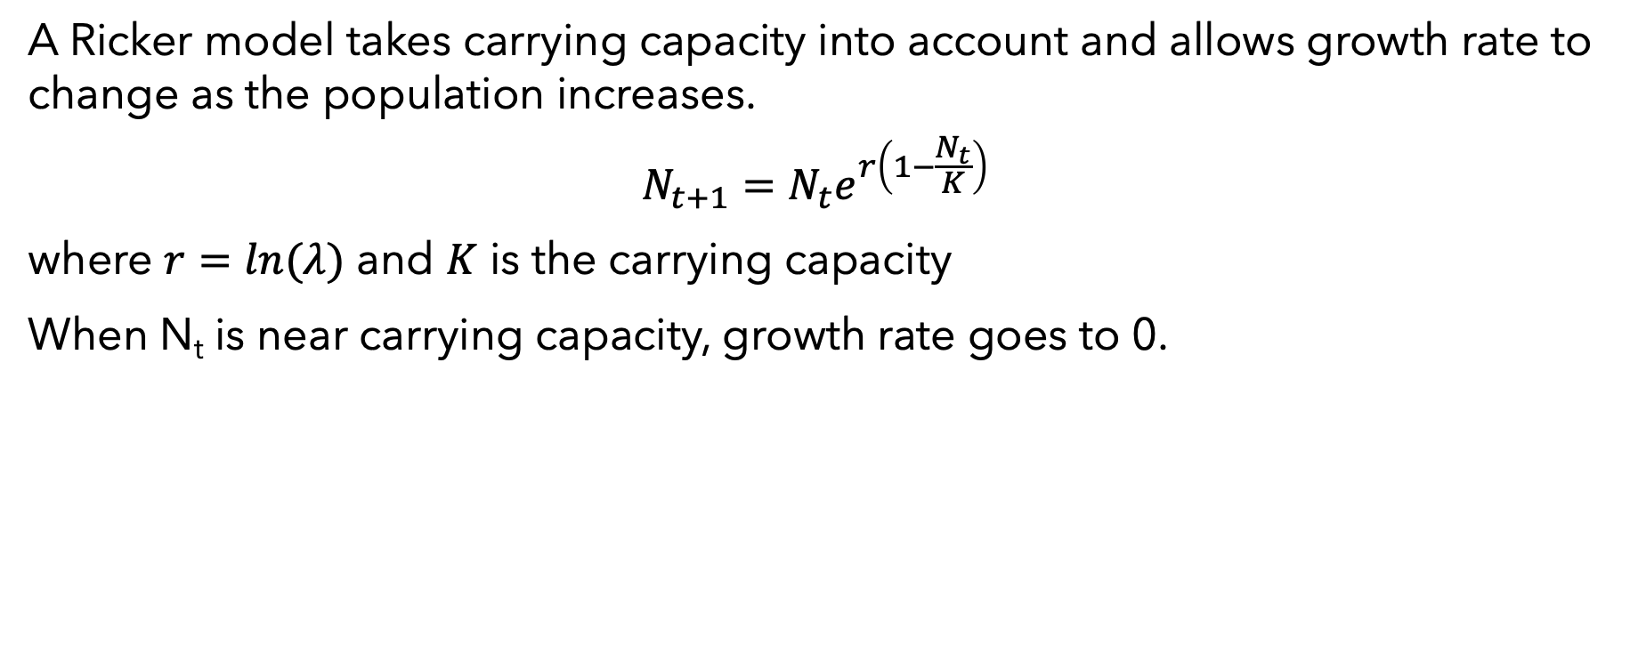
Ricker model
A Ricker model takes carrying capacity into account and allows growth rate to change as the population increases.
$$N_{t+1}=N_{t}e^{r\left(1−\frac{N_{t}}{K}\right)}$$
where $r=ln(λ)$ and $K$ is the carrying capacity
When N_{t} is near carrying capacity, growth rate goes to 0.

Slide 24

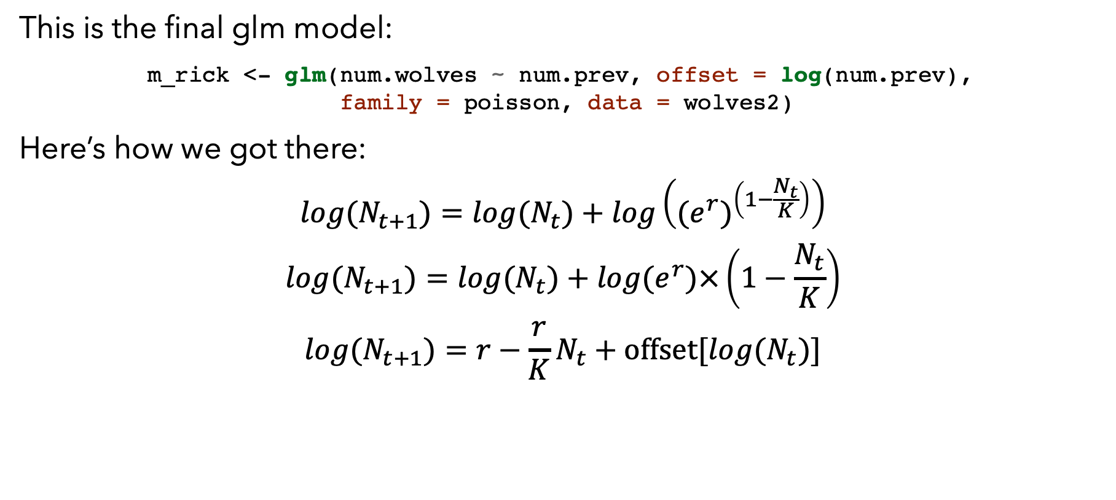
Hacking a Ricker model GLM
This is the final glm model:
m_rick <- glm(num.wolves ~ num.prev, offset = log(num.prev), family = poisson, data = wolves2)
Here’s how we got there:
$$log(N_{t+1})=log(N_{t})+log\left((e^{r})^{\left(1−\frac{N_{t}}{K}\right)}\right)$$
$$log(N_{t+1})=log(N_{t})+log(e^{r})×\left(1−\frac{N_{t}}{K}\right)$$
$$log(N_{t+1})=r−\frac{r}{K}N_{t}+offset[log(N_{t})]$$
$$ln(N_{t+1})=β_{0}+β_{1}x_{1}$$
$r$ = $β_{0}$
$$λ=exp(β_{0})$$
$β_{1}=−r/K$
$$K=−β_{0}/β_{1}$$

Slide 25
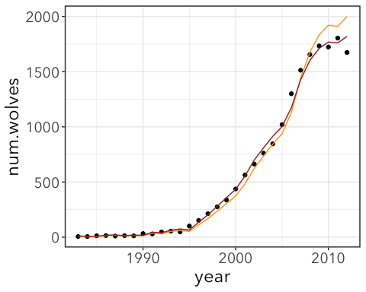
Notes:
Brown = ricker model with process error.

Slide 26
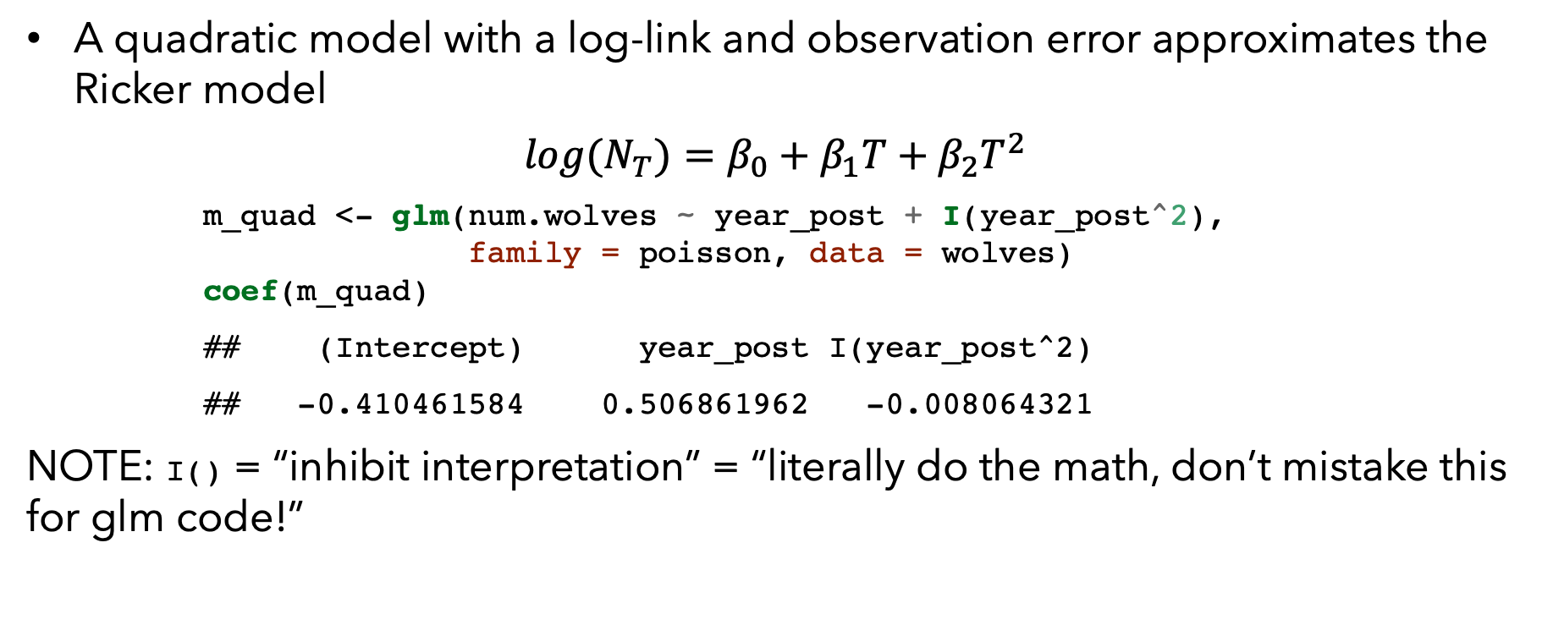
Quadratic Model
A quadratic model with a log-link and observation error approximates the Ricker model
$$log(N_{T})=β_{0}+β_{1}T+β_{2}T^{2}$$
m_quad <- glm(num.wolves ~ year_post + I(year_post^2), family = poisson, data = wolves) coef(m_quad)
## (Intercept) year_post I(year_post^2) ## -0.410461584 0.506861962 -0.008064321
NOTE: I() = “inhibit interpretation” = “literally do the math, don’t mistake this for glm code!”

Slide 27
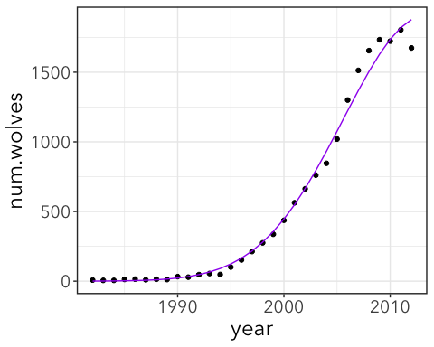

Slide 28
Model competition
nrow(wolves) == nrow(wolves2)
## [1] FALSE
That’s no good because we need to all models to the same data.
Re-fit exponential growth model using wolves2 (alternatively, know what wolf population was in 1994).
m_exp2 <- glm(num.wolves ~ year_post, family = poisson, data = wolves2)
AIC(m_exp2, m_process, m_rick, m_quad)
## df AIC ## m_exp2 2 1632.1823 ## m_process 1 468.1141 ## m_rick 2 326.0193 ## m_quad 3 381.9031
Notes:
Ricker model “wins”

