Slide 1
Interpreting Zero-inflated Models
Eric Scott

Slide 2
Bluebirds
Last time we fit several models to potentially explain the relationship between bluebird counts and latitude in the Christmas Bird Count data.
Simple Poisson GLM
Zero-inflated Poisson GLM (with latitude affecting counts, zeroes, or both)
Negative binomial GLM
Zero-inflated negative binomial GLM (with latitude affecting counts, zeroes, or both)

Slide 3
AIC competition
The winner was…
ZiNB with latitude affecting both counts and zeroes
zeroinfl(formula = count ~ Latitude | Latitude, offset = log(hours), dist = "negbin", data = birds2)
But a close second (dAIC = 1.1) was a simpler model, with latitude only affecting zeroes
zeroinfl(formula = count ~ 1 | Latitude, offset = log(hours), dist = "negbin", data = birds2)
Here’s an example where you might use the fact that dAIC < 2 to justify keeping both models and interpreting both. Let’s start with the simple one.

Slide 4
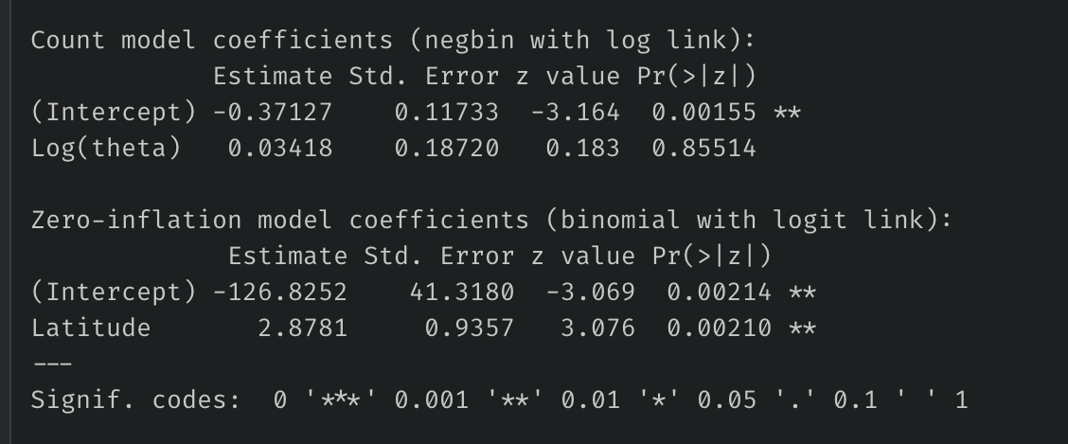
Interpreting ZiNB GLM
Mean # bluebirds per hour given that they are at a site = exp(-0.37127) = 0.69
summary(m_zinb2)
Probability a site is a “true” zero (i.e., bluebirds have migrated away from the site and you’ll never find them there) = plogis(-126.8252 + 2.8781 * Latitude)
at 41º Latitude, p(migration) = plogis(-126.8252 + 2.8781 * 41) = 0.0001
at 47º, p(migration) = 0.9998

Slide 5
What is the probability that we find zero birds at a site because they’re truly not there (and not just because we happened to not see any because of Poisson sampling)?
We now know that this probability varies with latitude. Let’s plot our results.
1. Create column of 1’s and 0’s
birds2 <- birds2 %>% mutate(zero = as.numeric(count == 0))
2. Plot presence/absence
migration_plot <- ggplot(birds2, aes(x = Latitude, y = zero)) + geom_point(alpha = 0.5) + #make points slightly transparent to see overplotting better. labs(y = "probability of true zero")
3. Create fitted data with our equation
Remember, y = plogis(-126.8252 + 2.8781 * Latitude)
pred_data <- tibble( Latitude = seq(min(birds2$Latitude), max(birds2$Latitude), 0.05), # x-values prob = plogis(-126.8252 + 2.8781 * Latitude) )
4. Add a line to the plot
migration_plot + geom_line(aes(y = prob), data = pred_data, color = "blue")

Slide 6
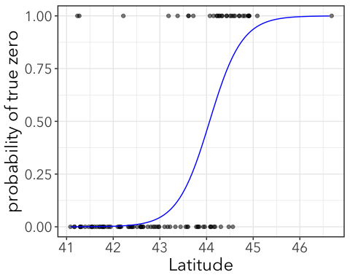
Chance that these are “true” zeroes
0.01%
99%
Interpretation:
At low latitudes, the zeroes are likely to be due to Poisson sampling (they’re probably there, but you just didn’t see any).
At high latitudes, the zeroes are likely due to true absence of bluebirds from those sites (maybe they migrated south)

