Slide 1
Interpreting Zero-inflated Models
Eric Scott

Slide 2
Bluebirds
Last time we fit several models to potentially explain the relationship between bluebird counts and latitude in the Christmas Bird Count data.
Simple Poisson GLM
Zero-inflated Poisson GLM (with latitude affecting counts, zeroes, or both)
Negative binomial GLM
Zero-inflated negative binomial GLM (with latitude affecting counts, zeroes, or both)

Slide 3
AIC competition
The winner was…
ZiNB with latitude affecting both counts and zeroes
zeroinfl(formula = count ~ Latitude | Latitude, offset = log(hours), dist = "negbin", data = birds2)
But a close second (dAIC = 1.1) was a simpler model, with latitude only affecting zeroes
zeroinfl(formula = count ~ 1 | Latitude, offset = log(hours), dist = "negbin", data = birds2)
Here’s an example where you might use the fact that dAIC < 2 to justify keeping both models and interpreting both. Let’s start with the simple one.

Slide 4
Interpreting ZiNB GLM
summary(m_zinb2)
## ## Call: ## zeroinfl(formula = count ~ 1 | Latitude, data = birds2, offset = log(hours), ## dist = "negbin") ## ## Pearson residuals: ## Min 1Q Median 3Q Max ## -1.0017 -0.4887 -0.2576 0.3822 2.9110 ## ## Count model coefficients (negbin with log link): ## Estimate Std. Error z value Pr(>|z|) ## (Intercept) -0.37127 0.11733 -3.164 0.00155 ** ## Log(theta) 0.03418 0.18720 0.183 0.85514 ## ## Zero-inflation model coefficients (binomial with logit link): ## Estimate Std. Error z value Pr(>|z|) ## (Intercept) -126.8252 41.3180 -3.069 0.00214 ** ## Latitude 2.8781 0.9357 3.076 0.00210 ** ## --- ## Signif. codes: 0 '***' 0.001 '**' 0.01 '*' 0.05 '.' 0.1 ' ' 1 ## ## Theta = 1.0348 ## Number of iterations in BFGS optimization: 29 ## Log-likelihood: -392.3 on 4 Df
Mean # bluebirds per hour given that they are at a site = exp(-0.37127) = 0.6898577
Probability a site is a “true” zero (i.e., bluebirds have migrated away from the site and you’ll never find them there) = plogis(-126.8252 + 2.8781 * Latitude)
at 41º Latitude, p(migration) = plogis(-126.8252 + 2.8781 * 41 = 0.0001
at 47º, p(migration) = 0.9998

Slide 5
Back to the question
Remember, our question is what is the probability that we find zero birds at a site because they’re truly not there (and not just because we happend to not see any because of Poisson sampling).
We now know that this probability varies with latitude. Let’s plot our results.
1. Create column of 1’s and 0’s
birds2 <- birds2 %>% mutate(zero = as.numeric(count == 0))
2. Plot presence/absence
migration_plot <- ggplot(birds2, aes(x = Latitude, y = zero)) + geom_point(alpha = 0.5) + #make points slightly transparent to see overplotting better. labs(y = "probability of true zero")
3. Create fitted data with our equation
Remember, y = plogis(-126.8252 + 2.8781 * Latitude)
pred_data <- tibble( Latitude = seq(min(birds2$Latitude), max(birds2$Latitude), 0.05), # x-values prob = plogis(-126.8252 + 2.8781 * Latitude) )
4. Add a line to the plot
migration_plot + geom_line(aes(y = prob), data = pred_data, color = "blue")

Slide 6
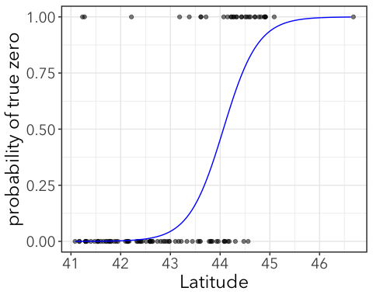

Slide 7
Interpretation: At low latitudes, the zeroes (confusingly the top of the plot) are likely to be due to Poisson sampling. At high latitudes, the zeroes are likely due to true absence of bluebirds from those sites.

