Slide 1
From Probability to Likelihood
Eric Scott

Slide 2
Probability Definition #2
Graphical example [on board]

Slide 3
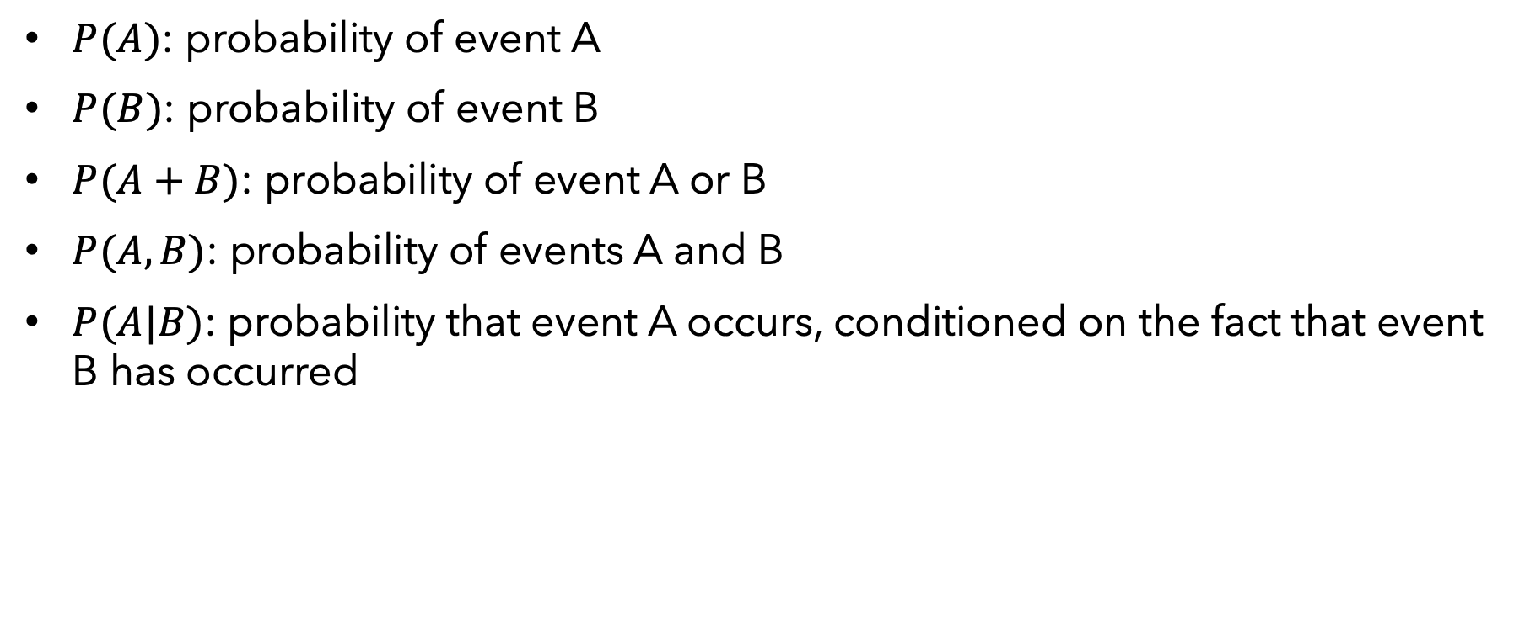
Probability Notation:
$P(A)$: probability of event A
$P(B)$: probability of event B
$P(A+B)$: probability of event A or B
$P(A,B)$: probability of events A and B
$P(A|B)$: probability that event A occurs, conditioned on the fact that event B has occurred

Slide 4
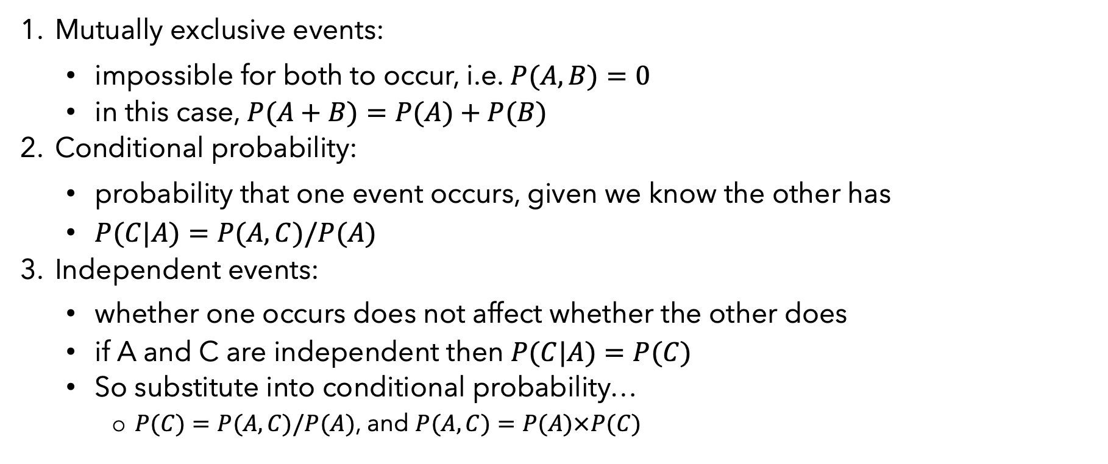
Definitions
Mutually exclusive events:
impossible for both to occur, i.e. $P(A,B)=0$
in this case, $P(A+B)=P(A)+P(B)$
Conditional probability:
probability that one event occurs, given we know the other has
$P(C|A)=P(A,C)/P(A)$
Independent events:
whether one occurs does not affect whether the other does
if A and C are independent then $P(C|A)=P(C)$
So substitute into conditional probability…
$P(C)=P(A,C)/P(A)$, and $P(A,C)=P(A)×P(C)$

Slide 5
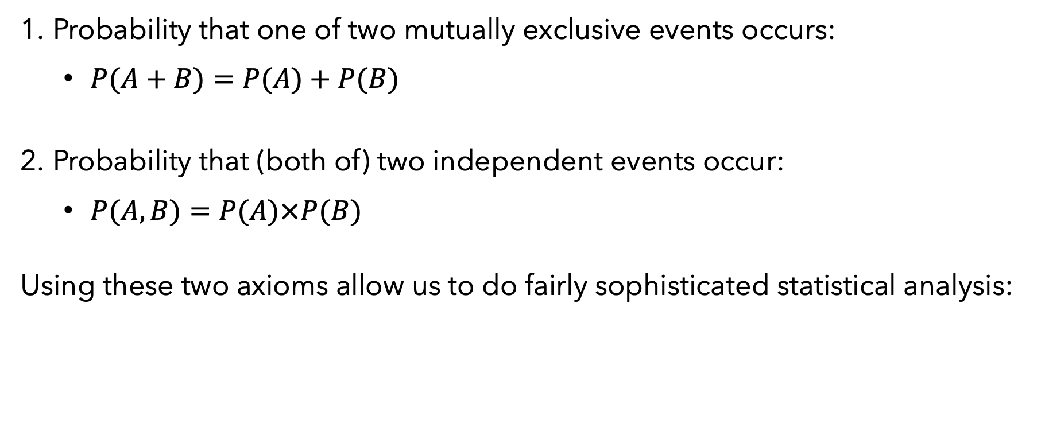
Two MAJOR axioms of probability
Probability that one of two mutually exclusive events occurs:
$P(A+B)=P(A)+P(B)$
Probability that (both of) two independent events occur:
$P(A,B)=P(A)×P(B)$
Using these two axioms allow us to do fairly sophisticated statistical analysis:

Slide 6

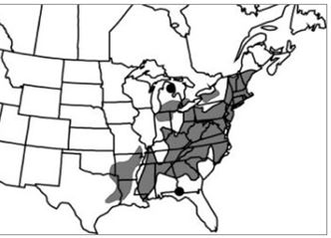

Small whorled pogonia (Isotria medeoloides) : Rare orchid found in forests of eastern North America

Slide 7
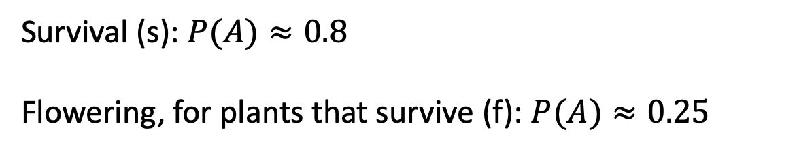
Example: our small orchid population
We have 5 plants, 4 live, and 1 of these flowers
Plant# | fate
1 | Flowering
2 | Vegetative
3 | Vegetative
4 | Vegetative
5 | Dead
Survival (s): $P(A)≈0.8$
Flowering, for plants that survive (f): $P(A)≈0.25$

Slide 8
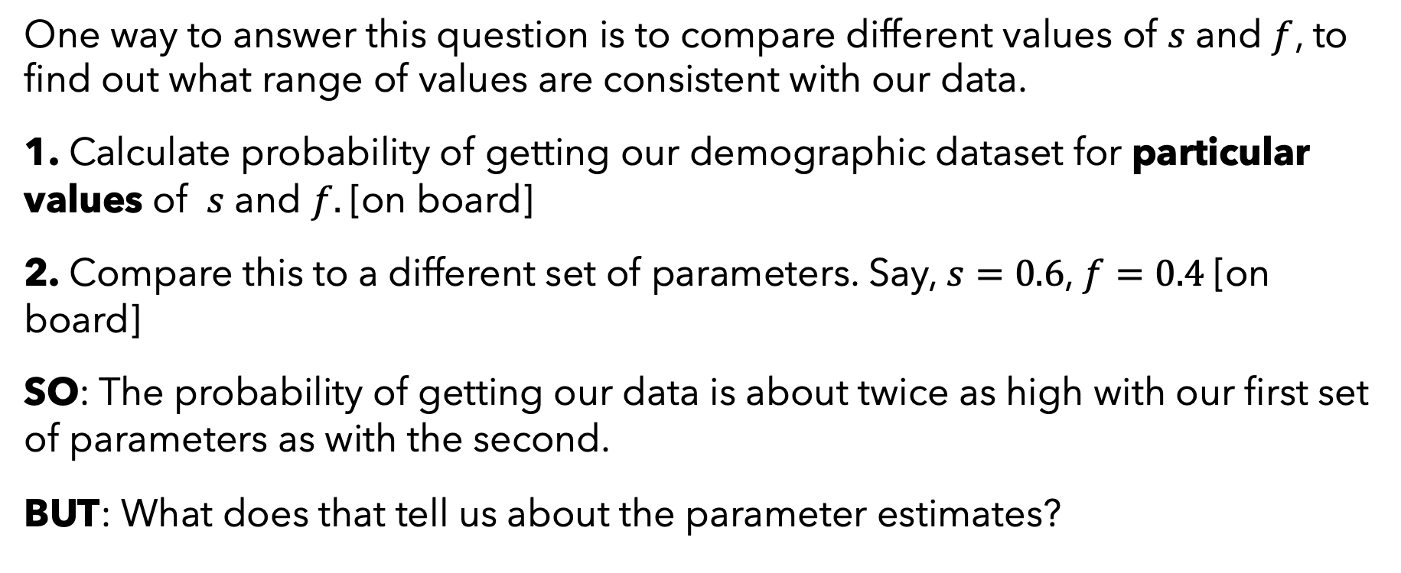
Is N “large enough” to get a good estimate?
One way to answer this question is to compare different values of $s$ and $f$, to find out what range of values are consistent with our data.
1. Calculate probability of getting our demographic dataset for particular values of $s$ and $f.$[on board]
2. Compare this to a different set of parameters. Say, $s=0.6$, $f=0.4$[on board]
SO: The probability of getting our data is about twice as high with our first set of parameters as with the second.
BUT: What does that tell us about the parameter estimates?

Slide 9
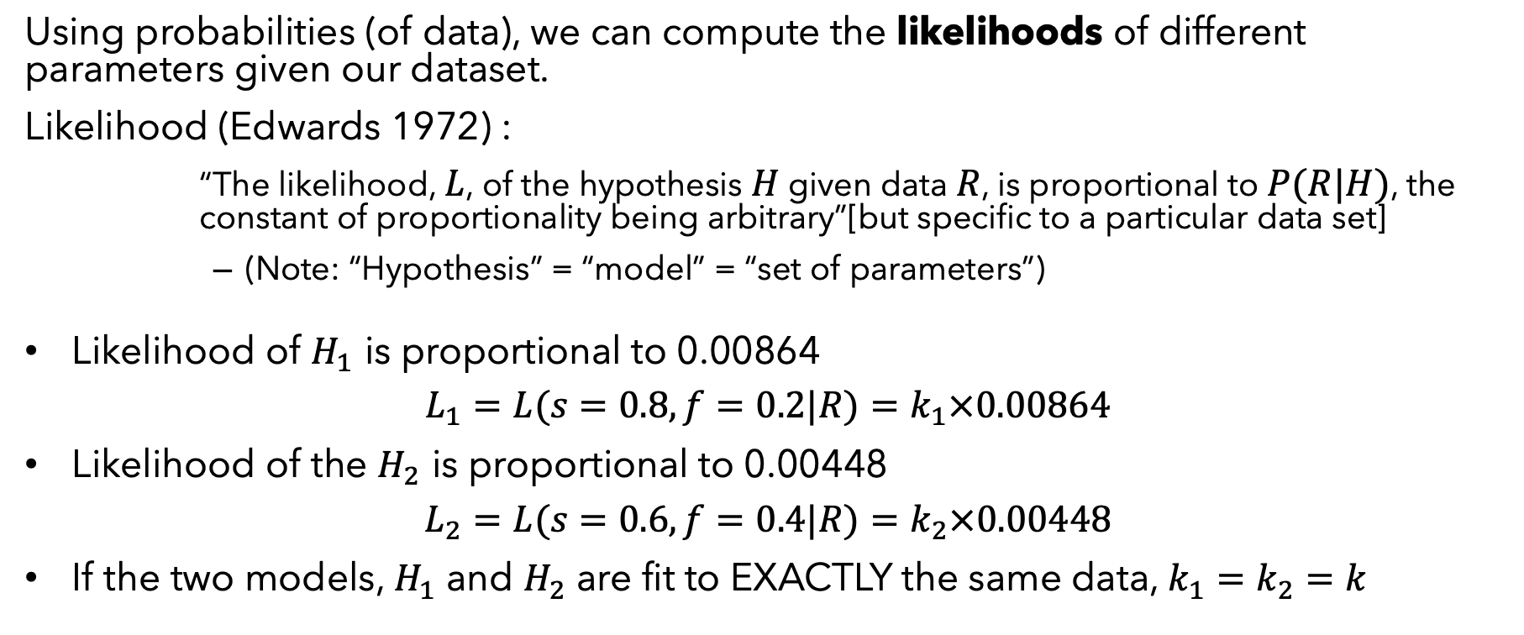
Likelihood
Using probabilities (of data), we can compute the likelihoods of different parameters given our dataset.
Likelihood (Edwards 1972) :
“The likelihood, $L$, of the hypothesis $H$ given data $R$, is proportional to $P(R|H)$, the constant of proportionality being arbitrary”[but specific to a particular data set]
(Note: “Hypothesis” = “model” = “set of parameters”)
Likelihood of $H_{1}$ is proportional to 0.00864
$$L_{1}=L(s=0.8,f=0.2|R)=k_{1}×0.00864$$
Likelihood of the $H_{2}$ is proportional to 0.00448
$$L_{2}=L(s=0.6,f=0.4|R)=k_{2}×0.00448$$
If the two models, $H_{1}$ and $H_{2}$ are fit to EXACTLY the same data, $k_{1}=k_{2}=k$

Slide 10
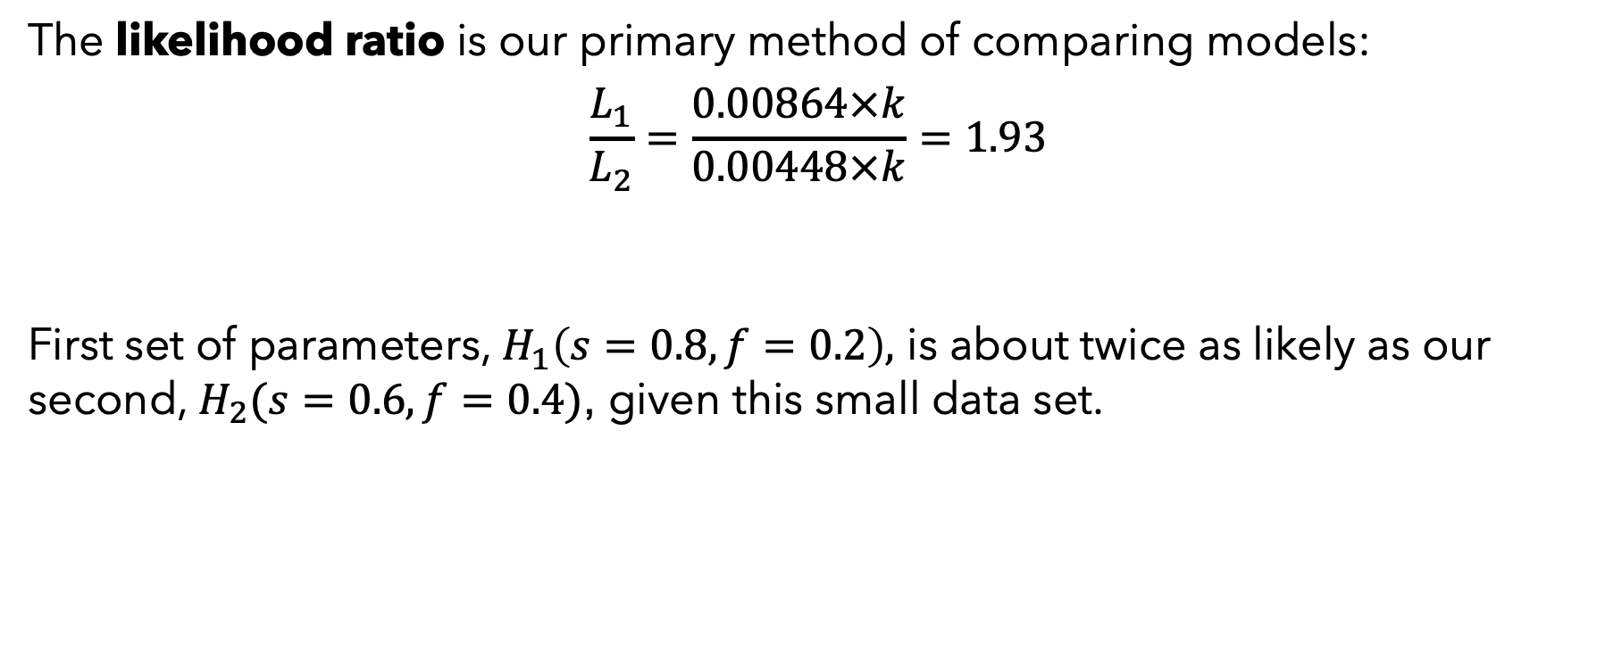
Likelihood ratio
The likelihood ratio is our primary method of comparing models:
$$\frac{L_{1}}{L_{2}}=\frac{0.00864×k}{0.00448×k}=1.93$$
First set of parameters, $H_{1}\left(s=0.8,f=0.2\right),$ is about twice as likely as our second, $H_{2}(s=0.6,f=0.4)$, given this small data set.

Slide 11
We have gone from calculating the probability of our data, given fixed parameters, to making inferences about support for different possible values of our parameters (AKA models, hypotheses), given a dataset.
Likelihoods can be used to test if one set of parameters is significantly better than another (coming soon).

Slide 12
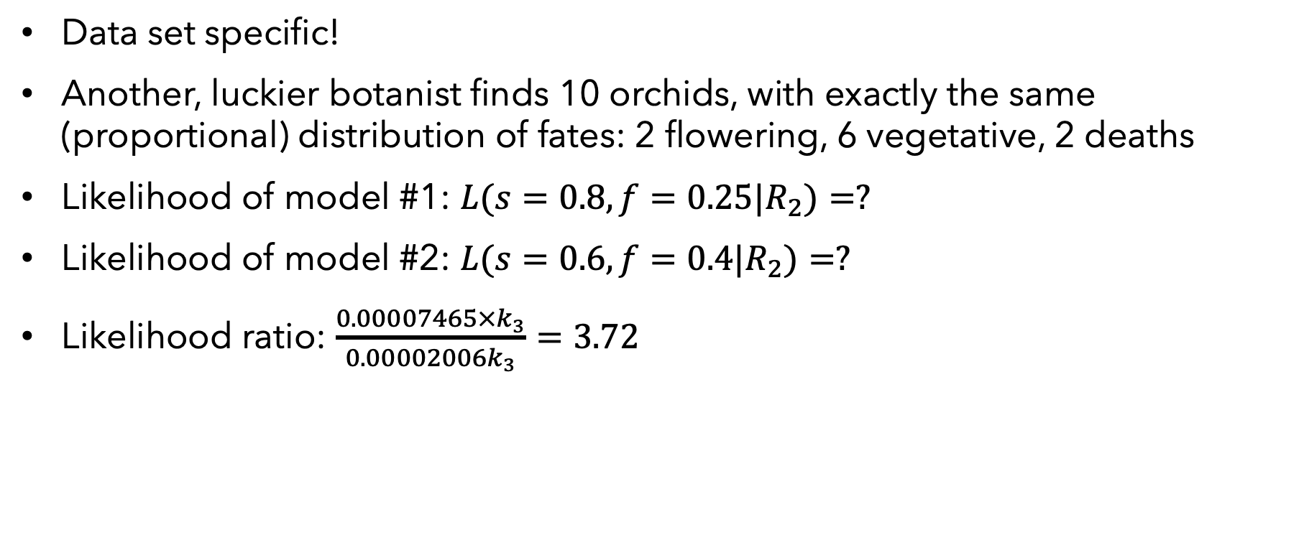
More About Likelihoods
Data set specific!
Another, luckier botanist finds 10 orchids, with exactly the same (proportional) distribution of fates: 2 flowering, 6 vegetative, 2 deaths
Likelihood of model #1: $L(s=0.8,f=0.25|R_{2})=?$
Likelihood of model #2: $L(s=0.6,f=0.4|R_{2})=?$
Likelihood ratio: $\frac{0.00007465×k_{3}}{0.00002006k_{3}}=3.72$

Slide 13
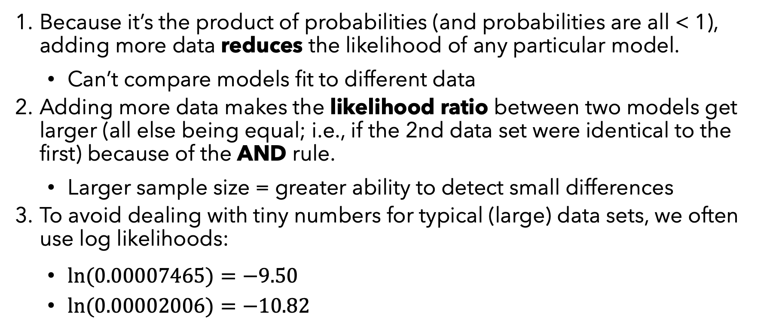
3 Features of Likelihood
Because it’s the product of probabilities (and probabilities are all < 1), adding more data reduces the likelihood of any particular model.
Can’t compare models fit to different data
Adding more data makes the likelihood ratio between two models get larger (all else being equal; i.e., if the 2nd data set were identical to the first) because of the AND rule.
Larger sample size = greater ability to detect small differences
To avoid dealing with tiny numbers for typical (large) data sets, we often use log likelihoods:
$ln(0.00007465)=−9.50$
$ln(0.00002006)=−10.82$

Slide 14
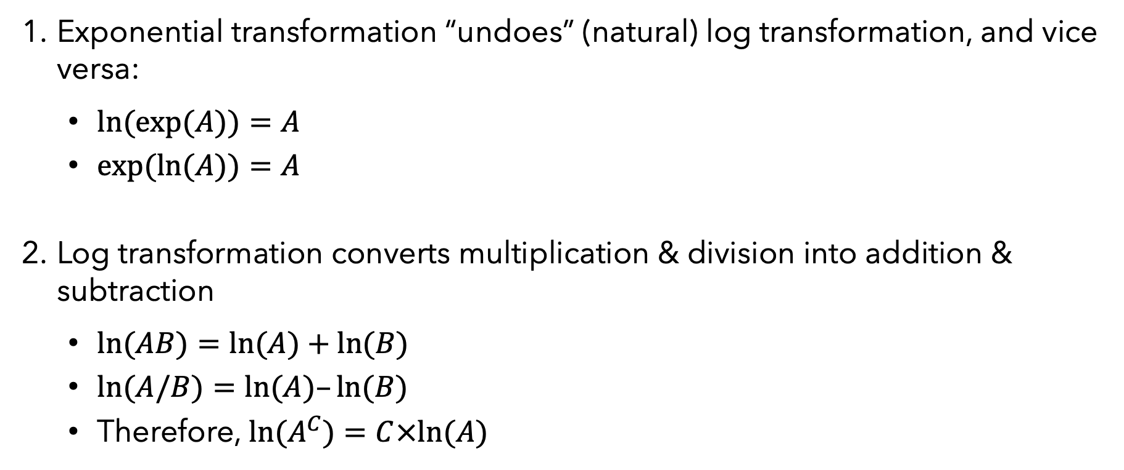
Rules of working with exponents and logarithms:
Exponential transformation “undoes” (natural) log transformation, and vice versa:
$ln(exp(A))=A$
$exp(ln(A))=A$
Log transformation converts multiplication & division into addition & subtraction
$ln(AB)=ln(A)+ln(B)$
$ln(A/B)=ln(A)–ln(B)$
Therefore, $ln(A^{C})=C×ln(A)$

Slide 15
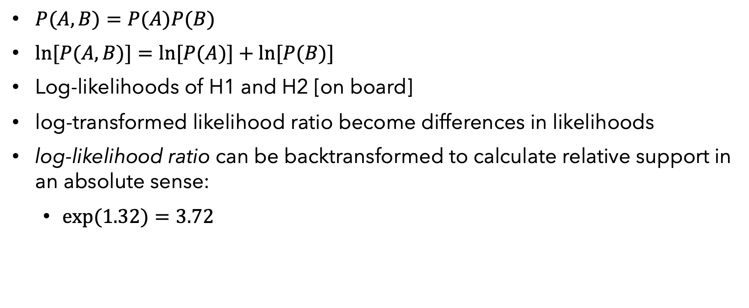
Implications for the and axiom of probability
$P(A,B)=P(A)P(B)$
$ln[P(A,B)]=ln[P(A)]+ln[P(B)]$
Log-likelihoods of H1 and H2 [on board]
log-transformed likelihood ratio become differences in likelihoods
log-likelihood ratio can be backtransformed to calculate relative support in an absolute sense:
$exp(1.32)=3.72$

Slide 16
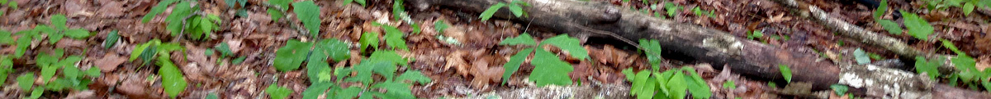
Ignoring flowering (for now), explore the likelihood of different values of survival, given the 5-plant data set (1 dies, 4 survive).
Calculate the likelihood of survival having each of the following values: 0.1, 0.2, 0.3, 0.4, 0.5, 0.6, 0.7, 0.8, 0.9.
Make a graph of the log-likelihood (y-axis) vs. value of survival (x-axis).
Repeat a&b for the 10-plant data set (2 die, 8 survive). How does the shape of the graph change?
What is the likelihood that survival is 0? Or 1? What happens to the log-likelihood at these values?
2. Thinking about probabilities…
What is P(B|A) for two mutually exclusive events? Is it possible for events to be independent and mutually exclusive?
What is P(A+B), the probability that A or B occurs, if they are independent events?

