Slide 1
Binomial Probability Distribution
Eric Scott

Slide 2
Comments on HW
Each event should be a point on the plot
If you are doing this exercise for real, you might want to randomize the order of the x-axis.

Slide 3
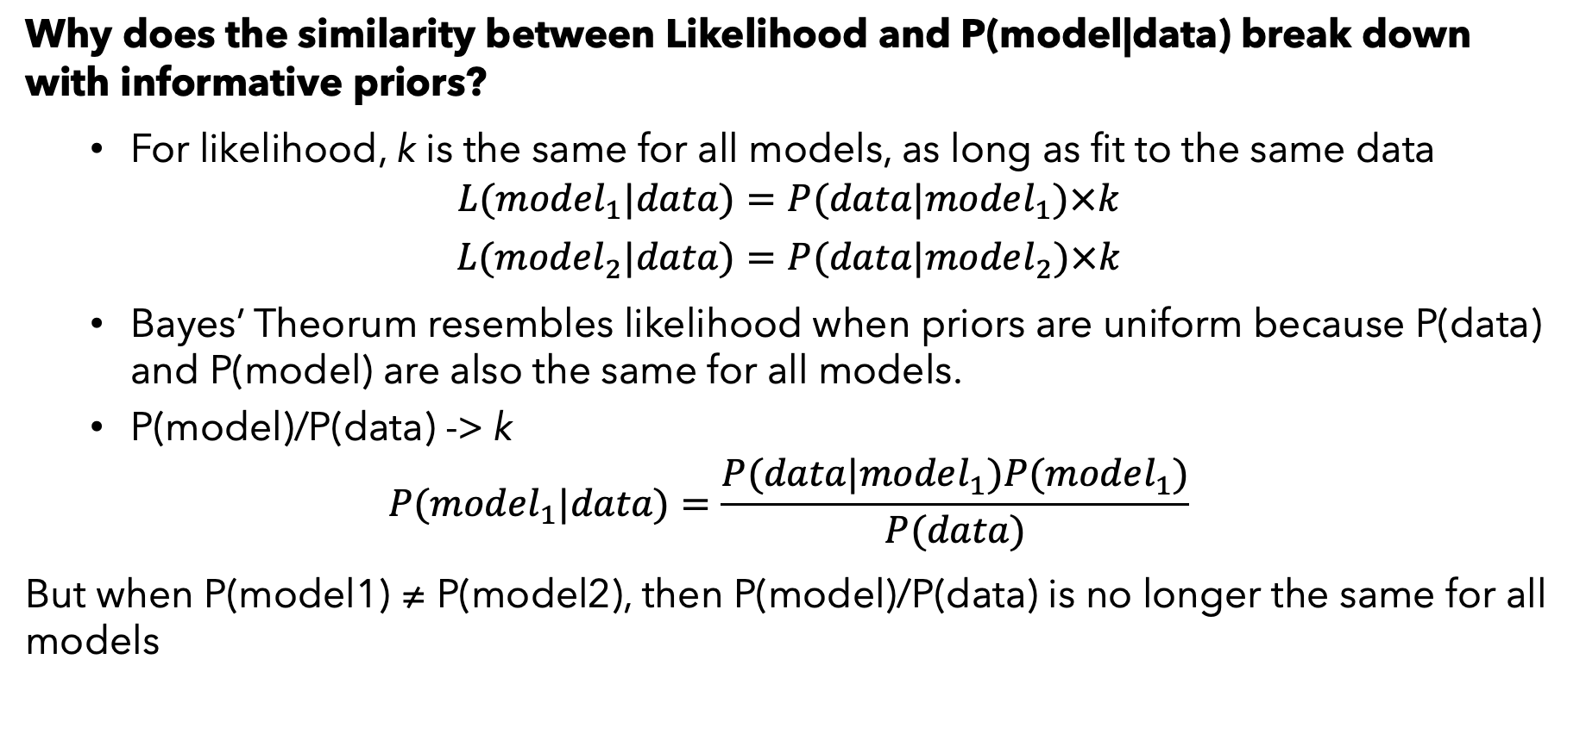
Questions from last time:
Why does the similarity between Likelihood and P(model|data) break down with informative priors?
For likelihood, k is the same for all models, as long as fit to the same data
$$L(model_{1}|data)=P(data|model_{1})×k$$
$$L(model_{2}|data)=P(data|model_{2})×k$$
Bayes’ Theorum resembles likelihood when priors are uniform because P(data) and P(model) are also the same for all models.
P(model)/P(data) -> k
$$P(model_{1}|data)=\frac{P(data|model_{1})P(model_{1})}{P(data)}$$
But when P(model1) ≠ P(model2), then P(model)/P(data) is no longer the same for all models

Slide 4
Where does P(data) come from?
M1
M2
M3
M4
Notes:
What do these represent? Probability of all 4 hypotheses. They add up to 1.

Slide 5
Where does P(data) come from?
M1
M2
Data
M3
M4

Slide 6
Where does P(data) come from?
M1
M2
P(M4|data) = P(M4, data) / P(data)
Probability that M4 is true (we are somewhere in the blue square) given the data, is the area of the blue/grey overlap divided by the total area of the ellipse.
This “scales” the posterior probabilities (wedges of the grey ellipse) so they all add up to 1.
The area of that ellipse is P(data)
Data
M3
M4

Slide 7
Where does P(data) come from?
M1
M2
This ”wedge” is P(data, M4).
Likelihood is the ratio of this “slice” to the entire area of the hypothesis.
P(data|M4) = P(data,M4) / P(M4)
(definition of conditional probability)
Rearrange to P(data, M4) = P(data|M4) * P(M4)
So P(data) = area of all the slices = sum[P(data|M_{j}) * P(M_{j})]
Data
M3
M4

Slide 8
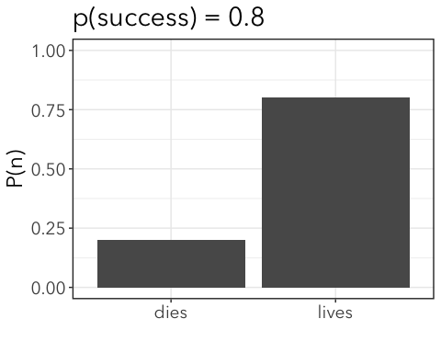
Probabilty distributions
Probability distribution is the probability assigned to each possible value of the response variable (outcome of an experiment or observation)
So far, we’ve had only two possible mutually exclusive outcomes.
This is a Bernouli probability
Bernouli distribution of probabilities only defined by Pr(“success”).

Slide 9

We write the distribution as:
$$X∼Bernouli(p)$$
Where X is the response variable (outcome) and p is probability of success and “~” is read as “distributed as”.

Slide 10
Binomial distribution
What if we have more than one trial?
The Binomial distribution is related to Bernoulli. It shows the probability of getting k events out of N unordered trials, if each trial has probability p of an event. by convention
N = # trials
k = # events (AKA “successes”)
p = probability an event occurs

Slide 11
Binomial example
Example: say you do two walks and see butterflies on one of the walks.
N = 2 trials (a walk)
k = 1 event (saw butterflies)
Possible outcomes of two walks:
walk 1 | walk 2
1 | 1
1 | 0
0 | 1
0 | 0
So there’s only ONE possibility where you see butterflies twice, only ONE possibility that you see no butterflies, but TWO ways to see butterflies once.
Pr{k=2|N=2, p} = p² (walk 1 AND walk 2)
Pr{k=0|N=2, p} = (1-p)² (not walk 1 AND not walk 2)
Pr{k=1|N=2, p} = p(1-p) + (1-p)p = 2p(1-p) (walk 1 AND not walk 2 OR walk 2 AND not walk 1)

Slide 12
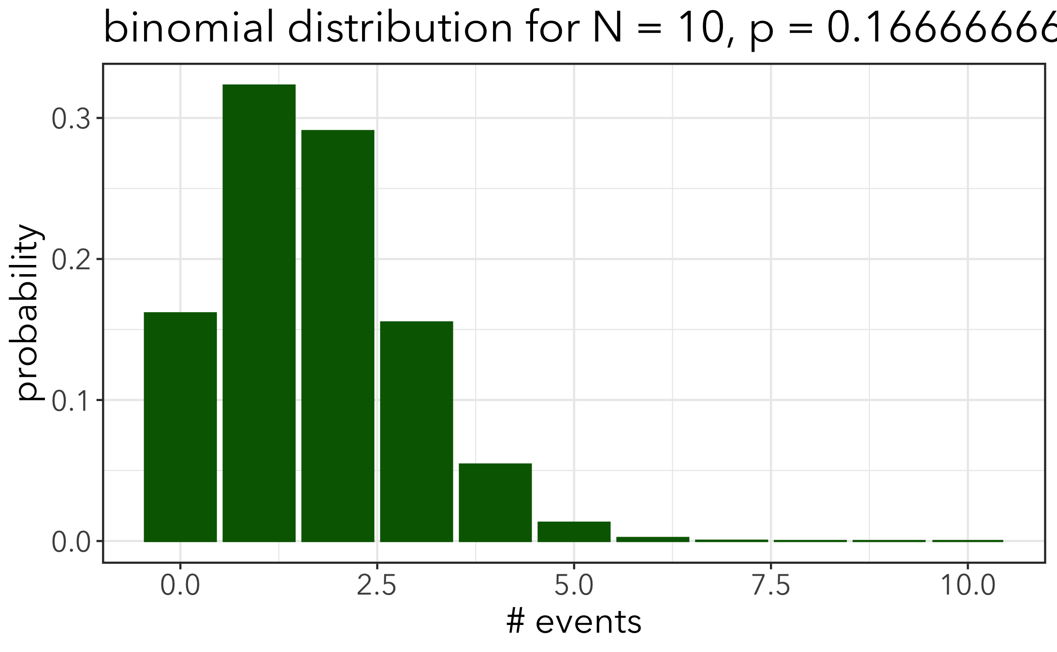
This is a “distribution” because it shows the probabilities of different outcomes, given the data
x-axis = # of events
y-axis = probability

Slide 13
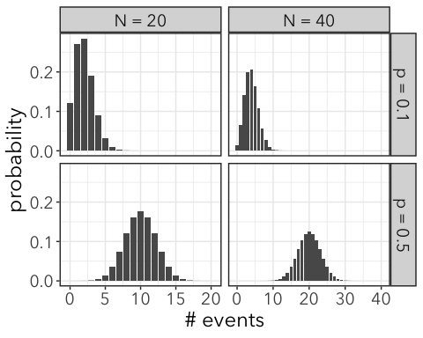
Notes:
Not just one binomial distribution, but distributions. Shape determined by N and p

Slide 14
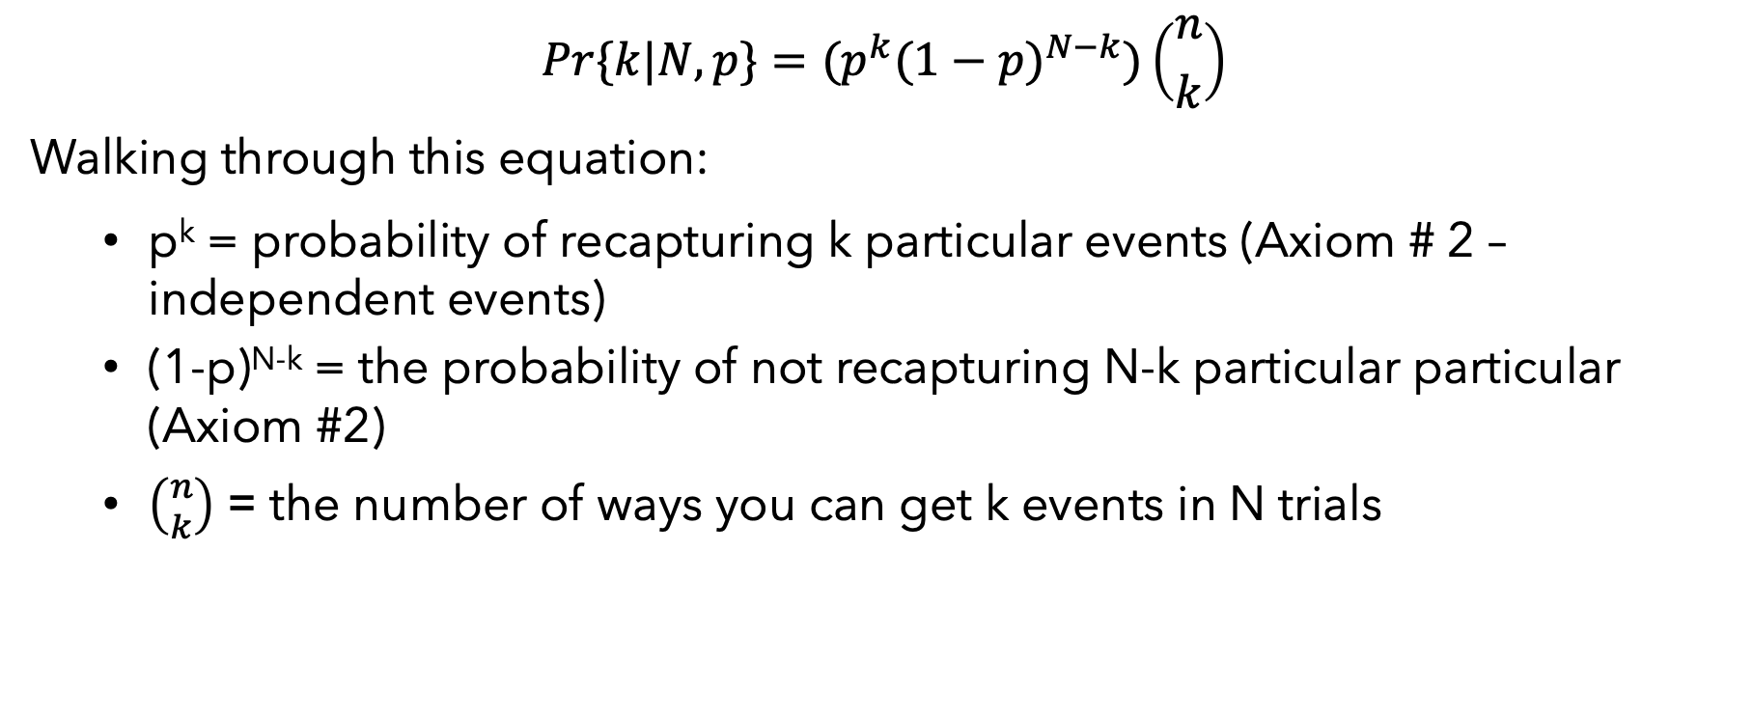
Binomial distribution as an equation:
$$Pr\{k|N,p\}=(p^{k}(1−p)^{N−k})\left({n \atop k}\right)$$
Walking through this equation:
p^{k} = probability of recapturing k particular events (Axiom # 2 – independent events)
(1-p)^{N-k} = the probability of not recapturing N-k particular particular (Axiom #2)
$\left({n \atop k}\right)$ = the number of ways you can get k events in N trials

Slide 15
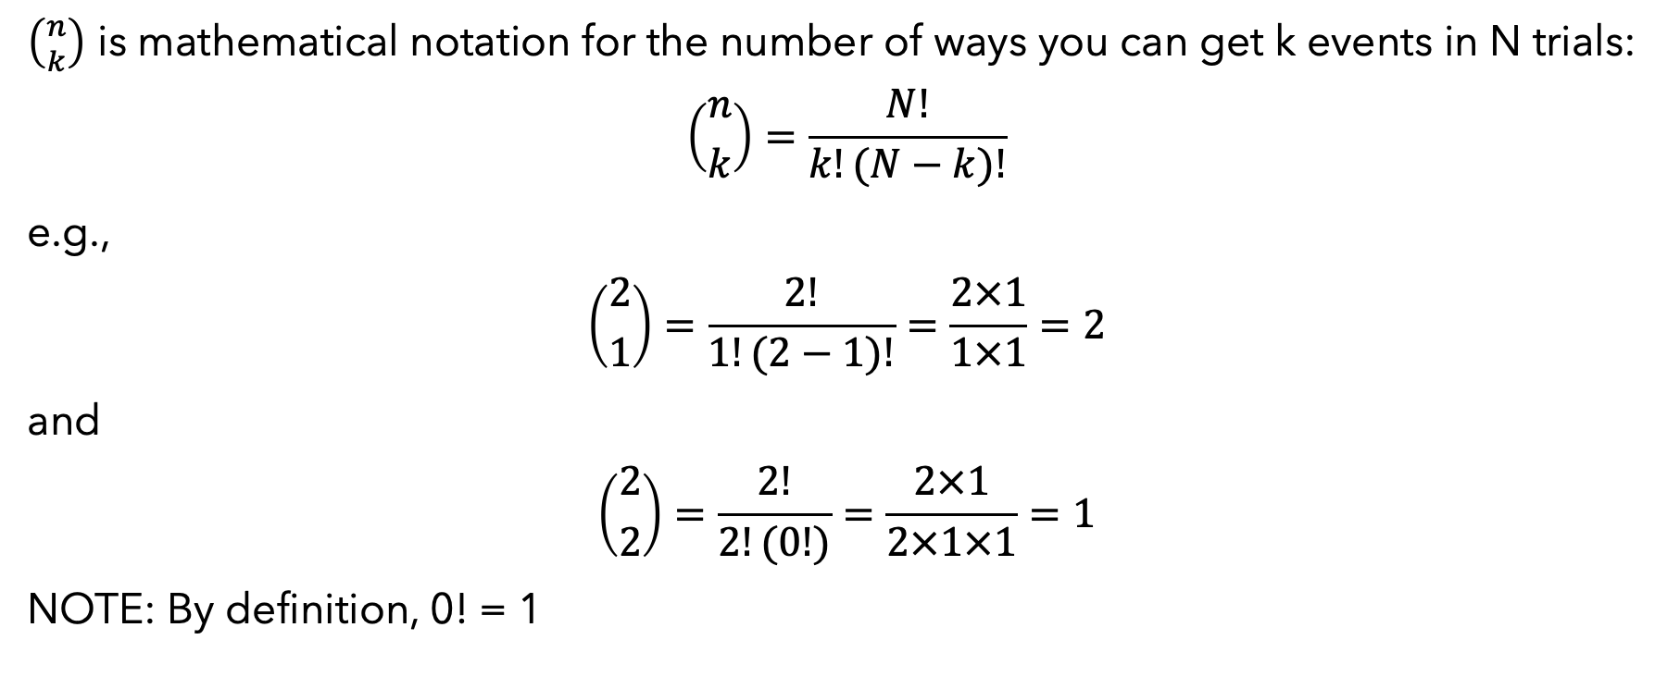
N choose k
$\left({n \atop k}\right)$ is mathematical notation for the number of ways you can get k events in N trials:
$$\left({n \atop k}\right)=\frac{N!}{k!(N−k)!}$$
e.g.,
$$\left({2 \atop 1}\right)=\frac{2!}{1!(2−1)!}=\frac{2×1}{1×1}=2$$
and
$$\left({2 \atop 2}\right)=\frac{2!}{2!(0!)}=\frac{2×1}{2×1×1}=1$$
NOTE: By definition, 0! = 1

Slide 16
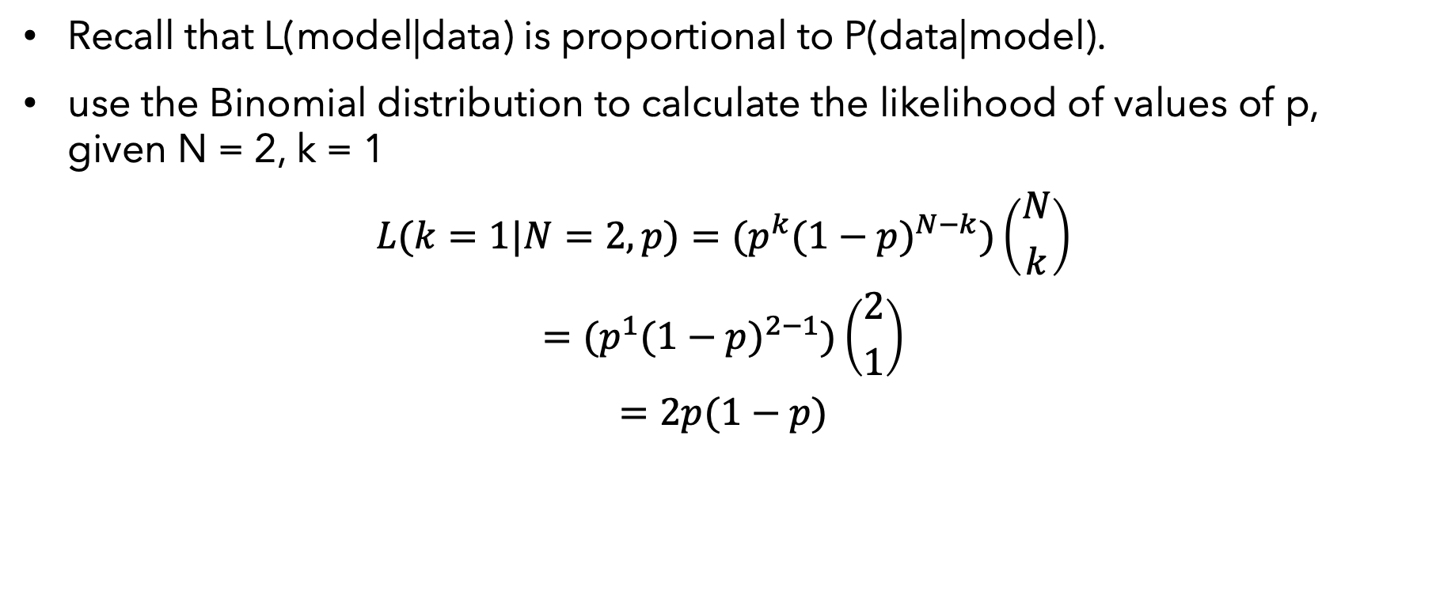
Using Binomial distribution to calculate support for a model:
Recall that L(model|data) is proportional to P(data|model).
use the Binomial distribution to calculate the likelihood of values of p, given N = 2, k = 1
$$L(k=1|N=2,p)=(p^{k}(1−p)^{N−k})\left({N \atop k}\right)$$
$$=(p^{1}(1−p)^{2−1})\left({2 \atop 1}\right)$$
$$=2p(1−p)$$

Slide 17
Binomial distribution in R
In R, you can get the probability of data given a binomial model using the function dbinom()
dbinom(x, size, prob, log)
where
x = # events, k
size = # trails, N
prob = probability of an event in a single trial, p
log = TRUE or FALSE … do you want the log of the probability, or the probability?
Notes:
Switch to R to look at this

Slide 18
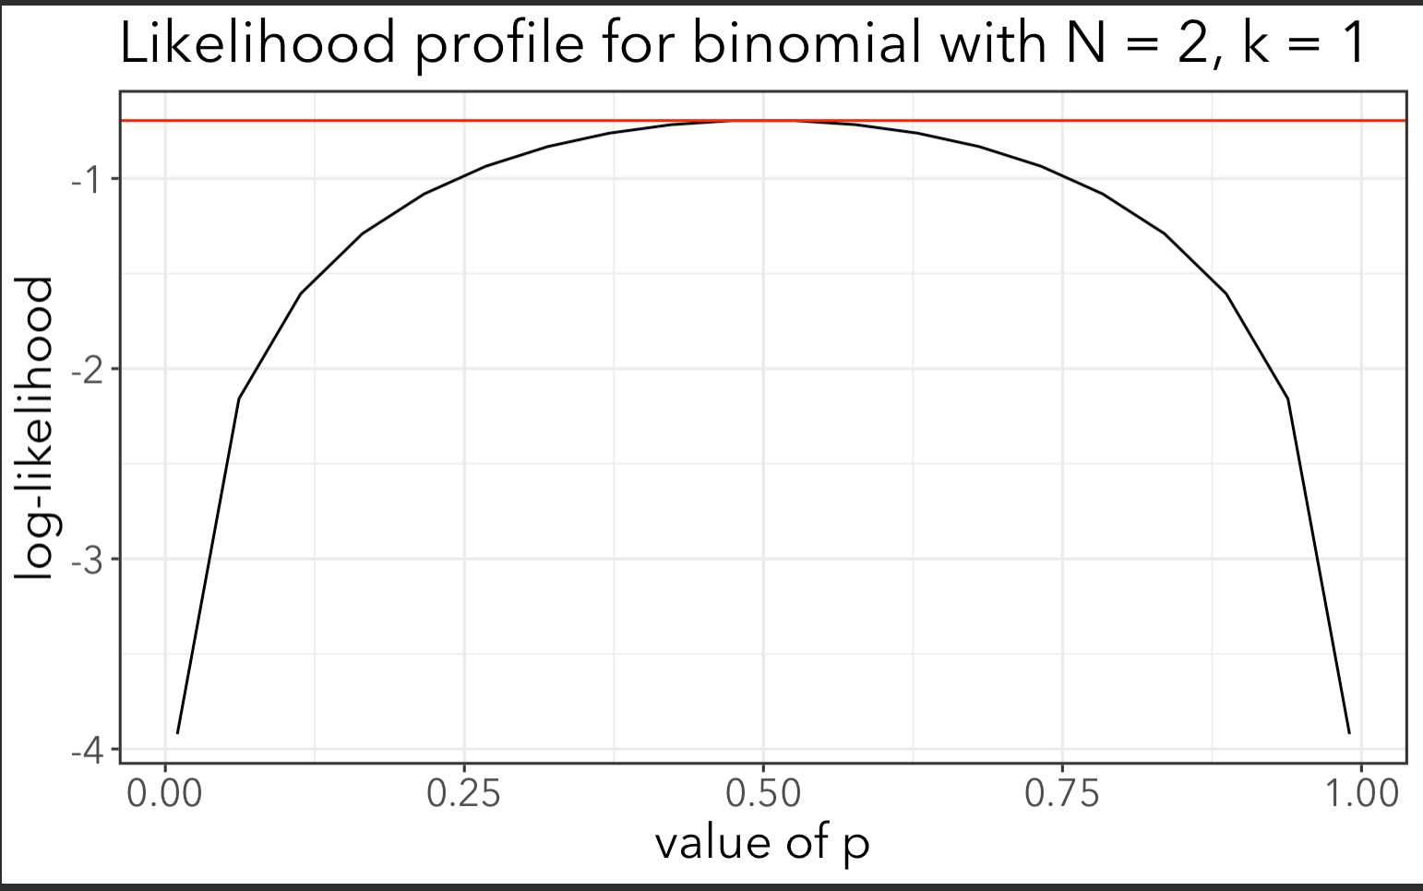
Because probability of the data (output from dbinom()) is proportional to likelihood, we can calculate a likelihood profile in R.
The maximum likelihood estimate is the parameter values that maximize likelihood of the data
Found where slope = 0
Here, it’s p = 0.5 for the probability of getting 1 success in 2 trials.

Slide 19
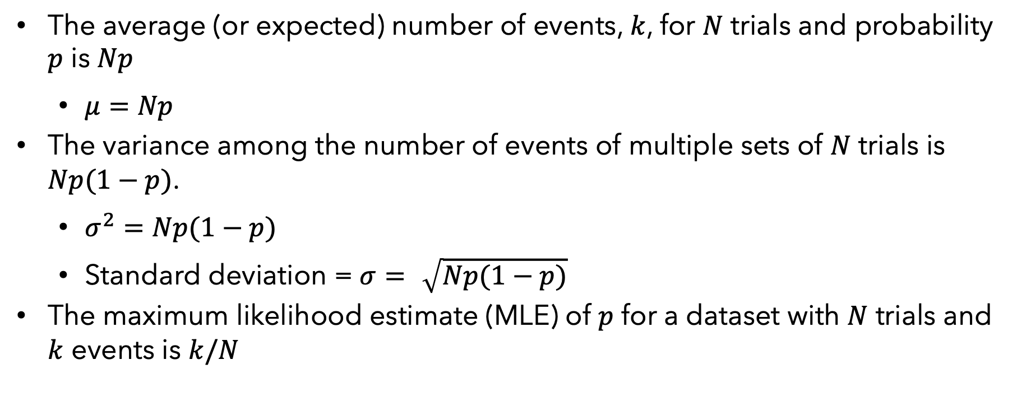
True Facts about binomial distribution
The average (or expected) number of events, $k$, for $N$ trials and probability $p$ is $Np$
$μ=Np$
The variance among the number of events of multiple sets of $N$ trials is $Np(1−p)$.
$σ^{2}=Np(1−p)$
Standard deviation = $σ=\sqrt{Np(1−p)}$
The maximum likelihood estimate (MLE) of $p$ for a dataset with $N$ trials and $k$ events is $k/N$

Slide 20
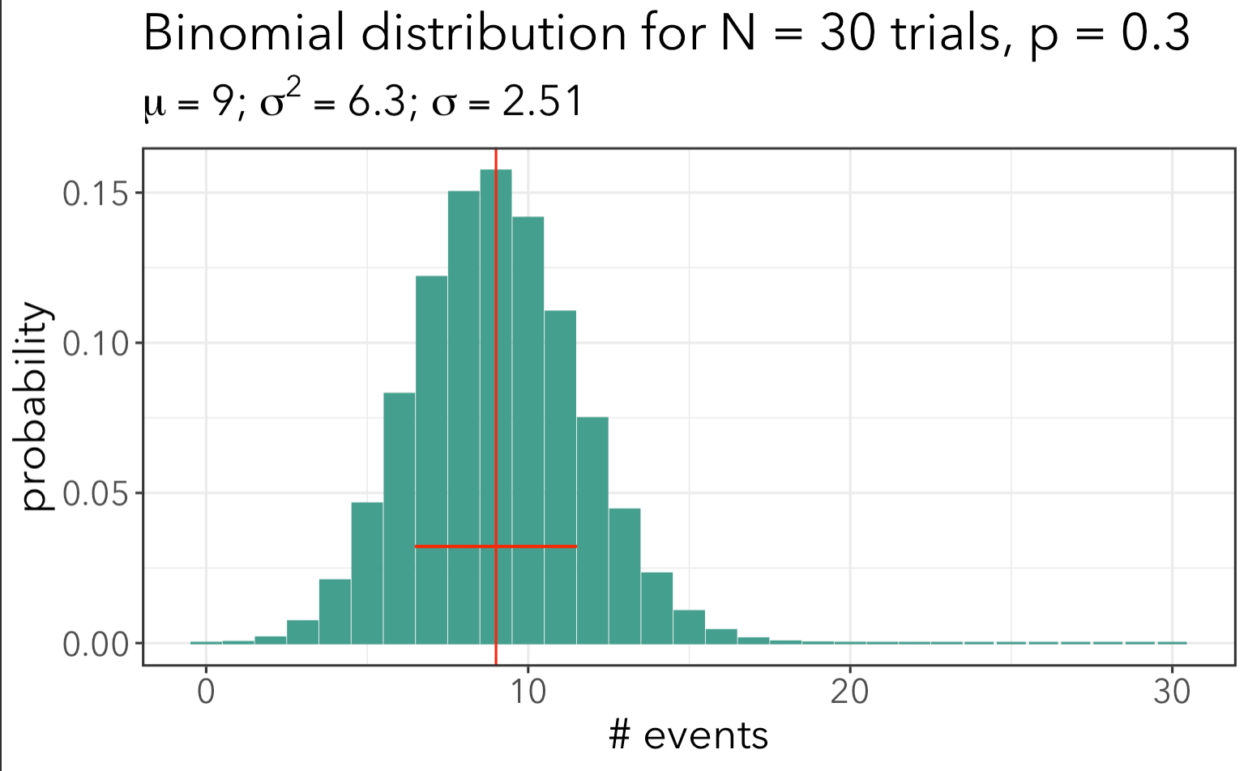

Slide 21
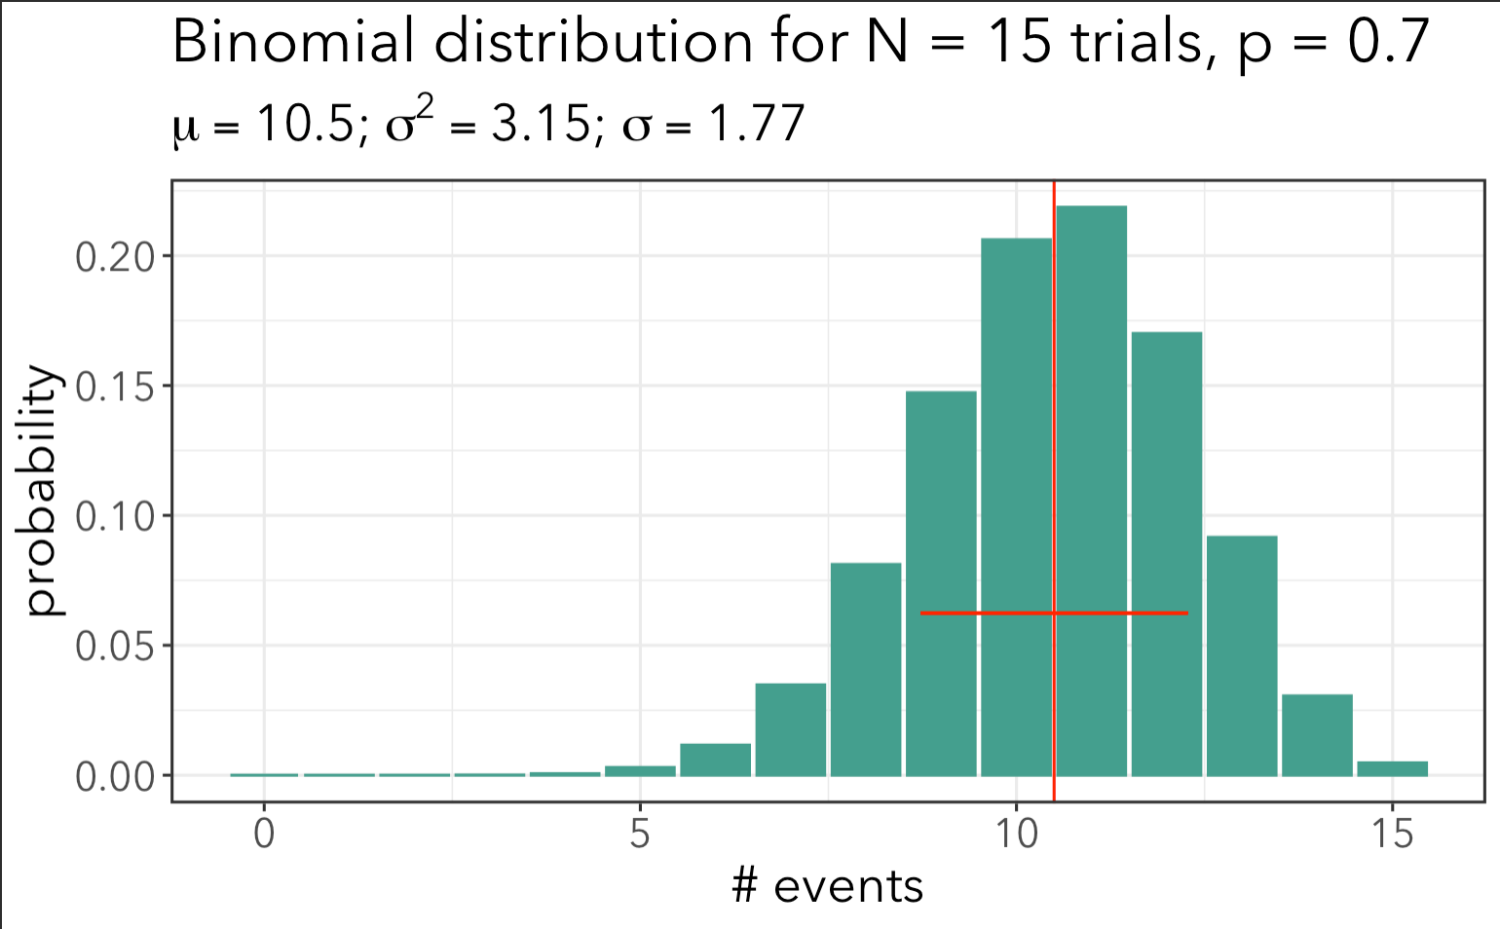

Slide 22
Ecological significance
For binomial processes (e.g. survival), the variance in the number of events is a function of the number of trials and probability (p).
Variance is not a free parameter (the way it is in the Normal distribution).
If a process is probabilistic, we expect variation in the outcome
even if we take very precise measurements, and know p very precisely, we cannot predict the outcome of any particular set of trials
You can use the “null” binomial variance as a basis for estimating other sources of variation, such as differences among years, sites, or individual animals or plants

Slide 23


Worked example: Anne’s calypso orchids…

Slide 24
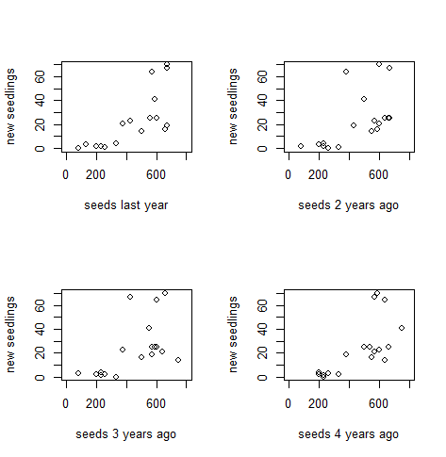
Last time, I gave you the log-likelihoods for each of these models.
Let’s use R to calculate them for ourselves now.
# new seedlings in year t
# seeds in t-1
# seeds in t-2
# in year t-3
# in year t-4

