Slide 1
Back to Oaks
Calculate a log-likelihood for the data
Assuming a single p for the whole dataset
Assuming different p for each site (ignoring oak species)
Assuming different p for each species (ignoring site)
Use a LRT to see if estimating different p for each species or for each site improves model significantly
Use AIC to see which of the three models best fits the data
 |  | acorns with…
site | oak.sp | weevils | none
H | red | 584 | 187
H | white | 406 | 74
S | red | 910 | 118
S | white | 308 | 66
V | red | 391 | 101
V | white | 500 | 82
DATA: Prof. Michael Steele, Wilkes University, http://www.wilkes.edu/pages/969.asp?pidm=6010

Slide 2
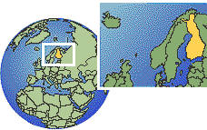
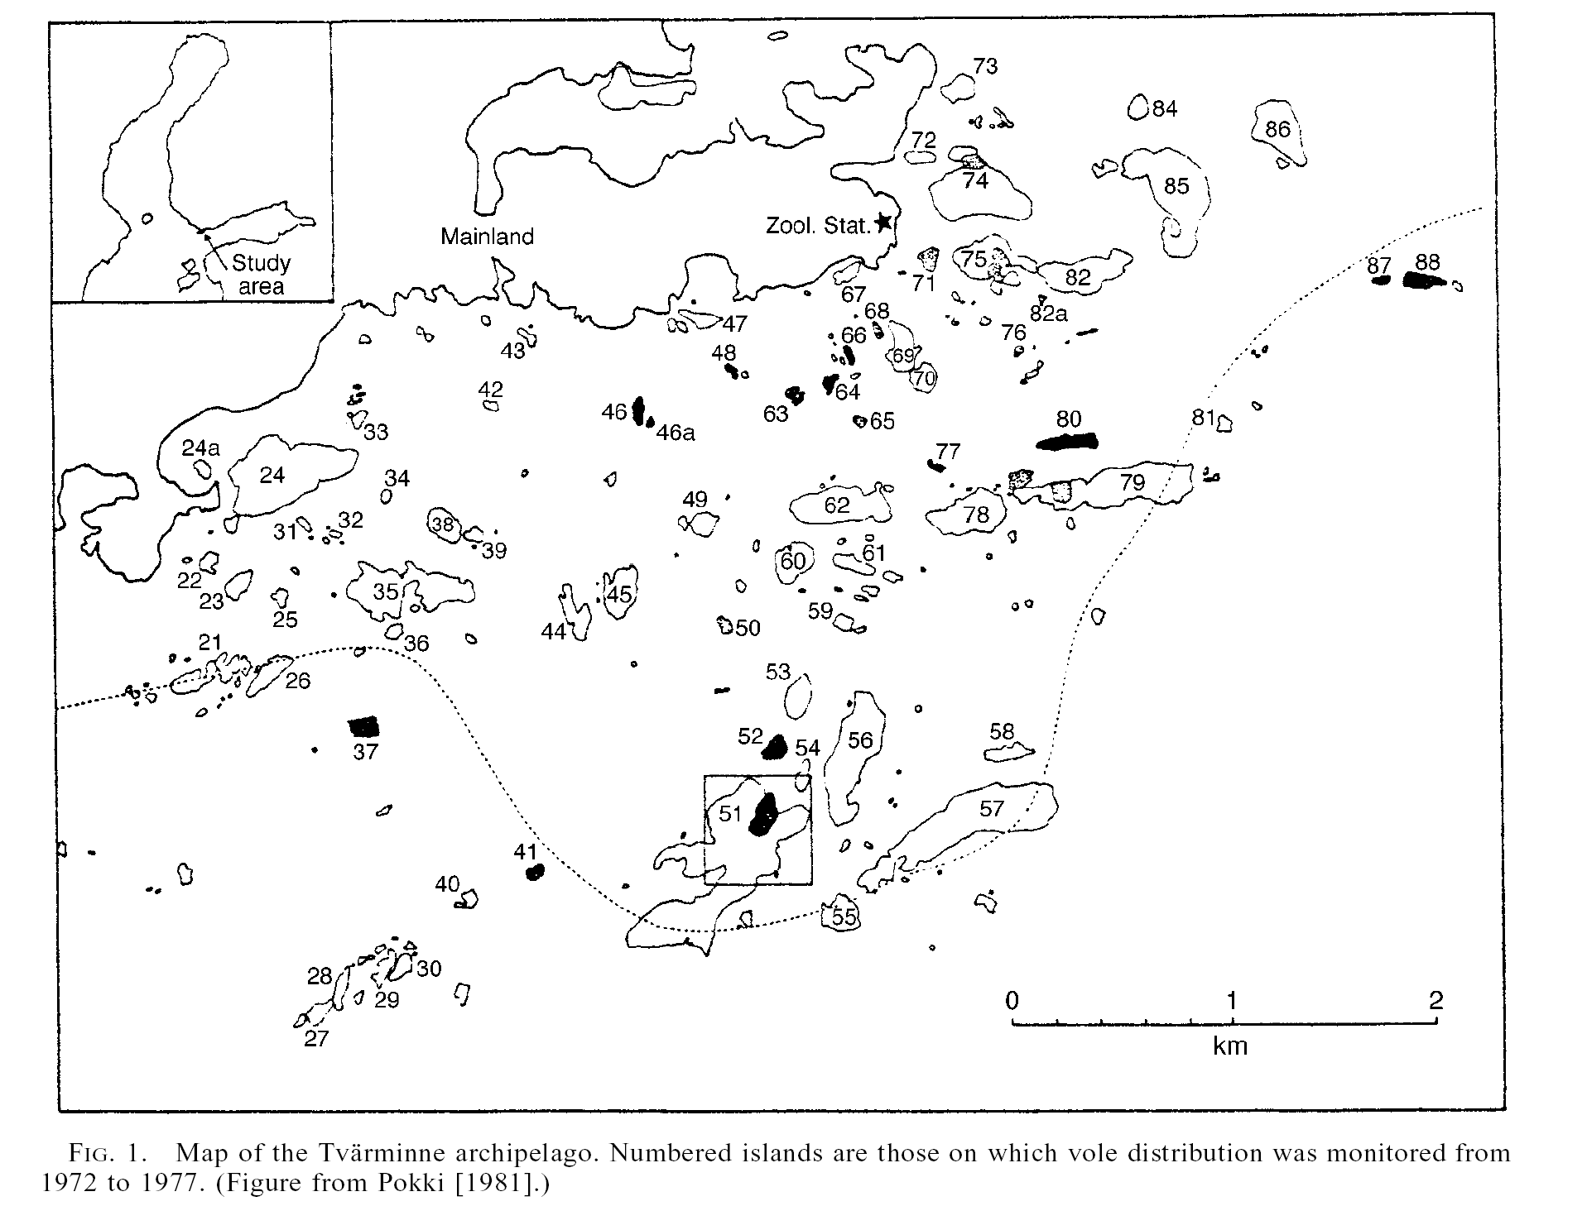

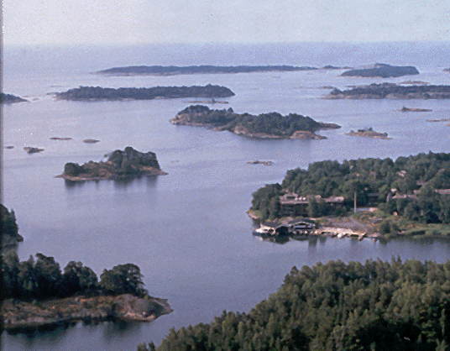
Field voles in the Tvärminne Archipelago
(Finland)
Pokki, 1981 Acta Zoologica Fennica 164:1-48
Notes:
Tiny islands called skerries. Rocky, less than 5 ha in area, only 5-20% vegetation

Slide 3
Smallest, rocky islands called “skerries” have populations that are repeatedly established and then go extinct
Each skerry part of a larger “metapopulation”
Pokki tracked occupancy from 1972–1977 on 40 skerries
Live traps, snap traps, scat
Metapopulation theory says you can estimate population growth rate just by knowing something about how occupancy changes

Slide 4


Dynamics of island occupancy:
 | # of skerries
year | with voles | w/o voles
1972 | 16 | 24
1973 | 17 | 23
1974 | 28 | 12
1975 | 21 | 19
1976 | 4 | 36
1977 | 19 | 21
3 models: Proportion occupied is…
Constant
Different each year
Shows a linear trend through time
Notes:
Live trapping and snap-trapping, also looking for scat. Because islands are so small, unlikely that they missed any voles.

Slide 5
Models
Model A: 1 parameter = probability of occupancy = p_{all}

Slide 6
Models
Model A: 1 parameter = probability of occupancy = p_{all}
Model B: 6 parameters = probability of occupancy in each year:
p₁₉₇₂
p₁₉₇₃
p₁₉₇₄
p₁₉₇₅
p₁₉₇₆
p₁₉₇₇

Slide 7
Models
Model A: 1 parameter = probability of occupancy = p_{all}
Model B: 6 parameters = probability of occupancy in each year:
Model C: 2 parameters = slope and intercept:
y = mx + b, re-written:
p_{i} = β₀ + β₁ ⨯ year

Slide 8
Which models are nested?
Nested models mean that one is a special case of the other
Model A vs. B
Nested because model B is a special case of model A that happens when:
p₁₉₇₂ = p₁₉₇₃ = p₁₉₇₄ = p₁₉₇₅ = p₁₉₇₆ = p₁₉₇₇ = p_{all}

Slide 9
Which models are nested?
Nested models mean that one is a special case of the other
Model A vs. B
Nested because model A is a special case of model B that happens when:
p₁₉₇₂ = p₁₉₇₃ = p₁₉₇₄ = p₁₉₇₅ = p₁₉₇₆ = p₁₉₇₇ = p_{all}
Model A vs. C
Nested because model A is a special case of model C that happens when β₁ = 0:
p_{i} = β₀ + 0 ⨯ year,
so p_{all} = β₀

Slide 10
Which models are nested?
Model B vs. C?
Also nested! Because the model B could turn out looking like a perfect line:
p₁₉₇₃ = p₁₉₇₂ + β₁ ⨯ 1
p₁₉₇₄ = p₁₉₇₂ + β₁ ⨯ 2
p₁₉₇₅ = p₁₉₇₂ + β₁ ⨯ 3
p₁₉₇₆ = p₁₉₇₂ + β₁ ⨯ 4
p₁₉₇₇ = p₁₉₇₂ + β₁ ⨯ 5

Slide 11
Comparing pairs of models with LRT:
Fit each model in R
LRT of Model a (constant) vs. b (years differ)
LRT of Model a (constant) vs. c (linear trend)

Slide 12
Creating a Dataframe Directly in R
data for island occupancy by voles
vole_dat <- tibble( year = 1972:1977, with_voles = c(16, 17, 28, 21, 4, 19), no_voles = c(24,23,12,19,36,21) ) %>% mutate(year_factor = as.factor(year))
# create version of the year variable coded as 6 categories (for model b) head(vole_dat)
## # A tibble: 6 x 4 ## year with_voles no_voles year_factor ## <int> <dbl> <dbl> <fct> ## 1 1972 16 24 1972 ## 2 1973 17 23 1973 ## 3 1974 28 12 1974 ## 4 1975 21 19 1975 ## 5 1976 4 36 1976 ## 6 1977 19 21 1977

Slide 13
Inspect data
str(vole_dat)
## Classes 'tbl_df', 'tbl' and 'data.frame': 6 obs. of 4 variables: ## $ year : int 1972 1973 1974 1975 1976 1977 ## $ with_voles : num 16 17 28 21 4 19 ## $ no_voles : num 24 23 12 19 36 21 ## $ year_factor: Factor w/ 6 levels "1972","1973",..: 1 2 3 4 5 6
Notes:
Refresher on factors

Slide 14
Comparing models with LRT
1. Fit each model
Model A: constant occupancy
ma <- glm(cbind(with_voles, no_voles) ~ 1, family = binomial(link = "identity"), data = vole_dat) coef(ma)
## (Intercept) ## 0.4375
logLik(ma)
## 'log Lik.' -29.33466 (df=1)

Slide 15
Comparing models with LRT
1. Fit each model
Model B: occupancy differs in each year
mb <- glm(cbind(with_voles, no_voles) ~ -1 + year_factor, family = binomial(link = "identity"), data = vole_dat) coef(mb)
## year_factor1972 year_factor1973 year_factor1974 year_factor1975 ## 0.400 0.425 0.700 0.525 ## year_factor1976 year_factor1977 ## 0.100 0.475
logLik(mb)
## 'log Lik.' -11.84353 (df=6)

Slide 16
Comparing models with LRT
1. Fit each model
Model C: linear trend in occupancy through time
mc <- glm(cbind(with_voles, no_voles) ~ year, family = binomial(link = "identity"), data = vole_dat) coef(mc)
## (Intercept) year ## 44.55917101 -0.02234586
logLik(mc)
## 'log Lik.' -28.62693 (df=2)
(pred_occupancy <- predict(mc))
## 1 2 3 4 5 6 ## 0.4931359 0.4707901 0.4484442 0.4260984 0.4037525 0.3814067

Slide 17
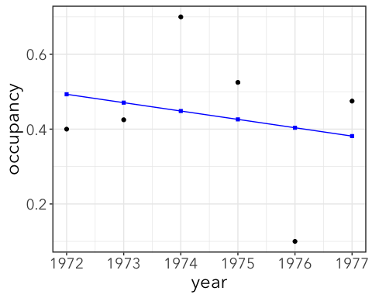
pred_occupancy <- predict(mc)
ggplot(vole_dat, aes(x = year, y = with_voles / (with_voles + no_voles))) + geom_point() + geom_line(aes(y = pred_occupancy), color = "blue") + geom_point(aes(y = pred_occupancy), color = "blue", shape = "square") + labs(y = "occupancy")

Slide 18
Comparing models with LRT
1. Fit each model
2. LRT of model A (constant) vs. model B (years differ)
logLik(ma)
## 'log Lik.' -29.33466 (df=1)
logLik(mb)
## 'log Lik.' -11.84353 (df=6)
LRstat <- -2*(logLik(ma) - logLik(mb)) %>% as.numeric() LRstat
## [1] 34.98227
test_df = 6-1 pchisq(LRstat, test_df, lower.tail = FALSE) #gives us a p-value
## [1] 1.516959e-06
Occupancy differs significantly among years!

Slide 19
Comparing models with LRT
1. Fit each model
2. LRT of model A (constant) vs. model B (years differ)
3. LRT of model A (constant) vs. model C (linear trend)
logLik(ma)
## 'log Lik.' -29.33466 (df=1)
logLik(mc)
## 'log Lik.' -28.62693 (df=2)
LRstat <- -2*(logLik(ma) - logLik(mc)) %>% as.numeric() LRstat
## [1] 1.415472
test_df = 2-1 pchisq(LRstat, test_df, lower.tail = FALSE) #gives us a p-value
## [1] 0.2341502
No evidence for a simple linear trend through time

Slide 20
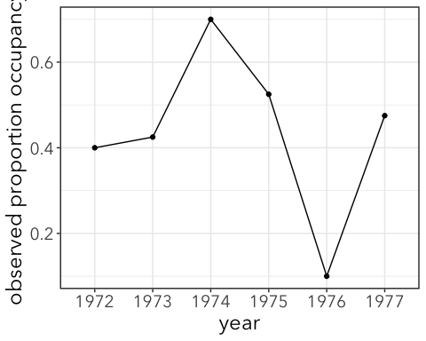
Relative support for all 3 using AIC
Compare all three models at once using AIC
AIC(ma, mb, mc)
## df AIC ## ma 1 60.66932 ## mb 6 35.68705 ## mc 2 61.25385
A shortcut to comparing AICs
library(bbmle)
ICtab(ma, mb, mc)
## dAIC df ## mb 0.0 6 ## ma 25.0 1 ## mc 25.6 2
The winner is model B (years differ)

Slide 21


Slide 22
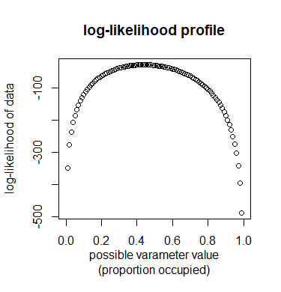
Likelihood Ratio Confidence Intervals
Likelihood profile = graph of likelihood (or log-likelihood) of data vs. possible parameter values
Confidence interval = set of parameter values that are not significantly worse than the MLE
I.e. imagine applying an LRT to compare MLE parameter to different values of parameter along x-axis →
LRT is significant when -2*LR > 3.84 or when L2 – L1 < -1.92
L2 < L1 – 1.92

Slide 23
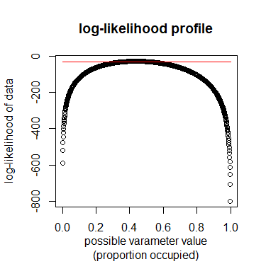
Further application of LRT:
Likelihood profile confidence limits
> coef(m1) # MLE
0.4375
> logLik(m1) # log-likelihood at MLE
-29.33466
> logLik(m1)-1.92 # threshold value for profile CI
-31.25466

Slide 24
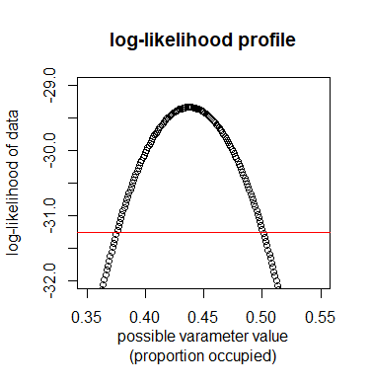
Further application of LRT:
Likelihood profile confidence limits
> coef(m1) # MLE
0.4375
> logLik(m1)-1.92 # threshold value for profile CI
-31.25466
> xvals[min(which(logLiks > -31.25466))] # lower limit
0.376
> xvals[max(which(logLiks > -31.25466))] # upper limit
0.5
Notes:
Be sure to walk through code slowly. Also be sure to show that this is same plot as before, just zoomed in.

Slide 25
Likelihood profile confidence limits (shortcut in R)
> confint(m1)
Waiting for profiling to be done...
2.5 % 97.5 %
0.3756531 0.5006765
> confint(m2)
Waiting for profiling to be done...
2.5 % 97.5 %
year.factor1972 0.2579273 0.5545247
year.factor1973 0.2800450 0.5792824
year.factor1974 0.5486114 0.8265016
year.factor1975 0.3723427 0.6745525
year.factor1976 0.0320840 0.2172387
year.factor1977 0.3254475 0.6276573
> confint(m3)
Waiting for profiling to be done...
2.5 % 97.5 %
(Intercept) -28.31300312 114.83273363
years -0.05793531 0.01456123

Slide 26
Likelihood profile confidence limits (shortcut in R)
> round(c(confint(m1), coef(m1)),3)
2.5 % 97.5 % (Intercept)
0.376 0.501 0.438
> round(cbind(confint(m2), coef(m2)),3)
2.5 % 97.5 % [MLE]
year.factor1972 0.258 0.555 0.400
year.factor1973 0.280 0.579 0.425
year.factor1974 0.549 0.827 0.700
year.factor1975 0.372 0.675 0.525
year.factor1976 0.032 0.217 0.100
year.factor1977 0.325 0.628 0.475
> round(cbind(confint(m3), coef(m3)), 3)
2.5 % 97.5 % [MLE]
(Intercept) -28.313 114.833 44.559
years -0.058 0.015 -0.022

Slide 27
What puts the “L” in GLM?
Linear models
y = mx + b OR
y = b + mx, where m = slope of the line
y = β₀ + β₁x
y
response variable
x
predictor variable(s)
Notes:
For now we’re going to ignore the

Slide 28
Fitting models to data:
# model a - constant occupancy
> m1 = glm(resp ~ 1, family = binomial(link = "identity"), data = vole.dat)
Only estimating the intercept-portion of the model; a single mean value across all observations
y = β₀

Slide 29
Fitting models to data:
# model b - occupancy differs each year
> m2 = glm(resp ~ -1 + year.factor, family = binomial(link = "identity"), data = vole.dat)
Estimating a different mean value for each individual year.
year.1972 year. 1973 year.1974 year.1975 year.1976 year.1977
0.400 0.425 0.700 0.525 0.100 0.475

Slide 30
Fitting models to data:
# model b - occupancy differs each year
> m2 = glm(resp ~ year.factor-1, family = binomial(link = "identity"), data = vole.dat)
Estimating a different mean value for each individual year.
year.1972 year. 1973 year.1974 year.1975 year.1976 year.1977
0.400 0.425 0.700 0.525 0.100 0.475

Slide 31
Fitting models to data:
# model b - occupancy differs each year
> m2 = glm(resp ~ -1 + year.factor, family = binomial(link = "identity"), data = vole.dat)
Estimating a different mean value for each individual year.
What happens if we include the intercept?
year.1972 year. 1973 year.1974 year.1975 year.1976 year.1977
0.400 0.425 0.700 0.525 0.100 0.475
# model b - occupancy differs each year
> m2 = glm(resp ~ 1 + year.factor, family = binomial(link = "identity"), data = vole.dat)
OR
> m2 = glm(resp ~ year.factor, family = binomial(link = "identity"), data = vole.dat)

Slide 32
Fitting models to data:
# model b - occupancy differs each year
> m2 = glm(resp ~ -1 + year.factor, family = binomial(link = "identity"), data = vole.dat)
Estimating a different mean value for each individual year.
What happens if we include the intercept?
year.1972 year. 1973 year.1974 year.1975 year.1976 year.1977
0.400 0.425 0.700 0.525 0.100 0.475
# model b - occupancy differs each year
> m2 = glm(resp ~ 1 + year.factor, family = binomial(link = "identity"), data = vole.dat)
(Intercept) year.1973 year.1974 year.1975 year.1976 year.1977
0.400 0.025 0.300 0.125 -0.300 0.075

Slide 33
How is this a line?
# model b - occupancy differs each year
> m2 = glm(resp ~ 1 + year.factor, family = binomial(link = "identity"), data = vole.dat)
(Intercept) year.1973 year.1974 year.1975 year.1976 year.1977
0.400 0.025 0.300 0.125 -0.300 0.075
Let’s start with a simpler example. Let’s say there’s just two years: 1972 and 1973

Slide 34
How is this a line?
Let’s start with a simpler example. Let’s say there’s just two years: 1972 and 1973
R turns year.factor into a “dummy variable” that equals 1 when year is 1973 and 0 when year is 1972
# model b - occupancy differs each year
> m2 = glm(resp ~ 1 + year.factor, family = binomial(link = "identity"), data = vole.dat)
(Intercept) year.1973
0.400 0.025
y = β₀ + β_{1⨯}year.1973

Slide 35
How is this a line?
# model b - occupancy differs each year
> m2 = glm(resp ~ 1 + year.factor, family = binomial(link = "identity"), data = vole.dat)
(Intercept) year.1973
0.400 0.025
y = β₀ + β₁⨯year.1973
When the year is 1972, our dummy variable `year.1973` = 0 and the equation simplifies to y = β₀
When the year is 1973, `year.1973` = 1 , and the equation is y = β₀ + β_{1.}
Β₀ = 0.400, β₁ = 0.025
For 6 years, we need 5 dummy variables that = 0 when its not that year and =1 when it is that year.

Slide 36
Fitting models to data:
# model b - occupancy differs each year
> m2 = glm(resp ~ -1 + year.factor, family = binomial(link = "identity"), data = vole.dat)
Estimating a different mean value for each individual year.
What happens if we include the intercept?
means parameterization vs. effects parameterization
year.1972 year. 1973 year.1974 year.1975 year.1976 year.1977
0.400 0.425 0.700 0.525 0.100 0.475
(Intercept) year.1973 year.1974 year.1975 year.1976 year.1977
0.400 0.025 0.300 0.125 -0.300 0.075
Notes:
Means parameterization versus effects parameterization (more useful for testing for a difference between the means among regions, i.e., testing whether the effect of any given year is equal to zero, versus directly reporting the estimated expected values

Slide 37
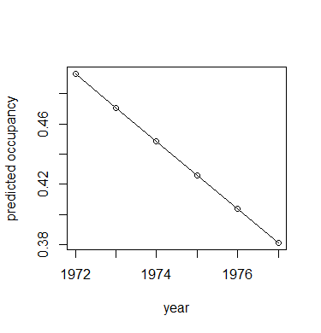
Fitting models to data:
# model c - linear trend in occupancy through time
> m3 = glm(resp ~ years, family = binomial(link = "identity"), data = vole.dat)
(Intercept) years
44.55917101 -0.02234586
Notes:
Represents the change in the response (here, the proportion occupied) for each unit change in the predictor, here, years
The intercept is really big because we’re looking at 1972-1977

