Slide 1
Maximum Likelihood
Eric Scott

Slide 2
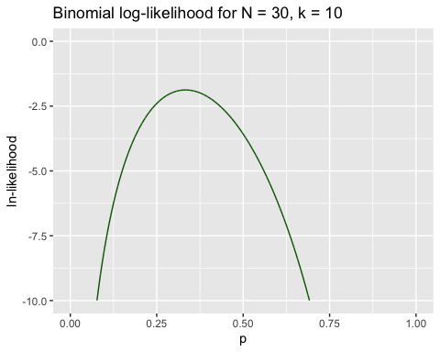
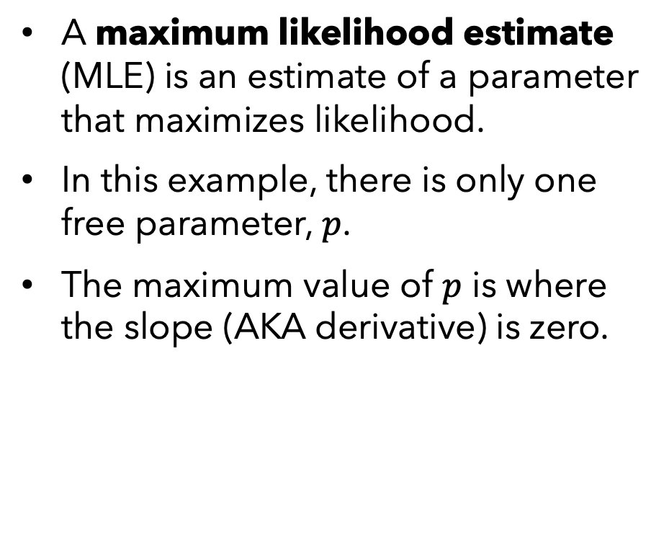
Maximum Likelihood Estimates
A maximum likelihood estimate (MLE) is an estimate of a parameter that maximizes likelihood.
In this example, there is only one free parameter, $p$.
The maximum value of $p$ is where the slope (AKA derivative) is zero.

Slide 3
Finding Maximum Likelihood
To find the maximum likelihood estimate (MLE) of our parameters…
Likelihood Profile (grid search of all parameter combinations)
slow
you might miss a sharp maximum
Calculus
not always solvable
Clever search algorithms (R uses these)

Slide 4
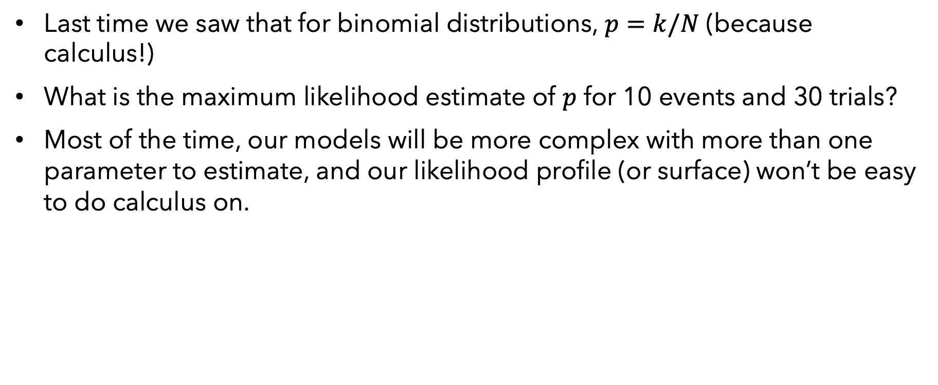
Calculus
Last time we saw that for binomial distributions, $p=k/N$ (because calculus!)
What is the maximum likelihood estimate of $p$ for 10 events and 30 trials?
Most of the time, our models will be more complex with more than one parameter to estimate, and our likelihood profile (or surface) won’t be easy to do calculus on.

Slide 5
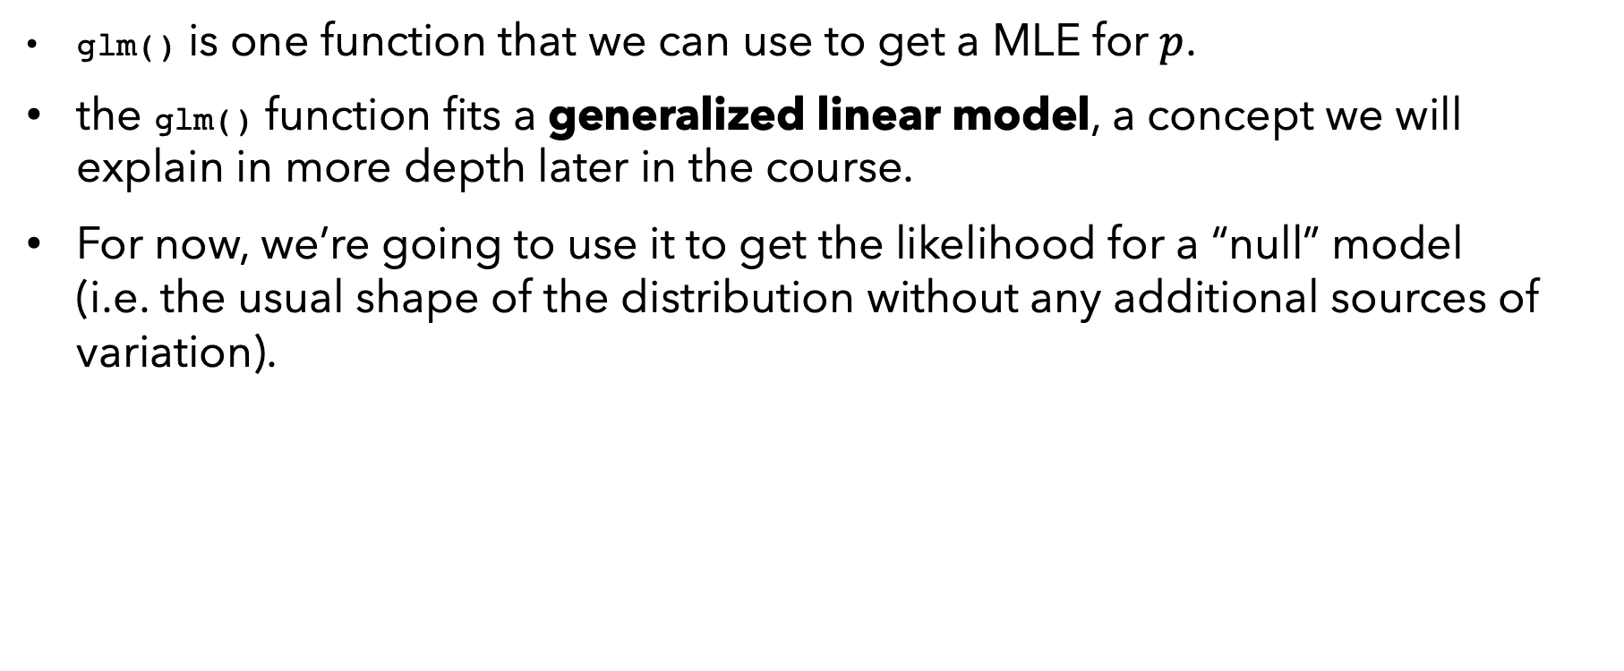
In R using clever algorithms
glm() is one function that we can use to get a MLE for $p$.
the glm() function fits a generalized linear model, a concept we will explain in more depth later in the course.
For now, we’re going to use it to get the likelihood for a “null” model (i.e. the usual shape of the distribution without any additional sources of variation).

Slide 6
R code for MLE using glm()
success <- 10 failure <- 30 - success mydat <- cbind(success, failure) # successes and failures, i.e., k and N-k glm(mydat ~ 1, family = binomial(link = "identity")) # function to estimate parameters
m1 <- glm(mydat ~ 1, family = binomial(link = "identity")) # need to save the analysis as an object to see results
logLik(m1) # extract the log likelihood, evaluated at MLE
coef(m1) # extract the maximum likelihood estimates of the coefficients
Notes:
Switch over to R to demonstrate. Use orchid example as well.

Slide 7
Under the hood of glm()
The glm() function in turn calls glm.fit() which in turn calls glm.control().
It uses an algorithm to find the parameter values that maximize likelihood.
You don’t need to know how to do these calculations, R does them for you!
So why am I telling you about this? Because common error messages encountered when running glm() can only be understood if you have an idea of what is going on under the hood.
Terms you’ll want to understand:
“convergence”
“starting values”
“iterations”
“tolerance”

Slide 8
Maximum Likelihood algorithms
GOAL:
Find p where slope (derivative) = 0 in situations where you can’t solve the general equation using calculus.

Slide 9
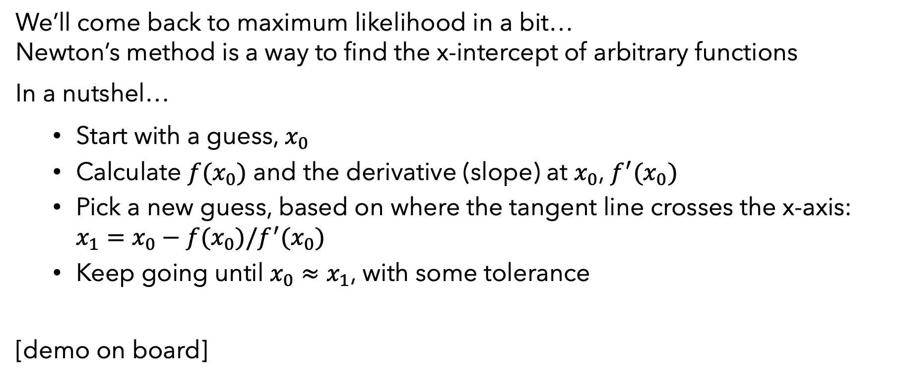
Newton’s Method
We’ll come back to maximum likelihood in a bit… Newton’s method is a way to find the x-intercept of arbitrary functions
In a nutshel…
Start with a guess, $x_{0}$
Calculate $f(x_{0})$ and the derivative (slope) at $x_{0}$, $f^{′}(x_{0})$
Pick a new guess, based on where the tangent line crosses the x-axis: $x_{1}=x_{0}−f(x_{0})/f^{′}(x_{0})$
Keep going until $x_{0}≈x_{1}$, with some tolerance
[demo on board]

Slide 10
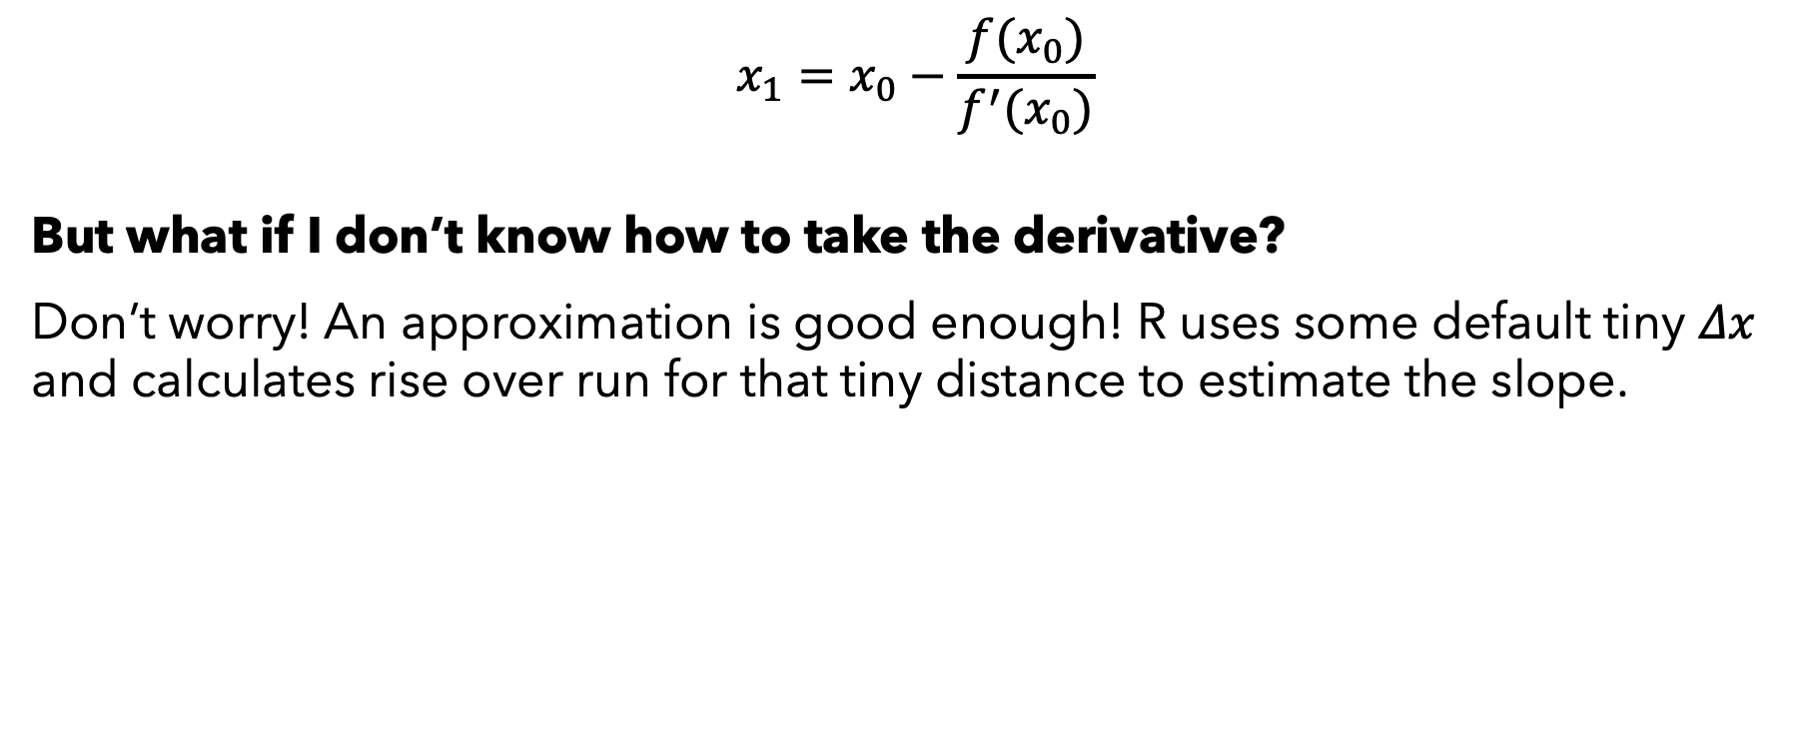
Newton’s Method
$$x_{1}=x_{0}−\frac{f(x_{0})}{f^{′}(x_{0})}$$
But what if I don’t know how to take the derivative?
Don’t worry! An approximation is good enough! R uses some default tiny $Δx$ and calculates rise over run for that tiny distance to estimate the slope.

Slide 11
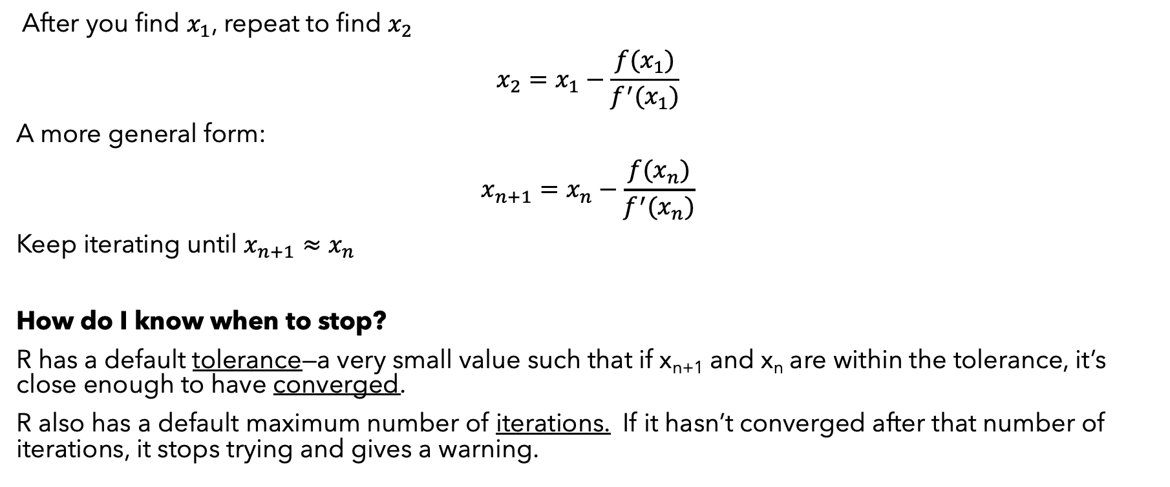
Iterate
After you find $x_{1}$, repeat to find $x_{2}$
$$x_{2}=x_{1}−\frac{f(x_{1})}{f^{′}(x_{1})}$$
A more general form:
$$x_{n+1}=x_{n}−\frac{f(x_{n})}{f^{′}(x_{n})}$$
Keep iterating until $x_{n+1}≈x_{n}$
How do I know when to stop?
R has a default tolerance—a very small value such that if x_{n+1} and x_{n} are within the tolerance, it’s close enough to have converged.
R also has a default maximum number of iterations. If it hasn’t converged after that number of iterations, it stops trying and gives a warning.

Slide 12
Follow @ChelseaParlett on Twitter and Instagram for more stats memes

Slide 13
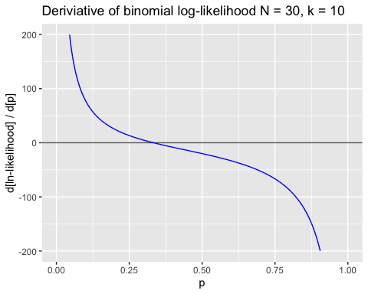

Using Newton’s Method for MLE
But we want to find a maximum not a root! We can use derivatives to find where the slope, $f^{′}(x)=0$ instead of finding where $f(x)=0$

Slide 14

Using Newton’s Method for MLE
So, you could do Newton’s method on the first derivative of the likelihood profile.
Alternatively, just re-write Newton’s method using first derivative and second derivative.
$$x_{1}=x_{0}−f^{′}(x_{0})/f^{′′}(x_{0})$$
For those of you interested in math, you might recognize this as a special case of a Taylor polynomial.

Slide 15

Example
10 trials, 30 events. What is the MLE for p(event)?
Pick a starting value, $p_{0}$
find $p_{1}$
repeat until $p_{n}≈p_{n+1}$

Slide 16
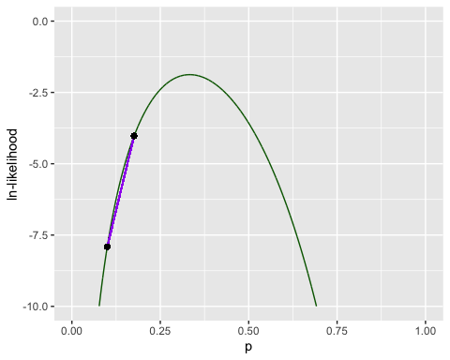
step 1
p_{i} | f’(p_{i}) | f’’(p_{i}) | p_{i+1}
0.1 | 77.727 | -1022.7 | 0.176

Slide 17
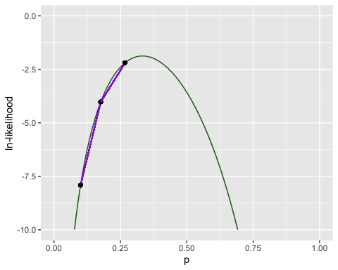
step 2
p_{i} | f’(p_{i}) | f’’(p_{i}) | p_{i+1}
0.1 | 77.7 | -1022.7 | 0.176
0.176 | 32.5 | -351.9 | 0.268

Slide 18
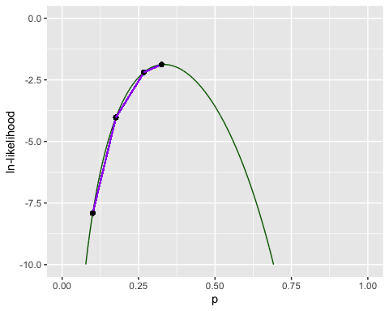
Step 3
p_{i} | f’(p_{i}) | f’’(p_{i}) | p_{i+1}
0.1 | 77.7 | -1022.7 | 0.176
0.176 | 32.5 | -351.9 | 0.268
0.268 | 10.0 | -176.5 | 0.325

Slide 19
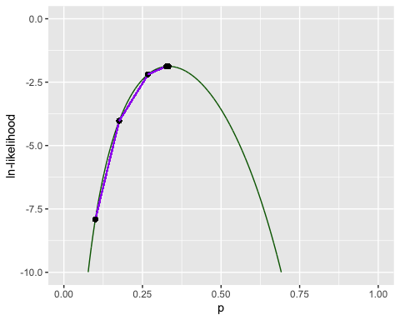
Step 5
p_{i} | f’(p_{i}) | f’’(p_{i}) | p_{i+1}
0.1 | 77.7 | -1022.7 | 0.176
0.176 | 32.5 | -351.9 | 0.268
0.268 | 10.0 | -176.5 | 0.325
0.325 | 1.1 | -138.5 | 0.333

Slide 20
Step 6
p_{i} | f’(p_{i}) | f’’(p_{i}) | p_{i+1}
0.1 | 77.7 | -1022.7 | 0.176
0.176 | 32.5 | -351.9 | 0.268
0.268 | 10.0 | -176.5 | 0.325
0.325 | 1.1 | -138.5 | 0.333
0.333 | 0.038 | -135.1 | 0.333
(Convergence!!)

Slide 21
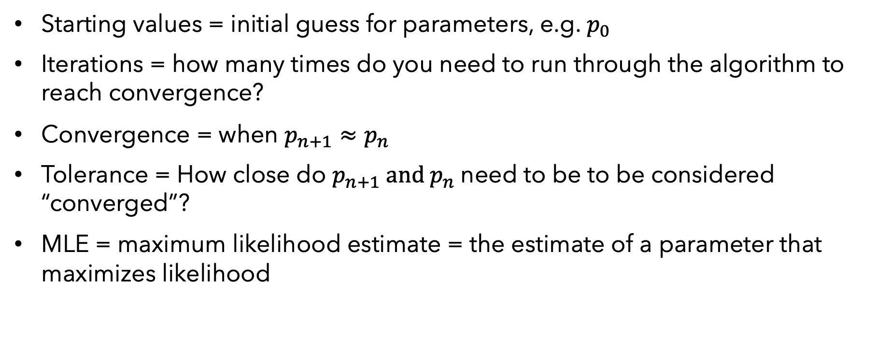
Vocab Recap
Starting values = initial guess for parameters, e.g. $p_{0}$
Iterations = how many times do you need to run through the algorithm to reach convergence?
Convergence = when $p_{n+1}≈p_{n}$
Tolerance = How close do $p_{n+1} and p_{n}$need to be to be considered “converged”?
MLE = maximum likelihood estimate = the estimate of a parameter that maximizes likelihood

Slide 22
Real error messages you might see:
Warning: glm.fit: algorithm did not converge
OR
Warning: glm.fit: algorithm stopped at boundary value
These are not actually errors. That is, glm() sill runs and spits out an answer.
However, you should not trust the MLE of any parameters in these cases!
How to fix? You can tell R to try harder by doing more iterations and sometimes that works!

Slide 23
Real error messages you might see:
Error in eval(family$initialize) : cannot find valid starting values: please specify some
This is an error. That is, glm() doesn’t run and doesn’t produce any results.
How to fix? You can supply some starting values. HOWEVER, this error often results from other more complicated underlying issues.
success <- c(0,0,0,0,0) failure <- 30 - success X = cbind(success, failure) glm(X ~ 1, family = binomial(link = "identity"))
## Error: no valid set of coefficients has been found: please supply starting values
Here, it can’t find starting values because it’s really hard to estimate the probability of an event that never happens! You’ve got bigger problems than valid starting values for glm.fit()!

Slide 24
Exercise 1: Orchids
Using the orchid dataset (available on Canvas) first, use math to get the MLE for proportion of seeds from the previous spring that become seedlings
Hint: seeds = “trials”, seedlings = “events”
Next, use dbinom() to calculate the log-likelihood using your MLE for p
Use glm() to get MLE for proportion of seeds from the previous spring that become seedlings and the log-likelihood
Repeat the glm() for seeds from 1, 2, 3, and 4 years ago
Which model has the highest log-likelihood?

Slide 25
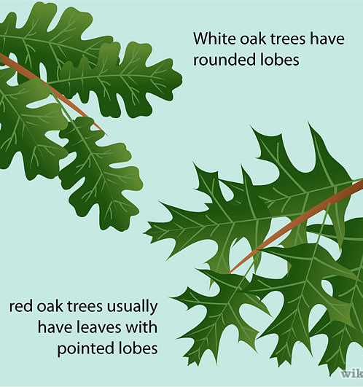
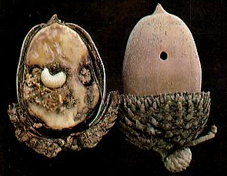
Real data
 |  | acorns with…
site | oak.sp | weevils | none
H | red | 584 | 187
H | white | 406 | 74
S | red | 910 | 118
S | white | 308 | 66
V | red | 391 | 101
V | white | 500 | 82
Estimate the MLE proportion of acorns with weevils, for each species
DATA: Prof. Michael Steele, Wilkes University, http://www.wilkes.edu/pages/969.asp?pidm=6010

Slide 26
R code for glm with some real data…
red.events = c (584, 910, 391) # successes, k
red.fails = c (187,118,101) # successes, k
red.dat = cbind(red.events, red.fails)
m2 = glm(red.dat~1, family = binomial(link = "identity")) # save the analysis as an object
logLik(m2) # extract the log likelihood, evaluated at MLE
coef(m2) # extract the maximum likelihood estimates of the coefficients
 |  | acorns with…
site | oak.sp | weevils | none
H | red | 584 | 187
H | white | 406 | 74
S | red | 910 | 118
S | white | 308 | 66
V | red | 391 | 101
V | white | 500 | 82

