Slide 1
Welcome to Ecological Statistics and Data!
Eric Scott

Slide 2
Overview
20th century: design experiments to fit statistical analysis assumptions
21st century: option to design statistical models to be more like data
Focus on linear models and their extensions

Slide 3
Why “Ecological” statistics?
Ecologists often count things and watch when they reproduce and die
These types of data have special properties
Violate assumptions of statistical tests typically covered in more general or introductory courses

Slide 4
Introductions
The team:
Eric Scott (eric.scott@tufts.edu)
Avalon Owens (avalon.owens@tufts.edu)
The class:
Undergraduate and graduate students from several departments with varied backgrounds in math, statistics, computer programming, and ecology.

Slide 5
Today’s Outline
Logistics
Probability
Homework

Slide 6
Logistics
Take a look at the syllabus:
General format (lectures mixed with computer exercises – find a partner or 2)
Books: Bolker, R4DS
Syllabus
Access to laptops
Lab

Slide 7
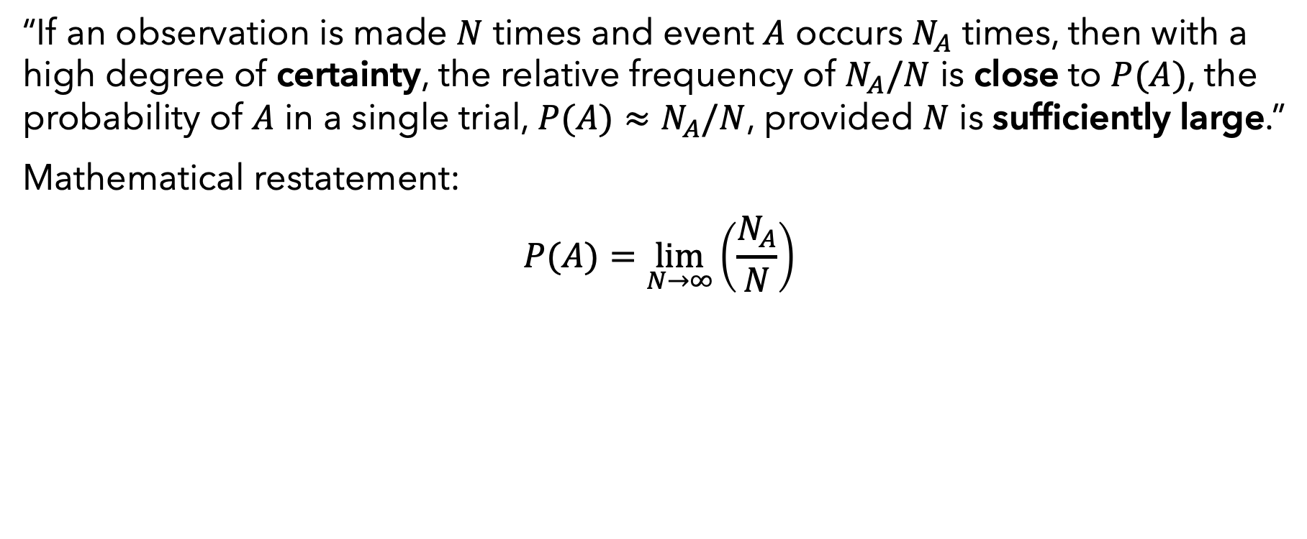
Probability: textbook definition
“If an observation is made $N$ times and event $A$ occurs $N_{A}$ times, then with a high degree of certainty, the relative frequency of $N_{A}/N$ is close to $P(A)$, the probability of $A$ in a single trial, $P(A)≈N_{A}/N$, provided $N$ is sufficiently large.”
Mathematical restatement:
$$P(A)=\lim_{N→∞}\left(\frac{N_{A}}{N}\right)$$

Slide 8
Example application
Common ecological application: survival and reproduction of perennial wildflowers
Mark individual plants and watch their performance over time.
What is the probability that a plant will survive from one year to the next?
What is the probability that a plant that survives will flower?

Slide 9

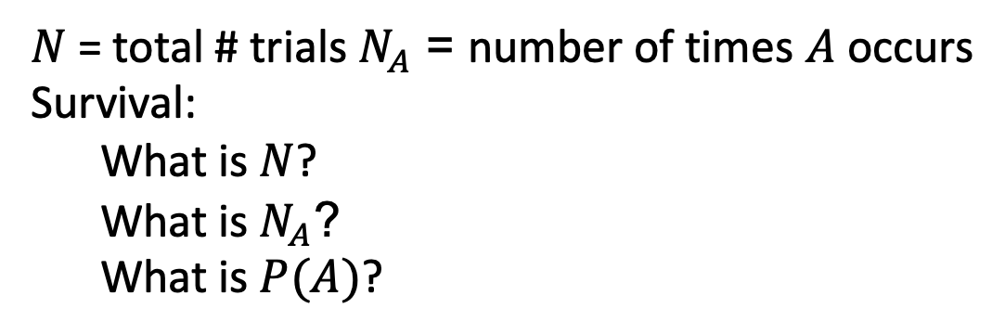
Example application
For a particular dataset, we can use the definition of probability to estimate these probabilities (“provided N is sufficiently large”)
Say we have 5 plants, 4 live, and 1 of these flower
Plant # | fate
1 | Flowers
2 | Vegetative
3 | Vegetative
4 | Vegetative
5 | Dead
$N$ = total # trials $N_{A}$ = number of times $A$ occurs
Survival:
What is $N$?
What is $N_{A}$?
What is $P(A)$?
Flowering, for plants that survive:
What is $N$?
What is $N_{A}$?
What is $P(A)$?
FOR THOUGHT: Based on these data, what is the probability that a plant survives AND flowers?

Slide 10
Sampling and Scope of Inference
Definition of probability assumes trials are representative of a “population”
“population” (statistics definition) = larger group for which you estimating the probability
Trials should be representative and independent.
Sampling types:
Random
Stratified (e.g. randomly selected transects)
Systematic (e.g. every 10 paces along transect)
Haphazard

Slide 11
Sampling and Scope of Inference
Scope of inference = “population” over which your data are a representative and independent observations

Slide 12
Homework
Measure a probability of some event by sampling a population.

