Slide 1
Welcome to Ecological Statistics and Data! (Bio 133)
Instructor: Eric Scott

Slide 2
Overview
20th century: design experiments to fit statistical analysis assumptions
21st century: option to design statistical models to be more like data
Our focus for this course
Focus on theory and interpretation
Focus on learning flexible tools rather than memorizing statistical tests

Slide 3
Why “Ecological” statistics?
Ecologists often count things and watch when they reproduce and die
These types of data have special properties
Violate assumptions of statistical tests typically covered in more general or introductory courses
Rather than trying to force data to match one of a list of statistical tests, use flexible tools to model data generated by a variety of ecological processes

Slide 4
Introductions
The team:
Eric Scott (eric.scott@tufts.edu)
Avalon Owens (avalon.owens@tufts.edu)
The class:
Undergraduate and graduate students from several departments with varied backgrounds in math, statistics, computer programming, and ecology.

Slide 5
Today’s Outline
Logistics
Probability
Homework

Slide 6
Logistics
Take a look at the syllabus:
General format (lectures mixed with computer exercises – find a partner or 2)
Books: Bolker, R4DS
Access to laptops
Lab

Slide 7


Probability: textbook definition
“If an observation is made $N$ times and event $A$ occurs $N_{A}$ times, then with a high degree of certainty, the relative frequency of $N_{A}/N$ is close to $P(A)$, the probability of $A$ in a single trial, $P(A)≈N_{A}/N$, provided $N$ is sufficiently large.”
Mathematical restatement:
$$P(A)=\lim_{N→∞}\left(\frac{N_{A}}{N}\right)$$
Notes:
Write definitions on board

Slide 8
Example application
Common ecological application: survival and reproduction of perennial wildflowers
Useful to know to understand and predict what will happen to populations over time
Mark individual plants and watch their performance over time.
What is the probability that a plant will survive from one year to the next?
What is the probability that a plant that survives will flower?

Slide 9
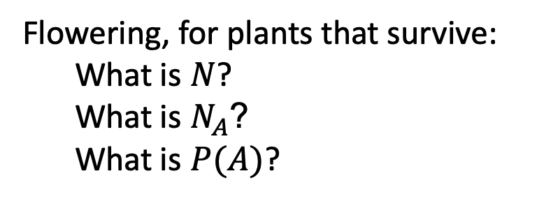
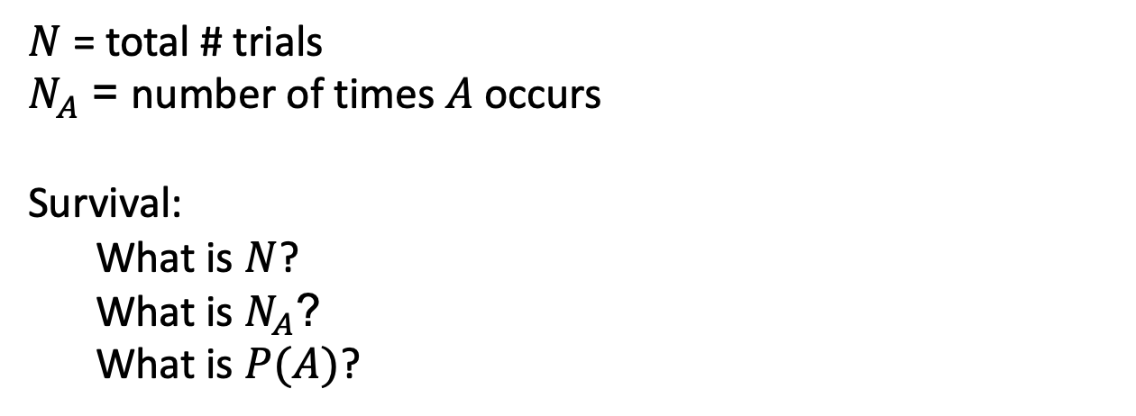
Example application
FOR A PARTICULAR DATA SET, we can use the definition of probability to estimate these probabilities (“provided N is sufficiently large”)
Say we have 5 plants, 4 live, and 1 of these flower
Plant # | fate
1 | Flowers
2 | Vegetative
3 | Vegetative
4 | Vegetative
5 | Dead
$N$ = total # trials
$N_{A}$ = number of times $A$ occurs
Survival:
What is $N$?
What is $N_{A}$?
What is $P(A)$?
Flowering, for plants that survive:
What is $N$?
What is $N_{A}$?
What is $P(A)$?
FOR THOUGHT: Based on these data, what is the probability that a plant survives AND flowers?

Slide 10

Sampling and Scope of Inference
Definition of probability assumes trials are representative of a “population”
“population” (statistics definition) = larger group for which you estimating the probability
Trials should be representative and independent.
Scope of inference = “population” over which your data are representative and independent observations

Slide 11

Types of Sampling
Random
Label all plants in population with numbers. Choose subset at random
Systematic
Walk a transect and sample individuals every 10 paces
Haphazard
Choose samples without any conscious bias (Be careful! Unconscious bias exists!!!)
Stratified
Sample in forest and old field separately. # samples in each determined by relative area and variability
Forest
Old Field

Slide 12
Homework
Measure a probability of some event by sampling a population.

