Slide 1
Water Body Detection and Mapping
Digital Image Processing
SEMESTER PROJECT
Submitted By:
Muhammad Aarish Mughal (223570)
Aymen Majid (223574)
Submitted To:
Ma’am Atika Ali.

Slide 2
INTRODUCTION
Goal
Relevance
Automatically detect and analyze water bodies in satellite images.
Useful for environmental monitoring, flood mapping, and urban planning.

Slide 3
CORE CONCEPTS
HSV Colour Space Conversion
Colour-based Segmentation (Blue Detection)
Binary Masking & Thresholding
Contour Detection
Histogram Analysis
Edge Detection

Slide 4
WORKFLOW
WORKFLOW
WORKFLOW
Load Satellite Image
Convert to HSV
Apply Blue Mask
Detect Contours
Display Filtered Image
Compute Area
WORKFLOW

Slide 5
TOOLS & TECH
Python
OpenCV, NumPy, Matplotlib, Tkinter
Web Application with ReactJs
Satellite or remote-sensed imagery

Slide 6
KEY FEATURES
Save Filtered Image
Zoom & Pan
Dynamic Blue Range Tuning
Contour Highlighting
Colour Channel Histograms
Edge Detection View
Pixel Count Summary Table

Slide 7
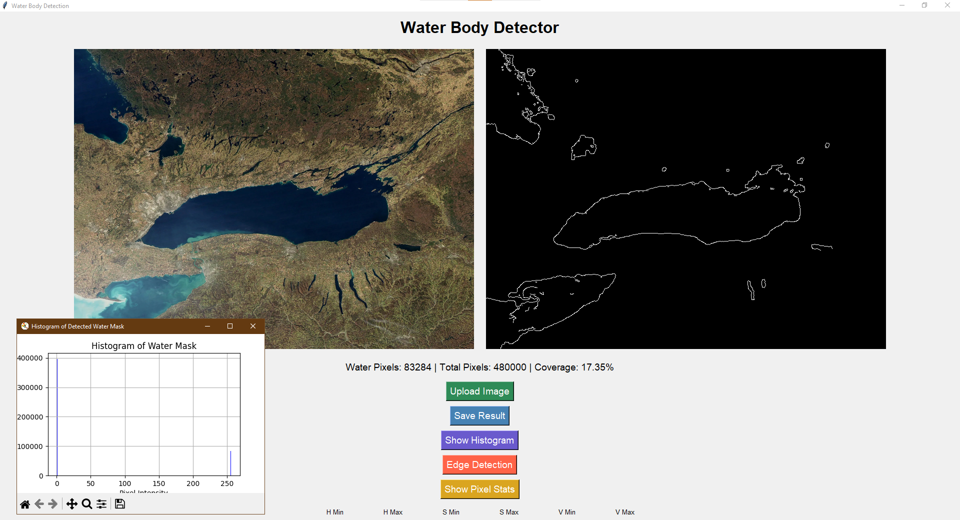
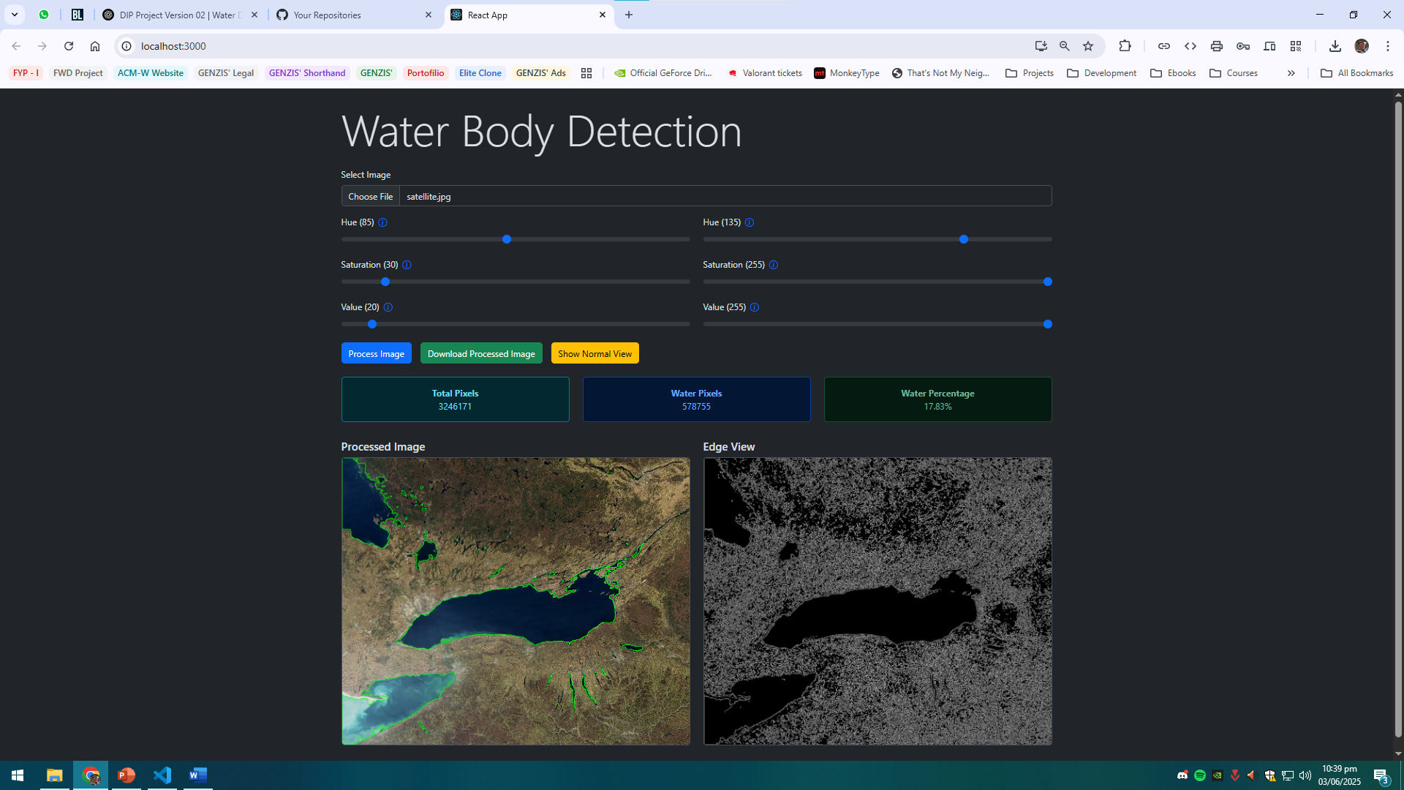
NEW UI VS OLD UI
Old UI
New UI

Slide 8
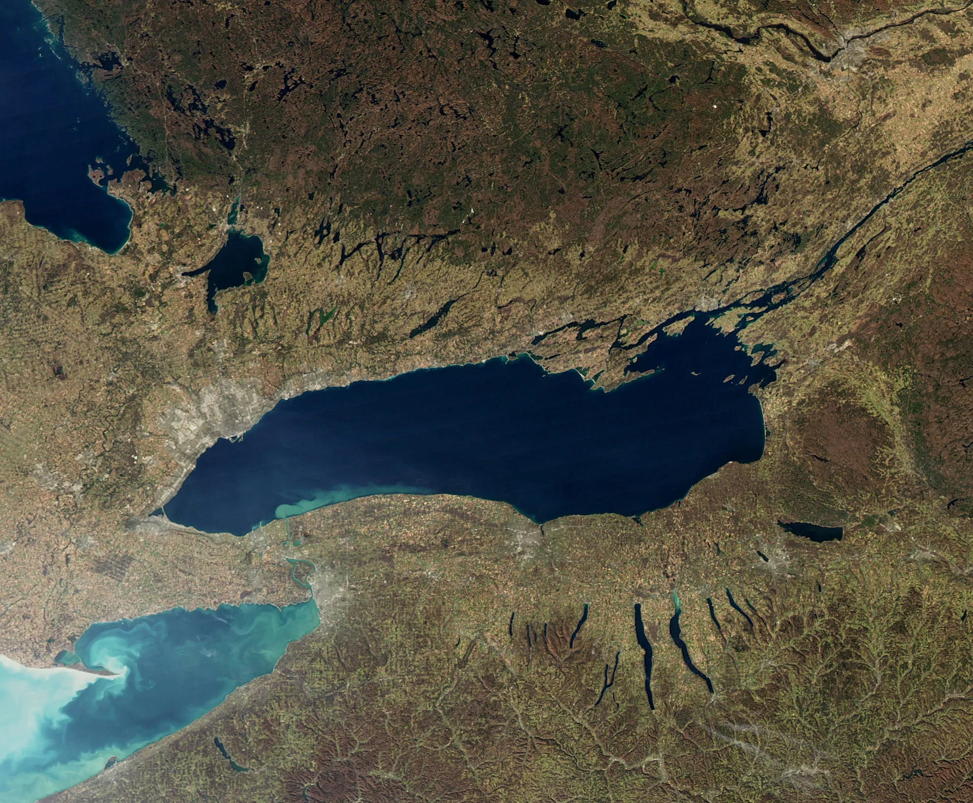
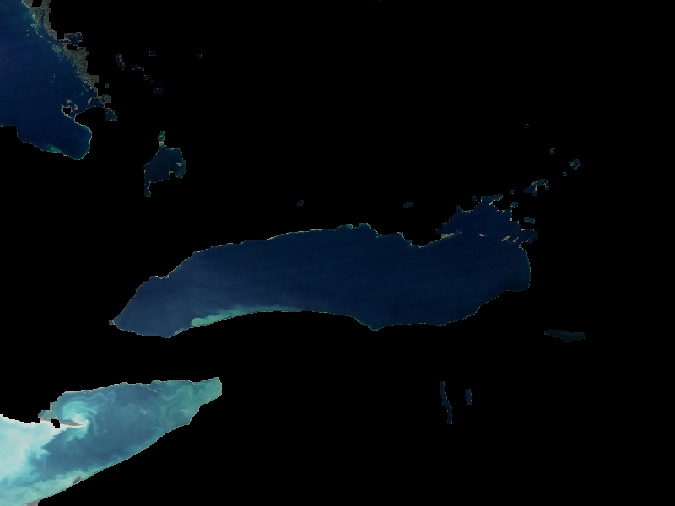
RESULTS & DEMO
Original Image
Output Image

Slide 9
Thank you.

