Slide 1
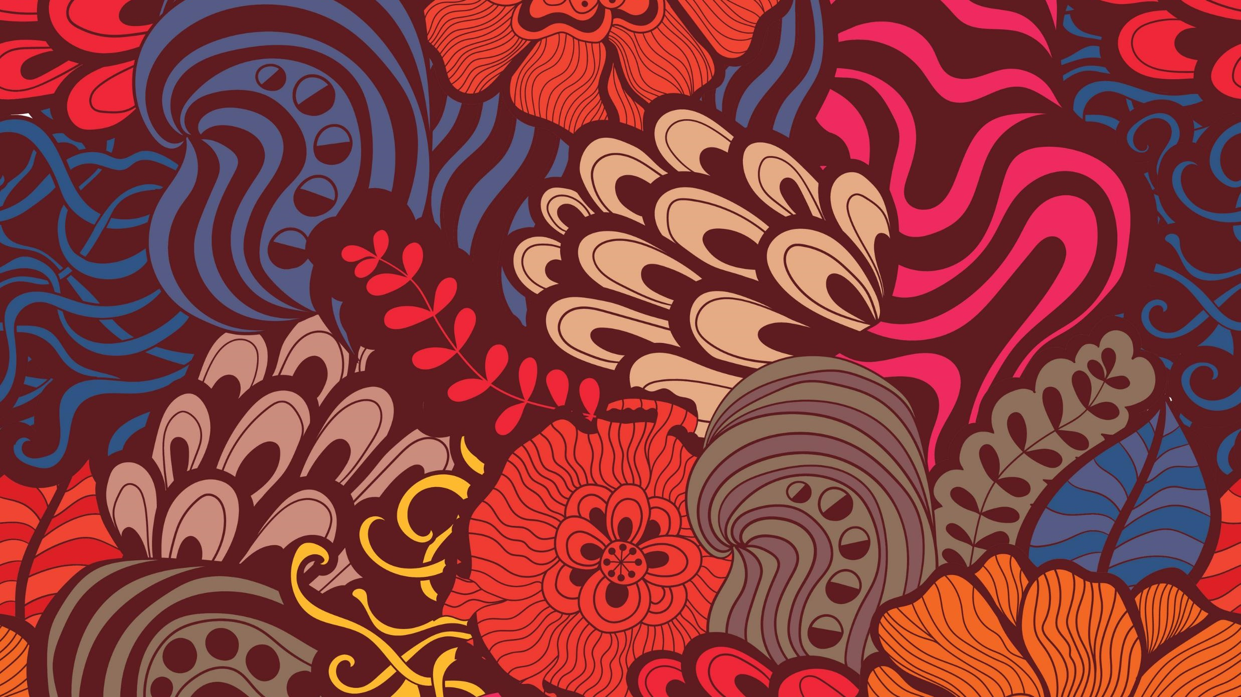
India Moving
Summary: Chapters 1 & 2
- Abhishek Dixit
Notes:
The chapter opens with the claim that the route to diversity in any region can follow two paths, one through migration and the other through isolation and the lack of migration. It was a common view that India was a land of low spatial mobility and only the occasional pilgrim, merchant or warrior on a mission would travel outside the self-sufficient villages. However, the author starkly questions this and refutes it by saying that “India witnessed some of the world’s largest episodes of voluntary and involuntary migration”. The first chapter of the book deals with the internal and external migration in India before the 19th century.

Slide 2
Key Principle
Diversity
Migration
Isolation

Slide 3
Chapter 1: Indian Diversity and Global Migrations
Notes:
The chapter opens with the claim that the route to diversity in any region can follow two paths, one through migration and the other through isolation and the lack of migration. It was a common view that India was a land of low spatial mobility and only the occasional pilgrim, merchant or warrior on a mission would travel outside the self-sufficient villages. However, the author starkly questions this and refutes it by saying that “India witnessed some of the world’s largest episodes of voluntary and involuntary migration”. The first chapter of the book deals with the internal and external migration in India before the 19th century.

Slide 4
The Brownian Movement
In migration, Out migration, and internal migration for centuries.
Prehistoric migration – dictated by geographic features and the technology available for crossing them
Lineages in India (seen through evolution of skin color and general features):
Indo-European, Dravidian, Austro-Asiatic, Tibeto-Burman
Caste system and endogamy

Slide 5
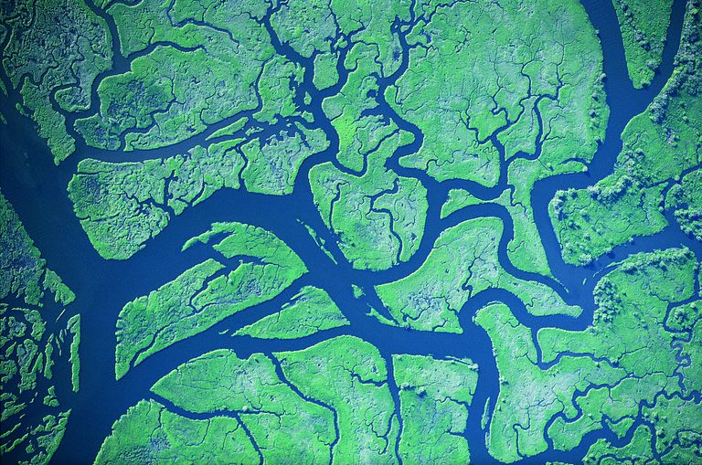
“Streams of Migration” Analogy
Affected by the Caste System and Endogamy in India
Image Source: https://www.thoughtco.com/what-is-stream-order-1435354

Slide 6
Historic Reasons for Migration
Religion
Trade
Agriculture
Warfare

Slide 7
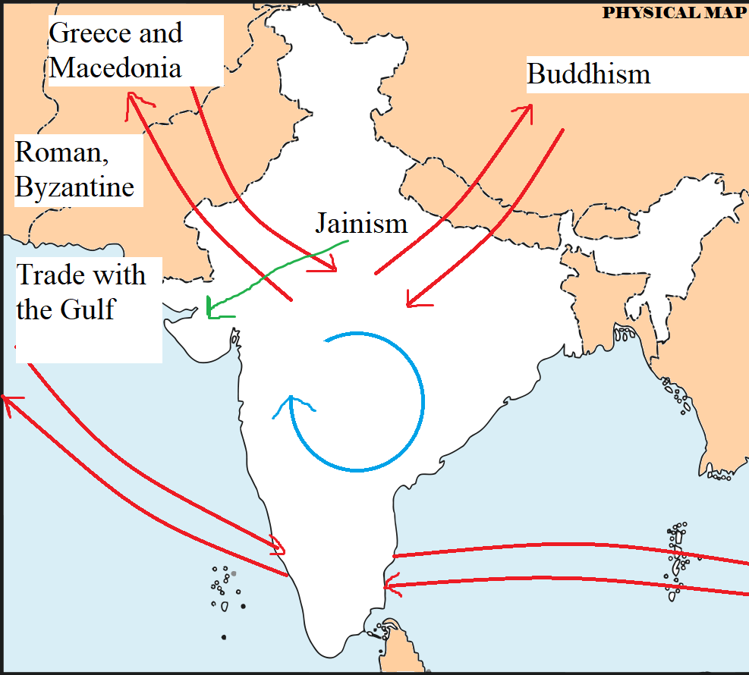
Ancient Migrations
Recorded in Arthashastra
Maurya, Gupta, Chola Empires Prevail
Map Source: http://www.bestwebsiteinindia.com/blog/wp-content/uploads/2014/10/Physical-Map-of-India.png

Slide 8
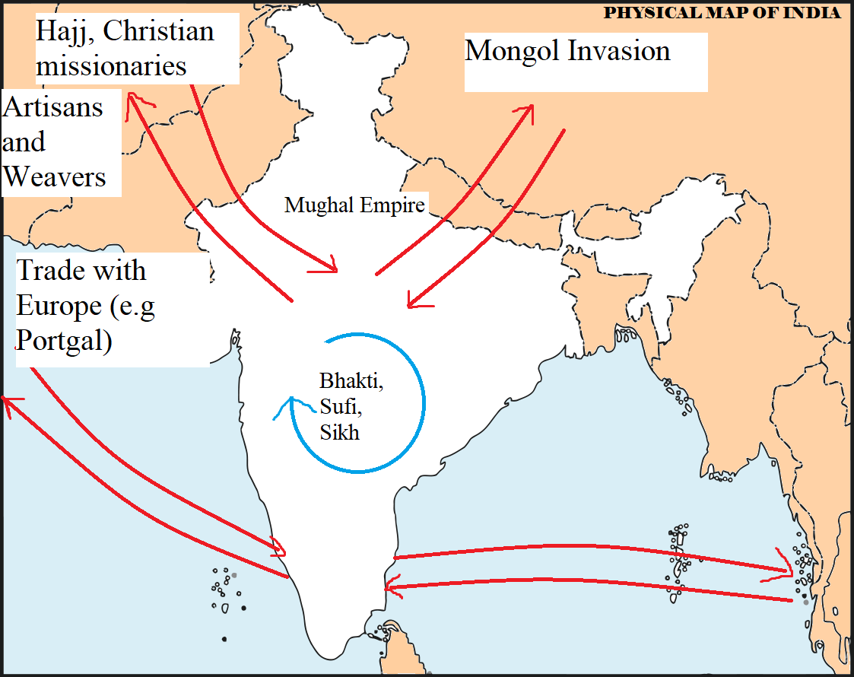
Medieval Migrations
The birth of the Mughal Empire
Map Source: http://www.bestwebsiteinindia.com/blog/wp-content/uploads/2014/10/Physical-Map-of-India.png

Slide 9
Modern Migrations
Colonization by European Countries
East India Company
Restriction on Nomadic Tribes – for surveillance
The start of ‘criminal’ activities in many tribes
‘Criminal Tribes Act’
Increase in Migrant Labourers – Gunpowder, Indigo, Opium manufacture

Slide 10
The KEY to understanding Migration in India: Look at the Reason and Duration on Migration

Slide 11
Chapter 2: The Great Indian Migration Wave

Slide 12
It Is Still Happening…
Mass migration
Male-dominated
Semi-permanent
Remittance-yielding
The influence of Migration seen through Folk Music, Festivals, Conversations

Slide 13
Case Studies (main effect on sex ratio of migrants’ home-states)
Ratnagiri
Males migrate to Mumbai
Nepali migrants handling mango cultivation
Udupi
Brahmins from Udupi, Karnataka
Pure-veg Udupi restaurants
Saran, Bihar
Male migration to Bengal
Brahmins, Rajputs, Ahirs, Koiris, Kurmis and Chamars, Muslim, communities - Agricultural labor
Caste-based at first. Urban areas then started employing anyone else
Opportunities in Western and Central India
Effect of low density in Bihar seen on socio-political scenario
Maratha and Mahar Migrations

Slide 14
Ganjam, Odisha
Circular male migration due to cyclones in the hometown
Agricultural work in Myanmar
Coastal Migrations
Kerala to Gulf – oil and construction
Tamil Nadu to S-East Asia – rubber, sugar, oil plantations
Hinterlands
Cities like Pune, Bengaluru, Hyderabad – only urban-urban migrations
Tamil Nadu to interiors of India – tea and coffee plantations
Textile work in Surat
Imp remittance based migrants: from UP, west Bihar, Jharkhand, Chhattisgarh, East Punjab, Himalayan belt

Slide 15
Role of Railways and Postal Money
Railways moved migrant laborers from and to their home-states
Railways were also opportunity for work.
Postal service saw a huge increase in money orders.

Slide 16
“Circular Migration in India is dictated by the factors at the source and destination of the migrant”

