Slide 1

SUPERSTORE DATA
ANALYSIS
BY ARJUN GAWANDE
ARJUN GAWANDE

Slide 2
🔎 Problem Statement
The Superstore dataset contains sales transactions from 2011–2015 across multiple markets, regions, and product categories.
Key challenges include:
Understanding sales trends 📊 across geographies, time, and customer segments.
Identifying profitability issues 💸, e.g., high discounts leading to negative profits.
Evaluating shipping costs & delivery times 🚚 and their impact on profit.
Optimizing product performance 📦 by analyzing categories, sub-categories, and regions.
Managing customer segmentation & loyalty 👥 for targeted strategies.
ARJUN GAWANDE

Slide 3
📊 Data Overview (2011–2015 Superstore)
✨ Dataset Size: 51,290 rows × 24 columns
📦 Product Coverage: 3 main categories (Office Supplies, Furniture, Technology)
🌍 Markets: Africa, APAC, EMEA, LATAM, US, EU
👥 Segments: Consumer, Corporate, Home Office
📌 Key Points (with Emojis)
📑 Row ID → Unique transaction identifier
🧾 Order ID → Tracks each customer’s order
📅 Dates → Order & Shipping for delivery performance
🚚 Ship Mode → Standard, Second Class, etc.
🧍 Customer Info → ID, Name, Segment
🏙️ Location Data → City, State, Country, Market, Region
ARJUN GAWANDE

Slide 4
🛒 Product Info → ID, Name, Category, Sub-category
💵 Sales → Revenue from sale
📦 Quantity → Number of items sold
🎟️ Discount → Applied discount (%)
📈 Profit → Profit/Loss from sale
🚛 Shipping Cost → Logistic cost
🔥 Order Priority → Urgency (Low, Medium, High, Critical)
ARJUN GAWANDE

Slide 5
ARJUN GAWANDE

Slide 6
Superstore dataset
CREATE TABLE superstore_sales (
Row_ID INT PRIMARY KEY,
Order_ID VARCHAR(50),
Order_Date DATE,
Ship_Date DATE,
Ship_Mode VARCHAR(50),
Customer_ID VARCHAR(50),
Customer_Name VARCHAR(255),
Segment VARCHAR(50),
City VARCHAR(100),
State VARCHAR(100),
Country VARCHAR(100),
Postal_Code INT NULL,
Market VARCHAR(50),
Region VARCHAR(50),
Product_ID VARCHAR(50),
Category VARCHAR(50),
Sub_Category VARCHAR(50),
Product_Name VARCHAR(255),
Sales DECIMAL(10,2),
Quantity INT,
Discount DECIMAL(5,2),
Profit DECIMAL(10,2),
Shipping_Cost DECIMAL(10,2),
Order_Priority VARCHAR(50)
);
ARJUN GAWANDE

Slide 7
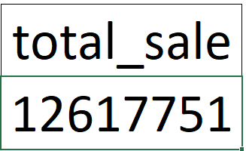

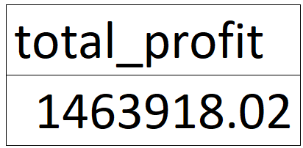



1. Find total sales for superstore dataset
2. Find total profit for superstore dataset
3. Find top product based by sales and profit
ARJUN GAWANDE

Slide 8
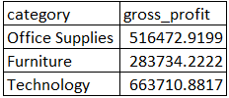
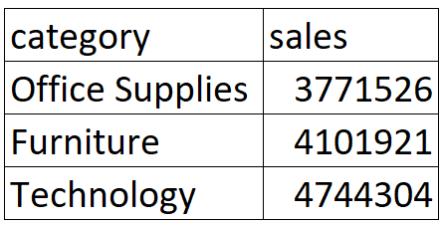

4. Find Profitability as per Category
5. Find sales as per category
6. Find total customers
ARJUN GAWANDE

Slide 9
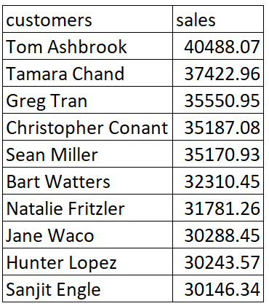
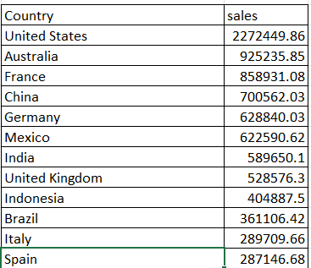
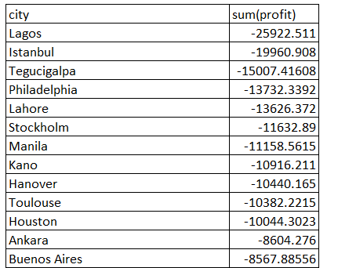
7.Find top 10 customers by sale
8.Find 10 top countries by sale
9.Find the loss making cities
ARJUN GAWANDE

Slide 10
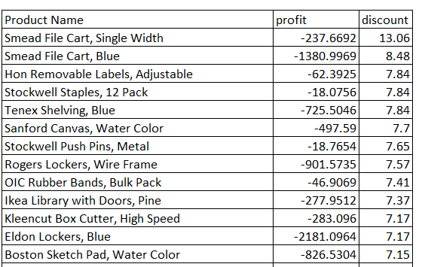
10.Find Top Loss-making products (due to heavy discounts)
ARJUN GAWANDE

Slide 11
Visuals
ARJUN GAWANDE

Slide 12
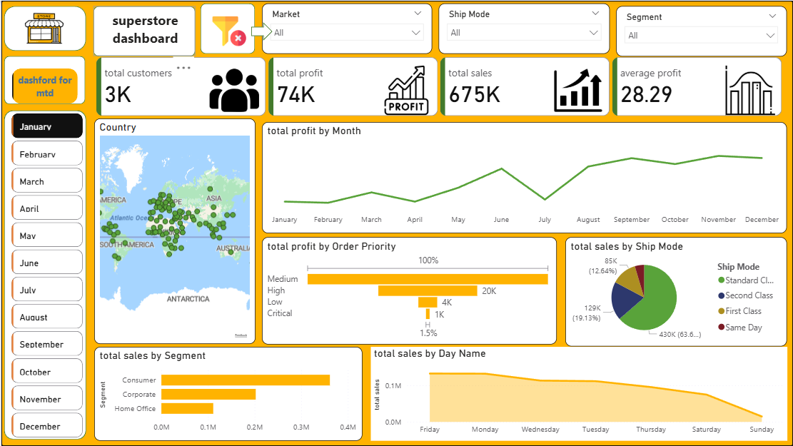
ARJUN GAWANDE

Slide 13
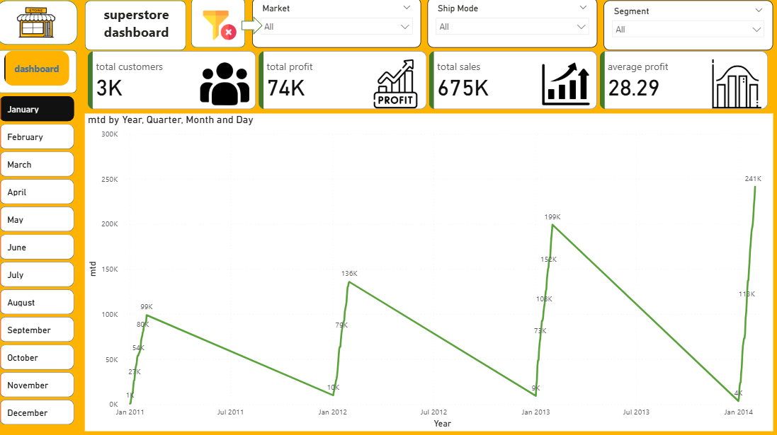
ARJUN GAWANDE

