Slide 1
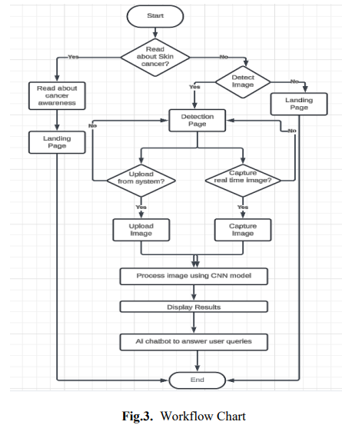
Skinsense: Lesion Detection with Different Convolutional Neural Architectures
Explore the performance of various convolutional neural network architectures in detecting skin lesions. Gain insights into the strengths and limitations of these models for accurate and reliable skin cancer diagnosis.

Slide 2
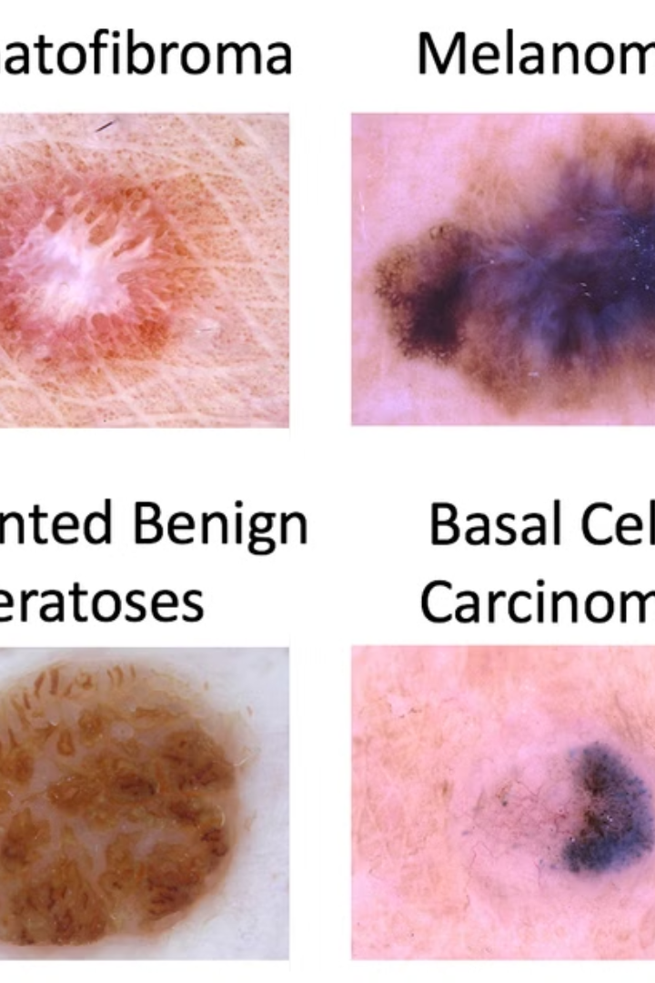
Skinsense: Skin Lesion Detection
Fibroma
Melanoma
Skinsense is an AI-powered system that integrates multiple convolutional neural network (CNN) architectures to provide accurate and reliable skin lesion detection. This comprehensive solution aims to assist medical professionals and empower patients in early diagnosis and management of various skin conditions.
Benign Keratosis
Basal Cell Carcinoma

Slide 3

Presenters and Affiliation
The presentation is delivered by Aark Deep Sarkar , Aman Prasad Gupta and Dr. Jeya R from the SRM Institute of Science and Technology , Kattankulathur, Tamil Nadu, India.
The presentation will be given at the ICSCSP 2024 on 22/06/2024.

Slide 4
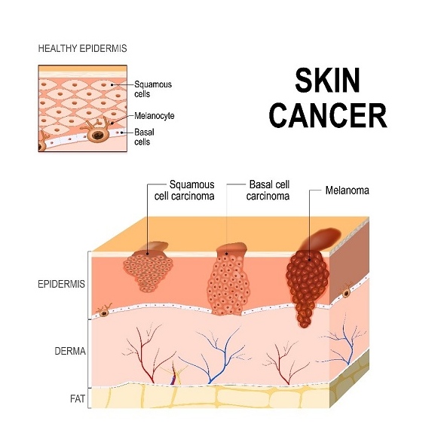
Main Objectives
Robust Skin Lesion Analysis
Develop a powerful tool for analyzing skin lesions and detecting potential cancerous conditions.
CNN Architecture Comparison
Compare the performance of different
convolutional neural network (CNN) architectures
in skin lesion detection.
Lesion Classification
Apply deep learning models to classify skin lesions as cancerous or benign.

Slide 5
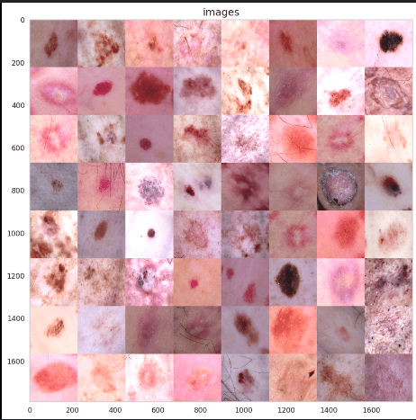
HAM10000 Dataset
Diverse Lesion Types
The dataset includes 10,015 dermoscopic images spanning 7 diagnostic categories, from actinic keratoses to melanoma.
Training Neural Networks
The dataset is used to train and evaluate convolutional neural networks for automated skin lesion diagnosis.
Comprehensive Coverage
The wide range of lesion types in the dataset allows for robust model development and evaluation.

Slide 6
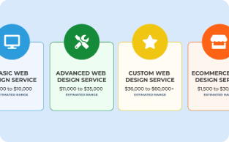
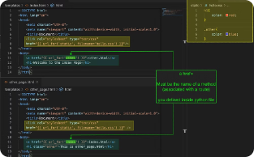
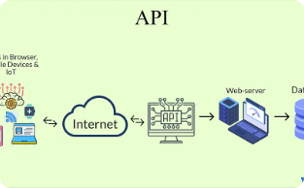
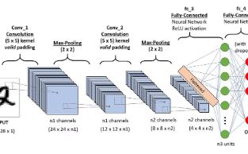
System Architecture
Client Tier
Backend Tier
API Tier
Model Tier
The user interface is built with HTML, CSS, and JavaScript, providing an interactive and responsive experience.
The backend is managed by the Flask framework, handling business logic and data processing.
The API tier facilitates communication with external systems through the Gemini framework.
The model tier incorporates various CNN architectures for data analysis and predictions.

Slide 7
Workflow
1
User Interaction
2
Image Upload
3
Deep CNN Models
4
Output
5
AI Chatbot
Users can detect lesions or learn about skin cancer. They can upload images via file selection or real-time capture. The images are processed by deep CNN models, providing lesion categorization and severity index. An AI-powered chatbot is available to address user queries.

Slide 8
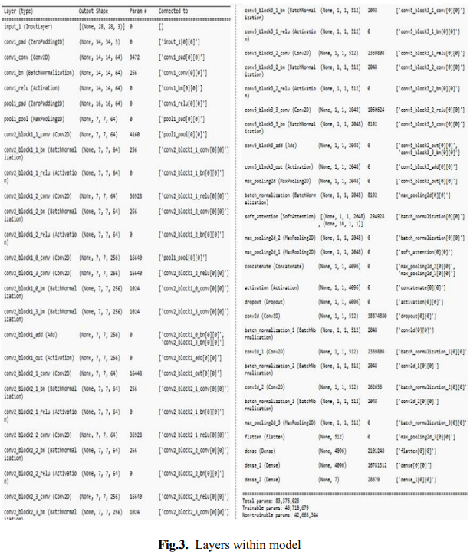
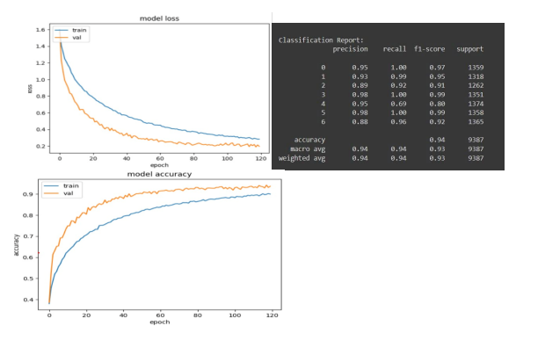
Best Precision Model
RESNET101+Custom Layers
Performance Metrics
Uses 28x28x3 input layers and a pre-trained ResNet101 backbone. Custom soft attention layer enhances focus on relevant input parts.
Accuracy: 94%
Number of Layers: 290
Total Parameters: 83,376,023
Trainable Parameters: 40,710,679
Non-Trainable Parameters: 42,665,344

Slide 9
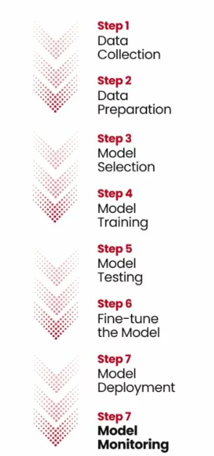
Model Training
1
Data Preparation
The dataset is split into training and validation sets to ensure unbiased model evaluation.
2
Model Optimization
Sparse categorical cross-entropy loss and Adam optimizer are used to train the model effectively.
3
Performance Monitoring
ModelCheckpoint is utilized to save the best-performing model during the training process.

Slide 10
Model Architecture
Input Layer
ResNet101 Backbone
Soft Attention
The model starts with a 28x28x3 input layer, representing the preprocessed medical images.
A pre-trained ResNet101 model is used as the backbone, providing a strong foundation for feature extraction.
The soft attention layer enhances the model's focus on the most relevant features, improving classification performance.

Slide 11






Data Preprocessing
Image Mapping
Map image IDs to file paths and lesion types.
Category Assignment
Assign unique category IDs to each lesion type.
Image Loading
Read images into arrays for processing.
Color Extraction
Extract and average color information from images.
Resizing
Reshape and resize images for model training.
Class Balancing
Address class imbalance through oversampling techniques.

Slide 12
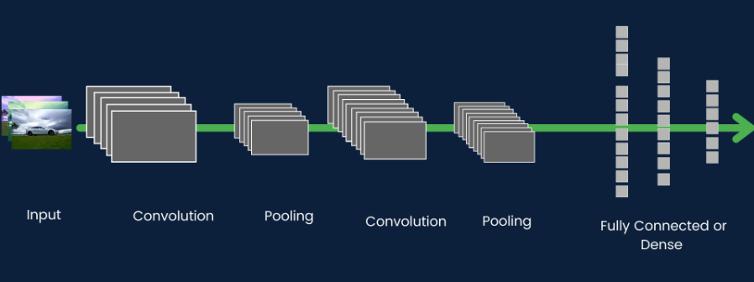
Soft Attention Layer
1
Dynamically Focus on Relevant Parts
2
Configurable Complexity
3
Compute Attention Weights
Attention parameters control the complexity and granularity of the attention mechanism, allowing fine-tuning for optimal performance.
The attention layer computes a set of weights that highlight the salient features of the input, guiding the model's decision-making.
The soft attention layer dynamically focuses the model on the most important regions of the input image during the classification process.

Slide 13
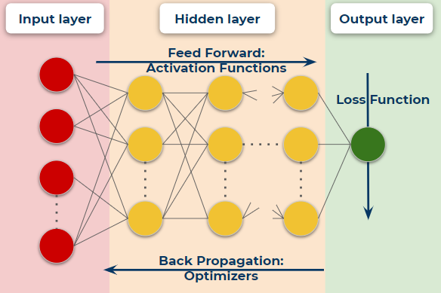
Model Training
Data Preparation
1
The model is trained on the X_train and Y_train datasets, with a 30% validation split.
Loss and Optimizer
2
Sparse categorical cross-entropy loss is used with the Adam optimizer to optimize the accuracy metric.
Training Process
3
The model is trained in batches of 128 samples, and the best model is saved based on validation accuracy.

Slide 14
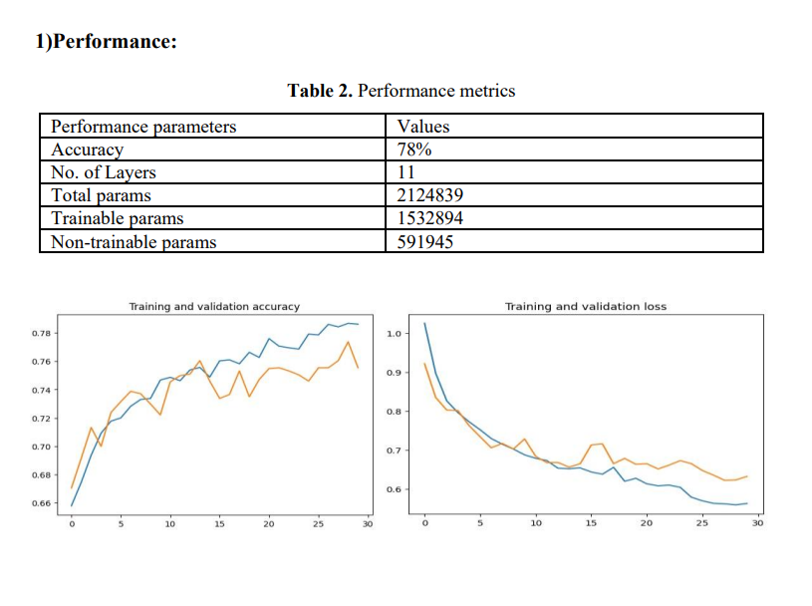
Comparative Analysis of Architectures
Input Layer: Accepts skin lesion images, typically in dimensions representing height, width, and RGB channels.
Convolutional Layers: Apply filters to extract features from images.
Activation Functions: Non-linear functions (e.g., ReLU) added after each convolution layer to capture complex patterns.
Pooling Layers: Reduce spatial dimensions to lower computational load while preserving key features.
Flattening Layer: Converts feature maps into a one-dimensional vector for the next layers.
Fully Connected Layers: Dense layers that learn to classify the extracted features, making high-level decisions.
Output Layer: Produces the final predictions. For skin cancer detection, it typically includes neurons corresponding to different classes (e.g., cancerous or non-cancerous). Uses softmax to output probabilities for each class.
1
Baseline-CNN
Simple architecture for image classification with 78% accuracy and 11 layers.

Slide 15
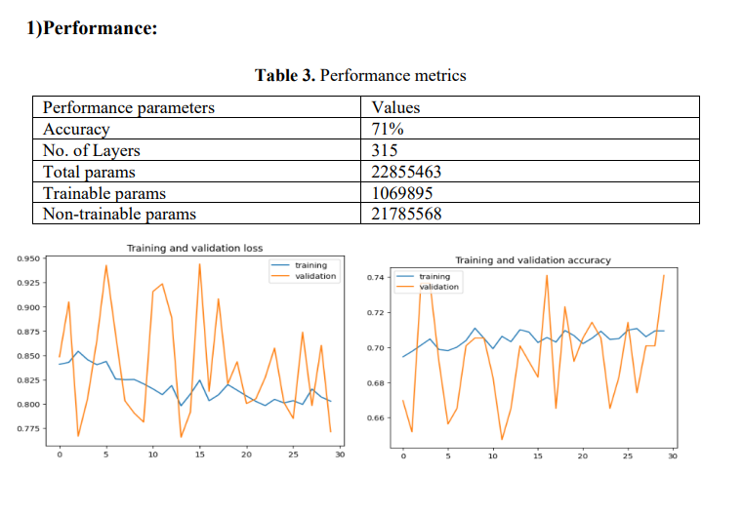
Comparative Analysis of Architectures
2
Inception v3
Advanced feature extraction with factorized convolutions, achieving 71% accuracy and 315 layers.
Inception Modules: Use multiple convolution operations with different filter sizes concurrently to capture diverse features. Inception v3 enhances this with factorized convolutions and batch normalization.
Factorized Convolutions: Split standard convolutions into depthwise and pointwise convolutions, reducing computational cost while maintaining representational capacity.
Batch Normalization: Applied after each convolution to stabilize and accelerate training by normalizing layer activations and improving gradient flow.
Auxiliary Classifiers: Intermediate classifiers included during training to improve gradient flow and prevent overfitting.

Slide 16
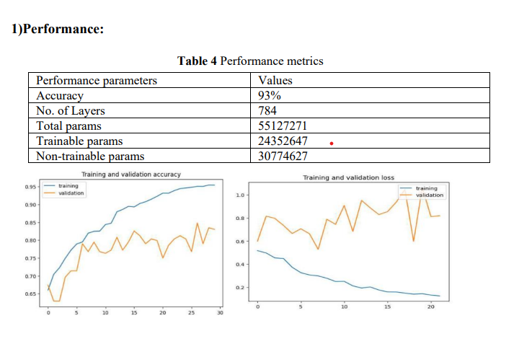
Comparative Analysis of Architectures
Inception ResNet v2
Inception Modules: Combine multiple convolution operations with different filter sizes to capture diverse features within a single layer.
Residual Connections: Use connections that bypass certain layers to simplify optimization of deep networks and address the vanishing gradient problem.
Factorized Convolutions: Split convolutions into depthwise and pointwise operations, reducing complexity while maintaining feature representation.
Batch Normalization: Normalize activations throughout the network to stabilize and speed up training, improving gradient flow and convergence.
Auxiliary Classifiers: Include intermediate classifiers during training to enhance gradient flow and prevent overfitting.
3
Combines Inception modules with residual connections, resulting in 93% accuracy and 784 layers.

Slide 17
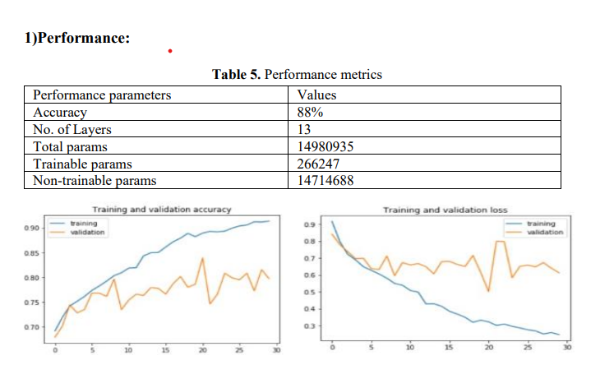
Comparative Analysis of Architectures
VGG16
VGG-16 Overview: Developed by the University of Oxford's VGG, VGG-16 is a popular CNN architecture for image classification, including skin cancer detection.
Convolutional Layers: Features 13 convolutional layers with 3x3 filters and a stride of 1, capturing detailed features from images.
Max Pooling Layers: Uses max pooling with a 2x2 window and a stride of 2 after each convolution layer to reduce spatial dimensions.
Activation Functions: Applies ReLU activation after each convolutional layer to introduce non-linearity and learn complex patterns.
Fully Connected Layers: Includes 3 dense layers following the convolutional layers for high-level reasoning and classification.
Softmax Output: The final layer outputs class probabilities using the softmax function, enabling predictions about whether a lesion is cancerous or not.
4
Deep network with 13 convolutional layers, delivering 88% accuracy.

Slide 18
Key Achievements
Integrated Architectures
Highest Precision
Comprehensive Solution
Skinsense successfully integrates multiple CNN models to enhance the accuracy and robustness of skin lesion detection.
The ResNet101+Custom model achieves the highest precision among the tested architectures.
Skinsense provides not only diagnostic capabilities but also educational and interactive features for users.

Slide 19




Future Enhancements
Explore New Models
Investigate additional deep learning models and techniques to further improve the system's performance.
Expand Dataset
Acquire a more diverse and extensive dataset of skin lesion images to enhance the model's generalization.
Improve Interactivity
Enhance the user interface and educational components to provide a more engaging and informative experience.

