Slide 1


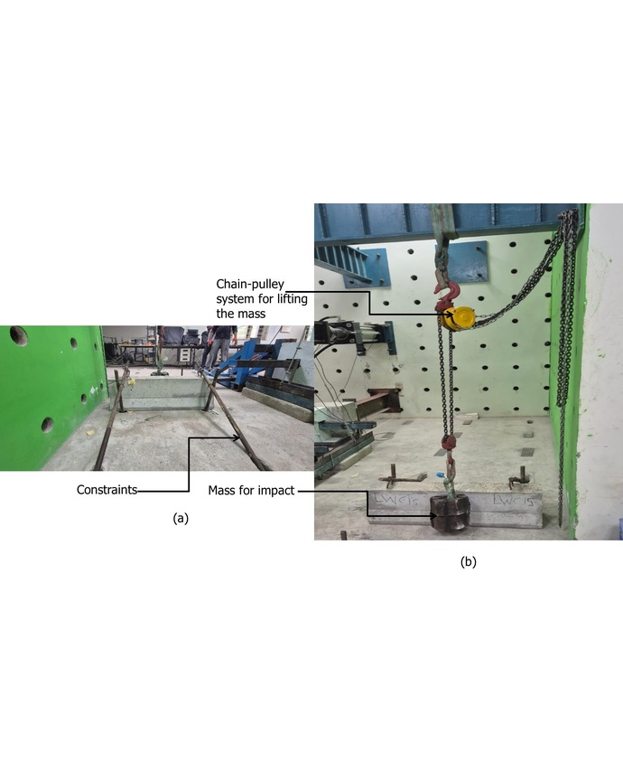
IIT BHUBANESWAR • SCHOOL OF INFRASTRUCTURE
PRE-FILING IPR COMMITTEE PRESENTATION
Novel concrete composition for impact-energy-dissipating crash barriers
Steel-fibre-reinforced sintered-fly-ash lightweight aggregate concrete
Haruna Al-Amir Saleh • Pratik Kanungo • Anush K. Chandrappa • Dinakar Pasla
AI-generated concept visualization: containment • internal dissipation • controlled damage
School of Infrastructure, Indian Institute of Technology Bhubaneswar Odisha, India • 14 August 2026
Design hypothesis Porous aggregate crushing + hooked-fibre pull-out → higher impact-energy dissipation
Status: not yet filed | Purpose: IPR approval to proceed with patent filing
CONFIDENTIAL • PRE-FILING IITBBS IPR COMMITTEE EVALUATION • NOT YET FILED
01

Slide 2
BACKGROUND
Background: crash barriers and material rationale
CRASH-BARRIER TAXONOMY AND USE
COMMERCIAL RIGID BARRIER VS PROPOSED MATERIAL
MATERIAL EDGE AND LOW-CARBON CONTEXT
Flexible / cable
Attribute | Conventional RC | Proposed LWC15
Reported density | ≈2,400–2,466 kg/m³ | 1,987 kg/m³
Dissipation mode | Vehicle deformation + brittle cracking | SFA crushing + fibre pull-out
Fragmentation | Large local fragments possible | Finer/dispersed debris observed*
Strength | M40 class | 55.4 MPa at 28 d
Validation | Mature/full-scale systems | Laboratory + one-third-scale proof
SFA versus crushed stone (experimental inputs)
Large deflection; open medians; energy absorbed by system movement
Specific gravity
SFA
1.43
Stone
2.73
Semi-rigid / W-beam
Water absorption
Moderate deflection; roadside and median protection; repair after impact
SFA
18.00%
Stone
1.38%
Rigid / concrete
Edge: lower mass and internal damping. Trade-off: high absorption and lower aggregate toughness require moisture/workability control.
Near-zero working width; bridges, medians and high-containment locations
Geopolymer efficiency context—not the present binder
OPC
100
GPC
91
Primary function: contain, redirect and shield vehicles from opposing traffic, edges and fixed hazards.
*Qualitative; full-scale containment, ASI/THIV and debris velocity remain untested.
Relative CO₂-e index from Turner & Collins: 9% lower for GPC. Published outcomes are system-dependent. Present patent mix is OPC–GGBS, not geopolymer; product LCA is pending.
Source: Zain & Mohammed (2015); Turner & Collins (2013), doi:10.1016/j.conbuildmat.2013.01.023; Habert et al. (2011), doi:10.1016/j.jclepro.2011.03.012; ACI 213R / ASTM C567.
CONFIDENTIAL • PRE-FILING IITBBS IPR COMMITTEE EVALUATION • NOT YET FILED
02
Notes:
BACKGROUND — speaking points
• Crash barriers are flexible, semi-rigid or rigid according to their working width and energy-management mechanism. Cable systems dissipate energy through large movement; W-beams combine deformation and redirection; concrete barriers are selected where working width is restricted and durable containment is needed.
• Commercial concrete barriers are strong and low-maintenance, but their high stiffness means that collision energy is largely managed by vehicle deformation and local concrete fracture. The proposed material adds internal dissipation through porous aggregate crushing and fibre pull-out while retaining M40-plus strength.
• SFA has approximately half the specific gravity of crushed stone, which supports lower self-weight. Its 18% absorption and higher aggregate-impact value are not pure advantages: they demand moisture conditioning, workability control and quality assurance.
• Geopolymer concrete is shown only as wider low-carbon background. Turner and Collins found a 9% CO2-equivalent reduction in a comprehensive case, while other studies vary substantially. Our tested patent embodiment contains OPC and GGBS and must not be called geopolymer concrete. Its environmental claim requires a product-specific LCA.

Slide 3
GLOBAL EVIDENCE
Global context: road safety, material demand and circularity
Indicator | Global estimate | Research relevance | Primary source
Road-traffic mortality | 1.19 million y⁻¹ | Need to reduce crash severity | WHO (2023)
Sand + gravel use | ≈50 Gt y⁻¹ | Pressure on natural aggregate | UNEP (2022)
Cement production | ≈4.0 Gt (2024) | Large infrastructure material flow | USGS (2025)
Cement CO₂ intensity | just under 0.6 t/t | Binder decarbonisation pressure | IEA (2023)
Coal fly ash | >1 Gt y⁻¹ (order) | Potential circular feedstock | Reid et al. (2020)
92%
Figure 1. Global road-traffic deaths by country income group (2021)
Research relevance: the proposed barrier material links impact-energy management with reduced self-weight and industrial by-product utilisation.
Evidence boundary: no product-level LCA or full-scale vehicle crash test has yet been completed.
Source: WHO (2023), pp. 4, 14; UNEP (2022); USGS MCS—Cement (2025); IEA Cement (2023); Reid, Carpenter & Masili, IEA CCC/303 (2020).
CONFIDENTIAL • PRE-FILING IITBBS IPR COMMITTEE EVALUATION • NOT YET FILED
03
Notes:
• The global road-safety burden is about 1.19 million deaths annually. WHO estimates that 92% occur in low- and middle-income countries. The pie chart is based on a global dataset: 35% upper-middle, 44% lower-middle, 13% low-income, and 8% high-income countries.
• At the same time, construction operates at planetary material scale: UNEP estimates 50 billion tonnes of sand and gravel are used each year; USGS estimates about 4.0 billion tonnes of cement were produced in 2024, while IEA reports direct cement-emissions intensity just under 0.6 tonnes of CO₂ per tonne.
• Coal combustion also generates more than one billion tonnes of fly ash annually by order of magnitude. Availability and specification vary regionally, so this figure supports the resource opportunity—not a guaranteed feedstock claim.
• The invention sits at the intersection of three needs: safer roadside infrastructure, lower self-weight and virgin-aggregate demand, and productive use of industrial by-products.
• Be explicit about the environmental boundary. The mix uses GGBS and sintered fly ash aggregate, but sintering consumes energy and the high steel-fibre dosage has embodied impacts. A comparative, region-specific LCA is required before claiming a net carbon reduction.
• Transition: global need alone does not establish novelty. The next slide maps the prior-art trade space.

Slide 4
RESEARCH GAP
Literature and prior-art synthesis
Approach | Containment / strength | Energy dissipation | Damage control | Scale / cost | Residual gap
Rigid NWC barrier | High | Low–moderate | Brittle / debris risk | Mature | Harsh impact pulse
Steel / cable | System-dependent | High via deflection | Repair after impact | Corrosion / clear zone | Space + maintenance
Rubberised + fibre | Strength trade-off | Improved | Improved | Processing complexity | Durability / scale
UHPC / ECC | Very high | Mix-dependent | Good crack control | High material cost | Stiffness / economics
Lightweight barrier concepts | Demonstrated in prior art | Potential | Design-specific | Limited adoption | No SFA–fibre proof set
This invention | M40+ in tested mixes | High in repeated impact | Controlled cracking observed | Precast-compatible | Full-scale proof pending
Avoid a broad “first lightweight concrete barrier” assertion: Lightweight concrete barrier concepts appear in conference literature. Centre novelty on the specific integrated composition, SFA function, hooked-fibre crack control, quantified synergy and manufacturing/control envelope.
PATENT POSITIONING
Source: Zain & Mohammed (2015); Raj et al. (2020), ASCE J. Mater. Civ. Eng.; Shen et al. (2014), Constr. Build. Mater.; Bonin et al. (2004), II Int’l Congress SIIV proceedings; Grzebieta et al. (2005), 19th ESV Conference proceedings; Xue et al. (2025).
CONFIDENTIAL • PRE-FILING IITBBS IPR COMMITTEE EVALUATION • NOT YET FILED
04
Notes:
• Conventional rigid concrete barriers are mature and effective for containment, but their low deflection can create a severe vehicle pulse, and brittle damage can generate debris under severe impact.
• Flexible and semi-rigid systems dissipate energy through global deflection, but require working width and post-impact repair. Rubberised, UHPC and ECC concepts each solve part of the problem, while introducing strength, cost, stiffness or processing trade-offs.
• A critical patentability point: prior conference literature includes lightweight concrete road-safety barrier concepts—for example Bonin and co-authors at the 2004 SIIV congress. Therefore, do not rely on a sweeping “first lightweight barrier” proposition.
• The narrower and more defensible thesis is the integrated OPC/GGBS/SFA/hooked-end-fibre composition, its use as the load-bearing crash-barrier material, and the observed synergy: structural strength, lower reported density, major post-cracking impact resistance and controlled fragmentation.
• The literature and patent searches documented by the inventors are preliminary. A professional claim-by-claim patentability and freedom-to-operate search is still required, including composition ranges, SFA manufacture/specification, fibre geometry and barrier-system claims.

Slide 5
TECHNICAL CONCEPT
Mechanistic hypothesis and invention architecture
Material feature | Micromechanical process | Expected engineering consequence
Sintered fly-ash lightweight aggregate | Local particle crushing; pore collapse; internal damping | Reduced density and distributed impact-energy dissipation
Hooked-end steel fibre | Crack bridging; debonding; frictional pull-out | Higher split tension, residual toughness and fragment restraint
OPC–20% GGBS matrix | Matrix load transfer and interfacial bonding | M40+ compressive strength and stable fibre anchorage
PROPOSED ENERGY PARTITION
Eᵢₘₚ = Eₘₐₜᵣᵢₓ + Ecrush + Edebond/pull-out + Efracture + Eresidual
System-level hypothesis More absorbed energy + controlled deformation → lower force-transmission potential
Inventive thesis: the specific material combination creates a semi-energy-absorbing rigid barrier while retaining structural-grade strength.
Lower transmitted force is a mechanistic hypothesis; vehicle-level force, ASI and THIV remain unmeasured.
Source: Wang & Wang (2013), doi:10.1016/j.conbuildmat.2012.09.016; Nadesan & Dinakar (2017), doi:10.1016/j.cscm.2017.09.005; Sahoo et al. (2020), doi:10.1016/j.cemconcomp.2020.103712.
CONFIDENTIAL • PRE-FILING IITBBS IPR COMMITTEE EVALUATION • NOT YET FILED
05
Notes:
• The concept intentionally combines three functions. First, the porous SFA can crush locally and contribute internal damping. Second, hooked-end steel fibres bridge cracks and dissipate energy through progressive debonding, friction and pull-out. Third, the cement–GGBS matrix provides the structural-grade load path and transfers stress into the aggregate and fibres.
• The expected sequence is crack initiation, distributed bridging and controlled deformation, followed by progressive internal energy dissipation and improved residual integrity.
• This mechanism is consistent with published composite-material literature, but the invention’s value proposition is the protected integration and crash-barrier application supported by the experimental results.
• Phrase the final outcome carefully. The experiments demonstrate increased specimen deformation and cumulative absorbed energy. They do not directly demonstrate a lower peak vehicle force, reduced ASI or reduced occupant injury. Those remain mechanistically plausible validation targets.
• For claim drafting, consider separate families covering composition ranges, mixing/conditioning controls, a barrier article made from the composition, and functionally linked performance features where legally supportable.

Slide 6
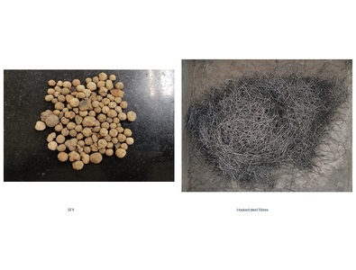
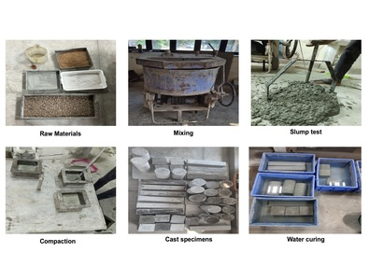
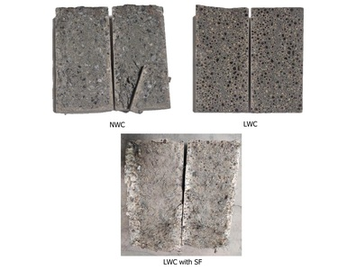
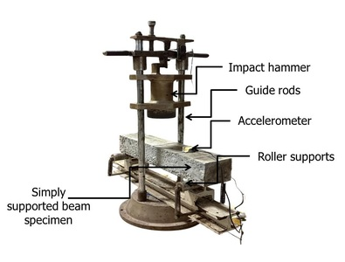
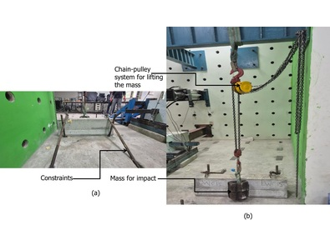
METHODS OVERVIEW
Experimental programme and evidence hierarchy
Five linked experimental stages establish composition, response and application-scale proof.
1 MATERIALS
2 MIX DESIGN
3 STATIC TESTS
4 PRISM IMPACT
5 BARRIER MODEL
OPC, GGBS, SFA and hooked fibres
NWC + LWC00/05/10/15
Slump, density, compression, split tension
N₁, N₂, E₁, E₂ and displacement
1:3 New Jersey pendulum impact
XRF • physical properties • absorption
ACI 211.2 / IS 10262 • five formulations
3 cubes + 3 cylinders per mix stated
Four beams reportedly cast per mix
1 NWC + 1 LWC15 barrier
Evidence hierarchy: material/static tests → repeated-impact screening → preliminary barrier-scale validation.
CONFIDENTIAL • PRE-FILING IITBBS IPR COMMITTEE EVALUATION • NOT YET FILED
06
Notes:
• The evidence was built in five layers: constituent characterization, mixture screening, static mechanical tests, repeated drop-weight impact testing and a one-third-scale barrier comparison.
• Four lightweight mixtures were evaluated with fibre volume increasing from zero to 1.5%, alongside an M40 normal-weight reference.
• Static tests provide the strength and density boundary. The repeated impact test provides the key post-cracking energy evidence. Acceleration signals were processed to derive displacement. The selected highest-performing mixture was then used in a New Jersey barrier model and compared with NWC.
• This is a coherent reduction-to-practice chain and is valuable for enablement. However, the uncertainty reporting is incomplete. The article states that three cubes, three cylinders and four beams were cast per mix, but the impact result tables do not provide N1/N2 dispersion. Only one NWC and one selected lightweight barrier were cast.
• The deck therefore uses measured ratios as experimental observations—not as statistically generalized performance guarantees.

Slide 7
MIXTURE DESIGN
Experimental mixture matrix and selected embodiment
Mix | OPC | GGBS | Water | Fine agg. | Nat. coarse | SFA | Steel fibre | PCE
NWC | 338.8 | 87.4 | 173.6 | 795.6 | 948.8 | — | — | 1.9
LWC00 | 422.4 | 105.6 | 195.2 | 466.5 | — | 596.3 | — | 2.8
LWC05 | 422.4 | 105.6 | 195.2 | 466.5 | — | 596.3 | 39.2 | 2.8
LWC10 | 422.4 | 105.6 | 195.2 | 466.5 | — | 596.3 | 78.5 | 2.8
LWC15 | 422.4 | 105.6 | 195.2 | 466.5 | — | 596.3 | 117.8 | 2.8
SELECTED EMBODIMENT • LWC15
• 1.5% fibre by concrete volume • 20% GGBS replacement of total binder • 100% SFA substitution for natural coarse aggregate • Hooked fibre: 30 mm × 0.5 mm; aspect ratio 60 • Reported density: 1,987 kg/m³ • 28 d compressive strength: 55.4 MPa
All constituent quantities in kg/m³. Extra-water quantity intentionally omitted pending method correction.
MIX USED FOR BARRIER MODEL
CONFIDENTIAL • PRE-FILING IITBBS IPR COMMITTEE EVALUATION • NOT YET FILED
07
Notes:
• The experimental programme isolates the effect of the lightweight aggregate and the progressive addition of crack-bridging reinforcement.
• NWC is the structural reference. LWC00 establishes what the porous lightweight aggregate does without fibre. LWC05, LWC10 and LWC15 then trace the fibre-content response.
• LWC15 was selected for the barrier comparison because it maximized repeated-impact endurance and cost per unit of absorbed impact energy while maintaining strength above the M40 requirement.
• The source document contains an unresolved method inconsistency: one passage states that compensation water was added, another says it was not added directly, and the final table lists an extra-water quantity. At the user’s direction, this deck omits that quantity rather than silently choosing one version.
• The source also alternates between “wet” and “dry” density. Accordingly, the deck uses the neutral term “reported density.” Confirm the measurement basis before patent examples, specifications or publications are finalized.

Slide 8
MATERIAL RESULTS
Reported density and 28-day mechanical performance
Reported density
28-day compressive strength
28-day splitting tensile strength
LWC15 density −19.4%
LWC10 max = 56.8 MPa
LWC15 tension +76%
Workability: slump decreased from 165 to 87 mm; fibre dispersion and compaction are scale-up controls.
Reference lines — Density: 1,920 ACI 213R equilibrium limit; 2,000 project target; 2,400 typical NWC (ASTM C567 basis unresolved). Compression: 40 MPa IRC:119 M40; 48.25 MPa IRC:44 target. Tensile: NWC baseline only.
CONFIDENTIAL • PRE-FILING IITBBS IPR COMMITTEE EVALUATION • NOT YET FILED
08
Notes:
• The material clears the first gate: all mixtures are reported above the M40 target used for rigid crash barriers in the source.
• The selected LWC15 mixture has a reported density of 1,987 kg per cubic metre versus 2,466 for NWC—a 19.4% reduction. Because the manuscript alternates between wet and dry density, describe this as the reported value until the test basis is confirmed.
• Compressive strength is not the main source of the impact benefit, but it is preserved. LWC10 has the maximum measured value at 56.8 MPa; LWC15 remains at 55.4 MPa, 11.7% above NWC.
• The more important shift is tensile: LWC15 reaches 7.60 MPa versus 4.32 MPa for NWC, a 75.9% increase. This supports crack bridging and post-cracking integrity.
• The manufacturing trade-off is workability. Slump decreases to 87 mm at the highest fibre content. Mixing energy, fibre addition rate, moisture condition and compaction therefore belong in the process know-how and quality-control package.

Slide 9
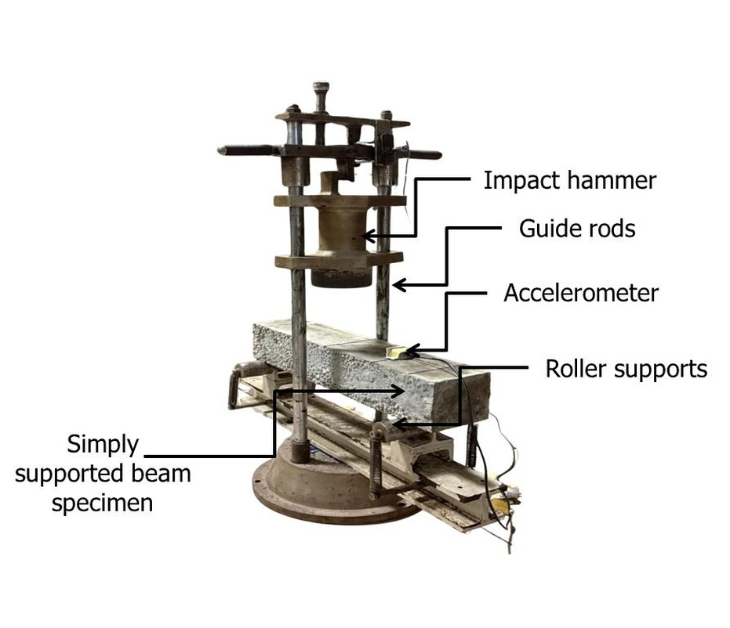
IMPACT METHODOLOGY
Repeated-impact test and signal-processing method
Parameter | Specified value
Beam geometry | 100 × 100 × 500 mm
Support span | 400 mm
Drop mass, m | 13.5 kg
Drop height, h | 100 mm
Energy per blow, mgh | 13.24 J
Recorded endpoints | N₁ first crack; N₂ failure
E₁ = N₁mgh | E₂ = N₂mgh | ΔNpost = N₂ − N₁
SIGNAL PROCESSING
4th-order zero-phase HP filter, 3 Hz
Figure 4. Repeated drop-weight impact apparatus for prismatic beams
detrend
∫a dt → v
drift correction
∫v dt → x
Source: ACI 544.2R-89, Measurement of Properties of Fiber Reinforced Concrete.
CONFIDENTIAL • PRE-FILING IITBBS IPR COMMITTEE EVALUATION • NOT YET FILED
09
Notes:
• The prism test uses a 13.5-kilogram hammer dropped 100 millimetres onto a simply supported 100-by-100-by-500-millimetre beam. Each impact supplies approximately 13.24 joules.
• N1 is the number of blows to the first visible crack; N2 is the number to complete failure. Multiplying the counts by mgh gives first-crack and failure energy.
• This test is especially useful for the invention because the differentiating mechanism is expected after cracking. The gap N2 minus N1 is a direct, if simplified, indicator of residual post-cracking endurance.
• An accelerometer recorded the first-impact response. The manuscript describes linear detrending, a fourth-order zero-phase Butterworth high-pass filter at 3 hertz, trapezoidal integration, drift correction and a second integration to derive displacement.
• This is technically stronger than relying only on compressive strength. However, repeated low-velocity drop-weight tests are screening tests—not a substitute for a full-scale oblique vehicle–barrier crash under MASH, EN 1317 or the applicable IRC protocol.

Slide 10
PRISM IMPACT RESULTS
Effect of steel-fibre dosage on repeated-impact endurance
Failure energy, E₂ (N·m)
Impact counts
55.3× vs NWC
110.5× vs plain LWC
N₂ = 221 blows
186 post-crack blows
ACI 544 defines the test method; it gives no N₁/N₂/E₂ acceptance threshold.
Error bars: mean ± 1 sample SD; n = 3
CONFIDENTIAL • PRE-FILING IITBBS IPR COMMITTEE EVALUATION • NOT YET FILED
10
Notes:
• Plain lightweight concrete is more brittle than NWC in this test: LWC00 fails after two blows and absorbs 26.49 newton-metres.
• Progressive crack-bridging reinforcement changes the response nonlinearly. The three reinforced variants reach 264.9, 596.0 and 2,927.8 newton-metres at failure, respectively.
• Relative to NWC, LWC15 absorbs 55.3 times the cumulative failure energy. Relative to the plain lightweight control, the factor is 110.5. These very large ratios are driven by post-cracking endurance rather than a comparable increase in compressive strength.
• LWC15 cracks after 35 blows but does not fail until 221 blows, leaving 186 blows in the post-cracking phase. This directly supports the crack-bridging and fibre pull-out mechanism.
• Use the magnitude as strong experimental evidence, but avoid implying a universal material factor. The table does not report dispersion for N1 and N2, and drop-weight impact counts often show high variability. Repeat testing with raw specimen-level data and a suitable statistical model should be a next-step validation task.

Slide 11
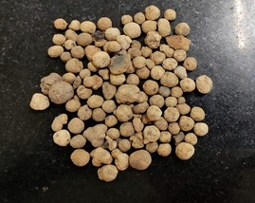
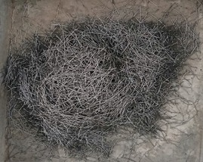
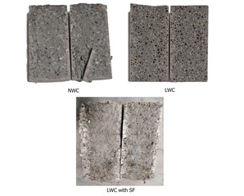
DYNAMIC RESPONSE
First-impact displacement and inferred dissipation mechanisms
Peak displacement after first impact
Porous SFA
Hooked fibres
Controlled crack path
Mechanism | Physical interpretation
Aggregate / porous-phase crushing | Local deformation and energy dissipation
Crack bridging | Stress transfer across opening cracks
Debonding and pull-out | Frictional work extends failure process
Fragment restraint | Improved residual integrity and smaller debris
NWC baseline
LWC10 has the highest first-impact displacement (0.85 mm); LWC15 is slightly stiffer (0.71 mm) yet vastly more durable under repeated impact.
Source: Mechanism context: Wang & Wang (2013); Gao et al. (1997), doi:10.1016/S0958-9465(97)00023-1; Sahoo et al. (2020).
CONFIDENTIAL • PRE-FILING IITBBS IPR COMMITTEE EVALUATION • NOT YET FILED
11
Notes:
• Peak displacement after the first impact rises sharply with reinforcement. The intermediate high-reinforcement variant reaches 0.85 millimetres and the selected variant reaches 0.71, compared with 0.28 for NWC and only 0.08 for plain LWC.
• The lower displacement of plain LWC should not be interpreted as superior stiffness. In the context of its immediate failure, it indicates a brittle, low-deformation response.
• The selected variant is slightly less deformable than the preceding variant on the first impact, plausibly because the denser reinforcement network increases stiffness. Yet it has vastly greater repeated-impact endurance. First-impact displacement and cumulative post-cracking toughness are different response dimensions.
• The material mechanism is a coupled sequence: SFA crushing, fibre bridging, debonding and frictional pull-out, followed by restraint of large fragments.
• The source supplies standard deviations for displacement; a future analysis should present full time histories, filtering sensitivity, uncertainty bands and independent displacement verification, because double integration of acceleration is sensitive to drift and cutoff selection.

Slide 12
TECHNO-ECONOMICS
Material cost and laboratory impact-energy efficiency
Material cost
Laboratory cost / impact energy
NWC baseline
Metric | NWC | LWC15 | Comparison
Material cost | ₹4,945/m³ | ₹16,192/m³ | 3.27× higher
Cost / prism E₂ | ₹93.36/(N·m) | ₹5.53/(N·m) | 16.9× lower unit cost
CONFIDENTIAL • PRE-FILING IITBBS IPR COMMITTEE EVALUATION • NOT YET FILED
12
Notes:
• The selected lightweight variant is not the cheapest concrete. Its inventor-estimated material cost is about 16,192 rupees per cubic metre, 3.27 times NWC, primarily because of the high steel-fibre dosage.
• The relevant engineering denominator is failure energy. When the reported prism impact capacity is included, LWC15 costs 5.53 rupees per newton-metre versus 93.36 for NWC—about 16.9 times better on this laboratory metric.
• This supports selection of LWC15 for the barrier test and creates a compelling value narrative: pay more per unit volume, receive substantially more post-cracking impact capacity.
• Keep the boundary explicit. This is not a full barrier cost, lifecycle cost or cost-benefit analysis. It omits reinforcement, formwork, labour, transport, curing, installation, repair frequency, downtime and uncertainty. Prices are local and time-specific.
• The commercial study should therefore compare complete installed systems and include lower transport mass, bridge-deck dead load, expected repair after impact, quality-control cost, industrial-aggregate logistics and any savings from modular precast deployment.

Slide 13
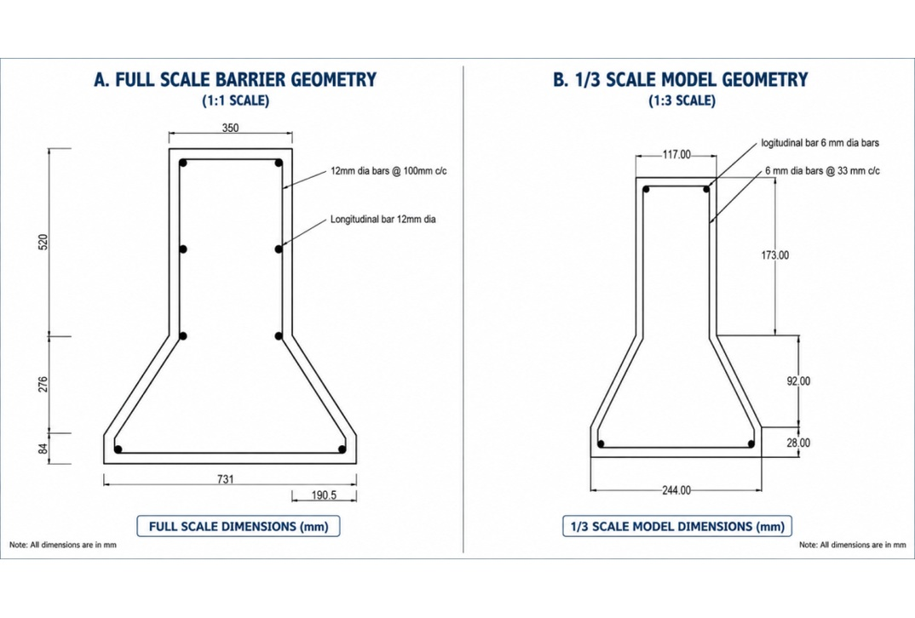
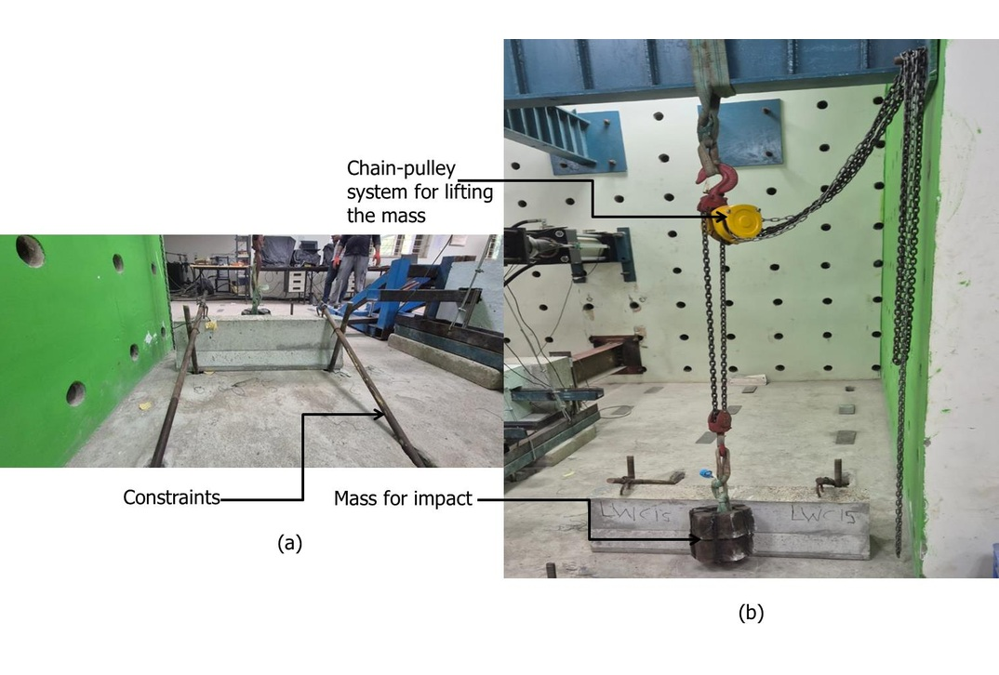
SCALED VALIDATION
One-third-scale New Jersey barrier: geometry and impact protocol
Full-scale and 1:3 Cross-section/reinforcement geometry
Pendulum rig: restrained specimen; rear-face accelerometer
Scale | Impactor mass | Vertical rise | Energy per blow | Comparison / replication
1:3 geometric model | 40 kg | 0.35 m | ≈137.3 J | 1 NWC and 1 selected LWC barrier
CONFIDENTIAL • PRE-FILING IITBBS IPR COMMITTEE EVALUATION • NOT YET FILED
13
Notes:
• To move beyond material coupons, the team fabricated one-third-scale New Jersey-profile barriers using NWC and the selected LWC15 mixture.
• The dimensions were reduced by a factor of three, and a pendulum rig applied repeated impact at mid-height. The impactor mass was 40 kilograms, the vertical rise 0.35 metres and the energy approximately 137.3 joules per blow.
• An accelerometer on the rear face captured the response for the same filtering and integration workflow used in the beam tests.
• This experiment is valuable as an application-scale proof of concept and supports reduction to practice. It also provides comparative failure patterns and cumulative impact energy.
• It is not a standards-compliant crash test. Geometric similarity alone does not guarantee similitude of strain rate, fracture, reinforcement bond, contact, mass, velocity and gravity effects. The specimen was restrained, and there was no vehicle to evaluate containment, redirection, wheel climb, rollover, occupant compartment intrusion, ASI or THIV.
• Also note the sample size: one barrier per material. Treat the result as preliminary but decision-relevant.

Slide 14
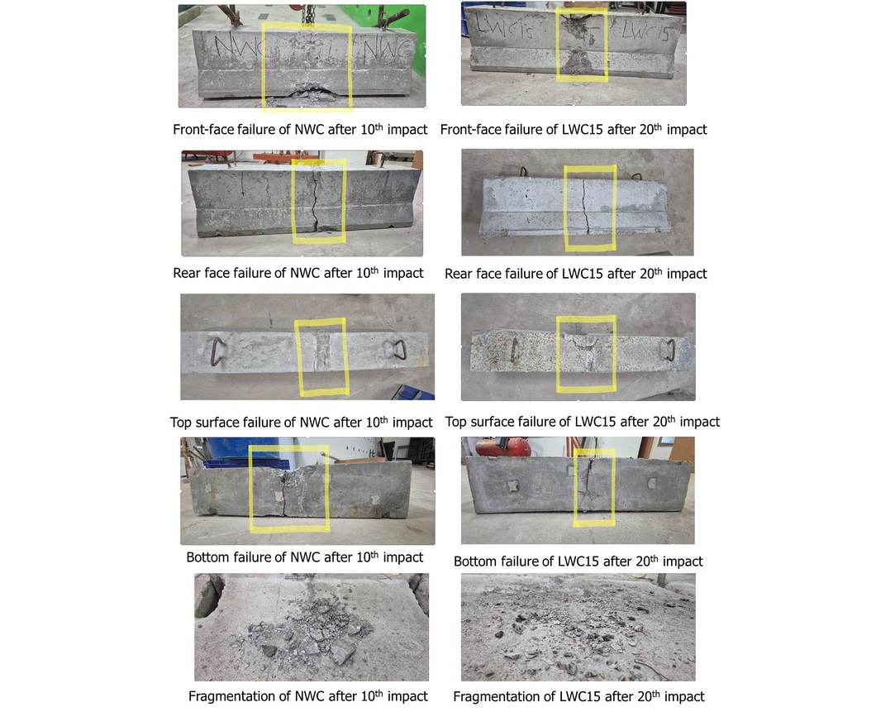
BARRIER RESULTS
Scaled-barrier impact response and failure morphology
Energy to failure
Peak deformation
NWC baseline
NWC baseline
Response | NWC | LWC15 | Observed ratio
Blows to failure, N₂ | 10 | 20 | 2.00×
Failure energy, E₂ | 1,373 N·m | 2,746 N·m | 2.0×
Peak deformation | 4.22 mm | 12.70 mm | 3.01×
Fragmentation observation is qualitative: LWC15 showed finer, more dispersed debris; particle-size and mass measurements, as well as ejection-velocity measurements, are still required.
CONFIDENTIAL • PRE-FILING IITBBS IPR COMMITTEE EVALUATION • NOT YET FILED
14
Notes:
• The application-scale result points in the same direction as the prism tests. The NWC barrier failed after 10 blows and 1,373 newton-metres; LWC15 reached 20 blows and 2,746 newton-metres—exactly twice the cumulative impact energy in the reported setup.
• Peak deformation increased from 4.22 to 12.70 millimetres, a factor of approximately 3.01. Controlled deformation is consistent with the intended energy-dissipation philosophy.
• The failure photographs show a broader, more brittle crack and large localized fragments in NWC, while LWC15 exhibits a narrower crack path and finer, more distributed debris after more impacts.
• That fragmentation finding is qualitative. A stronger patent and commercialization evidence package should sieve and weigh debris, map crack width and density, measure ejection velocity, and assess residual load capacity after prescribed impacts.
• Because n equals one per mix, do not attach confidence intervals or claim a guaranteed two-times product performance. State that the single comparative barrier experiment reproduced the direction of the material-level benefit and justifies replicated/full-scale validation.

Slide 15
STUDY SYNOPSIS
Research contribution and quantitative evidence
Research question: Can structural lightweight concrete dissipate impact energy while retaining M40-class strength and post-cracking integrity?
Response | NWC reference | LWC15 | Relative effect | Evidence / scope
Reported density | 2,466 kg/m³ | 1,987 kg/m³ | −19.4% | Measured; basis to verify
28 d compression | 49.62 MPa | 55.40 MPa | +11.6% | 3 cubes per mix stated
28 d split tension | 4.32 MPa | 7.60 MPa | +75.9% | 3 cylinders per mix stated
Prism failure energy, E₂ | 52.97 N·m | 2,927.81 N·m | 55.3× | Repeated-impact screen
Scaled-barrier E₂ | 1,373 N·m | 2,746 N·m | 2.0× | n = 1 barrier per mix
Scaled-barrier deformation | 4.22 mm | 12.70 mm | 3.01× | n = 1 barrier per mix
Interpretation: Strongest contribution is post-cracking impact endurance, not simply compressive strength.
Boundary: occupant-risk reduction and standards compliance require full-scale vehicle testing.
CONFIDENTIAL • PRE-FILING IITBBS IPR COMMITTEE EVALUATION • NOT YET FILED
15
Notes:
• Lead with the evidence: relative to normal-weight concrete, the selected lightweight mixture has 19.4% lower reported density and 75.9% higher splitting tensile strength. In the repeated drop-weight prism test, it absorbed 55.3 times the failure energy of NWC.
• At the barrier scale, the one-third model absorbed twice the cumulative pendulum energy before failure and deformed approximately three times as much as the NWC model. That is the most application-relevant result, but it is preliminary because only one barrier per mix was tested.
• The patent thesis should not be “steel fibre is useful” or “lightweight aggregate is useful”; both are known. The potentially protectable value is the integrated composition, the use of SFA and hooked-end fibres in a crash-barrier system, the dual energy-dissipation mechanism, and the demonstrated performance combination.
• Commercially, the material can be used with conventional concrete/precast infrastructure. The cost per unit of laboratory impact energy is favourable, but no lifecycle cost analysis or environmental life-cycle assessment has yet been performed.
• Do not state that occupant injury has been reduced. Say that the measured deformation and energy absorption support a hypothesis of lower force transmission that must be tested at full scale.

Slide 16
IPR TECHNICAL ASSESSMENT
Evidence-to-claim support matrix
Evidence | Observed LWC15 result | Supports | Confidence
Reported density | 1,987 kg/m³; −19.4% vs NWC | Lightweight article / transport value | Medium*
Compressive strength | 55.4 MPa; M40+ | Structural-use enablement | High
Split tensile | 7.60 MPa; +76% | Fibre-bridging function | High
Prism failure energy | 2,927.8 N·m; 55.3× NWC | Unexpected technical effect | Medium
Scaled barrier | 2,746 N·m; 2.0× NWC | Barrier-use embodiment | Preliminary
Fragmentation | Finer / distributed debris observed | Controlled-damage function | Preliminary
Claim family | Technical basis in current record
Composition | OPC/GGBS/SFA/hooked-fibre ranges and tested embodiments
Manufacturing process | Moisture conditioning, mixing sequence, dispersion and QC
Barrier article | New Jersey profile + reinforcement + invented concrete
Performance linked | Density, strength, impact endurance and damage-control envelope
System/use | Precast transport-safety and protective-infrastructure applications
CONFIDENTIAL • PRE-FILING IITBBS IPR COMMITTEE EVALUATION • NOT YET FILED
16
Notes:
• This slide separates what is measured from what it may support in a patent application.
• Strength and splitting tensile data provide the strongest conventional evidence. The repeated-impact result may support an unexpected technical effect, but its uncertainty and test adaptation should be disclosed accurately.
• The barrier-scale result supports an article-of-manufacture embodiment and utility, while remaining preliminary due to n equals one and the absence of a standards-compliant vehicle test.
• A layered filing strategy can include: composition ranges; a process claim around moisture conditioning, mixing sequence, fibre dispersion and quality control; a barrier article made from the material; and carefully drafted functional/performance limitations where enabled.
• Avoid relying only on a narrow point recipe; include supported ranges and fallback positions around binder fraction, SFA substitution, fibre geometry/dosage and performance windows. Do not invent ranges not supported by the notebooks and experiments.
• Before filing, reconcile the water protocol and density terminology, preserve raw data and notebooks, and complete a professional patentability/FTO search. This slide is a technical aid and not legal advice.

Slide 17
PROPOSED CLAIM RANGE
Tested experimental claim window: LWC05–LWC15
Proposed experimental window—valid only for the three tested embodiments in this presentation; not a legal claim.
Constituent / parameter | LWC05 | LWC10 | LWC15 | Test-supported window
OPC (kg/m³) | 422.4 | 422.4 | 422.4 | 422.4 fixed
GGBS (kg/m³) | 105.6 | 105.6 | 105.6 | 105.6 fixed; 20% binder
Fine aggregate (kg/m³) | 466.46 | 466.46 | 466.46 | 466.46 fixed
SFA coarse aggregate (kg/m³) | 596.31 | 596.31 | 596.31 | 596.31; 100% coarse replacement
Hooked steel fibre (kg/m³) | 39.25 | 78.50 | 117.80 | 39.25–117.80 (0.5–1.5 vol%)
PCE (kg/m³) | 2.79 | 2.79 | 2.79 | 2.79 fixed
Performance response | LWC05 | LWC10 | LWC15 | Observed range
Reported density (kg/m³) | 1,923 | 1,951 | 1,987 | 1,923–1,987
28 d compression (MPa) | 53.7 | 56.8 | 55.4 | 53.7–56.8
Split tension (MPa) | 4.77 | 5.92 | 7.60 | 4.77–7.60
Failure energy E₂ (N·m) | 264.87 | 595.96 | 2,927.81 | 264.87–2,927.81
Cost / E₂ [₹/(N·m)] | 31.47 | 20.57 | 5.53 | 5.53–31.47
Claim boundary: no interpolation beyond the tested range; extra-water protocol and density basis must be reconciled before drafting.
CONFIDENTIAL • PRE-FILING IITBBS IPR COMMITTEE EVALUATION • NOT YET FILED
17
Notes:
PROPOSED EXPERIMENTAL CLAIM WINDOW — speaking points
• This window is derived only from LWC05, LWC10 and LWC15; NWC and unreinforced LWC00 are deliberately excluded from the proposed reinforced-product range.
• The constant matrix contains 422.4 kg/m3 OPC, 105.6 kg/m3 GGBS, 596.31 kg/m3 SFA and 466.46 kg/m3 fine aggregate. The experimentally varied parameter is hooked steel fibre from 0.5 to 1.5 percent by concrete volume.
• The three tested embodiments preserve compressive strength above M40 while producing a tunable impact-energy range from about 265 to 2,928 N-m.
• This is an evidence-support map, not final legal claim language. Counsel must determine defensible endpoints and fallback positions. Intermediate dosages were not separately tested, and the water/density records must be corrected before filing.

Slide 18
COMPARATIVE CLAIMS
Evidence-based claims relative to published approaches
Tested product tier | 28 d compression | Prism E₂ | E₂ / NWC | Cost / E₂ | Potential commercial role
LWC05 | 53.7 MPa | 264.87 N·m | 5.0× | ₹31.47/(N·m) | Moderate-impact / lower fibre input
LWC10 | 56.8 MPa | 595.96 N·m | 11.3× | ₹20.57/(N·m) | Balanced strength–impact tier
LWC15 | 55.4 MPa | 2,927.81 N·m | 55.3× | ₹5.53/(N·m) | Highest tested impact-demand tier
Published approach | Published benchmark | Specific distinction supported here | Citation
Steel-fibre rubcrete barrier | Up to 3× impact energy vs conventional concrete | Within-study prism ratios: 5.0×, 11.3× and 55.3× for LWC05/10/15 | Raj et al. (2020)
AAS no-fines safety concrete | ≈20 MPa with high absorption / fragmentability | 53.7–56.8 MPa across proposed reinforced window | Shen et al. (2014)
Steel-fibre lightweight concrete | Improved static and dynamic response | Specific SFA–GGBS–hooked-fibre barrier embodiment and 1:3 proof | Wang & Wang (2013)
Lightweight barrier elements | Application concept predates this work | Composition, dual mechanism, tested range and cost/E₂ package are narrower | Bonin et al. (2004)
Claim utility: fibre dosage provides a three-tier energy-absorption product family; cost per absorbed N·m improves as the tested impact tier increases.
Cross-study values are directional only because specimen geometry and impact protocols differ.
Source: Published comparators: Raj et al. (2020); Shen et al. (2014); Wang & Wang (2013); Bonin et al. (2004). Full details and DOIs are listed in the references.
CONFIDENTIAL • PRE-FILING IITBBS IPR COMMITTEE EVALUATION • NOT YET FILED
18
Notes:
COMPARATIVE CLAIMS — speaking points
• The primary claim supported by our own data is a tunable reinforced lightweight-concrete product family. LWC05, LWC10 and LWC15 all retain M40-plus strength, but span progressively higher repeated-impact energy and lower cost per absorbed N-m.
• LWC05 is the moderate-impact option, LWC10 provides the highest compressive strength and a balanced impact tier, and LWC15 is the highest tested energy-absorption option.
• Published rubcrete work reported up to three times conventional impact energy. Our within-study prism ratios are larger, but no direct cross-paper superiority claim should be made because test configurations differ.
• Shen's safety concrete achieved energy absorption at around 20 MPa. Our specific distinction is structural-grade strength together with impact endurance, a defined composition window and scaled-barrier validation.
• The cost-to-impact metric converts the materials premium into engineering utility: LWC15 costs more per cubic metre, yet has the lowest tested cost per unit of absorbed prism energy.

Slide 19
FUTURE WORK
Research gaps and staged validation plan
Stage | Research / IP question | Method | Decision criterion | Indicative timing
1. Protect | Is the integrated platform novel and enabled? | Professional patent search; reconcile records; file | IPR approval and filing | Now
2. Reproduce | Are effect sizes repeatable? | Specimen-level repeats; ≥3 barriers/mix; debris quantification | Uncertainty and effect-size bounds | 0–6 months
3. Mechanism + durability | Does performance persist under ageing and repeated impact? | FE calibration; fatigue; chloride; corrosion; fire/weather | Validated model + durability envelope | 6–12 months
4. Vehicle-scale safety | Does the system contain and redirect vehicles safely? | Full-scale IRC / EN 1317 / MASH-aligned tests; ASI/THIV | Containment, redirection and occupant-risk compliance | 12–24 months
5. Translation | Is the system manufacturable and beneficial at installed scale? | Precast QA; field pilot; comparative LCA and TEA | Pilot readiness and licensing package | 24–36 months
Critical uncertainties: full-scale vehicle response • fibre workability/balling • SFA moisture/variability • corrosion • installed cost • disclosure timing
Source: Standards context: IRC:119-2015; EN 1317; AASHTO MASH. Timing is an author-proposed validation sequence.
CONFIDENTIAL • PRE-FILING IITBBS IPR COMMITTEE EVALUATION • NOT YET FILED
19
Notes:
• The immediate action is protection: reconcile the technical record, complete professional searching and file before any publication, conference presentation, industry pitch or external distribution.
• In the first six months, repeat the key tests with specimen-level data, quantify uncertainty, resolve the method and density conflicts, replicate barrier specimens and turn fragmentation into a measured particle-size, mass and velocity dataset.
• In parallel, calibrate an LS-DYNA or ABAQUS vehicle–barrier model against the experiments, and add durability, corrosion, environmental exposure, repeated-impact and repairability studies.
• The decisive commercialization gate is a full-scale vehicle crash conducted to the required jurisdictional standard. It must evaluate containment, redirection, stability, debris, occupant compartment performance and occupant-risk measures such as ASI or THIV where applicable.
• A pilot then needs precast quality controls, fibre-dispersion inspection, SFA moisture/specification limits, a full installed-system cost model and comparative LCA.
• Candidate partners listed by the inventors include CRRI, MoRTH/NHAI, state PWDs, precast manufacturers, barrier suppliers and major infrastructure contractors.

Slide 20
CONCLUSIONS
Conclusions and request to the IPR committee
No. | Conclusion from current evidence | Quantitative basis
1 | The selected lightweight mixture clears the structural-strength gate. | 55.4 MPa; reported density −19.4% vs NWC
2 | Crack-bridging reinforcement primarily improves tensile and post-cracking response. | Split tension +76%; prism E₂ 55.3× NWC
3 | The one-third-scale barrier reproduces the direction of benefit. | E₂ 2.0×; deformation 3.01×; n = 1/mix
4 | Occupant-safety and certification claims remain outside the present evidence. | No vehicle containment, redirection, ASI or THIV test
IPR decision requested | Purpose
Approve patent filing | Authorize professional search, drafting and filing
Maintain confidentiality | Coordinate manuscript/public release after filing
Endorse staged validation | Replicates, debris metrics, FE and full-scale crash
Enable controlled transfer | Engage CRRI/NHAI/precast partners under IP controls
Recommendation: approve protection of the integrated material–mechanism–barrier platform; retain full-scale occupant-risk validation as the commercial release gate.
Technical assessment only: patentability, legal claim scope and safety certification require specialist review.
CONFIDENTIAL • PRE-FILING IITBBS IPR COMMITTEE EVALUATION • NOT YET FILED
20
Notes:
• The recommendation to the IIT Bhubaneswar IPR section is to approve proceeding with a focused patent filing. The team has reduced the concept to practice and demonstrated a distinctive combination of lower reported density, retained structural strength, major repeated-impact endurance and a positive one-third-scale barrier result.
• The evidence does not yet support a certified occupant-safety claim. The commercial release gate must be a full-scale standards-compliant vehicle test with occupant-risk, containment, redirection, stability and debris criteria.
• Four IPR decisions are requested: approve professional prior-art searching, drafting and filing; maintain confidentiality and coordinate manuscript release; endorse a staged validation programme; and enable controlled engagement with crash-test and precast partners.
• The claim strategy should protect the integrated platform rather than a single recipe: material composition and ranges, process controls, a barrier article, and the use/performance relationship where legally enabled.
• Final line: approve protection now, validate the occupant benefit next, and commercialize only after the full-scale safety gate is passed.
IPR DECISION TABLE — DETAILED REASONING
1. APPROVE PATENT FILING
Requirement: authorize a professional patentability/FTO search, claim drafting and filing before further disclosure.
Reason: the present record contains a specific composition, three reinforced embodiments, an unexpected repeated-impact response and a barrier-scale reduction to practice. Approval does not certify commercial safety; it preserves the opportunity to protect the integrated composition–process–barrier concept.
2. MAINTAIN CONFIDENTIALITY
Requirement: coordinate the submitted manuscript, presentations, industry discussions and data sharing with the IPR section until filing.
Reason: no patent has yet been filed. Public enabling disclosure may prejudice novelty in some jurisdictions. Exact formulations, process controls and claim ranges should therefore be shared externally only under IPR-approved conditions.
3. ENDORSE STAGED VALIDATION
Requirement: support replicated barrier tests, specimen-level uncertainty analysis, quantitative debris assessment, calibrated FE modelling and a standards-compliant full-scale crash programme.
Reason: material-level results are strong, but the barrier comparison uses one specimen per mix and does not measure vehicle containment, redirection, ASI or THIV. These tests are needed for certification and commercialization, not necessarily to establish initial patent utility.
4. ENABLE CONTROLLED TECHNOLOGY TRANSFER
Requirement: permit engagement with CRRI/NHAI, accredited crash-test facilities, precast producers and barrier manufacturers after filing or under appropriate confidentiality controls.
Reason: external partners provide facilities, manufacturing QA and field-validation capability unavailable at laboratory scale. Controlled engagement converts protected know-how into a certifiable product without premature disclosure.

Slide 21
REFERENCES
References: standards, datasets and sustainability
1. World Health Organization. (2023). Global Status Report on Road Safety 2023. https://www.who.int/publications/i/item/9789240086517
2. UNEP. (2022). Sand and Sustainability: 10 Strategic Recommendations to Avert a Crisis. https://wedocs.unep.org/20.500.11822/38362
3. U.S. Geological Survey. (2025). Mineral Commodity Summaries 2025—Cement. https://pubs.usgs.gov/periodicals/mcs2025/mcs2025-cement.pdf
4. International Energy Agency. (2023). Cement—Tracking Clean Energy Progress. https://www.iea.org/energy-system/industry/cement
5. Reid, I., Carpenter, A.M., & Masili, A. (2020). Beneficial Uses of Coal Fly Ash. IEA CCC/303. ISBN 978-92-9029-626-3.
6. IRC:119-2015. Guidelines for Traffic Safety Barriers. Indian Roads Congress, New Delhi.
7. IRC:6-2016. Standard Specifications and Code of Practice for Road Bridges. Indian Roads Congress.
8. IRC:44-2017. Guidelines for Cement Concrete Mix Design for Pavements. Indian Roads Congress.
9. ACI 213R-14. Guide for Structural Lightweight-Aggregate Concrete. American Concrete Institute.
10. ASTM C567/C567M-23. Standard Test Method for Determining Density of Structural Lightweight Concrete. doi:10.1520/C0567_C0567M-23.
11. ACI 211.2-98. Standard Practice for Selecting Proportions for Structural Lightweight Concrete. American Concrete Institute.
12. ACI 544.2R-89. Measurement of Properties of Fiber Reinforced Concrete. American Concrete Institute.
13. IS 9142 (Part 2):2018. Artificial Lightweight Aggregates—Sintered Fly Ash Aggregate. Bureau of Indian Standards.
14. Turner, L.K., & Collins, F.G. (2013). CO2-e emissions: geopolymer versus OPC concrete. Constr. Build. Mater., 43, 125–130. doi:10.1016/j.conbuildmat.2013.01.023.
15. Habert, G., d’Espinose de Lacaillerie, J.B., & Roussel, N. (2011). Environmental evaluation of geopolymer concrete. J. Clean. Prod., 19, 1229–1238. doi:10.1016/j.jclepro.2011.03.012.
16. Raj, A., Nagarajan, P., & Pallikkara, S.A. (2020). Application of fiber-reinforced rubcrete for crash barriers. J. Mater. Civ. Eng., 32, 04020358. doi:10.1061/(ASCE)MT.1943-5533.0003454.
CONFIDENTIAL • PRE-FILING IITBBS IPR COMMITTEE EVALUATION • NOT YET FILED
21

Slide 22
REFERENCES
References: peer-reviewed barrier and material studies
17. Shen, W. et al. (2014). Investigation on safety concrete for highway crash barriers. Constr. Build. Mater., 70, 394–398. doi:10.1016/j.conbuildmat.2014.07.060.
18. Zain, M.F.M., & Mohammed, H.J. (2015). Concrete road barriers subjected to impact loads: an overview. Lat. Am. J. Solids Struct., 12, 1824–1858. doi:10.1590/1679-78251783.
19. Wang, H.T., & Wang, L.C. (2013). Static and dynamic properties of steel-fibre lightweight concrete. Constr. Build. Mater., 38, 1146–1151. doi:10.1016/j.conbuildmat.2012.09.016.
20. Sahoo, S., Selvaraju, A.K., & Suriya Prakash, S. (2020). Structural lightweight concrete with SFA and fibres. Cem. Concr. Compos., 113, 103712. doi:10.1016/j.cemconcomp.2020.103712.
21. Nadesan, M.S., & Dinakar, P. (2017). Mix design and properties of fly-ash waste lightweight aggregates. Case Stud. Constr. Mater., 7, 336–347. doi:10.1016/j.cscm.2017.09.005.
22. Kim, W. et al. (2019). Concrete barriers with novel shock absorbers under impact. Arch. Civ. Mech. Eng., 19, 657–671. doi:10.1016/j.acme.2019.01.004.
23. Yang, J. et al. (2019). Crash performance of a movable median guardrail. Eng. Struct., 182, 459–472. doi:10.1016/j.engstruct.2018.12.090.
24. Abid, S.R. et al. (2020). Repeated drop-weight impact tests on microsteel-fibre concrete. Heliyon, 6, e03198. doi:10.1016/j.heliyon.2020.e03198.
25. Li, N., Park, B.B., & Lambert, J.H. (2018). Guardrails and fatal/severe freeway injuries. J. Transp. Saf. Secur., 10, 455–470. doi:10.1080/19439962.2017.1297970.
26. Mohammed, H.J., & Zain, M.F.M. (2016). EPS concrete in a prototype concrete barrier. Constr. Build. Mater., 124, 312–342. doi:10.1016/j.conbuildmat.2016.07.105.
27. Grzebieta, R.H. et al. (2005). Roadside Hazard and Barrier Crashworthiness Issues. Proc. 19th ESV Conference, Paper 05-0149-O.
28. Bonin, G., Cantisani, G., Loprencipe, G., & Ranzo, A. (2004). Road safety barriers with short lightweight-concrete elements. Proc. II Int’l Congress SIIV.
29. Xue, W. et al. (2025). Safety performance evaluation of a UHPC semi-assembled barrier. Applied Sciences, 15, 3156. doi:10.3390/app15063156.
30. Pachocki, Ł., & Bruski, D. (2020). Modelling and validation of a TB41 concrete restraint-system crash test. Arch. Civ. Mech. Eng. doi:10.1007/s43452-020-00065-7.
31. Elango, K.S. et al. (2021). Properties of lightweight concrete—a state-of-the-art review. Mater. Today Proc., 46, 4059–4062. doi:10.1016/j.matpr.2021.02.571.
32. Gao, J., Suqa, W., & Morino, K. (1997). Steel-fibre-reinforced high-strength lightweight concrete. Cem. Concr. Compos., 19, 307–313. doi:10.1016/S0958-9465(97)00023-1.
CONFIDENTIAL • PRE-FILING IITBBS IPR COMMITTEE EVALUATION • NOT YET FILED
22

