Slide 1
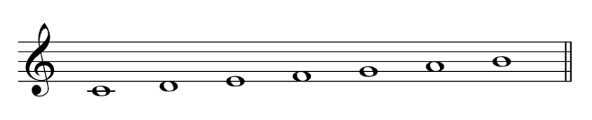
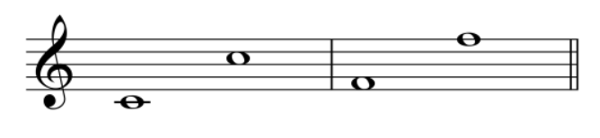
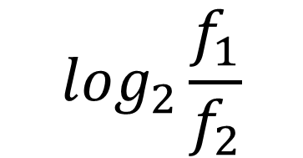

Octave
Note
$$\log_{2}\frac{f_{1}}{f_{2}}$$
$$2^{1/12}$$
Ex 440 Hz to 880 Hz
440 Hz to 220 Hz
Ex 440 Hz to 466 Hz
440 Hz to 415 Hz

Slide 2
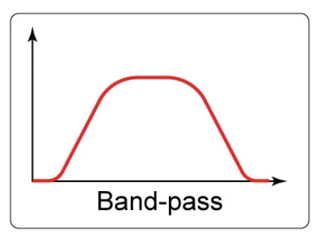
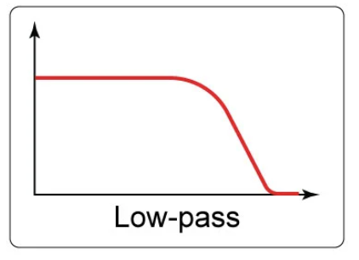
Low-pass filter
Band-pass filter
Attenuates low frequencies
Passes low frequencies
Passes middle frequencies
Passes middle frequencies
Attenuates high frequencies
Attenuates high frequencies

Slide 3
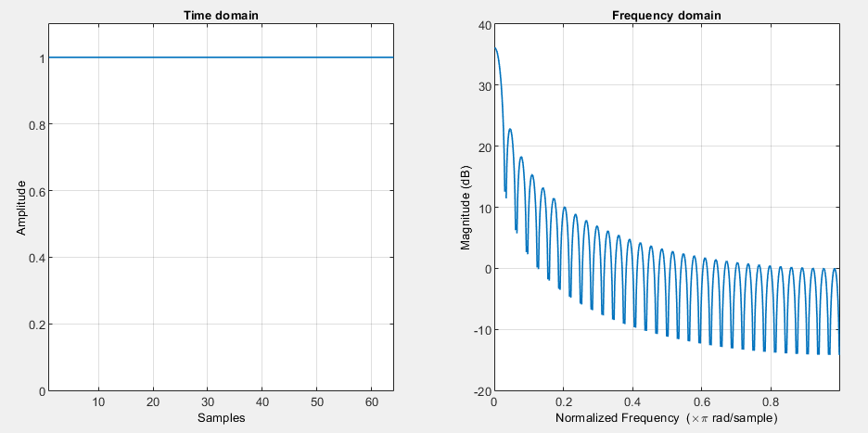
Rectangular Window

Slide 4
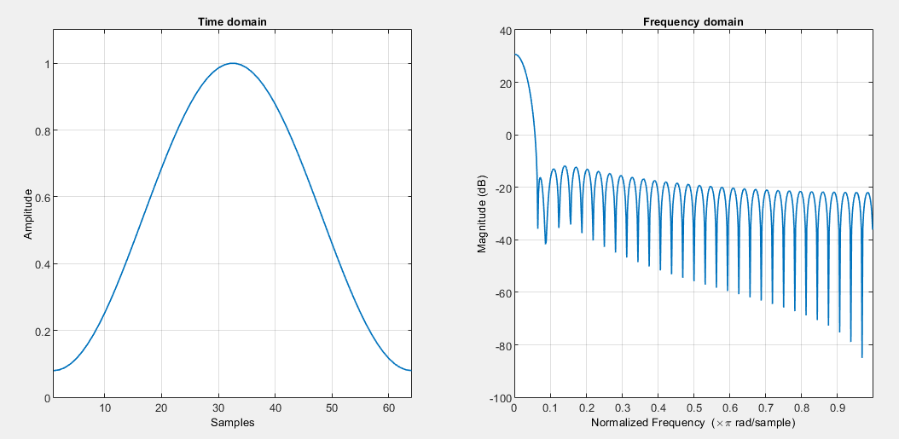
Hamming Window

Slide 5
Comparison
Window | Leakage Factor | Sidelobe Attenuation | Mainlobe width
Rectangular | 9.14% | -13.3 dB | 0.027
Hamming | 0.03% | -42.5 dB | 0.039
Blackman | 0% | -58.1 dB | 0.051

Slide 6
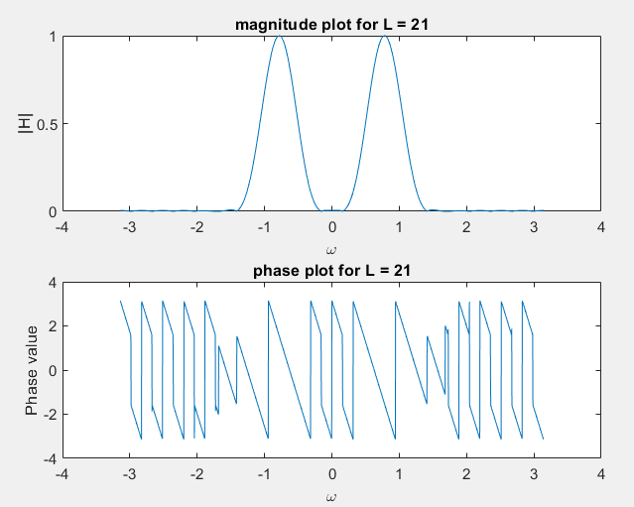
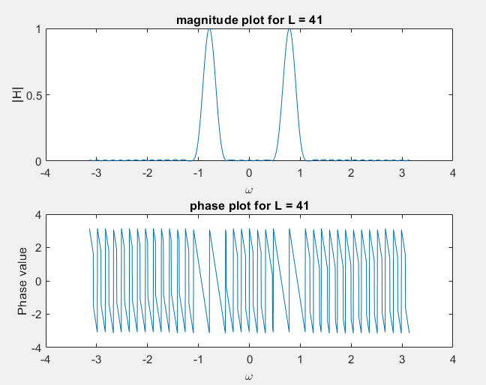
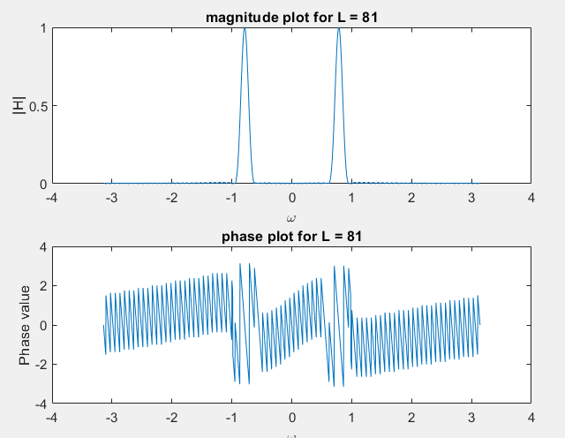
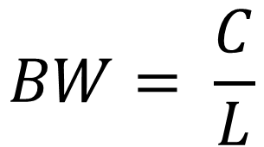
Variance with L
L = 21
L = 41
L = 81
$$BW= \frac{C}{L}$$

Slide 7
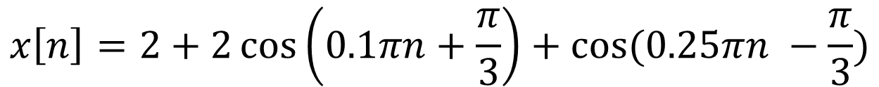
Example
$$x\left[n\right]=2+2\cos\left(0.1πn+\frac{π}{3}\right)+cos⁡(0.25πn −\frac{π}{3})$$
L = 41 Hamming band-pass FIR filter
$$x\left[n\right]=0.0147+0.0146\cos\left(0.1πn−2.03\right)+cos⁡(0.25πn −4.13)$$

Slide 8
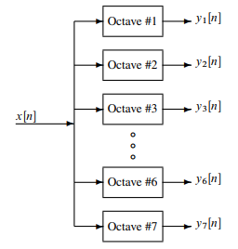
Exercise 5 - Decode Piano signal into octaves
Set of bandpass filters (BPFs) to isolate frequency bands (octaves)
Detector to determine which octave is active by using a “score”

Slide 9
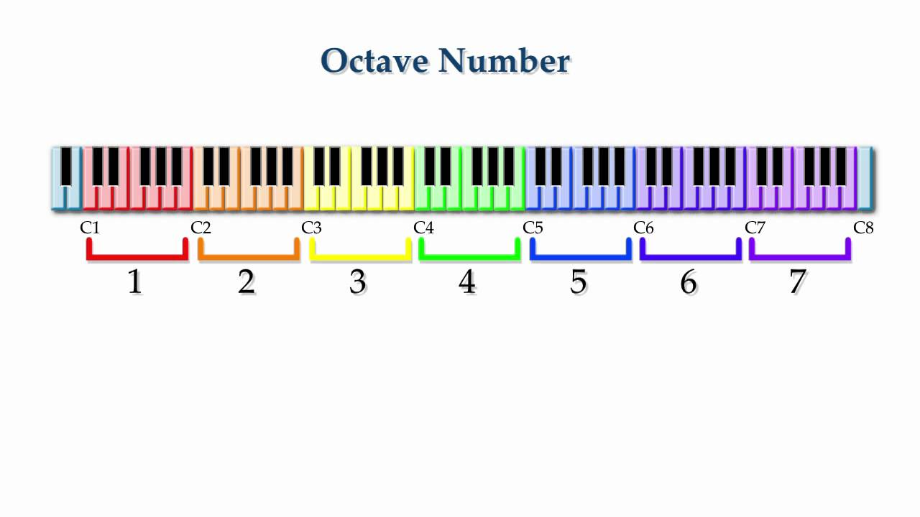
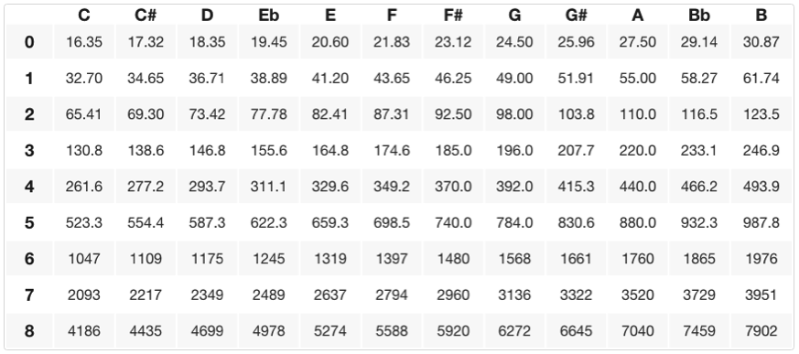
Bandpass Filter Frequency Bands (octaves 2-6)

Slide 10

Lower & Upper Edges of BPF
Frequency of nth key
$$f\left(n\right)=440∗2^{\frac{n−49}{12}}$$
Octave | Lower edge (rad) | High edge (rad) | Center (rad)
2 | 0.051370 | 0.102740 | 0.072648
3 | 0.102740 | 0.204480 | 0.145296
4 | 0.205480 | 0.410960 | 0.290593
5 | 0.410960 | 0.821921 | 0.581186
6 | 0.821921 | 1.643842 | 1.162372

Slide 11
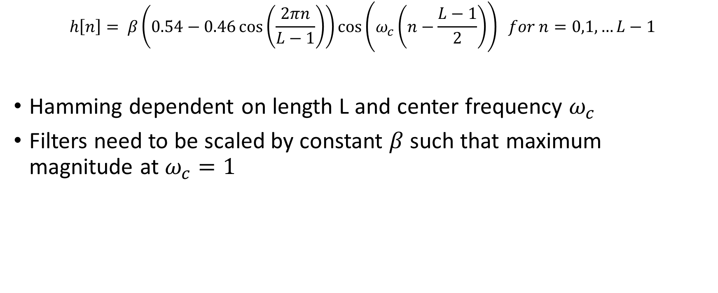
BPF Design Using Hamming
$$h\left[n\right]= β\left(0.54−0.46\cos\left(\frac{2πn}{L−1}\right)\right)\cos\left(ω_{c}\left(n−\frac{L−1}{2}\right)\right) for n=0,1,…L−1$$
Hamming dependent on length L and center frequency $ω_{c}$
Filters need to be scaled by constant $β$such that maximum magnitude at $ω_{c}=1$

Slide 12
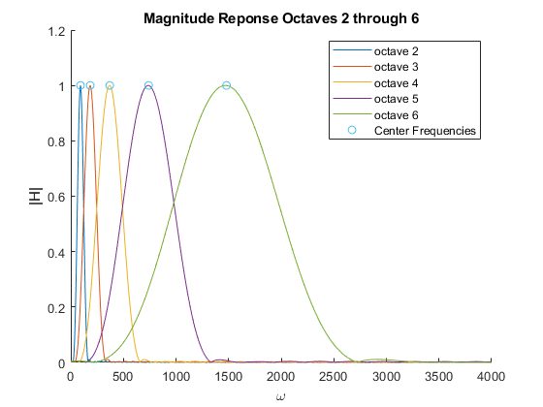
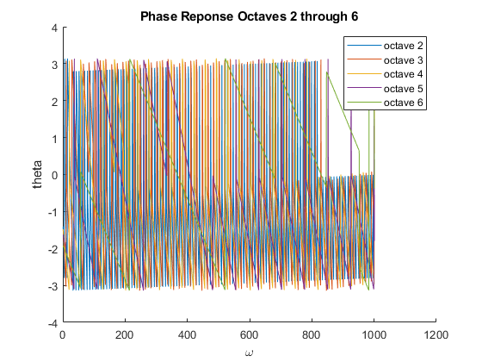

Slide 13

