Slide 1
DESIGN AND ANALYSIS OF ALGORITHMS
Merge Sort
A Divide and Conquer Sorting Algorithm
Aarnav Sahu 3-B · 25070521072
Unsorted array → sorted array
Notes:
Today we will see how Merge Sort turns an unsorted array into a sorted array by repeatedly dividing the problem and then merging the results.

Slide 2






WHY SORT?
Sorting turns scattered data into useful order
An ordering rule makes the next operation easier.
Arrange
Find faster
Sorting arranges values according to a rule, such as smallest to largest.
It makes searching, comparing, and analyzing data easier.
Use cases
Scale up
Examples: marks, student records, and product prices.
Merge Sort is an efficient algorithm for sorting large collections.
Notes:
Sorting is useful because many later operations become simpler when values follow a known order. Merge Sort is designed for large collections.

Slide 3
THE CORE IDEA
Merge Sort solves one large problem in three moves
01
02
03
Divide
Conquer
Combine
Split the array into smaller halves.
Recursively sort each half.
Merge the sorted halves into one sorted array.
Large array
Smaller problems
One sorted result
Divide → recursive sorting → Merge
Notes:
These three moves define Merge Sort. Divide creates manageable pieces, conquer sorts them recursively, and combine produces the final ordered array.

Slide 4




DIVIDE AND CONQUER
Sorted data helps with:
Divide and Conquer reduces complexity step by step
Searching: binary search finds an item quickly.
Ranking: top scores or best results appear first.
Organizing: records, such as students by roll number, stay in order.
Break a large problem into smaller versions of the same problem, solve them separately, then combine the results.
Divide: split the array.
Conquer: sort each smaller subarray.
Combine: merge two sorted subarrays.
Divide
Conquer
Sorting puts items in a chosen order, such as smallest to largest.
Before: 38, 27, 43, 3, 9, 82, 10
After: 3, 9, 10, 27, 38, 43, 82
Combine
Sorted result
Notes:
The important feature is repetition: every smaller problem has the same shape as the original problem. The algorithm keeps applying the same idea until the pieces are easy to handle.

Slide 5

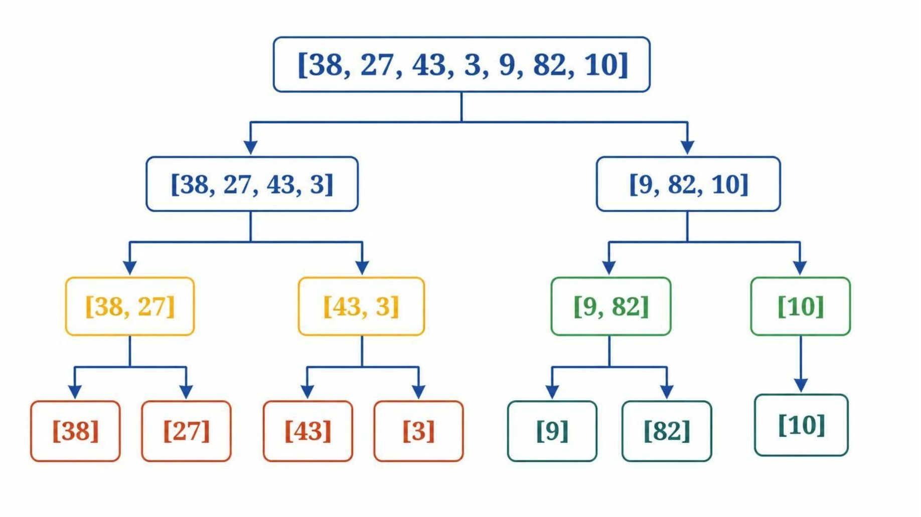
WORKED EXAMPLE · SPLIT PHASE
Example: keep splitting until every item stands alone
Start with [38, 27, 43, 3, 9, 82, 10]
Split level 1: [38, 27, 43, 3] and [9, 82, 10]
Continue in original order: [38, 27] [43, 3] [9, 82] [10] → [38] [27] [43] [3] [9] [82] [10]
Stop when each subarray contains one element.
Notes:
Notice that the right half contains three values, so the split is not perfectly balanced at the bottom. That is valid. The process stops when each subarray contains one element.

Slide 6
WORKED EXAMPLE · MERGE PHASE
Example: merge the smallest available values first
Compare the front elements of two sorted subarrays and copy the smaller value.
01
02
03
Pairs
Next level
Final merge
[27, 38] · [3, 43]
[9, 82] · [10]
[3, 27, 38, 43]
[9, 10, 82]
[3, 9, 10, 27, 38, 43, 82]
At each comparison, the smaller front value moves to the output.
Smallest available value → output array
Notes:
Once the pieces are sorted, merging is a controlled comparison. Look only at the front of each subarray, copy the smaller value, and continue until every value has moved to the output.

Slide 7
ALGORITHM
Algorithm: recurse, then merge
Check
If left < right, continue.
MERGE_SORT(array, left, right)
If left < right:
mid = floor((left + right) / 2)
MERGE_SORT(array, left, mid)
MERGE_SORT(array, mid + 1, right)
MERGE(array, left, mid, right)
Recurse
Sort the left and right halves.
Return
Merge the sorted sections upward.
MERGE combines two already-sorted subarrays into one sorted section.
Notes:
The recursive calls go down before the merge happens. When both halves return sorted, MERGE combines them into one sorted section as the recursion unwinds.

Slide 8
COMPLEXITY
Merge Sort keeps the same O(n log n) time in every case
Case | Time | Meaning
Best case | O(n log n) | Same split and merge structure
Average case | O(n log n) | Same split and merge structure
Worst case | O(n log n) | Same split and merge structure
Auxiliary space | O(n) | Standard array-based implementation
Why?
About log₂(n) split levels × O(n) total merge work per level.
Merge Sort is stable when equal elements keep their original relative order.
Standard array-based Merge Sort is generally not in-place.
Notes:
The predictable time comes from the structure of the algorithm. There are about log₂(n) levels, and each level performs O(n) total merge work.

Slide 9
TRADE-OFFS
Merge Sort trades extra memory for predictability
Advantages
Limitations and applications
Predictable O(n log n) performance
Stable when implemented correctly
Useful for large datasets
Works well for linked lists and external sorting
Standard arrays need extra memory.
Small arrays may see more overhead than simpler methods.
Applications: large datasets, linked lists, external sorting, and stability-sensitive records.
Notes:
Merge Sort is a strong choice when predictable performance and stability matter. The main cost is extra memory for standard array-based implementations.

Slide 10

RECAP
Merge Sort is structured, stable, and dependable
Remember
Thank You
It uses Divide and Conquer.
It divides, recursively sorts, and merges.
Best, average, and worst cases are O(n log n).
It is stable when implemented correctly, but standard arrays need extra memory.
Any Questions?
References
Thomas H. Cormen et al., Introduction to Algorithms
GeeksforGeeks, “Merge Sort”
MIT OpenCourseWare, “Algorithms”
Notes:
Close by repeating the three actions: divide, recursively sort, and merge. Emphasize the predictable O(n log n) time, stability, and the extra memory trade-off.

