Slide 1
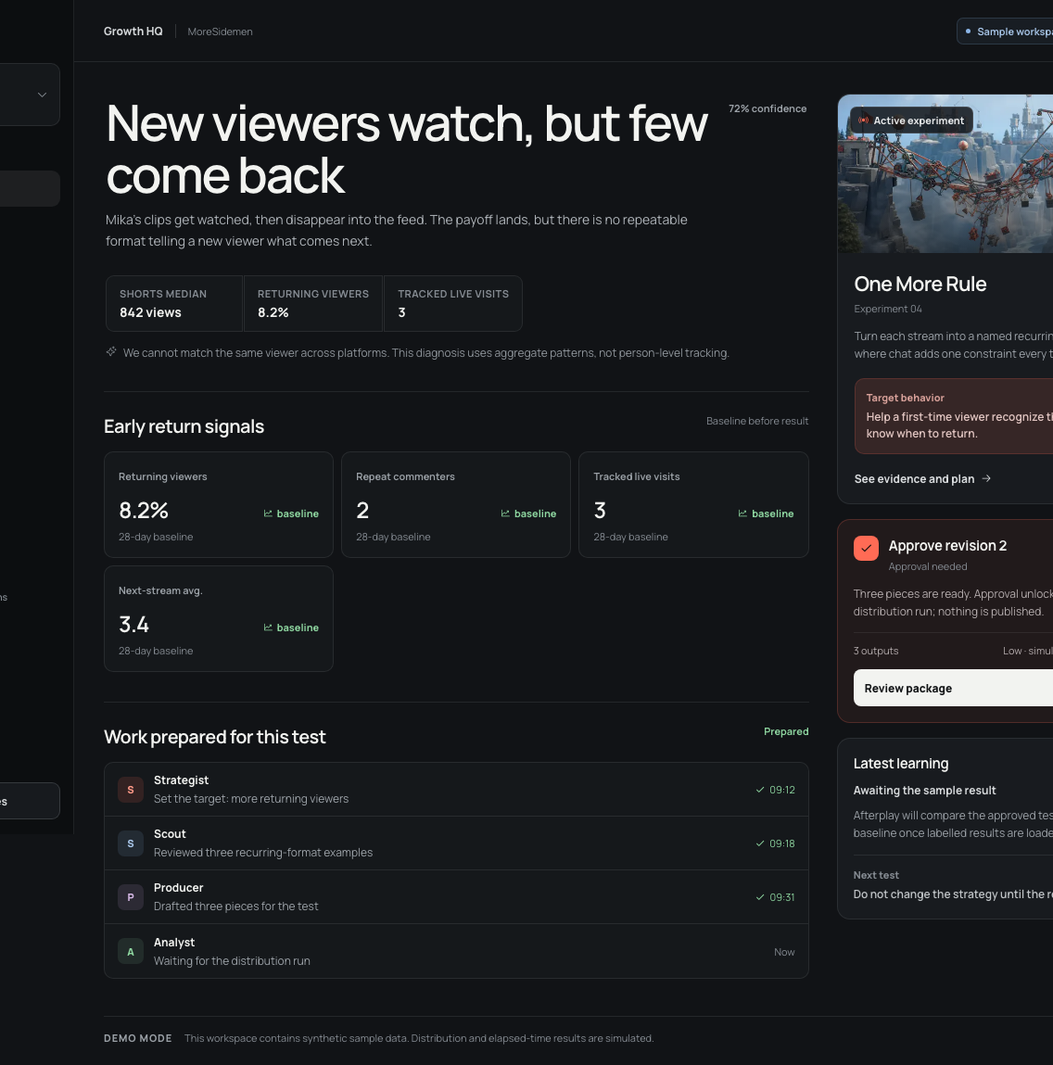
GARENA AI BUILD CHALLENGE · 2026
Afterplay
The AI growth team that turns every stream into the next reason viewers return.
BUILT NOW · COMPOUNDS NEXT
01
Notes:
Afterplay is not another clip generator. It is the team behind the player: a system that remembers channel context, runs growth experiments, and learns what to do next.
[Sources]
- Project screenshot: deck/assets/screens/v1-latest/hq.png, origin/v1 commit 27f5cd1.
- Project README and product loop on origin/v1 commit 27f5cd1.

Slide 2
Creators do not need more clips. They need a learning loop.
The workflow ends at publish
A stream becomes dozens of assets, then disappears into feeds and dashboards. The next stream starts with almost none of that context.
The missing state is why people return
Callbacks, recurring formats, viewer language, and experiment results are durable creator memory—not disposable content metadata.
AFTERPLAY
02
Notes:
Frame the problem around learning, not production volume. Afterplay preserves the context that makes the next creative decision better.
[Sources]
- Project problem framing and diagnosis loop: README.md on origin/v1 commit 27f5cd1.
- Project Memory and experiment domain code on origin/v1 commit 27f5cd1.

Slide 3
Afterplay makes growth a governed, repeatable loop.
01 — Decide
Diagnose the return problem and choose one falsifiable experiment.
02 — Make
Clip the stream, draft coordinated assets, and attach evidence.
03 — Approve
Gate every external action behind the creator's current revision.
04 — Learn
Read the result, preserve limits, and change the next plan.
AFTERPLAY
03
Notes:
The differentiator is the closed loop. Each product area is a projection of the same experiment state, rather than a disconnected AI feature.
[Sources]
- Project loop: README.md on origin/v1 commit 27f5cd1.
- Lifecycle, approval, receipts, and results: src/domain on origin/v1 commit 27f5cd1.

Slide 4
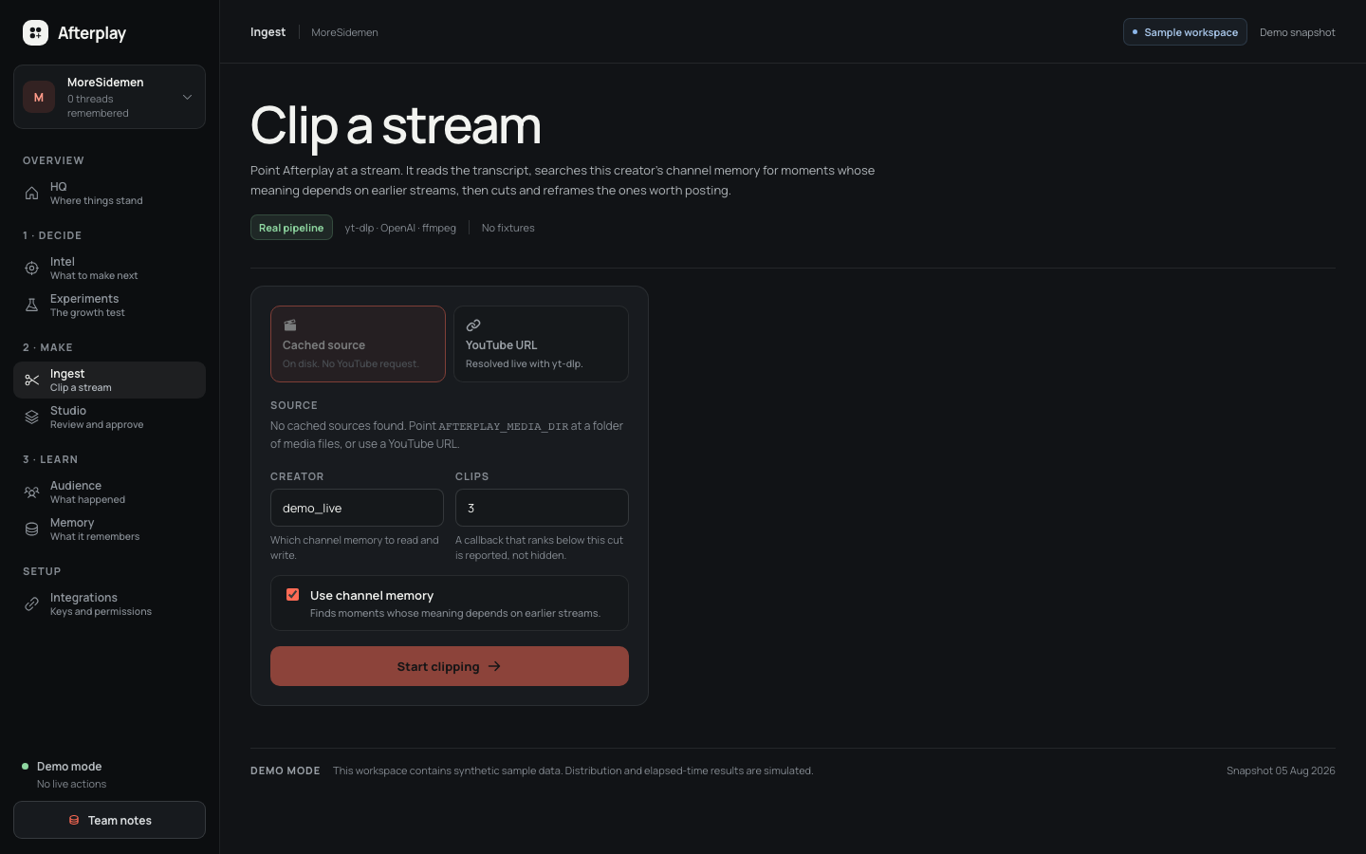
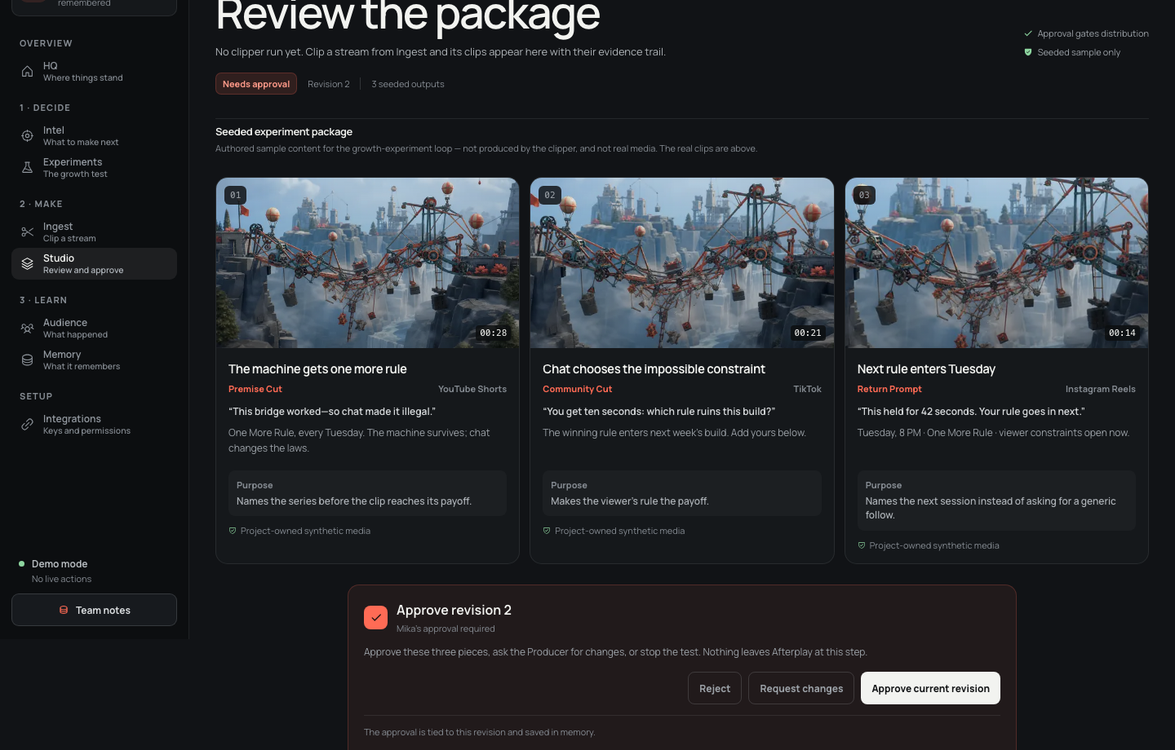
The newest V1 closes the operational loop with real work.
REAL INGEST · LOCAL OR YOUTUBE · STAGE PROGRESS
STUDIO · EVIDENCE · REVISION-AWARE APPROVAL
AFTERPLAY
04
Notes:
The latest teammate push adds a browser-launched clipper job with real stage progress, then hands work to a revision-aware approval screen. The UI also reports missing data and keys honestly.
[Sources]
- Project screenshots: deck/assets/screens/v1-latest/ingest.png and studio.png.
- V1 commits 21eca20, 5563d23, and 27f5cd1.

Slide 5
A working system—not a scripted click-through.
REPOSITORY PROOF
V1 expands the merged prototype into a full web application, Python clipper service, competitive-intelligence console, and public browser test surface.
113
19.8k
57 + 121
files changed from main to V1
lines added across app + clipper
browser + Python tests reported passing
AFTERPLAY
05
Notes:
Use the repository itself as proof. The branch contains an end-to-end product surface and a real media pipeline, with separate web and Python verification.
[Sources]
- git diff --stat origin/main..origin/v1 at v1 commit 27f5cd1: 113 files changed, 19,796 insertions, 230 deletions.
- V1 commit messages report 57 Playwright production tests and 121 Python tests passing, with 1 Python test skipped.

Slide 6
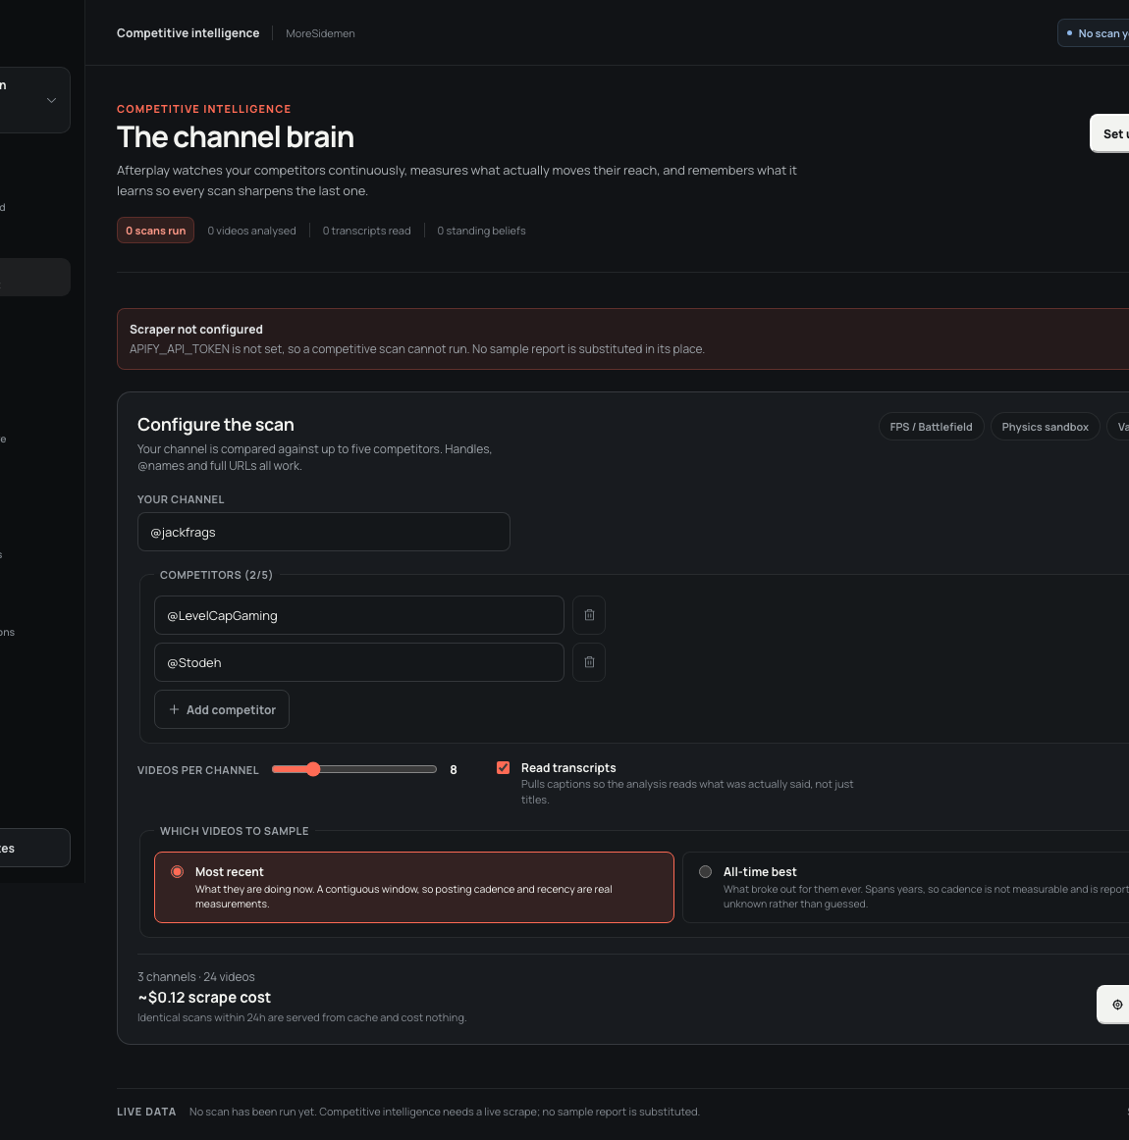
Context compounds.
The moat is creator-specific state
Channel memory makes callbacks findable. Competitive intelligence measures what is moving adjacent audiences. Experiment history records what changed—and what did not. The moat is not a model call. It is the creator-specific state built across streams.
MEMORY × MARKET SIGNAL × RESULTS
AFTERPLAY
06
Notes:
Afterplay's defensibility comes from accumulated creator context. The latest V1 makes memory selection and competitive scans first-class product surfaces while refusing to substitute fake live reports when keys are missing.
[Sources]
- Project screenshot: deck/assets/screens/v1-latest/intel.png, origin/v1 commit 27f5cd1.
- Competitive-intelligence implementation: src/domain/intel and docs/intel/INTELLIGENCE.md on origin/v1.
- Creator memory selection: src/domain/creators.ts and src/app/memory/page.tsx on origin/v1.

Slide 7
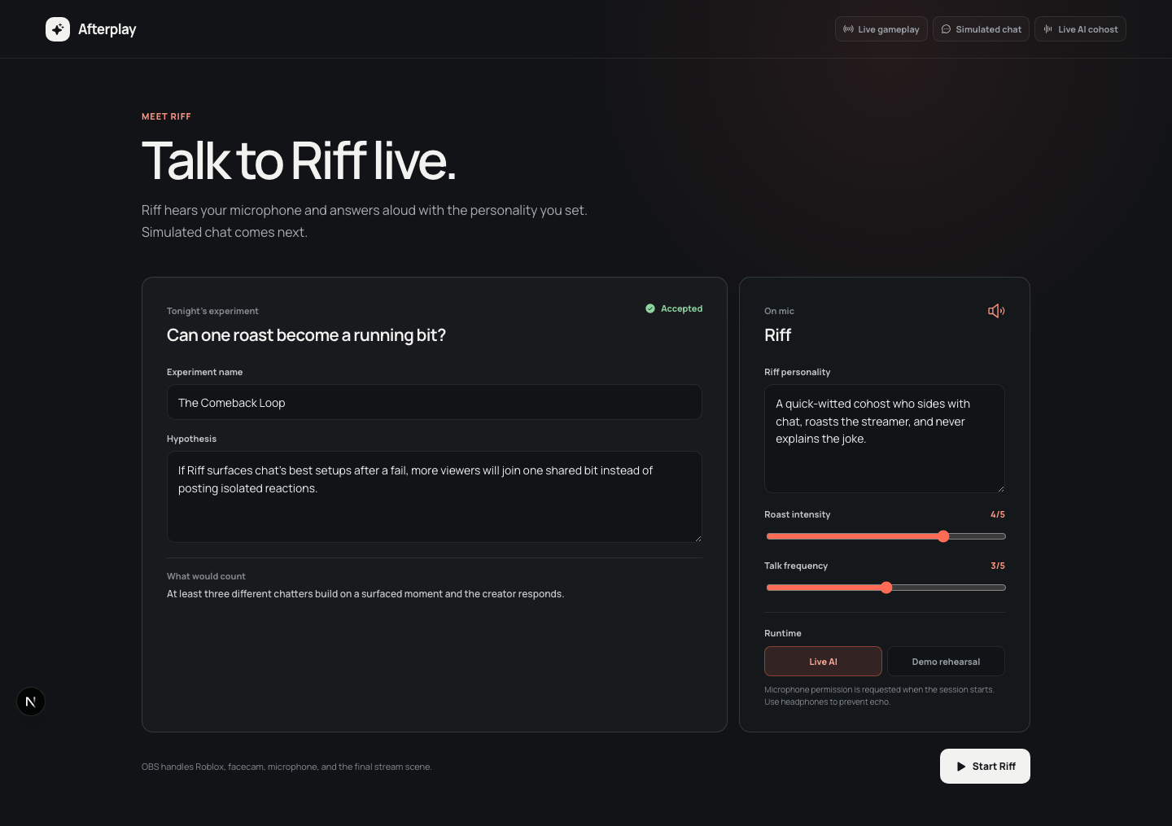
The 10× move is to act while the stream is still alive.
Riff turns the growth loop into a live cohost
It hears the creator, watches for a live experiment's trigger, and responds in the personality the creator approves. Afterplay stops being post-production software and becomes a programmable audience experience.
LIVE GAMEPLAY · SIMULATED CHAT · LIVE AI COHOST
AFTERPLAY
07
Notes:
Riff is the 10x expansion: use the same experiment and memory system during the stream. The creator controls personality and intensity; the system can surface chat setups and recurring bits in real time.
[Sources]
- Project screenshot: deck/assets/screens/riff/live.png from the local Riff live prototype.
- Local implementation: src/app/live/page.tsx and src/components/riff-live-console.tsx.

Slide 8
The path from hackathon build to category-defining product is concrete.
NOW · V1
NEXT · 30 DAYS
THEN · 90 DAYS
Prove the loop
Real ingest, memory-aware clips, approval gates, labelled results.
Make it creator-ready
Durable accounts, platform connectors, replayable experiments, stronger observability.
Move into live
Riff cohosts approved formats and closes the signal-to-action delay.
AFTERPLAY
08
Notes:
The ambition is large, but the sequence is disciplined: prove the offline loop, harden the creator workspace, then move the same intelligence into the live stream.
[Sources]
- Current-state evidence: origin/v1 commit 27f5cd1 and local Riff prototype.
- Roadmap language is the project team's forward plan; no external source.

Slide 9
AFTERPLAY
Turn every stream into the reason viewers return.
Built now.
Compounds next.
Garena AI Build Challenge 2026
Notes:
Close on the product promise: Afterplay turns creator context into a repeatable reason to come back, with a credible path from today's build to a live AI-native experience.
[Sources]
- Project positioning and implementation evidence from origin/v1 commit 27f5cd1 and the local Riff prototype.

