Slide 1
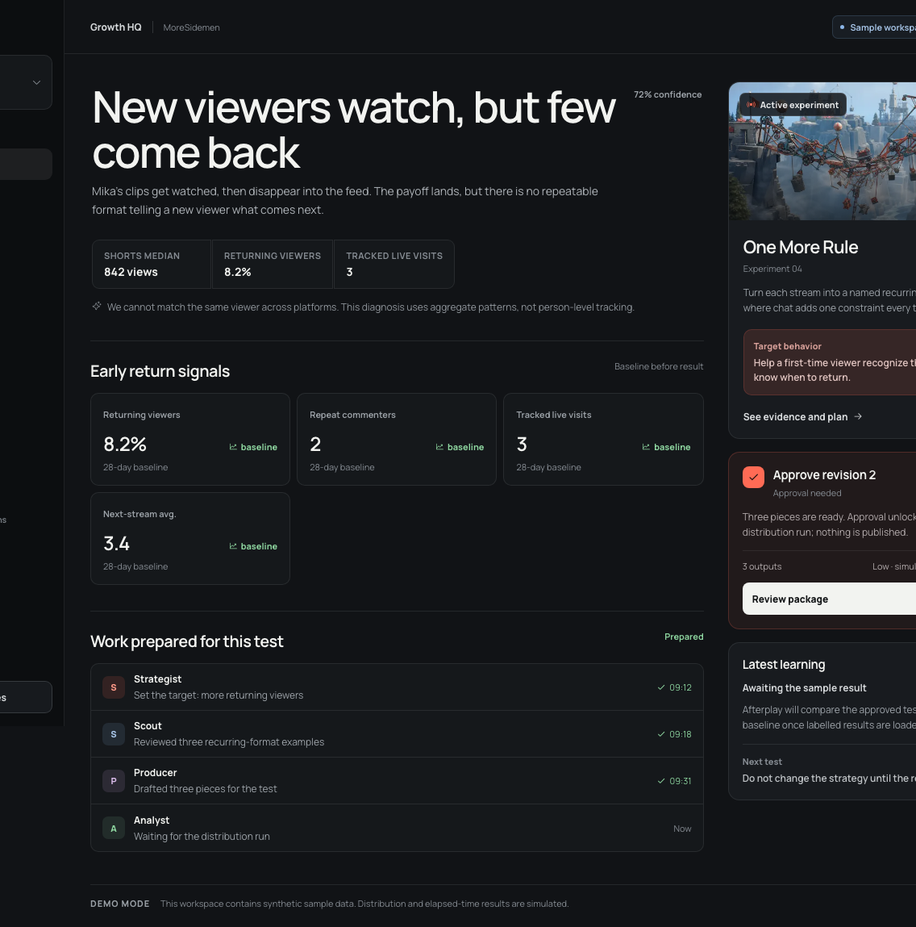
GARENA AI BUILD CHALLENGE · 2026
Afterplay
Afterplay remembers what made viewers come back, then plans one clear test for the next stream.
REMEMBER · TEST · LEARN
01
Notes:
Afterplay helps gaming creators learn what makes viewers come back. It keeps a record of the channel, plans one clear test at a time, and uses the result to choose what happens next.
[Sources]
- Project screenshot: deck/assets/screens/v1-latest/hq.png, origin/v1 commit 27f5cd1.
- Project README and product loop on origin/v1 commit 27f5cd1.

Slide 2
Creators can see what happened. They still have to guess what to do next.
What the tools show
A replay, clips, comments, and charts. Each lives in a different place.
What the next stream needs
Why did viewers care? What should carry into the next stream? Which idea is worth testing?
AFTERPLAY
02
Notes:
A creator can see every clip and chart and still lack a clear next move. The useful clues are split across footage, chat, comments, and analytics, so the next stream often depends on memory and guesswork.
[Sources]
- Project problem framing and diagnosis loop: README.md on origin/v1 commit 27f5cd1.
- Project Memory and experiment domain code on origin/v1 commit 27f5cd1.

Slide 3
The creator market is large. Attention and loyalty are scarce.
500 hrs/min
of new video is uploaded to YouTube.
<1%
regular viewers can make up less than 1% of viewers on newer or Shorts-heavy channels.
$44B
projected U.S. creator ad spend in 2026.
~4%
of global creators earn more than $100,000 a year.
Sources: YouTube Blog and Help · IAB 2025 Creator Economy Report · Goldman Sachs Research
AFTERPLAY
03
Notes:
Content supply is enormous, loyal audiences are hard to build, and creator revenue is already a large market. YouTube says viewers who return regularly are more likely to be recommended more videos from that channel. That is the behavior Afterplay targets.
[Sources]
- YouTube Blog, 1 Dec 2022: https://blog.youtube/culture-and-trends/youtube-podcast-launch-like-and-describe/
- YouTube Help, current page: https://support.google.com/youtube/answer/10246996?hl=en
- IAB 2025 Creator Economy Ad Spend & Strategy Report: https://www.iab.com/insights/2025-creator-economy-ad-spend-strategy-report/
- Goldman Sachs Research, 19 Apr 2023: https://www.goldmansachs.com/insights/articles/the-creator-economy-could-approach-half-a-trillion-dollars-by-2027

Slide 4
Afterplay is built for growing gaming creators.
WHO USES AFTERPLAY
The primary user streams often but lacks a strategy team. Editors, managers, and creator programs share the same evidence and approval record.
CREATOR
TEAM
PROGRAM
needs a clear next move after each stream
reviews evidence, clips, copy, and approvals
supports many creators with one repeatable process
AFTERPLAY
04
Notes:
The primary user is a growing gaming creator who streams regularly without a full strategy team. Editors and managers need the same evidence and approval state. Creator programs benefit from a repeatable process across several channels.
[Sources]
- Target-user and workspace contract: docs/product/PRODUCT.md on origin/v1 commit 27f5cd1.
- Reusable multi-account shell: README.md and src/domain/creators.ts on origin/v1 commit 27f5cd1.

Slide 5
Find a signal. Try one change. Learn.
A CONCRETE EXAMPLE
Viewers repeat an inside joke in chat. Afterplay suggests opening the next stream with that callback, then checks whether more viewers return.
FIND
TRY
LEARN
a callback viewers repeated in chat
open the next stream with that callback
did more viewers come back or stay longer?
AFTERPLAY
05
Notes:
The product finds a useful signal in the current stream and channel history. It turns that signal into one test for the creator to approve. After the test, it saves the result and recommends the next move.
[Sources]
- Project loop and product behavior: README.md and src/domain on origin/v1 commit 27f5cd1.

Slide 6
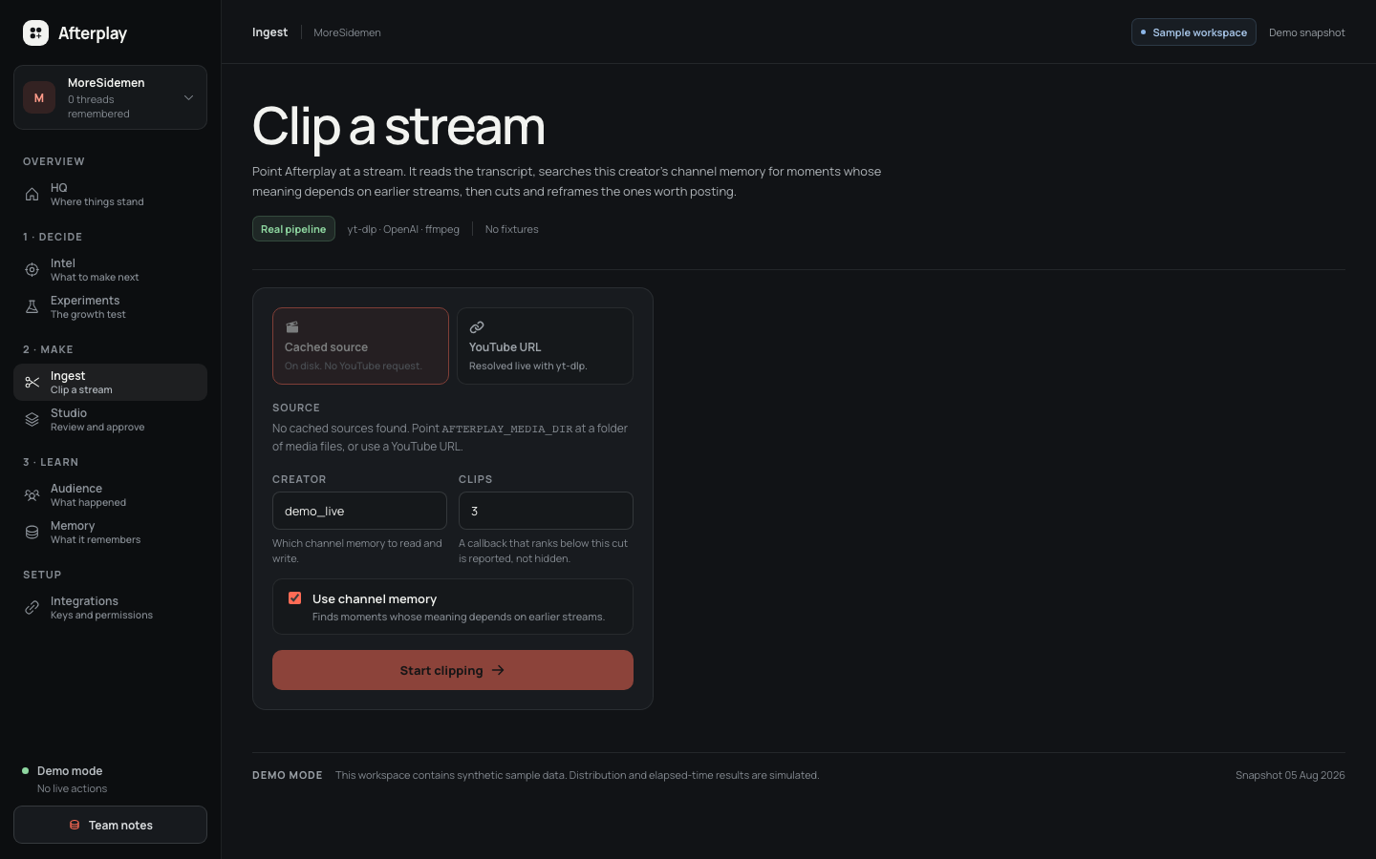
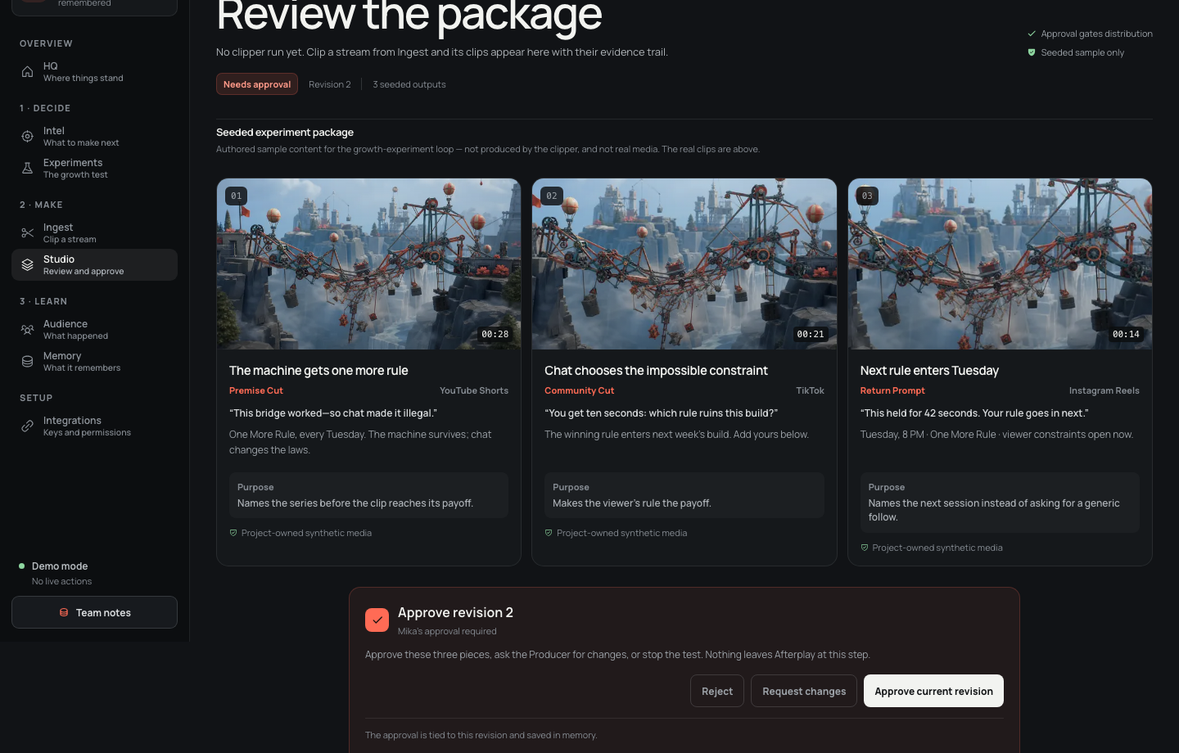
A creator can go from stream URL to approved test in one workspace.
1 INGEST THE STREAM AND REPORT REAL STAGES
2 REVIEW CLIPS, EVIDENCE, AND COPY BEFORE ACTION
AFTERPLAY
06
Notes:
V1 starts a real clipper job from the browser, reports its actual stages, and sends the output to Studio. The creator sees the clips, evidence, and copy before approving the current revision. Nothing is posted at this step.
[Sources]
- Project screenshots: deck/assets/screens/v1-latest/ingest.png and studio.png.
- V1 commits 21eca20, 5563d23, and 27f5cd1.

Slide 7
AI turns channel history into one test.
WHERE AI CONTRIBUTES
The model reads evidence across streams, writes a testable plan, and later explains what the result should change. Code enforces approval and action rules.
CONNECT
PLAN
LEARN
history + current stream → diagnosis
diagnosis → hypothesis, clips, and copy
results → memory update and next test
AFTERPLAY
07
Notes:
AI performs the semantic judgment that fixed analytics cannot: it connects meaning across streams, forms a falsifiable hypothesis, prepares creator-specific work, and interprets results in context. Code owns identity, validation, revisions, approval, action dispatch, and receipts.
[Sources]
- AI responsibilities and boundaries: docs/AI.md on origin/v1 commit 27f5cd1.
- Two-stage director decision: docs/decisions/0003-two-stage-director-not-agent-theatre.md on origin/v1 commit 27f5cd1.
- Implemented strategy adapter: src/ai/strategy.ts on origin/v1 commit 27f5cd1.

Slide 8
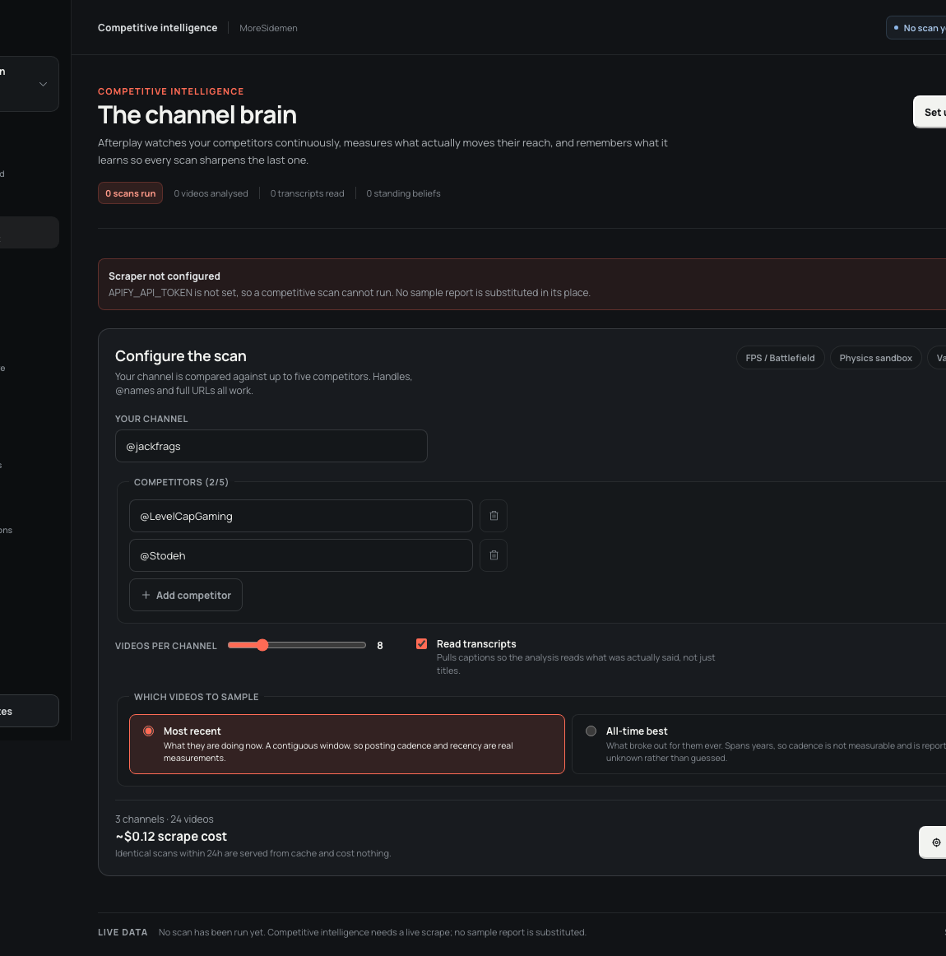
Three records guide each test.
The next test starts with evidence
Channel: recurring jokes, storylines, viewer quotes, and moments. Audience: who returned, what they repeated, and when they left. Market: what similar channels tried, which formats are growing, and where gaps remain.
CHANNEL · AUDIENCE · MARKET
AFTERPLAY
08
Notes:
Afterplay keeps the specific facts a creator would otherwise have to remember. V1 stores channel threads, exposes the selected creator across the workspace, and can scan adjacent channels without substituting a fake report when live data is unavailable.
[Sources]
- Project screenshot: deck/assets/screens/v1-latest/intel.png, origin/v1 commit 27f5cd1.
- Competitive-intelligence implementation: src/domain/intel and docs/intel/INTELLIGENCE.md on origin/v1.
- Creator memory selection: src/domain/creators.ts and src/app/memory/page.tsx on origin/v1.

Slide 9
Each technical layer has one clear job.
IMPLEMENTED V1 ARCHITECTURE
A Next.js app owns the experiment lifecycle. A Python service handles media. Both return validated records that the creator can inspect.
MODEL
APP
CLIPPER
Responses API + strict output + Zod
Next.js 16 + TypeScript + approval gates
Python + ffmpeg + transcript and callback scoring
AFTERPLAY
09
Notes:
V1 is one Next.js 16 application with framework-light TypeScript domain modules. Optional live planning uses the OpenAI Responses API with strict Structured Outputs, store false, and Zod validation. The separate Python clipper uses transcripts, creator memory, callback scoring, ffmpeg rendering, and quality checks. Demo state is seeded in process and distribution is simulated for a reliable judge run.
[Sources]
- Runtime dependencies: package.json on origin/v1 commit 27f5cd1.
- Architecture and trade-offs: docs/architecture/ARCHITECTURE.md on origin/v1 commit 27f5cd1.
- Model configuration and validation: docs/AI.md on origin/v1 commit 27f5cd1.
- Media pipeline: services/video-clipper on origin/v1 commit 27f5cd1.

Slide 10
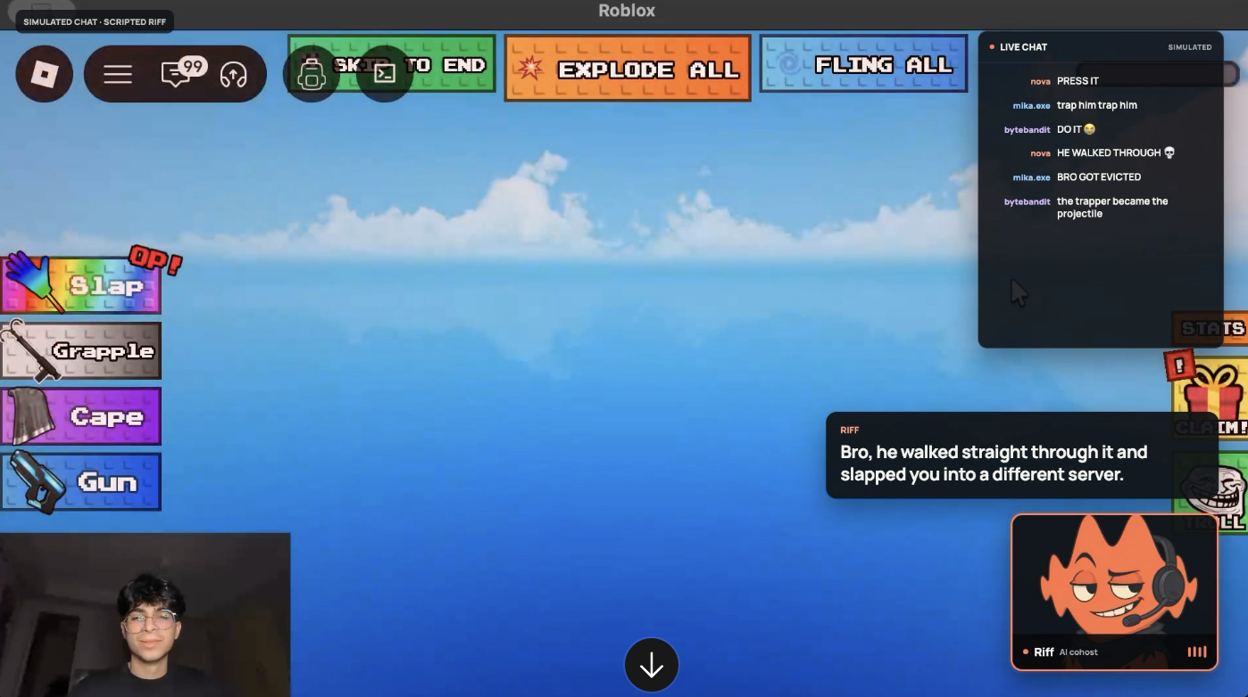
Riff brings that history into the next live stream.
The prototype is already live
Riff follows gameplay, the creator, chat, and the approved experiment. When a useful moment arrives, it speaks, challenges the creator, or recalls a callback. The working demo keeps simulated chat and scripted beats clearly labelled.
WORKING PROTOTYPE · GAMEPLAY · AI COHOST
AFTERPLAY
10
Notes:
This is the working live prototype, not a setup mockup. Riff follows the creator, selected gameplay, chat context, creator history, and the accepted experiment. It can speak, challenge the creator, surface a callback, or stay silent. The screenshot visibly labels simulated chat and scripted demo beats.
[Sources]
- User-provided project screenshot: /Users/vihaan/Documents/Screenshot 2026-08-09 at 9.18.42 PM.png.
- Local implementation: src/app/live, src/app/overlay/riff, src/app/api/live, src/app/api/realtime, src/components/riff-*, src/domain/live-session.ts, and electron.
- Prototype behavior and truth boundary: README.md, docs/product/PRODUCT.md, docs/AI.md, and docs/architecture/ARCHITECTURE.md in the current working tree.

Slide 11
Expected impact: faster decisions, clearer learning.
TIME
hours from stream ingest to an approved test
CADENCE
approved experiments completed per month
RETURN
regular-viewer rate and repeat live visits
TRACE
recommendations linked to evidence and prior results
Future success measures. Baselines and targets come from creator data.
AFTERPLAY
11
Notes:
The expected impact is less planning guesswork, more disciplined experiments, and a clearer path to a returning audience. We will measure time to decision, experiment cadence, returning behavior, and whether recommendations remain traceable to evidence. The prototype does not claim these outcomes have already been achieved.
[Sources]
- Expected outcomes and truth boundary: README.md and docs/product/PRODUCT.md on origin/v1 commit 27f5cd1.
- YouTube returning-viewer definition and guidance: https://support.google.com/youtube/answer/10246996?hl=en
- Public measurement seams: docs/testing/TEST-SEAMS.md on origin/v1 commit 27f5cd1.

Slide 12
The working prototype already covers the full loop.
BEFORE
DURING
AFTER
Plan with context
Saved accounts, live platform data, creator history, and one approved experiment.
Riff joins live
Riff sees gameplay, hears the creator, reads chat, and speaks when the moment earns it.
Close the loop
Ingest, clipping, memory, approval, results, and the next experiment run end to end.
AFTERPLAY
12
Notes:
All three stages are implemented in prototype form. Before the stream, Afterplay uses saved creator context, platform data, history, and an approved experiment. During the stream, Riff follows the live context and can speak. After the stream, Afterplay carries the moment into clipping, memory, approval, results, and the next experiment. Production hardening and real platform credentials remain future work; the core workflow is already built.
[Sources]
- Latest v1 base: origin/v1 commit 27f5cd1b422ee63cbb524ac7622d80cc7b1e6e82.
- Working growth loop: README.md, docs/product/PRODUCT.md, src/domain/experiment.ts, src/domain/workspace.ts, and the existing product routes.
- Working Riff extension: README.md, docs/decisions/0004-riff-connects-the-live-show-to-afterplay.md, src/domain/live-session.ts, src/app/live, src/app/overlay/riff, and tests/e2e/riff-* in the current working tree.
- Prototype boundary: platform connections, public posting, performance outcomes, and some demo inputs remain simulated or local; no production-readiness claim is made.

Slide 13
AFTERPLAY
Afterplay helps gaming creators learn what makes viewers come back.
Remember the channel.
Run the next test.
Learn from the result.
Notes:
Afterplay's promise is straightforward: remember the channel, run one approved test, and use the result to choose the next move.
[Sources]
- Project positioning and implementation evidence from origin/v1 commit 27f5cd1 and the local Riff prototype.

