Slide 1
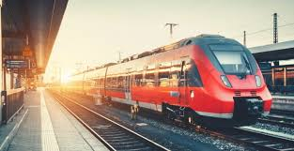
RailVision
AI-Driven Surveillance and Safety System for Indian Railways
Using existing CCTV network for crowd management, crime prevention, and work monitoring using AIML
By: Aarohi Saxena
Project id: PCS26-40
Project Mentor: Dr. Raj Kumar

Slide 2
Project Abstract
Overview
Key Objectives
Approach
The project utilizes AI and ML to automate surveillance and anomaly detection across railway stations, addressing challenges in crowd control, safety, and resource management. The solution leverages ResNet50 and other ML algorithms to detect unusual behavior, overcrowding, and potential threats, generating alerts and notifications in real-time.
Automated Anomaly Detection: Enable AI-based CCTV monitoring to detect and alert on suspicious activities or overcrowding in real-time.
Enhanced Resource Allocation: Use ML to predict peak hours and optimize staff deployment.
Safety and Security: Increase passenger safety by minimizing human error in surveillance.
Operational Efficiency: Improve work monitoring and ensure adherence to cleanliness and maintenance protocols.
Data Collection: Process real-time video feeds from CCTV networks across railway stations.
Preprocessing and Frame Extraction: Extract frames for analysis and preprocess them for model input.
ML Model Deployment (ResNet50): Use a Convolutional Neural Network to detect anomalies.
Alert System: Generate alerts (audio and visual) on detection of an anomaly and send video clips to a centralized portal.
Future Integration: Incorporate one-click emergency alerts for ambulance dispatch in medical cases.

Slide 3

Project Goals and Objectives
Safety and Surveillance:
1
Improve real-time monitoring for better crowd management and crime prevention..
2
Operational Excellence:
Automate routine checks (cleanliness, maintenance) to reduce human oversight.
Scalability and Resilience:
3
Create a scalable solution that can be expanded across railway networks..

Slide 4

Alignment with UN Sustainable Development Goals (SDGs)
SDG 9 (Industry, Innovation,
and Infrastructure):
SDG 11 (Sustainable Cities
and Communities):
Build resilient infrastructure by leveraging advanced AI technologies.
Enhance public safety and improve sustainable urban transportation.
SDG 16 (Peace, Justice,
and Strong Institutions)
Strengthen safety in public spaces, reducing crime and enhancing justice.

Slide 5





Methodology and Approach
Frame Extraction and Preprocessing:
Split CCTV video into frames, resize, and normalize for consistent model input.
Anomaly Detection Using ResNet50:
Classify each frame for anomalies related to crowd density, crime, or unusual activity.
Real-Time Alert System:
Generate audio alerts and send captured video segments to a secure portal.
Future Capabilities:
Integrate with emergency services for medical response, adding functionality as needed.

Slide 6
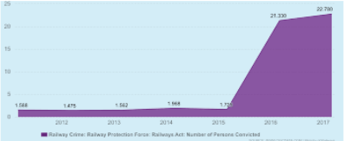



Expected Outcomes and Impact
Enhanced Safety
and Security:
Sustainable and
Scalable Solution
Data-Driven Decision Making
Improved real-time detection and quick response to potential threats or incidents.
Infrastructure that can expand across stations with minimal additional investment.
Utilize data insights for better resource management and strategic planning.

Slide 7

Key Project Deliverables
AI-Based Surveillance System:
Deployment of ResNet50 and real-time anomaly detection system.
Centralized Portal for Alerts:
A portal for security personnel to review and respond to detected anomalies.
Alert Mechanisms:
Audible alarms, video clips, and notification systems for immediate action.

Slide 8

Next Steps and Conclusion
1
Scale and Expand
2
Continuous Monitoring
and Improvement
Extend the solution to additional stations and include more functionalities.
Regularly evaluate model accuracy and system effectiveness.
3
Privacy and Ethical Compliance
Ensure ongoing compliance with data protection standards.

