Slide 1
Basic Concepts
Peng, Sheng-Lung
& Ondřej Navrátil
Department of Computer Science National Dong Hwa University

Slide 2
Basic Concepts
2
2
System Life Cycle
Data Abstraction and Encapsulation
Algorithm Specification
Performance Analysis and Measurement

Slide 3
Overview: System Life Cycle
3
3
Requirements
Analysis
  Bottom-up
  Top-down
Design
  Data objects: abstract data types
  Operations: specification & design of algorithms

Slide 4
Overview: System Life Cycle (contd.)
4
4
Refinement & Coding
  Choose representations for data objects
  Write algorithms for each operation on data objects
Verification
  Correctness proofs: selecting proved algorithms
  Testing: correctness & efficiency
  Error removal: well-documented

Slide 5
Evaluative Judgments about Programs
5
5
Meet the original specification?
Work correctly?
Document?
Use functions to create logical units?
Code readable?
Use storage efficiently?
Running time acceptable?

Slide 6
Role of Data Structures
6
6
Real problem:
  Order the students according to their heights
  Rank the students according to their scores
Abstract problem:
  Sorting problem
Algorithm:
  Bubble sort
  Quick sort
Data structure
  Array
  Linked list

Slide 7
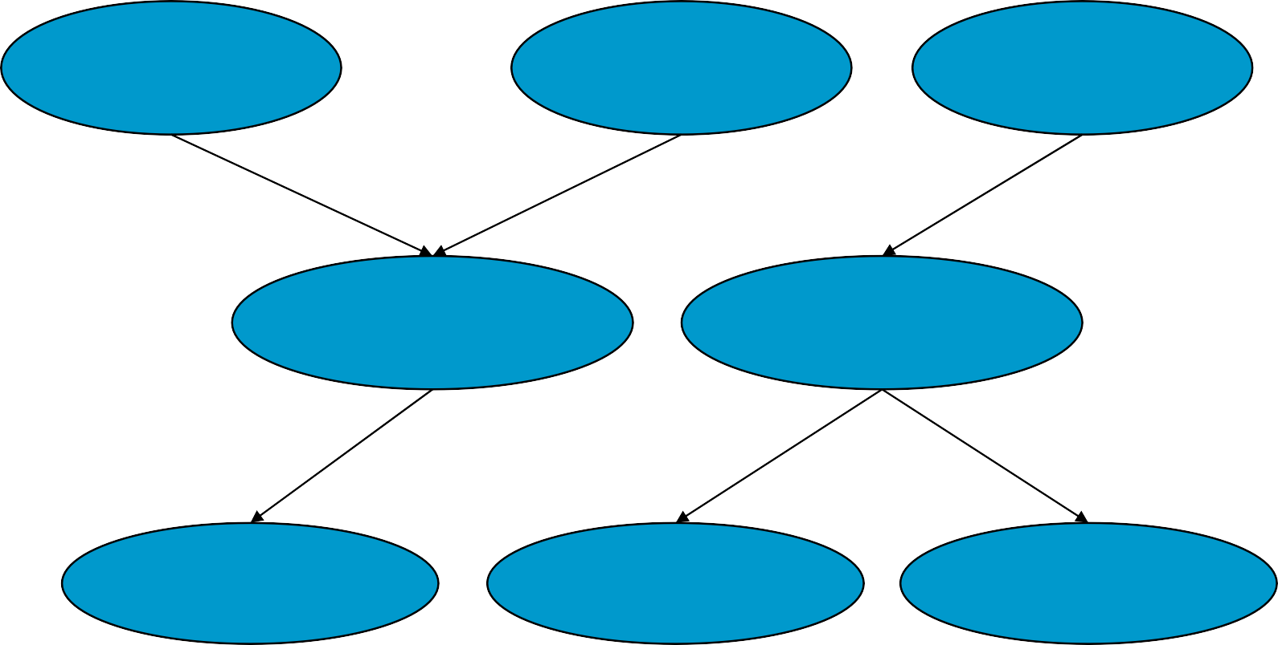
Role of Data Structures (contd.)
7
7
Real problem
Real problem
Real problem
Modeled as
Abstract problem
Abstract problem
Solved by
Algorithm
Algorithm
Algorithm

Slide 8
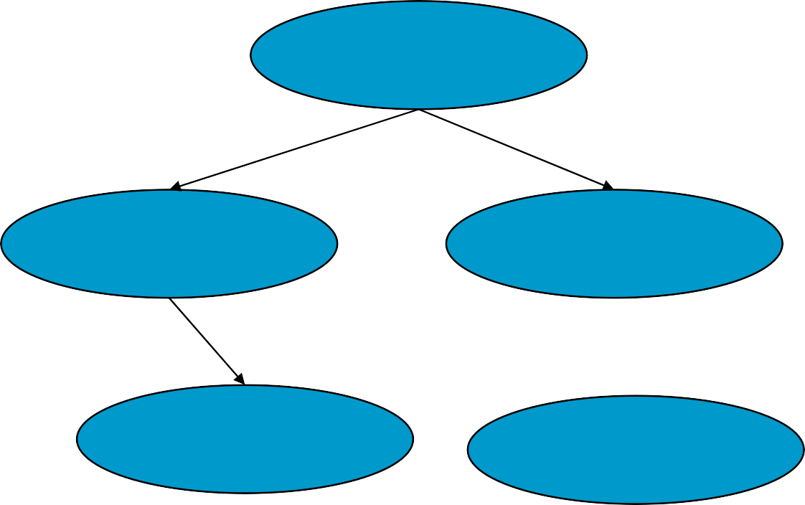
Role of Data Structures (contd.)
8
8
Algorithm
Algorithm
Used
Data Structure
Data Structure
Based on
Array
Primitive Data Structures
Linked List
Implemented into
Data Structure
Programs

Slide 9
Basic Concepts
9
9
System Life Cycle
Data Abstraction and Encapsulation
Algorithm Specification
Performance Analysis and Measurement

Slide 10
Data Abstraction and Encapsulation
10
10
Data encapsulation or information hiding is the concealing of the implementation details of a data object from the outside world
Data abstraction is the separation between the specification of a data object and its implementation
A data type is a collection of objects and a set of operations that act on those objects

Slide 11
Data Abstraction and Encapsulation
11
11
(contd.)
Specification
  Name of function
  Type of arguments
  Types of result
  Description of what the function does (without implementation details)
Representation:
  Implementation details
  E.g., char 1 byte, int 4 bytes

Slide 12
Data Abstraction and Encapsulation
12
12
(contd.)
A abstract data type (ADT) is a data type that
  is organized in such a way that the specification of the objects, and
  the specification of the operations on the objects is separated from the representation of the objects and the implementation of the operations
ADT is implementation-independent

Slide 13
13
13
Abstract data type NaturalNumber (p.9)
ADT NaturalNumber is
objects: an ordered subrange of the integers starting at zero and ending at the maximum integer (INT_MAX) on the computer
functions:
for all x, y ∈ Nat_Number; TRUE, FALSE ∈ Boolean and where +, -, <, and == are the usual integer operations.
Zero ( ):NaturalNumber Is_Zero(x):Boolean
::= 0
::= if (x) return FALSE else return TRUE
::= if ((x+y) <= INT_MAX)
return x+y
else return INT_MAX
::= if (x== y) return TRUE else return FALSE
::= if (x == INT_MAX)
return x else return x+1
::= if (x<y) return 0 else return x-y
Add(x, y):NaturalNumber
Equal(x,y):Boolean
Successor(x):NaturalNumber
Subtract(x,y):NaturalNumber
end Natural_Number

Slide 14
Basic Concepts
14
14
System Life Cycle
Data Abstraction and Encapsulation
Algorithm Specification
Performance Analysis and Measurement

Slide 15
Algorithm Specification
15
15
Definition
  An algorithm is a finite set of instructions that accomplishes a particular task.
Criteria
  Input
  Output
  Definiteness: clear and unambiguous
  Finiteness: terminate after a finite number of steps
  Effectiveness: instruction is basic enough to be carried out

Slide 16
Algorithm Specification (contd.)
16
16
One difference between an algorithm and a program is that the latter does not have to satisfy the fourth condition
  Program doesn’t have to be finite
  E.g., OS scheduling

Slide 17
Example 1: Selection Sort
17
17
From those integers that are currently unsorted, find the smallest and place it next in the sorted list.
for ( i=0; i<n; i++)
{
list[n-1] and suppose
Examine list[i] to
that smallest integer
is list[min]
Interchange list[i]
& list[min]
}

Slide 18
Example 1: Selection Sort (contd.)
18
18
void sort(int
{
list[
], int n)
for (i=0;
{
i<n-1;
= i;
i++)
int min for
(j=i+1; j<n; j++)
if (list[j]<list[min])
min=j;
SWAP(list[i], list[min],
temp);
}
}

Slide 19
Example 1: Selection Sort (contd.)
19
19
Input
– 20 10 15 6 17 30
Iteration 1
  Scan from list[0] to list[5]
  The smallest one is 6
  Swap 6 and list[0]
– 6 10 15 20 17 30

Slide 20
20
20

Slide 21
Example 2: Binary Search
21
21
while (there
{
are more
integers
to check)
middle
= (left
+ right) /2;
if (searchnum
< list[middle])
-1;
right
= middle
else if
(searchnum
== list[middle])
return else
left =
middle;
middle+1;
}

Slide 22
Example 2: Binary Search (contd.)
22
22
int compare(int x, int y)
/* return -1 for less than, 0 int binsearch(int list[], int
int right)
{
for equal */ searchno, int left,
while (left <= right) {
middle switch
case
= (left + right) / 2;
( COMPARE(list[middle],
-1:
searchno) ) {
left = middle +1; break;
case 0:
return middle; case 1:
right = middle -1;
}
}
}

Slide 23
Example 2: Binary Search (contd.)
23
23
Input
– 1 3 7 9 13 20 31
Search for 7
Search for 16

Slide 24
Search for 7
24
24

Slide 25
25
25
Search for 16

Slide 26
Example 2: Binary Search (contd.)
26
26
Comparison between sequential search and binary search
  Binary search is faster than sequential search
  However, binary search requires the input to be sorted in advance
Should we always use binary search?
  Not necessary.

Slide 27
Example 3: Selection Problem
27
27
Selection problem: select the k-th largest among N numbers
Approach 1
  Read N numbers into an array
  Sort the array in decreasing order
  Return the element in position k

Slide 28
Example 3: Selection Problem (contd.)
28
28
Approach 2
  Read k elements into an array
  Sort them in decreasing order
  For each remaining elements, read one by one
  Ignored if it is smaller than the k-th element
  Otherwise, place in correct place and bumping one out of array

Slide 29
Example 3: Selection Problem (contd.)
29
29
Input
– 20 9 15 6 17 30
Find the third largest number
Read three numbers and sort them in descending order
– 20 15 9
Read next: “6”
– 20 15 9

Slide 30
Example 3: Selection Problem (contd.)
30
30
Read next: “17”
– 20 17 15
  9 has been kicked out
Read next: “30”
– 30 20 17
  15 has been kicked out
The third largest number is 17

Slide 31
Example 3: Selection Problem (contd.)
31
31
Which one is better?
  Implementation difficulty
  Efficiency
    Time complexity analysis
Remember that time complexity is not the only yardstick
  Space complexity
  Easy to implement
– …

Slide 32
Recursive Algorithms
32
32
Recursion is usually used to solve a problem in a “divided-and-conquer” manner
Direct recursion
  Functions that call themselves
Indirect recursion
  Functions that call other functions that invoke calling function again
■ C(n,m) = n!/[m!(n-m)!]
– C(n,m)=C(n-1,m)+C(n-1,m-1)
Boundary condition for recursion

Slide 33
Recursive Summation
33
33
■ sum(1, n)=sum(1, n-1)+n
■ sum(1, 1)=1
int sum(int n)
{
if (n==1) return (1);
else
return(sum(n-1)+n);
}

Slide 34
Recursive Factorial
34
34
■ n!=n×(n-1)!
fact(n)=n×fact(n-1)
■ 0!=1
int fact(int n)
{
if ( n== 0) return (1);
else
return
(n*fact(n-1));
}

Slide 35
Recursive Multiplication
35
35
■ a×b=a×(b-1)+a
■ a×1=a
int mult(int
{
if ( b==1)
a, int b)
return (a); else
return(mult(a,b-1)+a);
}

Slide 36
Recursive Binary Search
36
36
int binsearch(int list[], int searchno, int left, int right)
{
if (left middle switch
case
<= right) {
= (left + right)/2; (COMPARE(list[middle], searchno) ) {
-1:
return
binsearch(list, searchno, middle+1, right)
case 0: return
case 1:
return
middle;
binsearch(list, middle-1);
searchno,
left,
}
}
return -1;
}

Slide 37
Recursive Permutations
37
37
Permutation of {a, b, c}
– (a, b, c), (a, c, b)
– (b, a, c), (b, c, a)
– (c, a, b), (c, b, a)
Recursion?
  a+Perm({b,c})
  b+Perm({a,c})
  c+Perm({a,b})

Slide 38
Perm(abc,2,3)
38
38
Perm(abc,3,3)
Perm(abc,1,3)
a ↔ a perm(abc,2,3) a ↔ a
a ↔ b perm(bac,2,3) b ↔ a
a ↔ c perm(cba,2,3) c ↔ a
b ↔ b perm(abc,3,3) b ↔ b
b ↔ c perm(acb,3,3)
c ↔ b
Print(abc)
Perm(acb,3,3)
Print(acb)
Perm(bac,2,3)
Perm(bac,3,3)
a ↔ a perm(bac,3,3) a ↔ a
a ↔ c perm(bca,3,3)
c ↔ a
Print(bac)
Perm(bca,3,3)
Print(bca)
Perm(cba,2,3)
Perm(cba,3,3)
b ↔ b perm(cba,3,3) b ↔ b
b ↔ a perm(cab,3,3) a ↔ b
Print(cba)
Perm(cab,3,3)
Print(cab)

Slide 39
Recursive Permutations (contd.)
39
39
void perm(char *list, int i, int n)
{
if (i==n) {
for (j=0; j<=n; j++) printf("%c", list[j]);
}
else {
for (j=i;
j<= n; j++) {
SWAP(list[i],
list[j],
temp);
perm(list, i+1, n);
SWAP(list[i], list[j],
temp);
}
}
}

Slide 40
Basic Concepts
40
40
System Life Cycle
Data Abstraction and Encapsulation
Algorithm Specification
Performance Analysis and Measurement

Slide 41
Performance Evaluation
41
41
Criteria
  Is it correct?
  Is it readable?
Performance analysis
  Machine independent
Performance measurement
  Machine dependent

Slide 42
Performance Analysis
42
42
Complexity theory
Space complexity
  Amount of memory
Time complexity
  Amount of computing time

Slide 43
Space Complexity
43
43
S(P) = c + S_{p}(I)
  c: fixed space (instruction, simple variables, constants)
  S_{p}(I): depends on characteristics of instance I
  Characteristics: number, size, values of I/O associated with I
If n is the only characteristic, S_{p}(I)= S_{p}(n)

Slide 44
Program
44
44
1.12:
(p.38)
float abc(float a, float b, float c)
{
return
a+b+b*c+(a+b-c)/(a+b)+4.00;
}
S_{abc}(I) = 0
Program
1.13
(p.39)
float sum(float
{
float tempsum
list[
= 0;
], int n)
S_{sum}(I) = 0
Recall: pass the address of the first element of the array & pass by value
int i; for (i=0;
i<n; i++)
+= list [i];
tempsum
return
tempsum;
}

Slide 45
45
45
Program 1.14: (p.39)
float rsum(float list[
], int n)
{
if (n)
return
rsum(list,
n-1) + list[n-1];
return 0;
}
S_{sum}(I)=S_{sum}(n)=6n
Assumptions:
Space needed for one recursive call of the program
Type | Name | Number of bytes
Parameter: float | list[ ] | 2
Parameter: integer | n | 2
Return address: (used |  | 2 (unless a far address)
internally)
Total |  | 6

Slide 46
Time Complexity
46
46
T(P) = c + T_{p}(I)
  c: compile time
  T_{p}(I): program execution time
    Depends on characteristics of instance I
Predict the growth in run time as the instance characteristics change

Slide 47
Time Complexity (contd.)
47
47
Compile time (c)
– Independent of instance characteristics
Run (execution) time T_{P}
A program step is a syntactically or semantically meaningful program segment whose execution time is independent of the instance characteristics.

Slide 48
Methods to Compute the Step Count
48
48
Introduce variable count into programs
Tabular method
Determine the total number of steps contributed by each statement
step per execution × frequency
Add up the contribution of all statements

Slide 49
Program 1.15: p.44)
49
49
float sum(float list[
{
], int n)
float tempsum
= 0;
/* for
count++;
assignment */
int i; for (i=0;
i<n; i++) {
the for
count++; tempsum += count++;
/* for
loop */
list[i];
/* for
assignment */
}
count++;
/* last execution
/* for return */
of for */
count++;
return
tempsum;
2n+3 steps
}

Slide 50
50
50
Program 1.17: (p.45)
float rsum(float
{
count++;
list[
], int n)
T(n)
=2+T(n-1)
=2+2+T(n-2)
…
=2n+T(0)
=2n+2
/* for if if (n<=0)
conditional */
{
count++;
// for
return
return 0
}
else {
count++;
// for
return
return
rsum(list,
n-1)
+ list[n-1];
}
count++;
return
list[0];
}

Slide 51
Tabular Method
51
51
Table 1.1: Step count table for Program 1.13 (p.48)
Statement | s/e | Frequency | Total steps
float sum(float list[ ], int n) { float tempsum = 0; for(int i=0; i <n; i++) tempsum += list[i]; return tempsum; } | 0 1 1 1 1 0 | 1 1 n+1 n 1 1 | 0 1 n+1 n 1 0
Total | 2n+3
s/e: steps per execution

Slide 52
Time Complexity
52
52
Cases
  Worst case
  Best case
  Average case
Worst case and average case analysis is much more useful in practice

Slide 53
Time Complexity (contd.)
53
53
Difficult to determine the exact step counts
What a step stands for is inexact
– e.g. x := y v.s. x := y + z + (x/y) + …
Exact step count is not useful for comparison
Step count doesn’t tell how much time step takes
Just consider the growth in run time as the instance characteristics change

Slide 54

Asymptotic Notation -Big “oh”
54
54
f(n)=O(g(n)) iff
– ∃ a real constant c>0 and an integer constant n₀≧1, f(n) ≤ cg(n) ∀ n, n ≥ n₀

Slide 55
Asymptotic Notation -Big “oh” (contd.)
55
55
Examples
– 3n+2 =O(n)
3n+2≤4n for all n≥2
– 10n²+4n+2=O(n²)
10n²+4n+2≤11n² for all n≥10
– 3n+2 = O(n²)
3n+2≤n² for all n≥4 Not tight enough
g(n) should be a lowest upper bound

Slide 56

Asymptotic Notation -Omega
56
56
f(n)=Ω(g(n)) iff
– ∃ a real constant c>0 and an integer constant n₀≧1, f(n) ≥ cg(n) ∀ n, n ≥ n₀

Slide 57
Asymptotic Notation –Omega (contd.)
57
57
Examples
– 3n+3=Ω(n)
3n+3≥3n for all n≥1
– 6*2^{n}+n²= Ω(2^{n})
6*2^{n}+n²≥2^{n} for all n≥1
– 3n+3= Ω(1)
3n+3≥3 for all n≥1
g(n) should be the highest lower bound

Slide 58
Asymptotic Notation -Theta
58
58
■ f(n)=Θ(g(n)) iff
– ∃ two positive real constants c₁,c₂>0, and an integer constant n₀ ≧1, c₁g(n) ≤ f(n) ≤
c₂g(n) ∀ n, n ≥ n₀
2
1
0

Slide 59
Asymptotic Notation –Theta (contd.)
59
59
Examples
– 3n+2= Θ(n) 3n≤3n+2≤4n, for all n≥2
– 10n²+4n+2= Θ(n²)
10n²≤10n²+4n+2≤11n², for all n≥5
g(n) should be both lower bound & upper bound

Slide 60
Some Rules
60
60
Rule 1:
If T₁(N)=O(f(N)) and T₂(N)=O(g(N)) Then
(a) T₁(N)+T₂(N) = max ( O(f(N)), O(g(N)) )
(b) T₁(N)×T₂(N) = O( f(N)×g(N) )
Rule 2:
If T(N) is a polynomial of degree k, then T(N)= Θ(N^{k})

Slide 61
Running Time Calculations
61
61
For loop
for (i=0;
{
i<n;
i++)
x++; y++; z++;
}
■ n×3=O(n)

Slide 62
Running Time Calculations (cont’d)
62
62
Nested for loops
for (i=0; i <n;
i++)
for (j=0; k++;
j<n;
j++)
■ n×n=O(n²)

Slide 63
Running Time Calculations (cont’d)
63
63
Consecutive statements
for (i=0; i<n; i++) A[i]=0;
for (i=0; i<n; i++) for (j=0; j<n; j++)
A[i]+=A[j]+i+j
■ max(1×n, 1×n×n)=1×n×n=O(n²)

Slide 64
Running Time Calculations (cont’d)
64
64
If/Else
if
(i>0) {
i++; j++;
}
else {
for (j=0;
j<n;
j++)
k++;
}
■ max(2, 1×n)=n

Slide 65
Running Time Calculations-
65
65
Recursive
T(N)
=T(N-1)+c
=T(N-2)+2c
…
=T(1)+(N-1)c
=cN-c+1
=O(N)
long int F(int N)
{
if (N<=1)
return 1; else
return
N*F(N-1);
}

Slide 66
Typical Growth Rate
66
66
c:
log N:
log²N:
N:
NlogN:
■ N²:
■ N³:
■ 2^{N}:
constant logarithmic Log-squared Linear
Quadratic Cubic Exponential

Slide 67
67
67
70
logn n nlogn
60
50
40
n^2
30
2^n
20
10
0
0
1
2
3
4
5
n->
6
7
8
9 10

Slide 68
Performance Measurement
68
68
Timing event
In C’s standard library time.h
  Clock function: system clock
  Time function

