Slide 1

Arrays
Peng, Sheng-Lung
& Ondřej Navrátil
Department of Computer Science National Dong Hwa University

Slide 2

Arrays
2
2
Array: a set of index and value
Uniform elements – same data type
Data structure
  For each index out of a certain pool, there is a value associated with that index.
Representation (possible)
  Implemented by using consecutive memory.
Example: int list[5]: list[0], …, list[4] each contains an integer
 | 0 | 1 | 2 | 3 | 4
list
2

Slide 3

3
3
class GeneralArray {
/* objects: A set of pairs < index, value> where for each value
of index in IndexSet there is a value of type float. IndexSet is a finite ordered set of one or more dimensions, for example, {0, …, n-1} for one dimension, {(0, 0), (0, 1), (0,
2), (1, 0), (1, 1), (1, 2), (2, 0), (2, 1), (2, 2)} for two
dimensions, etc. */
public:
GeneralArray(int j; RangeList list, float initValue = defatultValue);
/* The constructor GeneralArray creates a j dimensional array of floats; the range of the kth dimension is given by the kth element of list. For each index i in the index set, insert <i, initValue> into the array. */
float Retrieve(index i);
/* if (i is in the index set of the array) return the float associated with i in the array; else signal an error */ void Store(index i, float x);
/* if (i is in the index set of the array) delete any pair of the form <i, y> present in the array and insert the new pair <i,
x>; else signal an error. */
}; // end of GeneralArray
3

Slide 4
Ordered List
4
4
Ordered (linear) list
  (item₁, item₂, item₃, …, item_{n})
Examples:
  (MONDAY, TUEDSAY, WEDNESDAY, THURSDAY, FRIDAY, SATURDAYY, SUNDAY)
– (2, 3, 4, 5, 6, 7, 8, 9, 10, Jack, Queen, King, Ace)
– (1941, 1942, 1943, 1944, 1945)
– (a1, a2, a3, …, an-1, an)

Slide 5
Operations on Ordered List
5
5
Find the length, n, of the list.
Read the items from left to right (or right to left).
Retrieve the i-th element.
Store a new value into the i-th position.
Insert a new element at the position i , causing elements numbered i, I+1, …, n to become numbered i+1, i+2, …, n+1
Delete the element at position i , causing elements numbered i+1, …, n to become numbered i, i+1, …, n-1

Slide 6
Implementation on Ordered List
6
6
Implemeting ordered list by array
Sequential mapping
– (1)~(4) O
– (5)~(6) X
Performing operations 5 and 6 requires data movement
  Costly
This overhead motivates us to consider non- sequential mapping of order lists in Chapter 4
  Linked list
 | 0 | 1 | 2 | 3 | 4
list

Slide 7
Polynomial
7
7
Example:
– A(X)=3X²+2X+4, B(X)=X⁴+10X³+3X²+1
The largest exponent of a polynomial is called is degree
A polynomial is called sparse when it has many zero terms
Implement polynomials by arrays

Slide 8


8
8
class polynomial
{
objects: p( x) = a x^{e1} + ... + a x^{en}
a set of ordered pairs of <e , a >
1 n
i i
where a_{i} ∈Coefficient and e_{i} ∈ Exponent
We assume that Exponent consists of integers ≥ 0
public:
Polynomial();
// return the polynomial p(x) = 0
int operator!();
// if *this is the zero polynomial, return 1; else return 0; Coefficient Coef(Exponent e);
// return the coefficient of e in *this Exponent LeadExp();
// return the largest exponent in *this Polynomial Add(Polynomial poly);
// return the sum of the polynomials *this and poly Polynomial Mult(Polynomial poly);
// return the product of the polynomials *this and poly
float Eval(float f);
// Evaluate the polynomial *this at f and return the result
}; end of Polynomial
8

Slide 9
Polynomial Representation #1
9
9
private:
int degree;
// degree
≤ MaxDegree
float coef
[MaxDegree
+ 1];
x⁴+10x³+3x²+1
0 | 1 | 2 | 3 | 4
1 | 0 | 3 | 10 | 1
CoeffArray
Waste space when the degree of the polynomial is
much smaller than MaxDegree
9

Slide 10
Polynomial Representation #2
10
10
private:
int degree;
// degree
≤ MaxDegree
float *coef;
Polynomial::Polynomial(int d)
{
degree=d;
coef=new float[degree+1];
}
Waste space when the polynomial is sparse (e.g., x¹⁰⁰⁰+1)
10

Slide 11
Polynomial Representation #3
11
11
Use one global array to store all polynomials
Class member free gives the location of the next free location
A(X)=2X¹⁰⁰⁰+1
– B(X)=X⁴+10X³+3X²+1
 | A.Start | A.Finish | B.Start |  |  | B.Finish | free
coef | 2 | 1 | 1 | 10 | 3 | 1
exp | 1000 | 0 | 4 | 3 | 2 | 0
Index | 0 | 1 | 2 | 3 | 4 | 5 | 6
Specification: polynomial
Representation: <start, finish>
A B
<0,1>
<2,5>
11

Slide 12
Storage requirements: start, finish, 2*(finish-start+1) Non sparse: twice as much as representation 2
12
12
when all the items are nonzero
class term {
friend Polynomial;
private:
float coef; int exp; | // // | coefficient exponent
}; class Polynomial; | // | forward delcaration
private: static
term
termArray[MaxTerms];
static int free;
int Start, Finish;
term Polynomial::
termArray[MaxTerms];
// location of next
// in temArray
free location
int Polynomial::free = 0;
12

Slide 13
Adding Two Polynomials
13
13
 | A.Start | A.Finish | B.Start |  |  | B.Finish | free
coef | 2 | 1 | 1 | 10 | 3 | 1
exp | 1000 | 0 | 4 | 3 | 2 | 0
Index | 0 | 1 | 2 | 3 | 4 | 5 | 6
a
b
coef
Exp
Index | 7 | 8 | 9 | 10 | 11 | 12 | 13
13

Slide 14
14
Polynomial Polynomial:: Add(Polynomial B)
// return the sum of A(x) ( in *this) and B(x)
{
14
Polynomial C; int a = Start; int b = B.Start; C.Start = free; float c;
while ((a <= Finish) && (b <= B.Finish))
switch (compare(termArray[a].exp, termArray[b].exp)) {
case ‘=‘:
c = termArray[a].coef +termArray[b].coef;
if ( c ) NewTerm(c, termArray[a].exp); a++; b++;
break;
case ‘<‘:
NewTerm(termArray[b].coef, termArray[b].exp); b++;
case ‘>’:
NewTerm(termArray[a].coef, termArray[a].exp); a++;
} // end of switch and while
Analysis: O(n+m) where n (m) is
// add in remaining terms of A(x)
for (; a<= Finish; a++)
the number of non-zeros in A(B).
NewTerm(termArray[a].coef, termArray[a].exp);
// add in remaining terms of B(x)
for (; b<= B.Finish; b++) NewTerm(termArray[b].coef, termArray[b].exp);
C.Finish = free – 1;
return C;
} // end of Add
14

Slide 15
Adding a New Term
15
15
void
Polynomial::NewTerm(float
c, int e)
// Add a new term to C(x)
{
if (free >= MaxTerms) {
cerr << "Too many terms in
exit();
polynomials"<< endl;
}
termArray[free].coef = c; termArray[free].exp = e; free++;
} // end of NewTerm

Slide 16
Disadvantages of Representing
16
16
Polynomials by Arrays
The value of free is continually incremented until it tries to exceed MaxTerms
What should we do when free is going to exceed MaxTerms?
  Either quit or reuse the space of unused polynomials by compacting the global array
  It is costly!
A more elegant solution is proposed in Chapter 4 by employing linked list

Slide 17
Sparse Matrix
17
17
A general matrix consists of m rows and n columns of numbers
  An m×n matrix
  It is natural to store a matrix in a two- dimensional array, say A[m][n]
A matrix is called sparse if it consists of many zero entries
Implementing a spare matrix by a two- dimensional array waste a lot of memory
Space complexity is O(m×n)
17

Slide 18
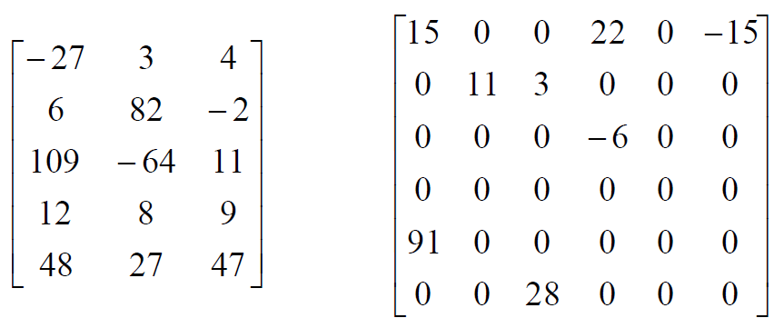
Sparse Matrix (contd.)
18
18
5x5
(a)
6×6
(b)
Figure 2.2: Two matrices
sparse matrix
18

Slide 19
Sparse Matrix Abastract Data Type
19
19
class SparseMatrix
/* objects: A set of triples, <row, column, value>, where row and column are integers and form a unique combinations; value is also an integer. */
public:
SparseMatrix(int MaxRow, int MaxCol);
/* the constructor function creates a SparseMatrix that can hold up to MaxInterms = MaxRow x MaxCol and whose maximum row size is MaxRow and whose maximum column size is MaxCol */
SparseMatrix Transpose();
/* returns the SparseMatrix obtained by interchanging
the row and column value of every triple in *this */
19

Slide 20
SparseMatrix Add(SparseMatrix b);
20
20
/* if the dimensions of a (*this) and b are the same, then the matrix produced by adding corresponding items, namely those with identical row and column values is returned
else error. */
SparseMatrix Multiply(SparseMatrix b);
/* if number of columns in a (*this) equals number of rows in b then the matrix d produced by multiplying a by b according to the formula d[i][j] = Σ(a[i][k] . b[k][j]), where d[i][j] is the (i, j)th element, is returned. k ranges from 0 to the number of columns in a – 1
else error
*/

Slide 21
Sparse Matrix Representation
21
21
Use triple <row, column, value>
Store triples row by row
For all triples within a row, their column indices are in ascending order.
Must know the numbers of rows and columns and the number of nonzero elements

Slide 22
22
22
•Represented by a two-dimensional array.
•Sparse matrix wastes space.
•Each element is characterized by <row, col, value>
row |  | col | value |  | row | col | value
a[0] 0 |  | 0 | 15 | b[0] | 0 | 0 | 15
[1] 0 |  | 3 | 22 | [1] | 0 | 4 | 91
[2] 0 |  | 5 | -15 | [2] | 1 | 1 | 11
[3] 1 |  | 1 | 11 | [3] | 2 | 1 | 3
[4] 1 2 3 _{transpose} [4] 2 5 28
[5] | 2 | 3 | -6 | [5] | 3 | 0 | 22
[6] | 4 | 0 | 91 | [6] | 3 | 2 | -6
[7] | 5 | 2 | 28 | [7] | 5 | 0 | -15
(a) (b)
row, column in ascending order

Slide 23
class
23
23
SparseMatrix; //
forward
declaration
class
MatrixTerm {
friend class
SparseMatrix
private:
int row, col,
value;
};
In class private:
SparseMatrix:
int Rows, Cols,
Terms;
MatrixTerm
smArray[MaxTerms];

Slide 24
Transpose a Matrix
24
24
For each row i
take element <i, j, value> and store it
in element <j, i, value> of the transpose.
difficulty: where to put <j, i, value> (0, 0, 15) ====> (0, 0, 15)
(0, 3, 22) ====> (3, 0, 22)
(0, 5, -15) ====> (5, 0, -15)
(1, 1, 11) ====> (1, 1, 11)
Move elements down very often.
For all elements in column j,
place element <i, j, value> in element <j, i, value>

Slide 25
25
25
row col value
row col value
CurrentB | a[0] | 0 | 0 | 15 | b[0] | 0 | 0 | 15
 | [1] | 0 | 3 | 22 | [1] | 0 | 4 | 91
 | [2] | 0 | 5 | -15 | [2] | 1 | 1 | 11
 | [3] |  |  |  | [3] | 2 | 1 | 3
 | [4] |  |  |  | [4] | 2 | 5 | 28
 | [5] |  |  |  | [5] | 3 | 0 | 22
 | [6] |  |  |  | [6] | 3 | 2 | -6
 | [7] |  |  |  | [7] | 5 | 0 | -15
Iteration 0: scan the array and process the entries with col=0

Slide 26
26
26
row col value
row col value
CurrentB | a[0] | 0 | 0 | 15 | b[0] | 0 | 0 | 15
 | [1] | 0 | 3 | 22 | [1] | 0 | 4 | 91
 | [2] | 0 | 5 | -15 | [2] | 1 | 1 | 11
 | [3] | 1 | 1 | 11 | [3] | 2 | 1 | 3
 | [4] | 1 | 2 | 3 | [4] | 2 | 5 | 28
 | [5] |  |  |  | [5] | 3 | 0 | 22
 | [6] |  |  |  | [6] | 3 | 2 | -6
 | [7] |  |  |  | [7] | 5 | 0 | -15
Iteration 1: scan the array and process the entries with col=1

Slide 27
27
27
SparseMatrix SparseMatrix::Transpose()
// return the transpose of a (*this)
{
SparseMatrix b;
b.Rows = Cols;
// rows in
// columns in b = rows in a
b = columns in a
b.Cols = Rows;
b.Terms = Terms; if (Terms > 0)
{
// terms in b
// nonzero matrix
= terms in a
int CurrentB = 0;
for (int c=0; c<Cols; c++)
// transpose by columns
for (int i = 0; i < Terms; i++)
c
{
// find elements in column
if (smArray[i].col == c)
b.smArray[CurrentB].row=c; b.smArray[CurrentB].col=smArray[i].row; b.smArray[CurrentB].value=
smArray[i].value; CurrentB++;
}
} // end of if (Terms > 0)
Time Complexity O(terms*cols)
return b;
} // end of transpose
27

Slide 28
Compared with 2-Dimensional
28
28
Array Representation
Discussion:
  O(columns×terms) vs. O(columns×rows)
  Terms - columns×rows when non-sparse
  O(columns²×rows) when non-sparse
Problem: Scan the array “columns” times.
Solution:
  Determine the number of elements in each column of the original matrix.
  Determine the starting positions of each row in the transpose matrix.

Slide 29
Fast Matrix Transposing
29
29
Store some information to avoid scanning all terms back and forth
FastTranspose requires more space than Transpose
  RowSize
  RowStart

Slide 30
30
30
row col value
row col value
a[0] | b[0] |  |  |  |  | 0 | 0 | 15
[1] | [1] |  |  |  |  | 0 | 4 | 91
[2] | [2] |  |  |  |  | 1 | 1 | 11
[3] | [3] |  |  |  |  | 2 | 1 | 3
[4] | [4] |  |  |  |  | 2 | 5 | 28
[5] | [5] |  |  |  |  | 3 | 0 | 22
[6] | [6] |  |  |  |  | 3 | 2 | -6
[7] | [7] |  |  |  |  | 5 | 0 | -15
index | [0][1][2][3][4][5]
RowSize | = | 3 | 2 | 1 | 0 | 1 | 1
RowStart | = | 0 | 3 | 5 | 6 | 6 | 7
•Calculate RowSize by scanning array b
•Calculate RowStart by scanning RowSize
30

Slide 31
row col value
31
31
row col value
a[0] | 0 | 0 | 15 |  | b[0] |  |  | 0 | 0 | 15
[1] |  |  |  |  | [1] |  |  | 0 | 4 | 91
[2] |  |  |  |  | [2] |  |  | 1 | 1 | 11
[3] |  |  |  |  | [3] |  |  | 2 | 1 | 3
[4] |  |  |  |  | [4] |  |  | 2 | 5 | 28
[5] |  |  |  |  | [5] |  |  | 3 | 0 | 22
[6] |  |  |  |  | [6] |  |  | 3 | 2 | -6
[7] |  |  |  |  | [7] |  |  | 5 | 0 | -15
index [0][1][2][3][4][5]
RowSize |  |  | = | 3 | 2 | 1 | 0 | 1 | 1
RowStart |  |  | = | 0 | 3 | 5 | 6 | 6 | 7
RowStart[0]++
31

Slide 32
row col value
32
32
row col value
a[0] | 0 | 0 | 15 |  | b[0] |  |  | 0 | 0 | 15
[1] |  |  |  |  | [1] |  |  | 0 | 4 | 91
[2] |  |  |  |  | [2] |  |  | 1 | 1 | 11
[3] |  |  |  |  | [3] |  |  | 2 | 1 | 3
[4] |  |  |  |  | [4] |  |  | 2 | 5 | 28
[5] |  |  |  |  | [5] |  |  | 3 | 0 | 22
[6] | 4 | 0 | 91 |  | [6] |  |  | 3 | 2 | -6
[7] |  |  |  |  | [7] |  |  | 5 | 0 | -15
index [0][1][2][3][4][5]
RowSize |  |  | = | 3 | 2 | 1 | 0 | 1 | 1
RowStart |  |  | = | 1 | 3 | 5 | 6 | 6 | 7
RowStart[4]++
32

Slide 33
row col value
33
33
row col value
a[0] | 0 | 0 | 15 |  | b[0] |  |  | 0 | 0 | 15
[1] | 0 | 3 | 22 |  | [1] |  |  | 0 | 4 | 91
[2] | 0 | 5 | -15 |  | [2] |  |  | 1 | 1 | 11
[3] | 1 | 1 | 11 |  | [3] |  |  | 2 | 1 | 3
[4] | 1 | 2 | 3 |  | [4] |  |  | 2 | 5 | 28
[5] | 2 | 3 | -6 |  | [5] |  |  | 3 | 0 | 22
[6] | 4 | 0 | 91 |  | [6] |  |  | 3 | 2 | -6
[7] | 5 | 2 | 28 |  | [7] |  |  | 5 | 0 | -15
index [0][1][2][3][4][5]
RowSize |  |  | = | 3 | 2 | 1 | 0 | 1 | 1
RowStart |  |  | = | 0 | 3 | 5 | 6 | 6 | 7
33

Slide 34
Fast Matrix Transposing (cond.)
34
34
SparseMatrix SparseMatrix::Transpose()
// The transpose of a(*this) is placed in b and is Q(terms + columns) time.
{
int *Rows = new int[Cols];
int *RowStart = new int[Cols]; SparseMatrix b;
b.Rows = Cols; b.Cols = Rows; b.Terms = Terms; if (Terms > 0) // nonzero matrix
{
// compute RowSize[i] = number of terms in row
found in
i of b
for (int i = 0; i < Cols; i++) RowSize[i] = 0;
// Initialize
O(columns)
for ( i = 0; i < Terms; i++) RowSize[smArray[i].col]++;
O(terms)
// RowStart[i] = starting position of row i in b
RowStart[0] = for (i = 1; i RowStart[i]
0;
< Cols; i++)
O(columns-1)
= RowStart[i-1] + RowSize[i-1];

Slide 35
Fast Matrix Transposing (cont’d)
35
35
for (i =0; i < Terms; i++)
{
// move from a to b
int j = RowStart[smArray[i].col];
O(terms)
b.smArray[j].row = b.smArray[j].col = b.smArray[j].value
smArray[i].col; smArray[i].row;
= smArray[i].value;
RowStart[smArray[i].col]++;
} // end of for
} // end of if
delete delete return
} // end
[] RowSize; [] RowStart; b;
of
FastTranspose
O(columns+terms)

Slide 36
Matrix Multiplication
36
36
Definition: Given A and B, where A is m×n and B is n×p, the product matrix Result has dimension m×p. Its [i][j] element is
n−1
result_{ij} = ∑a_{ik}b_{kj}
k =0
for 0 ≤ i < m and 0 ≤ j < p.
Please study Section 2.4.4 by yourself

Slide 37
Representation of Arrays
37
37
Multidimensional arrays are usually implemented by one dimensional array via either row major order or column major order.
Example: One dimensional array
α α+1 α+2 α+3 α+4
A[0] A[1] A[2] A[3] A[4]

Slide 38
Two Dimensional Array Row Major
38
38
Order
Col 0 Col 1 Col 2
X X X
X X X
Col u₂ -1
Row 0
X
Row 1
X
Row u₁ -1
X
X
X
X
u₂ elements | u₂ elements
Row 0 Row 1 i * u₂ eleme
Row i
Row u₁ -1
nt

Slide 39
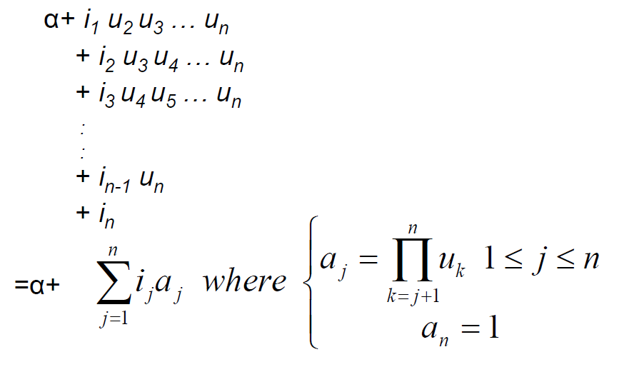
Generalizing Array Representation
39
39
The address indexing of Array A[i₁][i₂],…,[i_{n}] is

Slide 40
String
40
40
Usually string is represented as a character array.
General string operations include comparison, string concatenation, copy, insertion, string matching, printing, etc.
H | e | l | l | o |  | W | o | r | l | d | \0
40

Slide 41
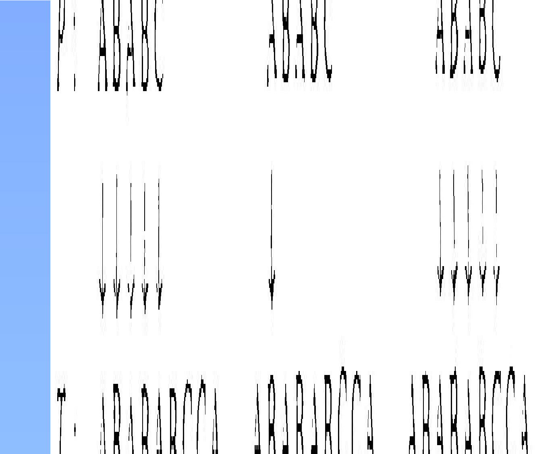
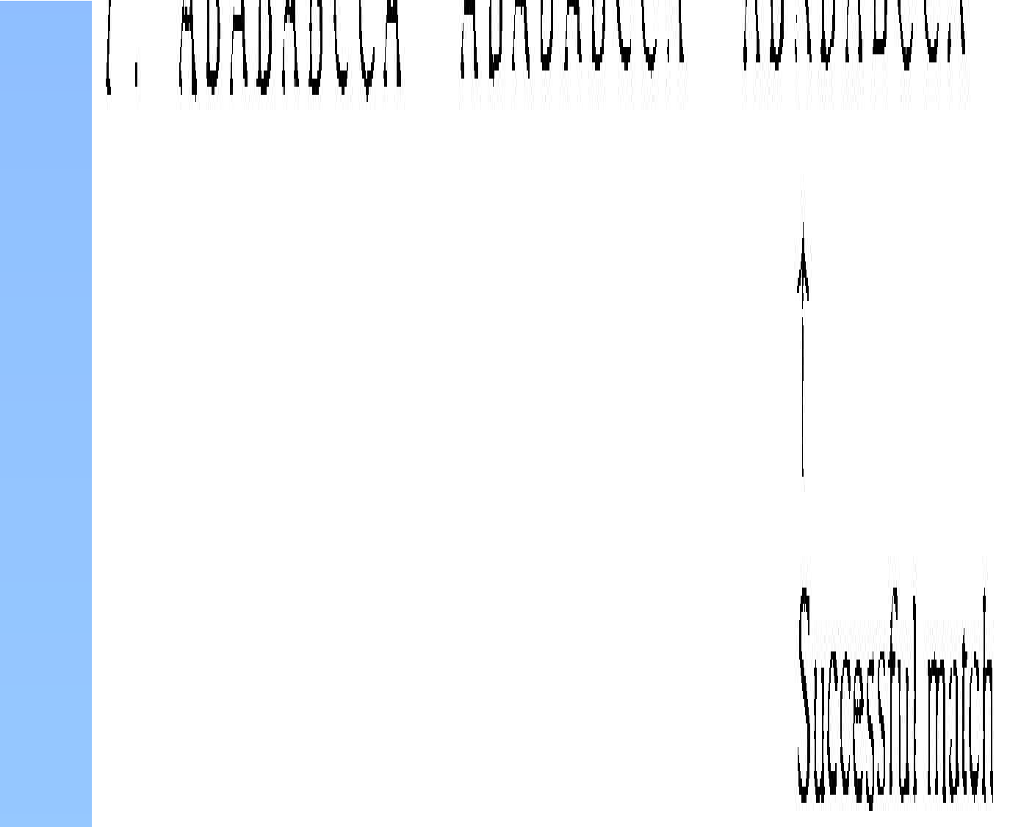
String Matching: Straightforward
41
41
Solution
Algorithm: Simple string matching
Input: P and T, the pattern and text strings; m, the length of P. The pattern is assumed to be nonempty.
Output: The return value is the index in T where a copy of P begins, or -1 if no match for P is found.
Worst-case complexity is θ(mn)

Slide 42
KMP Algorithm
42
42
KMP algorithm
  Proposed by Knuth, Morris and Pratt
Concept
  Use the characteristic of the pattern string
Phase 1:
  Generate an array to indicate the moving direction.
Phase 2:
  Use the array to move and match string

Slide 43
The First Case for the KMP
43
43
Algorithm
0 1 2 3 4 5 6 7 8 9…
0 1 2 3 4
Restart scanning here
0 1 2 3 4 5 6 7 8 9…
0 1 2 3 4
43

Slide 44






The Second Case for the KMP
44
44
Algorithm
0 1 2 3 4 5 6 7 8 9…
0 1 2 3 4 5 6
Restart scanning here
0 1 2 3 4 5 6 7 8 9…
0 1 2 3 4 5 6
44

Slide 45






The Third Case for the KMP
45
45
Algorithm
0 1 2 3 4 5 6 7 8 9…
0 | 1 | 2 | 3 | 4 | 5 | 6 | 7 | 8…
0 | 1 | 2 | 3 | 4 | 5 | 6 | 7 | Restart scanning here 8 9…
0 1 2 3 4 5 6 7 8…
45

Slide 46
KMP Algorithm (cont’d)
46
46
Failure Function
j
P
k
k
Action
S
P
j-1 j
46

Slide 47
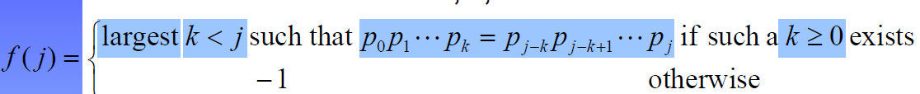
KMP Algorithm (cont’d)
47
47
Definition: If p = p₀p₁…p_{n-1} is a pattern, then its failure function, f, is defined as
If a partial match is found such that s_{i-j} … s_{i-1}
= p₀p₁…p_{j-1} and s_{i} ≠ p_{j} then matching may be resumed by comparing s_{i} and p_{f(j–1)+1} if j ≠ 0. If j = 0, then we may continue by comparing s_{i+1}
and p₀.
47

Slide 48
Fast Matching Example: Failure
48
48
_{Function Calculation} The largest k such that
1. k<j 2. k≥0
^{3. p}0^{p}1^{…p}k^{=p}k-1^{p}j-k+1^{…p}j
■ j=0
Since k<0 and k≧0, no such k exists
– f(0)= -1
■ j=1
Since k<1 and k≧0, k may be 0
When k=0€p₀=a and p₁=b€x
– f(1)= -1
j | 0 | 1 | 2 | 3 | 4 | 5 | 6 | 7 | 8 | 9
p | a | b | c | a | b | c | a | c | a | b
f | -1 | -1 | -1 | 0 | 1 | 2 | 3 | -1 | 0 | 1

Slide 49
Fast Matching Example: Failure
49
49
Function Calculation (contd.)
■ j=2
Since k<2 and k≧0, k may be 0,1
When k=1€p₀p₁=ab and p₁p₂=bc€x
When k=0€p₀=a and p₂=c€x
– f(2)= -1
j 0 1 2 3 4 5 6 7 8 9
p a b c a b c a c a b f -1 -1 -1 0 1 2 3
k=0
-1 0 1
k=1

Slide 50
Fast Matching Example: Failure
50
50
Function Calculation (contd.)
■ j=4
Since k<4 and k≧0, k may be 0, 1, 2, 3
When k=3€p₀p₁p₂p₃=abca and p₁p₂p₃p₄=bcab€x
When k=2€p₀p₁p₂=abc and p₂p₃p₄=cab€x
When k=1€p₀p₁=ab and p₃p₄=ab€ok
When k=0€p₀=a and p₄=b€x
– f(4)=1
j 0 1 2 3 4 5 6 7 8 9
p a b c a b c a c a b
f -1 -1 -1 0 1 2 3 -1 0 1
50

Slide 51
Fast Matching Example: Failure
51
51
Function Calculation (contd.)
A restatement of failure function
■ f(j)=
– -1 if j=0
– f^{m}(j-1)+1 where m is the least integer k for which
p = p
k
j
f ( j−1)+1
– -1 if there is no k satisfying the above
■ f¹(j)=f(j) and f^{m}(j)=f(f^{m-1}(j))
51

Slide 52
Fast Matching Example: String
52
52
Matching
j 0 1 2 3 4 5 6 7 8 9
p a b c a b c a c a b f -1 -1 -1 0 1 2 3 -1 0 1
2: check failure function (f(3))
s = a b c a ? p = a b c a b
? . . . ? ? ? ?
c a c a b
3: move pattern accordingly
1: fail at PosP=4
a b c a b c a c a b
Program 2.15 line 12
PosP=pat.f[PosP-1]+1
52

Slide 53
Fast Matching Example: String
53
53
Matching (contd.)
j | 0 | 1 | 2 | 3 | 4 | 5 | 6 | 7 | 8 | 9
p | a | b | c | a | b | c | a | c | a | b
f | -1 a a | -1 b b | -1 c c | 0 a a | 1 ? b | 2 ? c | 3 . a | -1 . c | 0 . a | 1 ? b
s =
p =
? ? ?
x
Imply f(3)=2 if this comparison is necessary
a b c | a | b | c | a | c | a | b
a b | c | a | b | c | a | c | a | b
a | b | c | a | b | c | a | c | a | b

Slide 54
The Analysis of the KMP Algorithm
54
54
O(m+n)
  O(m) for computing function f
    Program 2.16
  O(n) for searching P
    Program 2.15
The strstr function in Linux kernel 2.4.22 is implemented by exhaustive search
  Why?

Slide 55
Appendix

Slide 56
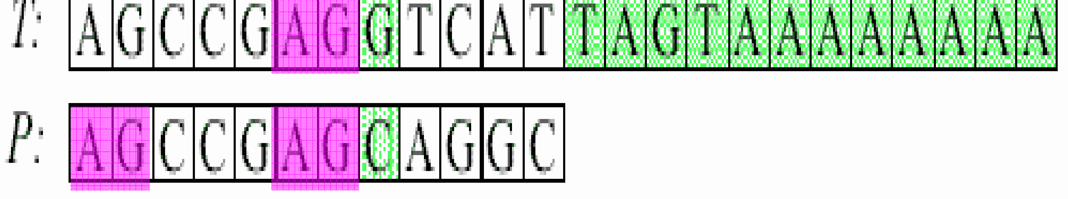

Rationale of KMP
56
56
Since the failure occurs in T₇, we have T₀T₁…T₆=P₀P₁…P₆
Failure occurs
0 1 2 3 4 5 6 7 8 9…
0 1 2 3 4 5 6 7 8…
56

Slide 57
Rationale of KMP (contd.)
57
57
The condition that we can right shift P only one step is T₁T₂…T₆=P₀P₁…P₅
Since T₀T₁…T₆=P₀P₁…P₆, the condition can be rewritten as P₀P₁…P₅=T₁T₂…T₆=P₁P₂…P₆
If the above condition is satisfied, the value of f(6) should be 5
0 1 2 3 4 5 6 7 8 9…
0 1 2 3 4 5 6 7 8…
57

