Slide 1
Project checker

Slide 2
Step 1: Download the code
https://github.com/Aaron-Cai/Checker

Slide 3
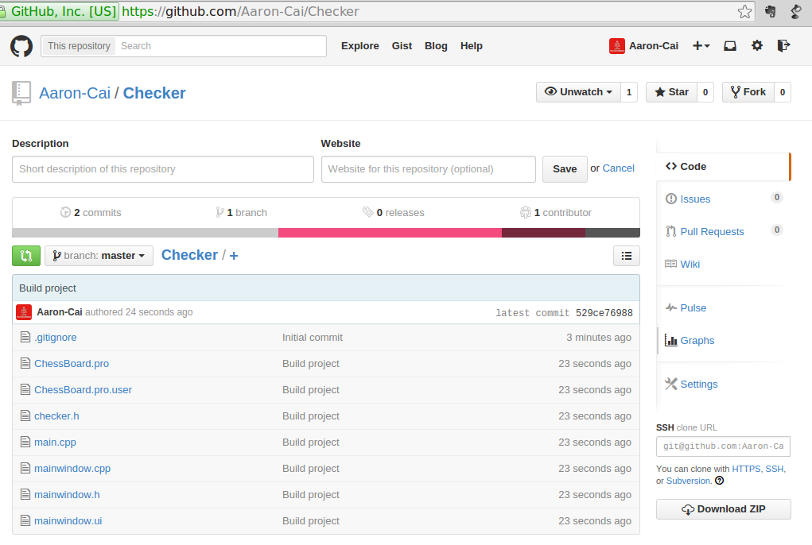

Slide 4
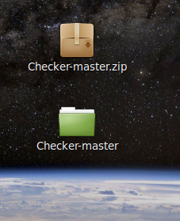
Step 2 Open the project with Qt creator
Unzip the code download first
Open Qt creator and press Open Project
Locate the file and open the project file named 'ChessBoard.pro'

Slide 5
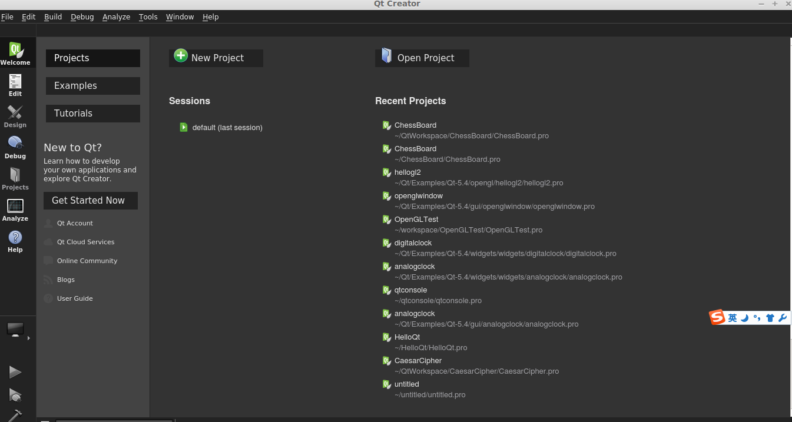

Slide 6
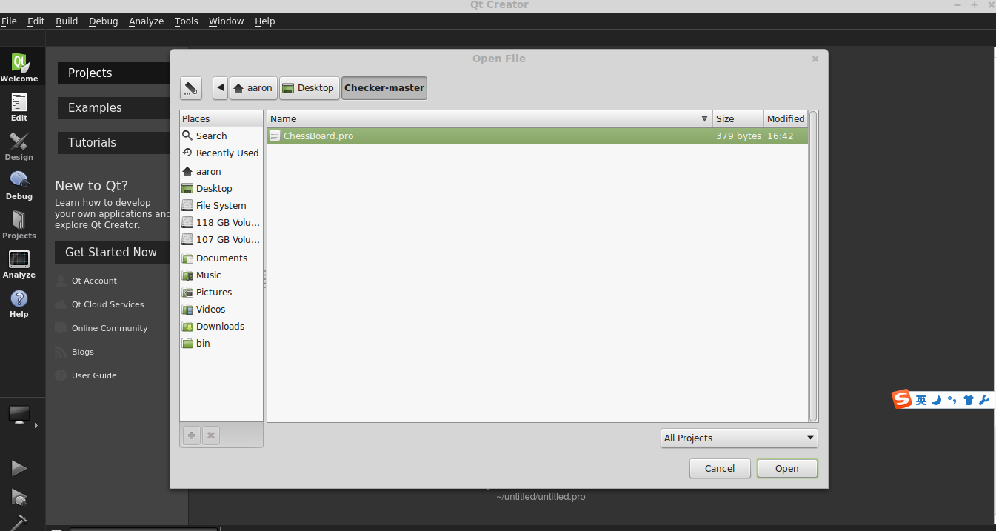

Slide 7
Step 3: Reset the build directory
Click Projects on the left
Choose build directory
Highly recommend to choose the directory just the same folder of the code, could avoid some strange errors

Slide 8
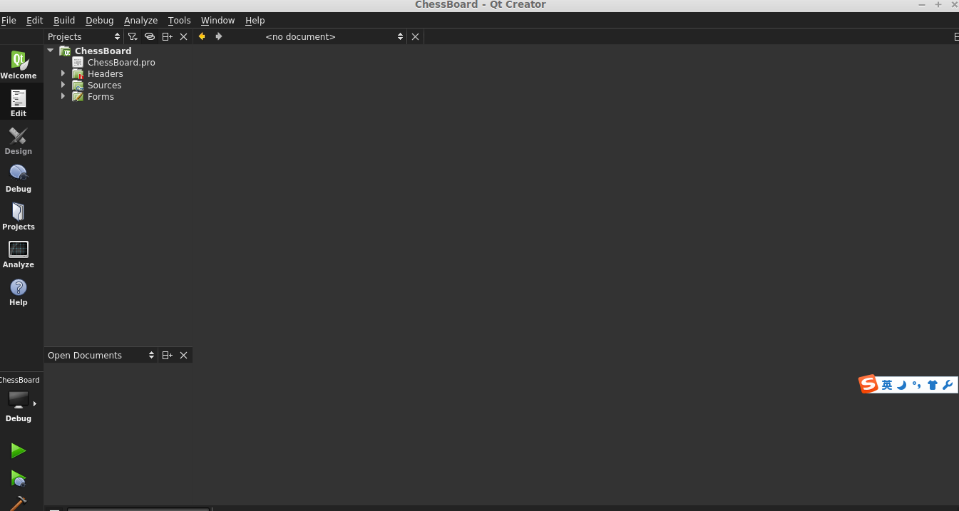

Slide 9
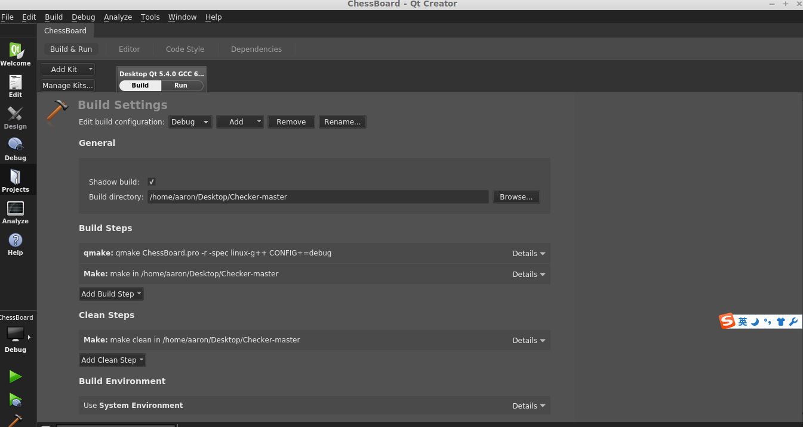

Slide 10
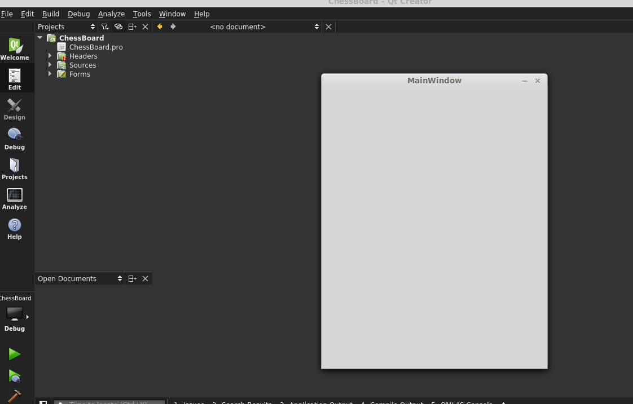
Step 4 Click the run button to check the project
You should get a window like this

