Slide 1
Bank Marketing
Subscription Prediction
Aaron Darcy | Abey Mathew
MSc Data Science - Machine Learning
Notes:
Introduce yourselves. Aaron Darcy and Abey Mathew, MSc Data Science at ATU Donegal.
Say: We picked a real-world dataset from a Portuguese bank and used machine learning to predict which customers would subscribe to a term deposit.
Keep it brief. The next slide sets up the problem properly.

Slide 2
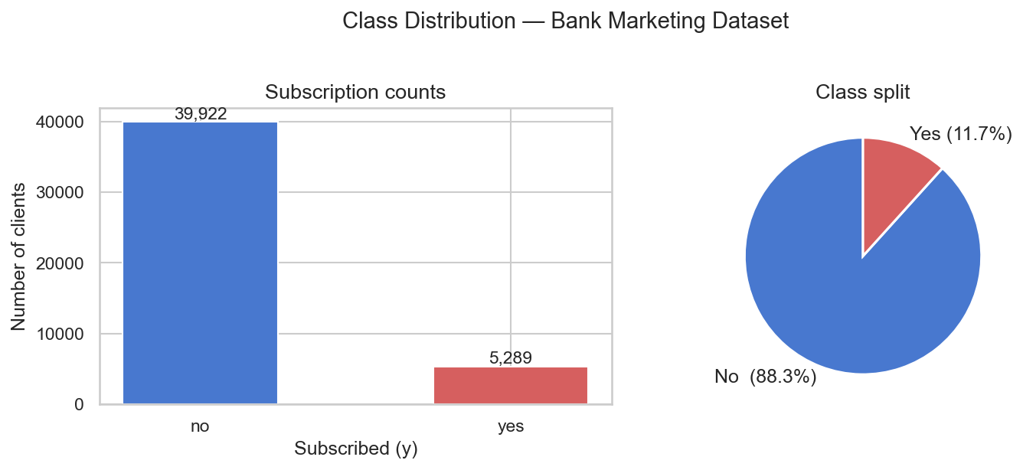
Problem
A bank ran a phone campaign selling term deposits. Most people said no.
A term deposit is a savings product where a customer locks money away for a fixed period in return for a guaranteed interest rate. Banks sell these through phone campaigns.
The bank contacted over 45,000 clients. The problem is that only 11.7% said yes. That is a very imbalanced result and it creates a real challenge for machine learning.
A model that simply predicts no for every single person would be 88% accurate. That sounds good but it is completely useless to the bank because it never identifies a single subscriber.
Our goal: build a model that can find the 12% who will say yes, so the bank can focus its calls on the right people.
45,211
11.7%
88.3%
contacts made
subscribed
said no
2
Notes:
Explain what a term deposit is first. Not everyone will know.
Point to the pie chart. 88% no, 12% yes.
The key point: accuracy alone is a misleading metric here. Stress this. We use ROC-AUC and recall instead throughout the project.
ROC-AUC measures how well the model ranks positive cases above negative ones. Recall measures what fraction of actual subscribers we correctly identified.

Slide 3
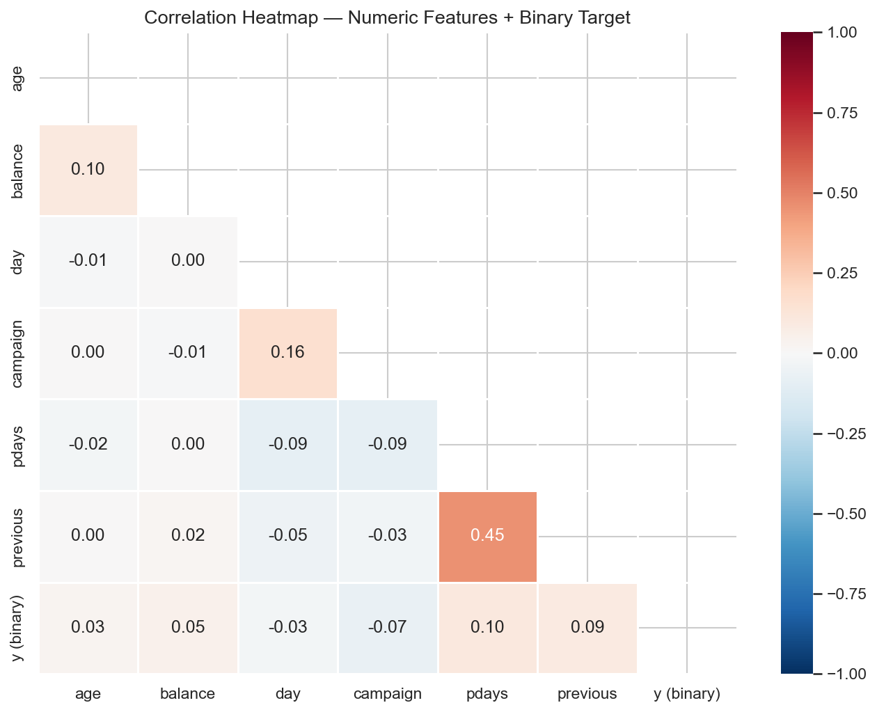
Data
UCI Bank Marketing dataset: one row per client contact, 16 features per row
The dataset comes from the UCI Machine Learning Repository. Each row represents one phone call from a bank campaign. The features describe three things:
Who the client is
Age, job, marital status, education, account balance and whether they have existing loans.
How the campaign contact went
Number of calls made this campaign, contact method, the month and day of the call.
Prior campaign history
Whether the client was contacted in a previous campaign, how many days ago, and what the outcome was.
One feature called duration records the call length in seconds. We removed it immediately: it is only known after the call ends and correlates strongly with the outcome for the wrong reason.
3
Notes:
The heatmap on the right shows correlations between all numeric features and the target.
Nothing correlates very strongly with subscribing except for features related to previous campaign contact. This tells us the problem is not simple.
Mention duration: it would show the highest correlation but we cannot use it because the bank does not know how long a call will last before making it.
After encoding the categorical columns, 16 features become 40 binary and numeric columns.

Slide 4
Cleaning
Four decisions made before any model saw the data
Raw data is rarely ready for a machine learning model. These four steps ensured the data was fair, consistent and free from information leakage.
1
Remove duration
Call length in seconds correlates 0.39 with the outcome but is only known after the call ends. Keeping it would let the model use future information to make predictions. This is called data leakage.
2
Fix unknowns selectively
job (0.6% unknown) and education (4.1% unknown) are genuinely missing and were replaced with the most common value. contact and poutcome unknowns were kept as valid categories: they carry real meaning.
3
Handle the pdays sentinel value
81.7% of rows had pdays = -1, which means the client was never contacted before. This is not a number of days. We replaced it with 0 and added a new binary column called contacted_before.
4
Encode and split
All text columns are converted to 0 and 1 columns using one-hot encoding. The data is then split 80/20 into training and test sets using stratified sampling so both sets have the same 11.7% positive rate.
4
Notes:
Walk through each step.
Step 1: data leakage is worth explaining. It means the model learns from information it would not have in a real deployment. Duration is the most common leakage trap in this dataset and the UCI documentation explicitly warns about it.
Step 2: treating all unknowns the same way would be wrong. contact = unknown means the record type was not captured. poutcome = unknown means no prior campaign existed. Replacing these with the mode would destroy valid information.
Step 3: pdays = -1 is a sentinel, not a number. If we left it in, the scaler would treat -1 as a real value and skew the distribution.
Step 4: stratified split is important. A random split could, by chance, put more subscribers in one set than the other.

Slide 5
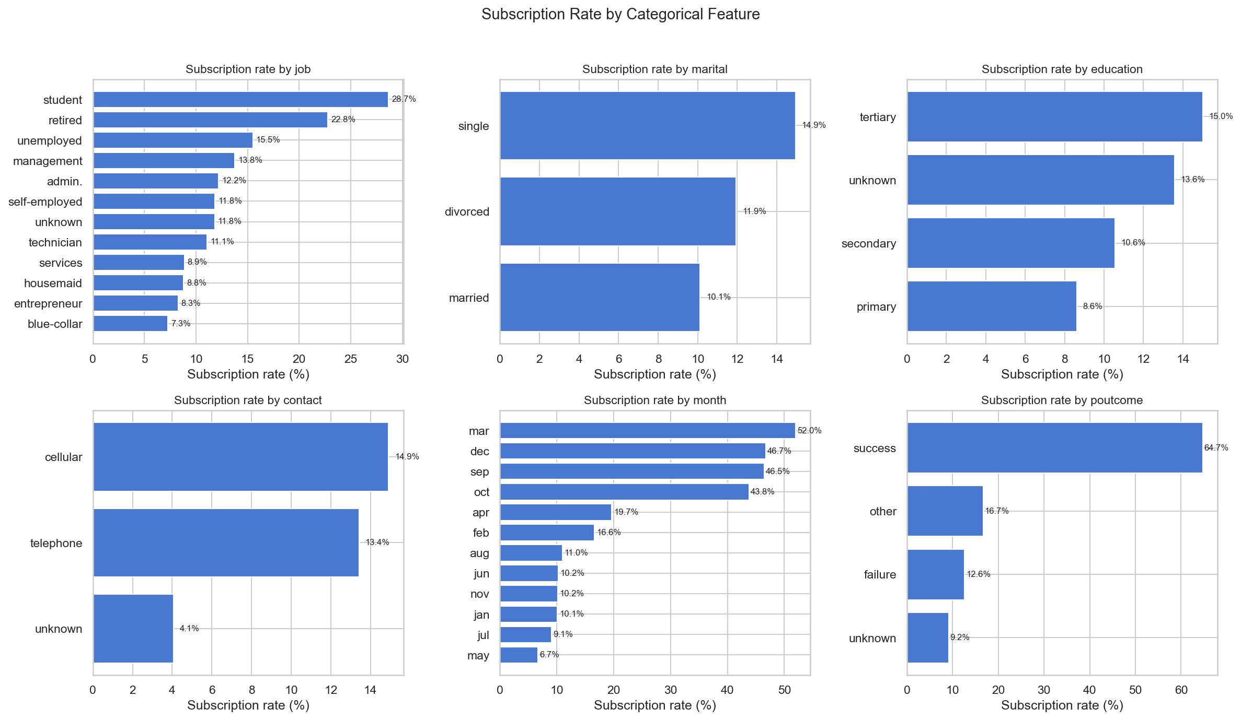
Patterns
Exploratory analysis before modelling: what does the data tell us?
Before training any model, we explored the data to understand which features are most associated with subscription. Three patterns stand out clearly.
Prior outcome is everything
Clients whose previous campaign ended in success convert at 64.7% this time. Clients never contacted before convert at just 9.2%.
Campaign timing matters more than volume
May has the highest number of calls in the dataset but only 6.7% subscribe. March, September, October and December all convert above 43%.
Over-contacting reduces conversion
Clients called more than 3 to 4 times in this campaign are less likely to subscribe than those called once or twice.
5
Notes:
Point to the poutcome panel first. Prior success converts at 64.7%. This is the strongest signal in the whole dataset before we train anything.
Point to the month panel. The bank spent most of its budget in May but got its worst conversion rate there. Q4 is where the money should go.
Point to the campaign panel or mention it verbally: over-contacting damages the relationship.
These patterns shape what the model should learn and they also help us interpret the feature importance results later.

Slide 6
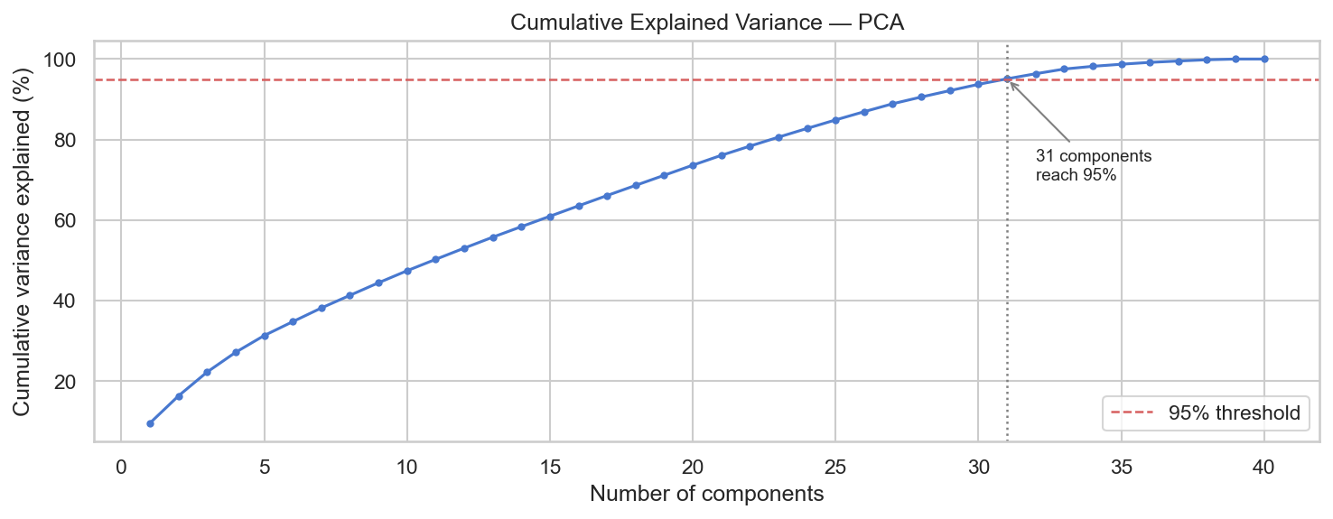
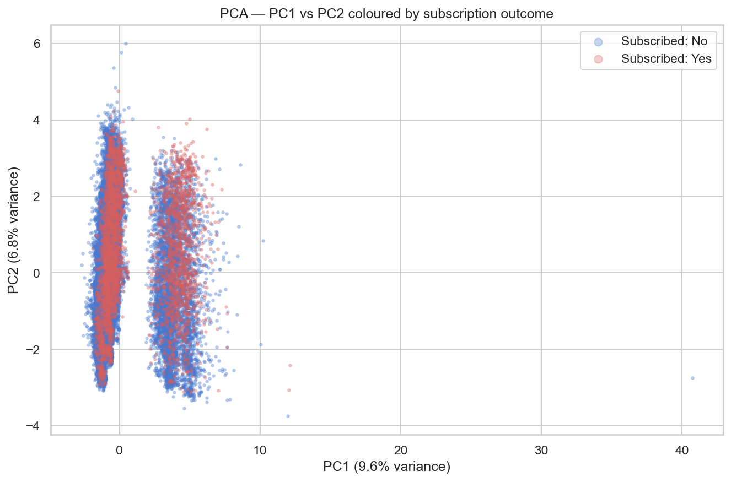
PCA
Dimensionality reduction: compressing 40 features into fewer dimensions for visualisation
PCA stands for Principal Component Analysis. It is a technique that takes a dataset with many features and finds a smaller set of directions that capture most of the variation.
Think of it like finding the best angle to look at a cloud of points so you can see as much spread as possible. We start with 40 features and PCA finds the directions where the data varies most.
We use it to ask one question: when we compress 40 features down to just two dimensions, can we see subscribers and non-subscribers forming separate groups? If yes, a simple model would work. If no, we need something more powerful.
40
31
16.4%
input features
components for 95% variance
variance in first 2 PCs
6
Notes:
Explain PCA in plain terms first. Students may never have heard of it.
The cumulative variance plot at top right: the x-axis is the number of components kept. The y-axis is how much of the original information is retained. We need 31 components to keep 95% of the information.
The scatter plot at bottom right: this is what the data looks like when we keep just the first two components. The blue dots are non-subscribers, red are subscribers. They overlap heavily. There is no clean line we could draw to separate them.
This tells us a simple linear model would not work well. We need non-linear classifiers.

Slide 7
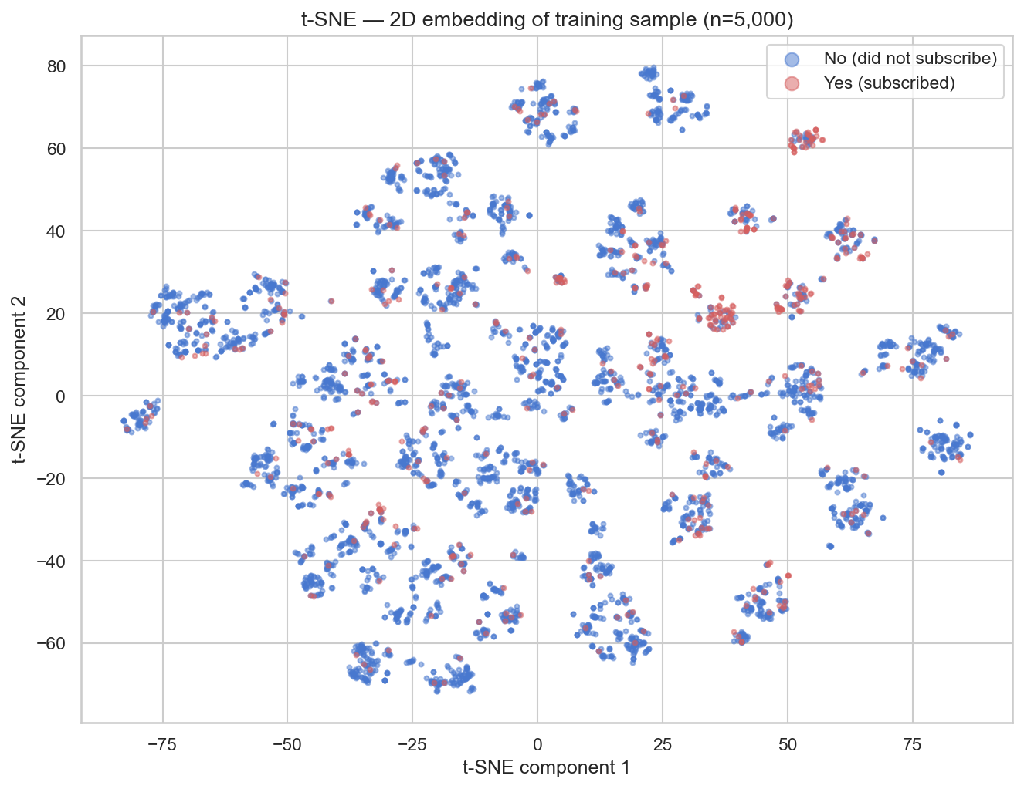
t-SNE
A second visualisation technique to check for hidden structure in the data
t-SNE is another dimensionality reduction technique, but it works differently to PCA. Instead of finding directions of maximum variance, it tries to keep similar points close together in 2D space.
It is particularly good at revealing clusters and structure that PCA might miss because it focuses on local similarity rather than global variance.
Because it is slow to compute on large datasets, we ran it on a random sample of 5,000 training rows. Each point is one client, coloured by whether they subscribed.
The result confirms what PCA showed: the yes and no points are mixed throughout the plot rather than forming one clean cluster each. This rules out simple linear classifiers and confirms we need non-linear models.
7
Notes:
t-SNE is harder to explain than PCA but the takeaway is simpler: look at the plot.
The yes points (red or orange) are scattered throughout the map. They are not in one place. If they were, we would see a clear region that predicts subscribers.
Instead they appear in small clusters dotted around. This means subscriber behaviour is driven by specific combinations of features, not any one dominant pattern.
This is why we chose Random Forest, Gradient Boosted Trees and SVM: they can all capture non-linear relationships and feature interactions.

Slide 8
Models
Three classifiers trained inside scikit-learn Pipelines with cross-validation
Each model is wrapped in a Pipeline: StandardScaler runs first, then the classifier. This is important because it means the scaler only ever sees training data during cross-validation and never leaks test set statistics into the model.
Random Forest
CV ROC-AUC: 0.7941
30 random combinations via RandomizedSearchCV, 5-fold cross-validation
Builds hundreds of decision trees, each trained on a random subset of the data and features. Their predictions are averaged. This reduces overfitting and works well with imbalanced classes when class_weight=balanced is set.
Gradient Boosted Trees
CV ROC-AUC: 0.7972
30 random combinations via RandomizedSearchCV, 5-fold cross-validation
Builds trees one at a time. Each new tree corrects the mistakes made by the previous ones. The model gradually focuses effort on the hardest-to-classify clients. Naturally handles imbalance through its error-correction process.
SVM - RBF Kernel
CV ROC-AUC: 0.7776
Full grid of 12 combinations via GridSearchCV, 5-fold cross-validation
Finds the widest possible boundary between classes by transforming the data into a higher-dimensional space. The RBF kernel allows curved, non-linear boundaries. class_weight=balanced applied. Significantly slower to train than the tree models.
8
Notes:
The pipeline design is the most important thing to explain here.
If you scale the data before splitting into folds, the scaler learns the mean and standard deviation of the whole dataset including what should be hidden validation data. Putting the scaler inside the pipeline prevents this.
All three models are tuned using ROC-AUC as the scoring metric, not accuracy. This pushes the search toward models that rank subscribers highly.
The cross-validation scores are close across all three. The test set results on the next slide reveal more meaningful differences.

Slide 9
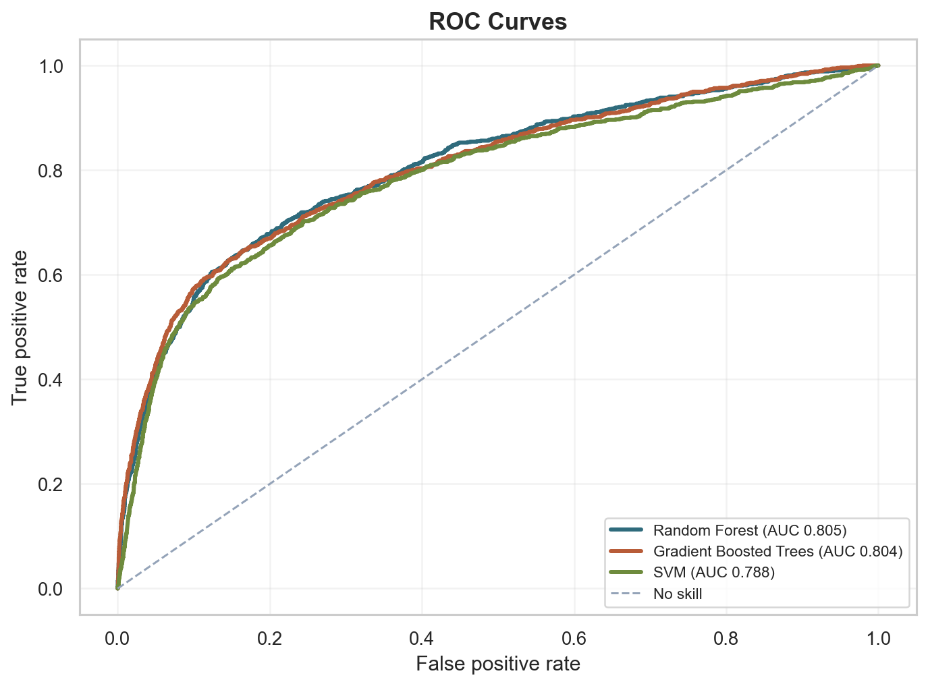
Results
Evaluated on 9,043 test rows the models never saw during training
Accuracy alone is misleading here. A model predicting no every time scores 88.3%. We focus on ROC-AUC, recall for subscribers (class 1) and F1 for class 1.
Model
ROC-AUC
Recall - Yes
F1 - Yes
Random Forest
0.8054
0.539
0.473
Recommended
GBT
0.8036
0.266
0.375
SVM
0.7881
0.591
0.458
GBT has the highest accuracy but recall for subscribers of just 26.6%. It predicts no most of the time and misses nearly three in four potential subscribers.
Random Forest finds 53.9% of subscribers with the best overall ranking quality.
9
Notes:
Walk through the table first.
GBT looks great on accuracy but its recall for class 1 is only 26.6%. That means for every 100 people who would subscribe, it finds 27 and misses 73. For a bank campaign that is a very poor result.
Random Forest finds 53.9% of subscribers and has the best ROC-AUC and F1.
Point to the ROC curves. All three are well above the diagonal random baseline. The closer the curve is to the top-left corner, the better. Random Forest and GBT are close on AUC but behave very differently at the default 0.5 decision threshold, which explains the recall difference.

Slide 10
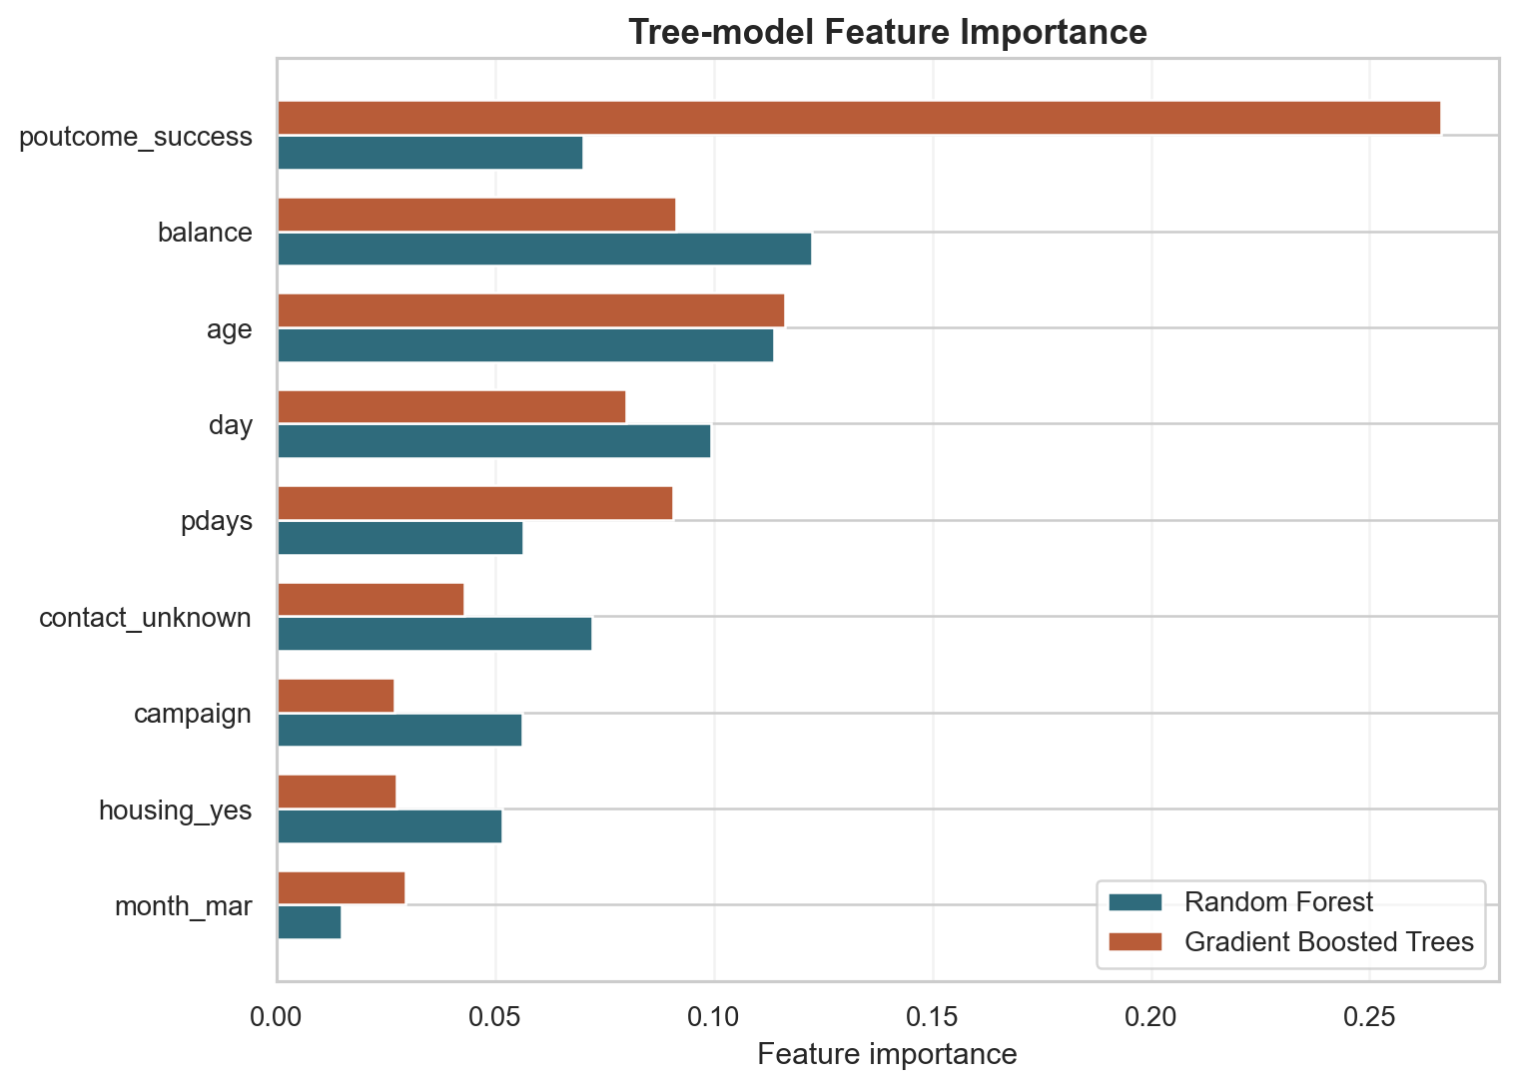
Insight
Feature importances: what did the models actually learn?
Tree-based models like Random Forest and GBT can tell us which features were most useful for making predictions. This is measured by how much each feature reduces prediction error across all trees.
Both models agree on the top features, which gives us confidence in the result.
poutcome - success
The strongest signal by a wide margin. Matches the 64.7% we saw in EDA.
balance and age
Wealthier and older clients are more likely to subscribe.
contacted_before and pdays
The feature we engineered from the pdays sentinel appears in both models, justifying that preprocessing decision.
Note: SVM has no built-in feature importances because its decision boundary is defined by support vectors in a transformed space, not by individual feature splits.
10
Notes:
The chart shows the top 15 features for both Random Forest (left) and GBT (right).
poutcome success is top in both and by a clear margin. This validates the EDA finding.
The contacted_before column we created from the pdays sentinel appears in both lists. Mention this as a direct outcome of the preprocessing decision.
balance and age make intuitive sense: term deposits are for people who have money to save and who are at a stage of life where saving for the longer term makes sense.
If asked about SVM: it does not have feature_importances_ as an attribute. You would need permutation importance or SHAP values to interpret it.

Slide 11
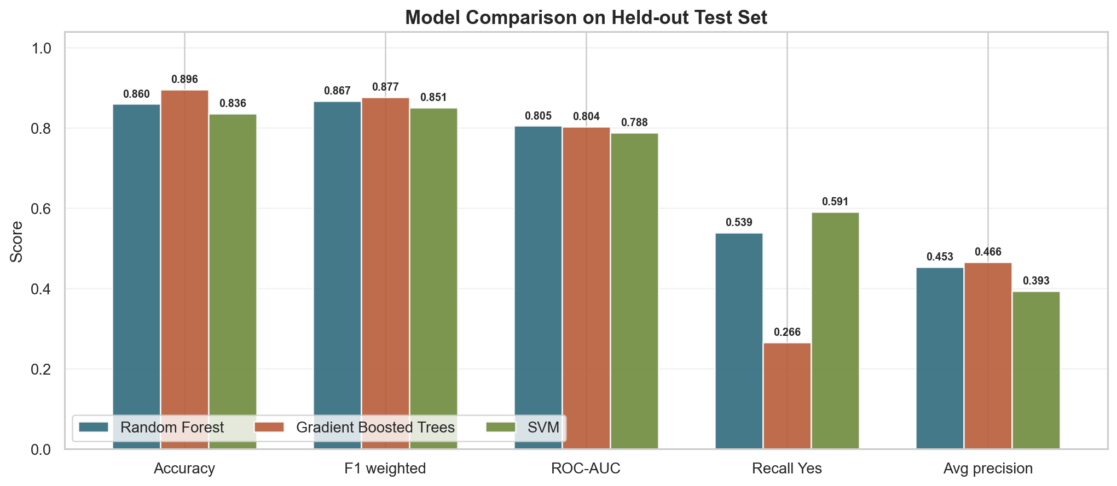
Conclusion
Recommended Model
Key Takeaways
Random Forest
Prior campaign outcome is the strongest predictor by a large margin. The bank should prioritise re-contacting past successes.
Campaign timing matters more than call volume. Q4 months consistently outperform May despite lower volumes.
Over-contacting within a campaign reduces conversion. A contact limit per client would likely improve results.
Best ROC-AUC (0.8054) and best F1 for subscribers (0.473). Correctly identifies 53.9% of all clients who would subscribe, far ahead of GBT which finds only 26.6%.
GBT accuracy of 89.6% is misleading: it misses 73% of subscribers. For a bank campaign that is not a useful result.
Aaron Darcy | Abey Mathew | ATU Donegal | April 2026
11
Notes:
Bring it together. Three models trained, one recommended.
Random Forest wins on the metrics that matter for this use case: identifying subscribers, not just predicting no.
The bar chart at the bottom shows the comparison visually across five metrics. Point out that GBT dominates on accuracy but lags badly on recall and F1 for class 1.
The three business takeaways are the most practical output of the project. These are actionable recommendations the bank could implement tomorrow.
If asked about future work: lowering the decision threshold below 0.5 would increase recall further. A time-based train/test split would better simulate deployment.

