Slide 1
Simulation of Squeezed Light Generation in an Optical Resonator
Aaron Dayton
Supervisor: Andrew MacRae
University of Victoria

Slide 2
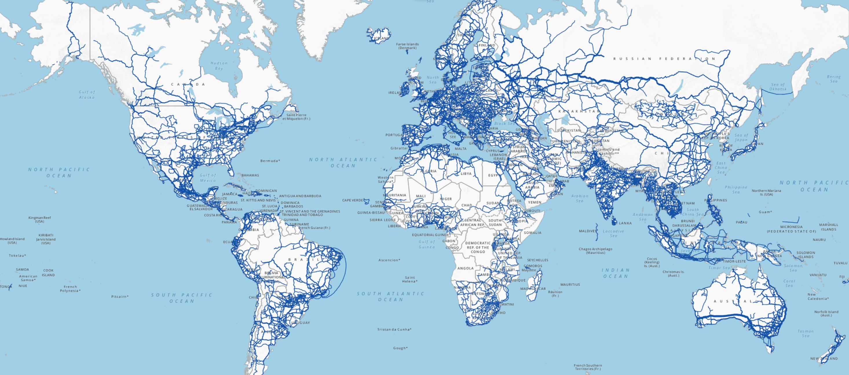

Slide 3
We Want to use Existing Telecom Infrastructure to Build a Quantum Internet

Slide 4
Problem: Telecom Bands Operate at Specific Wavelengths

Slide 5
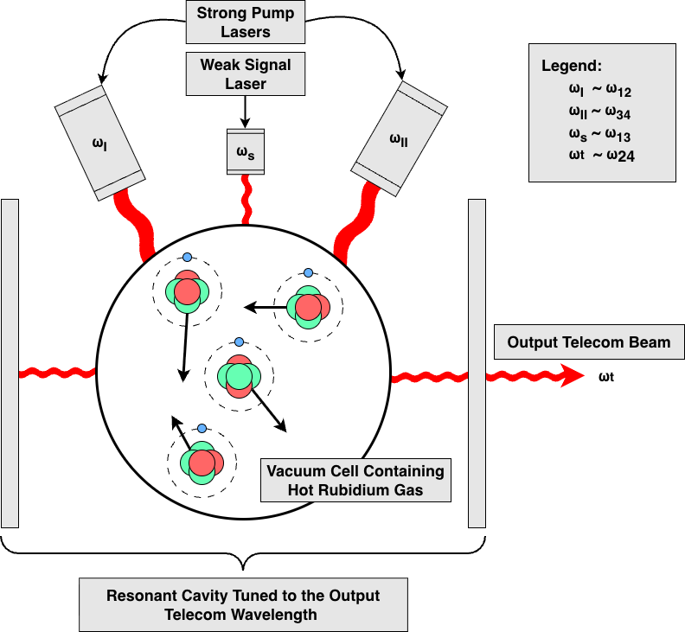
Frequency Converter Cartoon Setup

Slide 6
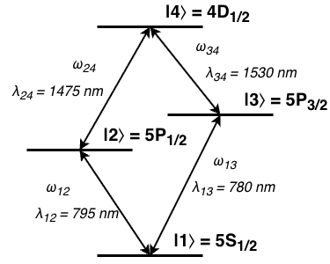
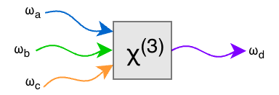
Four Wave Mixing

Slide 7
Four Wave Mixing
Generate light in the telecom C-band (1530 nm to 1565 nm)

Slide 8
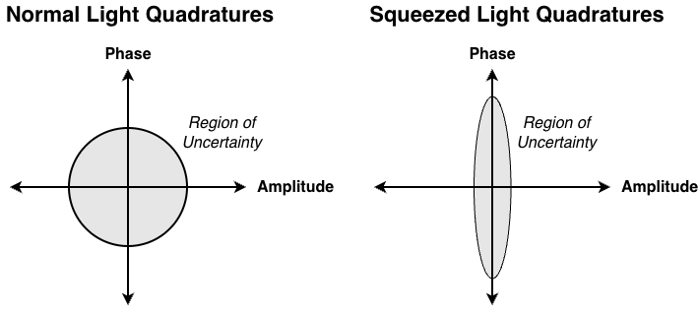

Four Wave Mixing Generates Squeezed Light

Slide 9

Electromagnetically Induced Transparency

Slide 10
Electromagnetically Induced Transparency
Use EIT to minimize decay within medium

Slide 11
Electromagnetically Induced Transparency
Use EIT to minimize decay within medium
EIT for the output transmission beam is desirable

Slide 12
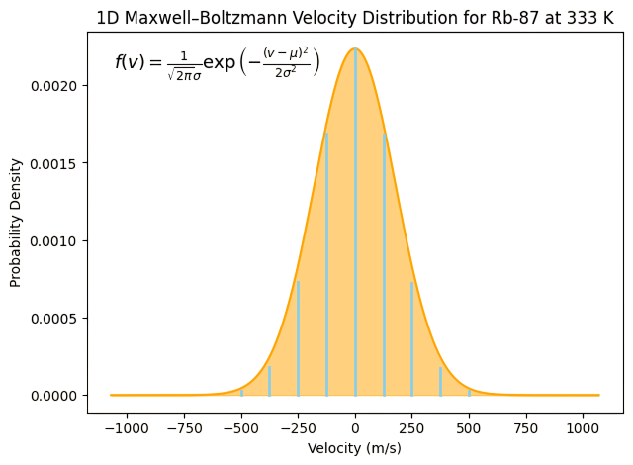
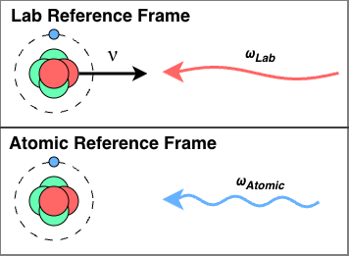
Problem: Things move (Doppler Broadening)

Slide 13
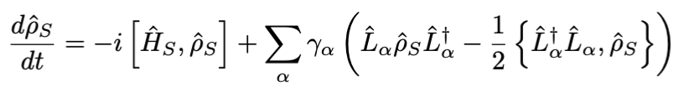
Solution Strategy
1) Solve for steady state

Slide 14
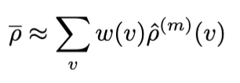
Solution Strategy
1) Solve for steady state
2) Average over velocity distribution

Slide 15
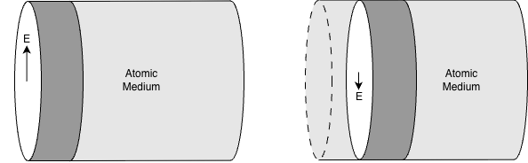
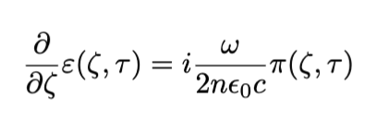
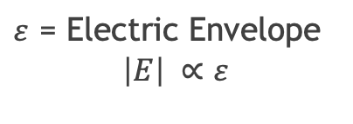
Another Problem: Things Change (Maxwell-Bloch)
$ε$ = Electric Envelope
$$\left|E\right| ∝ε$$

Slide 16
Solution Strategy
1) Solve for steady state at one position
2) Average over velocity distribution
3) Find the change in electric field strength
4) Repeat

Slide 17
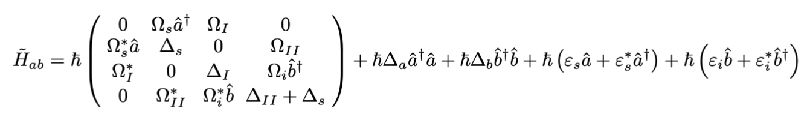
Results
System Hamiltonian

Slide 18
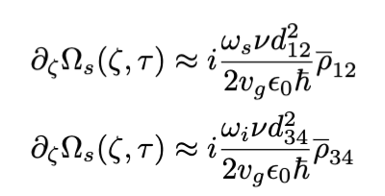
Results
System Hamiltonian
Maxwell-Bloch Equations

Slide 19
Developed Computational Tools
1) Solve for steady state at one position
2) Average over velocity distribution
3) Find the change in electric field strength
4) Repeat

Slide 20
Thank You
Aaron Dayton
Supervisor: Andrew MacRae
University of Victoria

