Slide 1

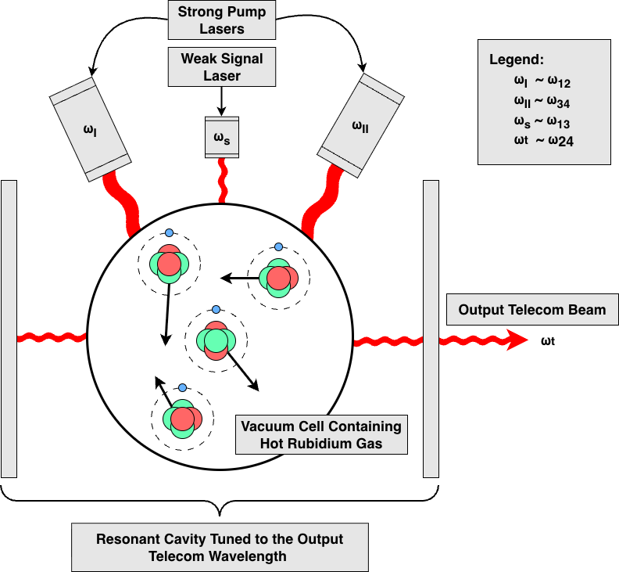
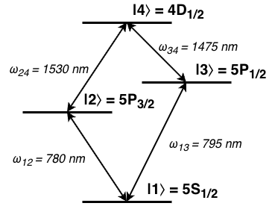
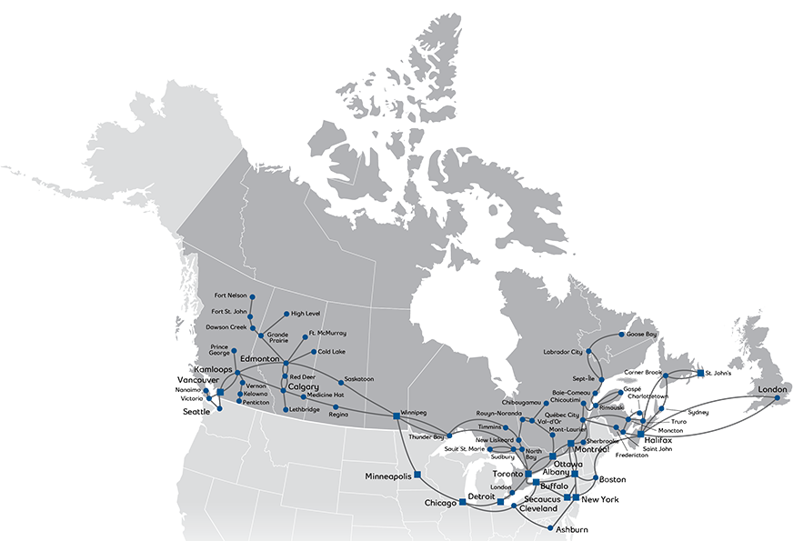

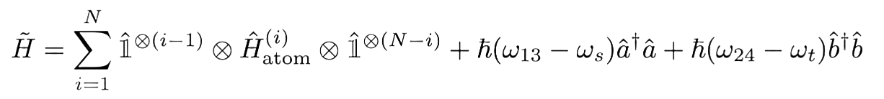
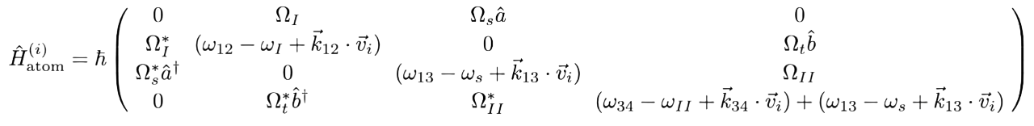


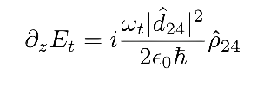


Simulation of Squeezed Light Generation in an Optical Resonator
Aaron Dayton
Supervisor: Prof. Andrew MacRae
Department of Physics and Astronomy
February 2026
University of Victoria
Why?
Quantum Internet
How?
Setup and Simulation Methods
Then What?
Takeaways and Outlook
There are existing fiber optic networks all over the world which can transport optically encoded information at the speed of light.
Current methods for encoding quantum information in optical beams produce photons at wavelengths not compatible with current infrastructure.
To rapidly deploy a quantum internet across Canada and the world, a cost effective and reliable method for converting optically-encoded continuous-variable quantum information to telecom-compatible wavelengths is required[1].
We must computationally model the quantum transitions of a hot gas composed of 4-level Diamond-Configuration atoms driven by multiple lasers tuned near-resonance of atomic transitions: two pump lasers stimulating transitions and one signal laser encoded with quantum information.
With a theoretical value of Conversion Efficiency and Squeezing Amplitude either experimental research can be justified or the relatively expensive alternative of using a super-cooled atomic system is supported.
The System Parameterizations which yield optimal results can be used as a starting point for experiments.
If hot atomic ensembles can be used to effectively transmit telecom signals, then connecting nodes in a quantum communication network would be fast, economically viable, and compatible with existing techniques.
Get Setup Pic
Fig. 2 – Diamond-Configuration Atomic Transition Structure.
Fig. 3 – Vacuum Chamber Driven within a Resonant Cavity Driven by Lasers Tuned near Transition Frequencies.
The overarching goal is to find system parameterizations which induce nonlinear optical processes to create quantum optical correlations known as Squeezed Light, which is light with reduced uncertainty in one quadrature (amplitude or phase) but increased uncertainty in the other such that the Generalized Uncertainty Principle is still observed.
Legend
Fig. 1 – Existing Bell Fiber Optic Network [2].
The objective is to use the following Hamiltonian describing the interaction between the atoms and the external fields, with atomic velocities ${\overset{⃑}{v}}_{i}$ distributed as a Multivariate Normal Distribution which results in Doppler Broadening.
$ω≡$ Electromagnetic Field Frequency or Transition Frequency
$Ω≡$ Rabi Frequency
$\overset{⃑}{k}≡$ Electromagnetic Field Wavevector
$\hat{a}≡$ Annihilation Operator of Signal Field
$\hat{b}≡$ Annihilation Operator of Telecom-Wavelength Idler Field
$\hat{ρ}≡$ Density Matrix
${\hat{L}}_{i}≡$ $i^{th}$ Decay Operator
$γ_{i}≡$ Decay Rate of $i^{th}$ Decay Operator
$E≡$ Electromagnetic Envelope
A potential candidate is hot rubidium-87 gas which may be able to convert information encoded in a 795 nm beam (which can be produced with modern techniques) to a 1530 nm beam (which is within the window of the telecom
C-band).
The wavelength-conversion happens via optical Four Wave Mixing and can be resonantly enhanced via Cavity Electromagnetically Induced Transparency at the telecom wavelength.
Four Wave Mixing involves driving an atomic sample by multiple beams to induce the emission of a separate beam of Squeezed Light such that the conservation equation and momentum conservation equations are satisfied.
$$ω_{s}+ω_{II}=ω_{t}+ω_{I}$$
$$k_{s}+k_{t}+k_{I}+k_{II}=0$$
Cavity Electromagnetically Induced Transparency involves driving the atomic sample within an enhancing resonant cavity such that beams interfere to produce a polarization field which allows one frequency of light to pass through the medium with minimal losses.
This is done by solving the Lindblad Master Equation (below) for the steady state dynamics (in particular, values of $ρ_{13}$ and $ρ_{24}$) of the system at various hyper-parameter configurations to find when Electromagnetically Induced Transparency and Four Wave Mixing phenomena occur simultaneously to generate Squeezed Light.
References
[1]:
[2]:
[3]:
Du, D., Castillo-Veneros, L., Cottrill, D., Cui, G., Stankus, P., Katramatos, D., Martínez-Rincón, J., & Figueroa, E. (2021). A long-distance quantum-capable internet testbed. arXiv (Cornell University). https://doi.org/10.48550/arxiv.2101.12742
Canada’s most extensive network coverage. Our Network | Bell Wholesale. (n.d.). https://wholesale.bell.ca/our-network
MacRae, A., & Kupchak, C. (2026). Propagation dynamics and transient amplification in warm and cold atomic EIT systems. Optics Communications, 606, 132893. https://doi.org/10.1016/j.optcom.2026.132893
These steady state values are then applied to Maxwell’s equations in a co-propagating frame to form the Maxwell-Bloch Equations yielding strength of the telecom-wavelength field envelope as it propagates through the medium [3].
This gives us a theoretical value for the Conversion Efficiency of the signal beam to the telecom-wavelength transmission beam, and a high Squeezing Amplitude makes the quantum information less prone to random fluctuations.
Notes:
Around 1912, Einstein wrote on the theory of gravitational lensing as a logical implication from his theory of relativity in an unpublished notebook. Gravitational lensing occurs when a massive body curves spacetime such that the path of light is deflected when in proximity to the body relative to an observer. This effect is analogous to the curving effect a lens has on light, hence the name.
Arthur Eddington proposed that the Sun’s mass could bend the light of nearby stars, based off Einstein’s the theory of general relativity. He supported this by measuring the deflected positions of stars near the sun during an eclipse in 1919. Einstein published on the theory afterwards. The first direct proof of gravitational lensing came in 1979 when a double quasar – the double image of a single quasar due to the lensing of a galaxy in its path ­­­­– was detected.
After this, more optical phenomena due to gravitational lensing were detected. Two of note are the Einstein cross and Einstein rings. The Einstein cross is a quasar lensed by a distant galaxy such that from Earth's perspective the quasar is seen four times. Measuring the time at which flickering occurs for each of the images allows for reliable astrological measurements. Einstein rings are when a light source is lensed by a massive body such that it appears as continuous ring around the body.
Talk on gravitational microlensing as well.
In my poster I will describe the phenomenon of gravitational lensing and how it affects lights path, the history of gravitational lensing, and phenomena caused by gravitational lensing.

