Slide 1
Introduction to Recommender Systems
Machine Learning 101 Tutorial
Strata + Hadoop World, NYC, 2015
Chris DuBois, Dato

Slide 2
Outline
Motivation
Fundamentals
Collaborative filtering
Content-based recommendations
Hybrid methods
Practical considerations
Feedback
Evaluation
Tuning
Deployment

Slide 3
ML for building data products
Products that produce and consume data.
Products that improve as they produce and consume data.
Products that use data to provide a personalized experience.
Personalized experiences increase engagement and retention.

Slide 4
Recommender systems
Personalized experiences through recommendations
Recommend products, social network connections, events, songs, and more
Implicitly and explicitly drive many of experiences you’re familiar with

Slide 5
Recommender uses
Netflix, Spotify, LinkedIn, Facebook with the most visible examples
“You May Also Like” “People You May Know” “People to Follow”
Also silently power many other experiences
Quora/FB/Stitchfix: given interest in A, what else might they be interested in?
Product listings, up-sell options, etc.
Notes:
• email targeting campaigns, churn prediction, sound, movies, etc
• Value of recommendations: improving and/or increasing user engagement
◦ 2/3 of netflix watched movies pass through the recommendation system
◦ Google News: large % more clickthrough
◦ Quora/FB/stitchfix: for logged out users… given interest in A, what else might they be interested in?
◦ Ranking trending events

Slide 6
Outline
Motivation
Fundamentals
Collaborative filtering
Content-based recommendations
Hybrid methods
Practical considerations
Feedback
Evaluation
Tuning
Deployment

Slide 7
Basic idea
Data
past behavior
similarity between items
current context
Machine learning models
Input data about users and items
Output a function that provides a list of items for a given context

Slide 8
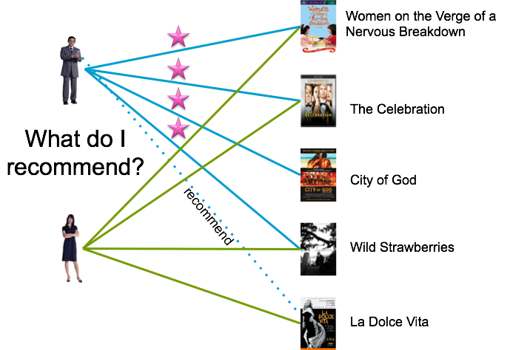
Collaborative filtering

Slide 9
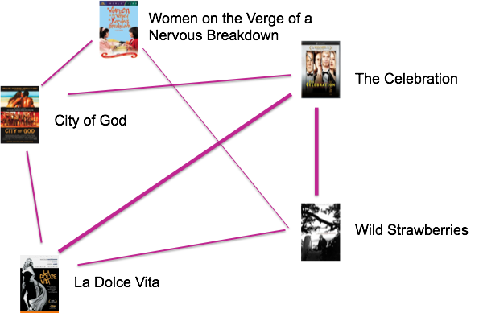
Content-based similarity

Slide 10
What data do you need?
Required for collaborative filtering
User identifier
Product identifier
Required for content-based recommendations
Information about each item
Further customization
Ratings (explicit data), counts
Side data
Notes:
CF: user-based: find similar users to me and recommend what they liked
CF: item-based: find similar items to those that I have previously liked

Slide 11
Outline
Motivation Fundamentals
Collaborative filtering
Content-based recommendations
Hybrid methods
Practical considerations
Feedback
Evaluation
Tuning
Deployment

Slide 12
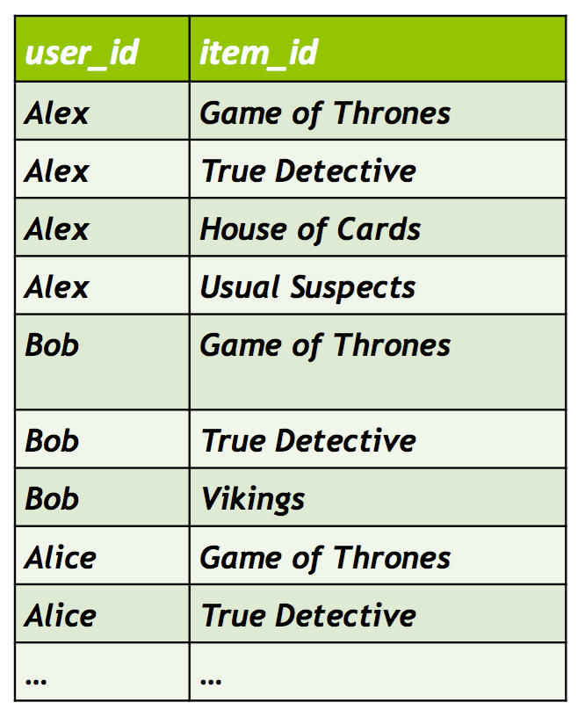
Implicit data
User x product interactions
Consumed / used / clicked / etc.

Slide 13
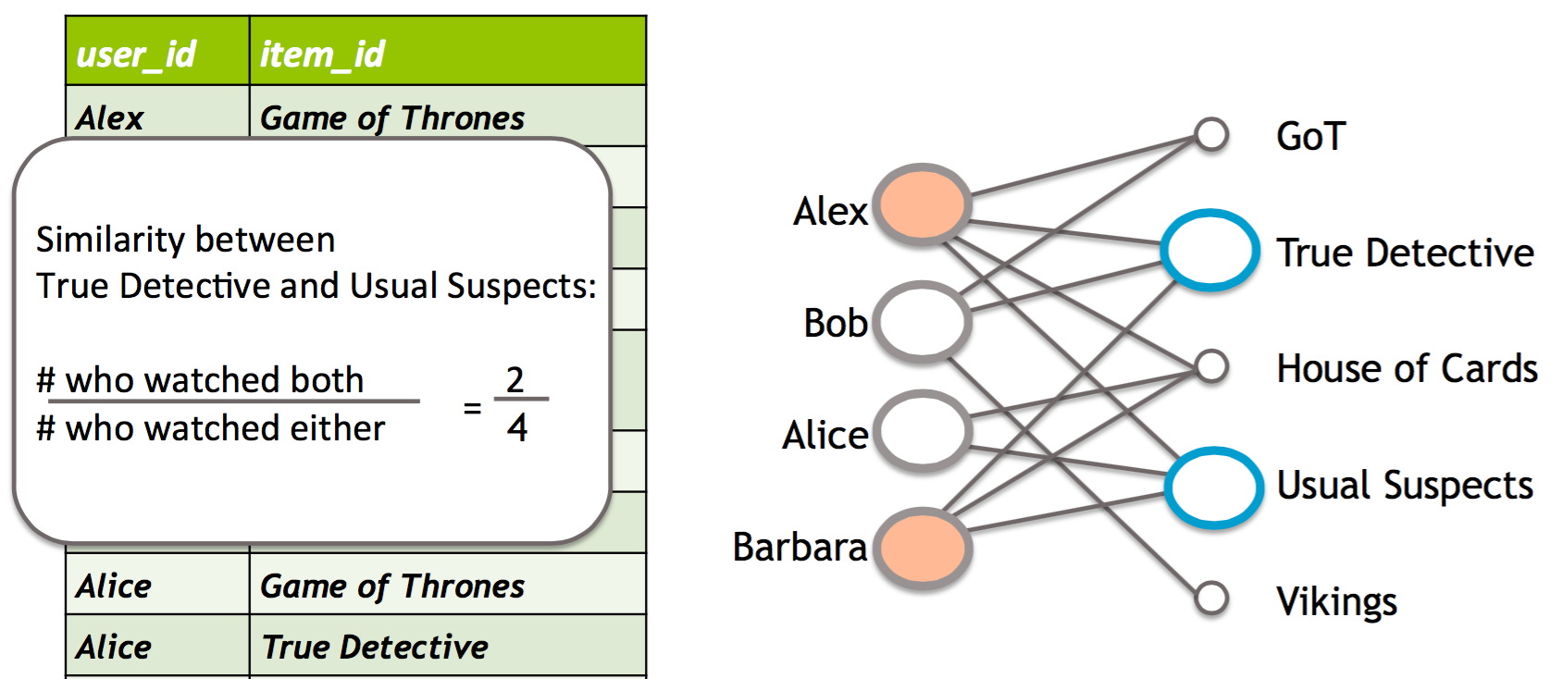
Item-based CF: Training

Slide 14
Item-based CF: predictions
Create a ranked list for a given user using the list of previously seen items
For each item, i, compute the average similarity between i and the items in the list
Compute a list of the top N items ranked by score
Alternatives
Incorporate rating, e.g., cosine distance
Other distances, e.g., Pearsons

Slide 15
Demo!

Slide 16
Matrix factorization
Treat users and products as a giant matrix with (very) many missing values
Users have latent factors that describe how much they like various genres
Items have latent factors that describe how much like each genre they are

Slide 17
Matrix factorization
Turn this into a fill-in-the-missing-value exercise by learning the latent factors
Implicit or explicit data
Part of the winning formula for the Netflix Prize
Predict ratings or rankings

Slide 18
Matrix factorization
Game of Thrones
True Detective
House of Cards
Usual Suspects
Vikings
Alex
5 | 5 | 5 | 3
5 | 4 |  |  | 5
1 |  | 5 | 4
 | 3 | 5 | 5
Bob
Alice
Barbara

Slide 19
Matrix factorization
Game of Thrones
Usual Suspects
House of Cards
True Detective
Vikings
Model parameters
Alex
5 | 5 | 5 | 3
5 | 4 |  |  | 5
1 |  | 5 | 4
 | 3 | 5 | 5
Bob
Alice
Barbara
Notes:
One common technique that became especially popular during the Netflix prize is matrix factorization.
This model assumes there exist a set of parameters for each user and each item; in this case we’ve assumed that dimension K is equal to 3. Large circles represent large values of those parameters. The model assumes that ratings are a dot-product of the two relevant vectors, so large circles for the user and large circles for the item, then the model will predict high ratings. We can then try and learn what parameters are most likely after having observed data. Currently learning these values is done via SGD.

Slide 20
Matrix factorization
Game of Thrones
Usual Suspects
House of Cards
True Detective
Vikings
HBO people
Alex
5 | 5 | 5 | 3
5 | 4 |  |  | 5
1 |  | 5 | 4
 | 3 | 5 | 5
Bob
Alice
Barbara

Slide 21
Matrix factorization
Game of Thrones
Usual Suspects
House of Cards
True Detective
Vikings
HBO people
Violent historical
Alex
5 | 5 | 5 | 3
5 | 4 |  |  | 5
1 |  | 5 | 4
 | 3 | 5 | 5
Bob
Alice
Barbara

Slide 22
Matrix factorization
Game of Thrones
Usual Suspects
House of Cards
True Detective
Vikings
HBO people
Violent historical
Kevin Spacey fans
Alex
5 | 5 | 5 | 3
5 | 4 |  |  | 5
1 |  | 5 | 4
 | 3 | 5 | 5
Bob
Alice
Barbara

Slide 23
Fill in the blanks
Learn the latent factors that minimize prediction error on the observed values
Fill in the missing values
Sort the list by predicted rating & recommend the unseen items

Slide 24
Demo!

Slide 25
Outline
Motivation
Fundamentals
Collaborative filtering
Content-based recommendations
Hybrid methods
Practical considerations
Feedback
Evaluation
Tuning
Deployment

Slide 26

talks[‘bow’] = gl.text_analytics.count_words(talks[‘abstract’])
talks[‘tfidf’] = gl.text_analytics.tf_idf(talks[‘bow’])
Text analysis toolkits
Machine learning toolkits
Easy recommender API
nn_model = gl.nearest_neighbors.create(talks, ‘id’, features=[‘tfidf’])
nbrs = nn_model.query(talks, label=‘id’, k=50)
sim_model = gl.item_similarity_recommender.create(historical, nearest=nbrs)
recs = sim_model.recommend()
>>> nn_model
Class : NearestNeighborsModel
Distance : jaccard
Method : brute force
Number of examples : 195
Number of feature columns : 1
Number of unpacked features : 5170
Total training time (seconds) : 0.0318
>>> talks
+------------+------------+-------------------------------+--------------------------------+
| date | start_time | title | tech_tags |
+------------+------------+-------------------------------+--------------------------------+
| 02/20/2015 | 10:40am | The IoT P2P Backbone | [MapReduce, Storm, Docker,... |
| 02/20/2015 | 10:40am | Practical Problems in Dete... | [Storm, Docker, Impala, R,... |
| 02/19/2015 | 1:30pm | From MapReduce to Programm... | [MapReduce, Spark, Apache,... |
| 02/19/2015 | 2:20pm | Drill into Drill: How Prov... | [JAVA, Docker, R, Hadoop, SQL] |
| 02/19/2015 | 4:50pm | Maintaining Low Latency wh... | [Apache, Hadoop, HBase, YA... |
| 02/20/2015 | 4:00pm | Top Ten Pitfalls to Avoid ... | [MapReduce, Hadoop, JAVA, ... |
| 02/20/2015 | 4:00pm | Using Data to Help Farmers... | [MapReduce, Spark, Storm, ... |
| 02/19/2015 | 1:30pm | Sears Hometown and Outlet\... | [Hadoop, Spark, Docker, R,... |
| 02/20/2015 | 11:30am | Search Evolved: Unraveling... | [Docker, R, Hadoop, SQL, R... |
| 02/19/2015 | 4:00pm | Data Dexterity: Immediate ... | [Hadoop, NoSQL, Spark, Sto... |
| ... | ... | ... | ... |
+------------+------------+-------------------------------+--------------------------------+
[195 rows x 4 columns]
>>> historical
+------------+----------+------------------+---------+------------+
| date | time | user | item_id | event_type |
+------------+----------+------------------+---------+------------+
| 2015-02-12 | 07:05:37 | 809c0dc2548cbbc3 | 38825 | like |
| 2015-02-12 | 07:05:39 | 809c0dc2548cbbc3 | 38825 | like |
| 2015-02-12 | 07:05:40 | 809c0dc2548cbbc3 | 38825 | like |
| 2015-02-12 | 07:05:49 | 809c0dc2548cbbc3 | 38681 | like |
| 2015-02-12 | 07:09:09 | 809c0dc2548cbbc3 | 38501 | like |
| 2015-02-12 | 07:09:10 | 809c0dc2548cbbc3 | 38501 | like |
| 2015-02-12 | 07:10:55 | 809c0dc2548cbbc3 | 39399 | like |
| 2015-02-12 | 07:10:55 | 809c0dc2548cbbc3 | 39399 | like |
| 2015-02-12 | 07:10:57 | 809c0dc2548cbbc3 | 38501 | like |
| 2015-02-12 | 07:10:57 | 809c0dc2548cbbc3 | 38501 | like |
| ... | ... | ... | ... | ... |
+------------+----------+------------------+---------+------------+
[50 rows x 5 columns]

Slide 27
talks[‘bow’] = gl.text_analytics.count_words(talks[‘abstract’])
talks[‘tfidf’] = gl.text_analytics.tf_idf(talks[‘bow’])
Text analysis toolkits
Machine learning toolkits
Easy recommender API
nn_model = gl.nearest_neighbors.create(talks, ‘id’, features=[‘tfidf’])
nbrs = nn_model.query(talks, label=‘id’, k=50)
sim_model = gl.item_similarity_recommender.create(historical, nearest=nbrs)
recs = sim_model.recommend()
>>> nn_model
Class : NearestNeighborsModel
Distance : jaccard
Method : brute force
Number of examples : 195
Number of feature columns : 1
Number of unpacked features : 5170
Total training time (seconds) : 0.0318
>>> sim_model
Class : ItemSimilarityRecommender
Schema
------
User ID : user_id
Item ID : item_id
Target : None
Additional observation features : 0
Number of user side features : 0
Number of item side features : 0
Statistics
----------
Number of observations : 1
Number of users : 1
Number of items : 196
Training summary
----------------
Training time : 0.0003
Settings
--------
only_top_k : 100
similarity_type : jaccard
threshold : 0.001
training_method : auto

Slide 28
Side features
Include information about users
Geographic, demographic, time of day, etc.
Include information about products
Product subtypes, geographic availability, etc.

Slide 29
Demo!

Slide 30
Outline
Motivation
Fundamentals
Collaborative filtering
Content-based recommendations
Hybrid methods
Practical considerations
Feedback
Evaluation
Tuning
Deployment

Slide 31
Collaborative Filtering
Users
Items

Slide 32
Content-based
Items
Features

Slide 33
Hybrid methods
Users
Items
Features

Slide 34
Hybrid methods
Current approaches
Linear model + Matrix factorization
Factorization machines with side data
Ensembles
Benefits
Cold start situations
Incorporating context
Downsides
Black box
Hard to tune
Hard to explain
Alternatives
Composite distance + nearest neighbors
Directly tune the notion of distance
Easy to explain

Slide 35
Hybrid methods
Users
Items
Features

Slide 36
Composite distances
Features
Distance
Weight
year
Euclidean
1.0
description
Jaccard
0.5
genre
Jaccard
1.5
latent factors
cosine
1.5

Slide 37
Composite distances
Features
Distance
Weight
year
Euclidean
1.0
description
Jaccard
0.5
genre
Jaccard
1.5
latent factors
cosine
1.5

Slide 38
Composite distances
Features
Distance
Weight
year
Euclidean
1.0
description
Jaccard
0.5
genre
Jaccard
1.5
latent factors
cosine
1.5

Slide 39
Composite distances
Features
Distance
Weight
year
Euclidean
1.0
description
Jaccard
0.5
genre
Jaccard
1.5
latent factors
cosine
1.5

Slide 40
Demo!

Slide 41
Outline
Motivation
Fundamentals
Collaborative filtering
Content-based recommendations
Hybrid methods
Practical considerations
Feedback
Evaluation
Tuning
Deployment

Slide 42
Outline
Motivation
Fundamentals
Collaborative filtering
Content-based recommendations
Hybrid methods
Practical considerations
Feedback
Evaluation
Tuning
Deployment

Slide 43
Feedback
Core assumption past behavior will help predict future behavior.
Collaborative filtering data often comes from log data.
Plan ahead!
value elicitation, e.g., like, watch, etc.
ratings, stars, etc.
critique, e.g. Improve the system’s recommendations!
preference: e.g., Which do you prefer?
Preprocessing
Item deduplication
Relationship to information retrieval
position bias
source of the event

Slide 44
Outline
Motivation
Fundamentals
Collaborative filtering
Content-based recommendations
Hybrid methods
Practical considerations
Feedback
Evaluation
Tuning
Deployment

Slide 45


Evaluating Models
Historical Data
Trained
Model
Deployed
Model
Predictions
Offline Evaluation
Live
Data
Online Evaluation
Notes:
Offline evaluation may be performed on the ML and business metric
Online evaluation is typically only performed on the business metric.

Slide 46
Evaluation
Train on a portion of your data
Test on a held-out portion
Ratings: RMSE
Ranking: Precision, recall
Business metrics
Evaluate against popularity
Notes:
Sample on a per-user basis!

Slide 47
Rankings?
Often less concerned with predicting precise scores
Just want to get the first few items right
Screen real estate is precious
Ranking factorization recommender

Slide 48
Evaluation: Example
Suppose we serve a ranked list of 20 recommendations.
“relevant” == user actual likes an item
“retrieved” == set of recommendations
Precision@5 % of top-5 recommendations that user likes
Precision@20 % of recommendations that user likes
Questions
What if only 5 are visible?
How do things vary based on the number of events?

Slide 49
Demo!

Slide 50
Outline
Motivation
Fundamentals
Collaborative filtering
Content-based recommendations
Hybrid methods
Practical considerations
Feedback
Evaluation
Tuning
Deployment

Slide 51
Model parameter search
Searching for which model performs best at your metric
Strategies
grid search
random search
Bayesian optimization

Slide 52
How to choose which model?
Select the appropriate model for your data (implicit/explicit), if you want side features or not, select hyperparameters, tune them…
… or let GraphLab Create do it for you and automatically tune hyperparameters

Slide 53
Outline
Motivation
Fundamentals
Collaborative filtering
Content-based recommendations
Hybrid methods
Practical considerations
Feedback
Evaluation
Tuning
Deployment

Slide 54
Monitoring & Management
Historical Data
Trained
Model
Deployed
Model
Predictions
Live
Data
Feedback
Notes:
-

Slide 55
Models over time
Historical
Data
Deployed
Model
Feedback
Offline
Metrics
Online
Metrics
Time
Notes:
Choose the granularity of batch predictions
- taste drift, etc
- freshness, diversity?

Slide 56




Request for Strata event data
Predictive
Service
User activity logged
Logs
Personalized recommendations

Slide 57
Summary
Motivation
Fundamentals
Collaborative filtering
Content-based recommendations
Hybrid methods
Practical considerations
Feedback
Evaluation
Tuning
Deployment

Slide 58
Thank you!
Email
Twitter
chris@dato.com
@chrisdubois

