Slide 1
Detect Fraud from Customer Transactions

Slide 2
Fraud Detection
help the banks to save money
help the government to crack down economic crimes
protect customers benefits
It’s a binary classification problem.
Use machine learning algorithms to solve this problem.

Slide 3
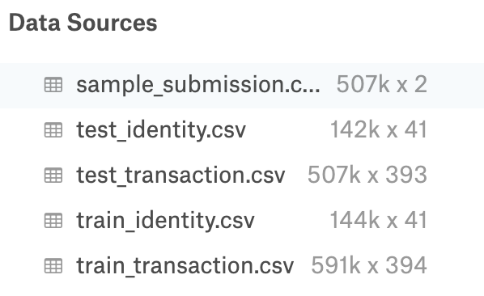
Data acquisition and cleaning
The data comes from Vesta's real-world e-commerce transactions and contains a wide range of features from device type to product features.

Slide 4
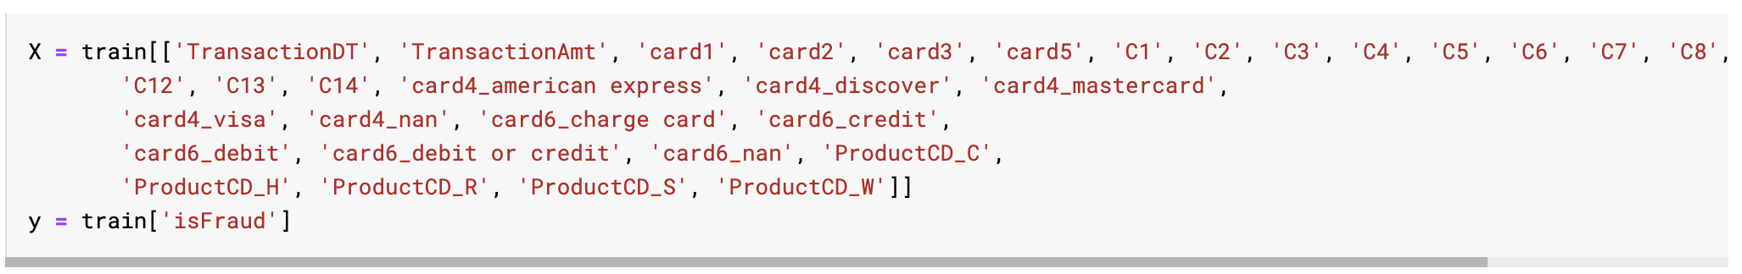
Data acquisition and cleaning
Merge the data to get train
Drop V1~V339 and id_01~id_38 columns
Handle missing values
Handle categorical values
Select Features

Slide 5
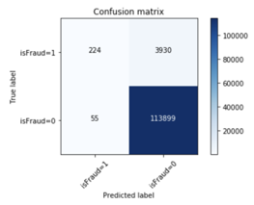
Logistic Regression
Logistic regression is the appropriate regression analysis to conduct when the dependent variable is dichotomous (binary).
Like all regression analyses, the logistic regression is a predictive analysis.

Slide 6
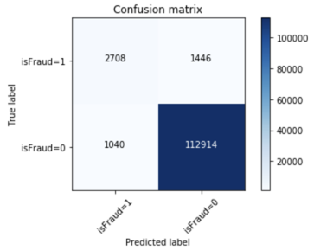
LightGBM
Faster training speed and higher efficiency.
Lower memory usage.
Better accuracy.
Support of parallel and GPU learning.
Capable of handling large-scale data.

Slide 7
Conclusion and future directions
LightGBM achieved better performance
Select better parameters for LightGBM
Feature engineering

