Slide 1
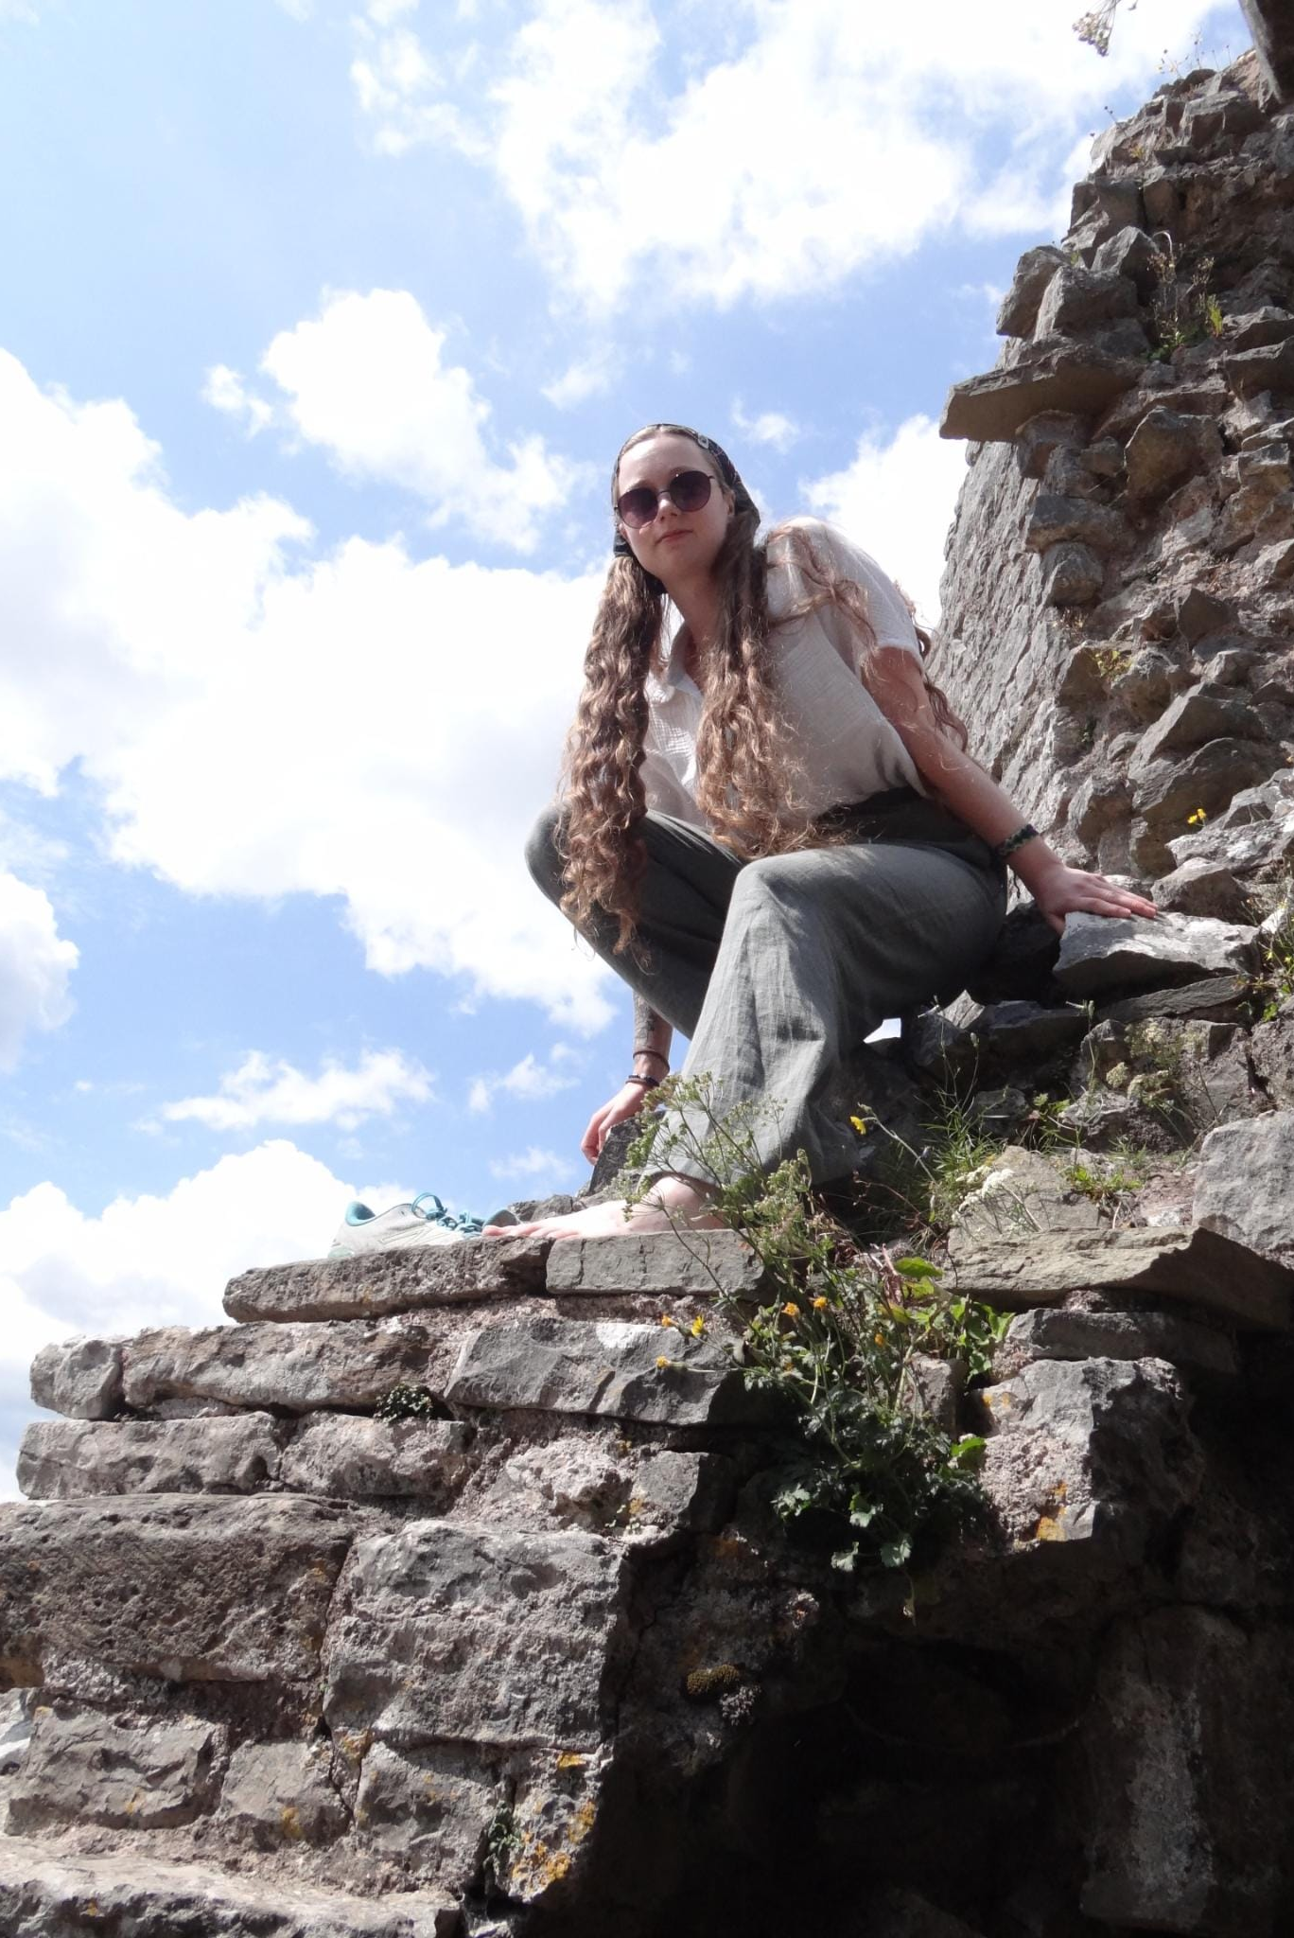

Anja Ehninger
Where I grew up:
University: Eastern Switzerland University of Applied Sciences
Study program: BSc Mechanical Engineering | Innovation
Year of study: 2024–2028
City: Rapperswil, Switzerland
Motto for life: Respect existence or expect resistance
Hobbies: KungFu, Reading, Writing, DnD, Viola, the odd creative project
Your expectations from the summer school: Constructive discussions on environmental protection and a fairer future
International Summer School • Engineering | Innovation • OST – Eastern Switzerland University of Applied Sciences

