Slide 1

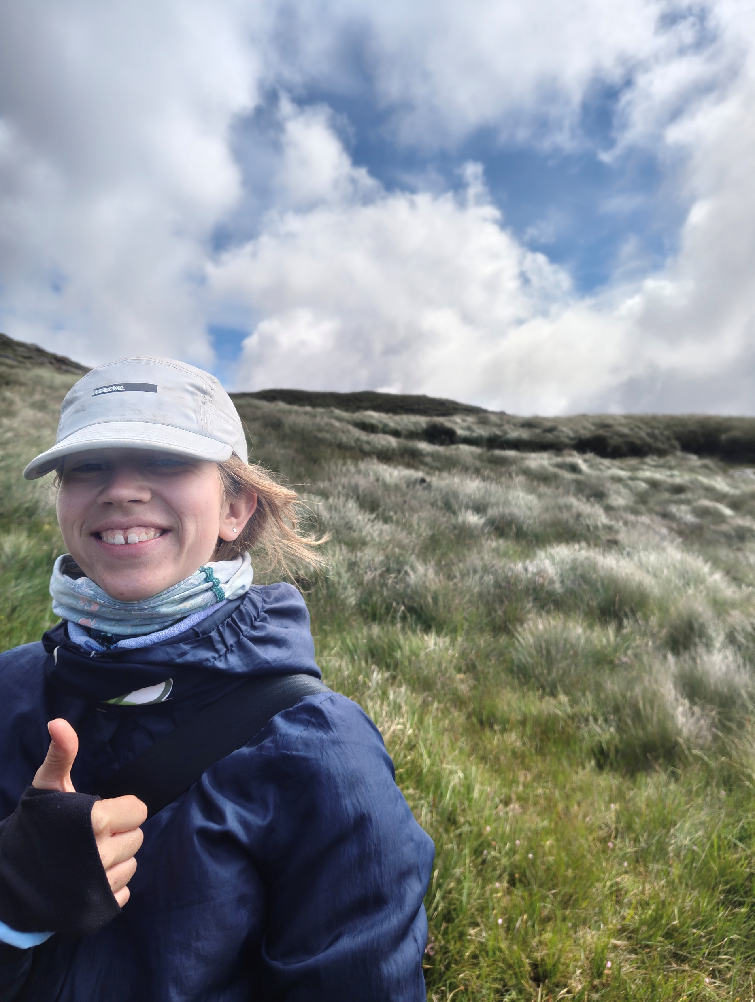




Babette Speelman
University: Eastern Switzerland University of Applied Sciences
Study program: Renewable energies and environmental technology
Year of study: 3. Semester
City: Rapperswil SG, Switzerland
Motto for life: Everything will be fine.
Hobbies: Rowing, Sailing, skiing, hiking, bicycling, painting
Your expectations from the summer school: Meet cool new people who also care about the planet and learn something new with them.
Location where I study,
and where I live 
Karlsruhe
31 August to 11 September 2026

