Slide 1


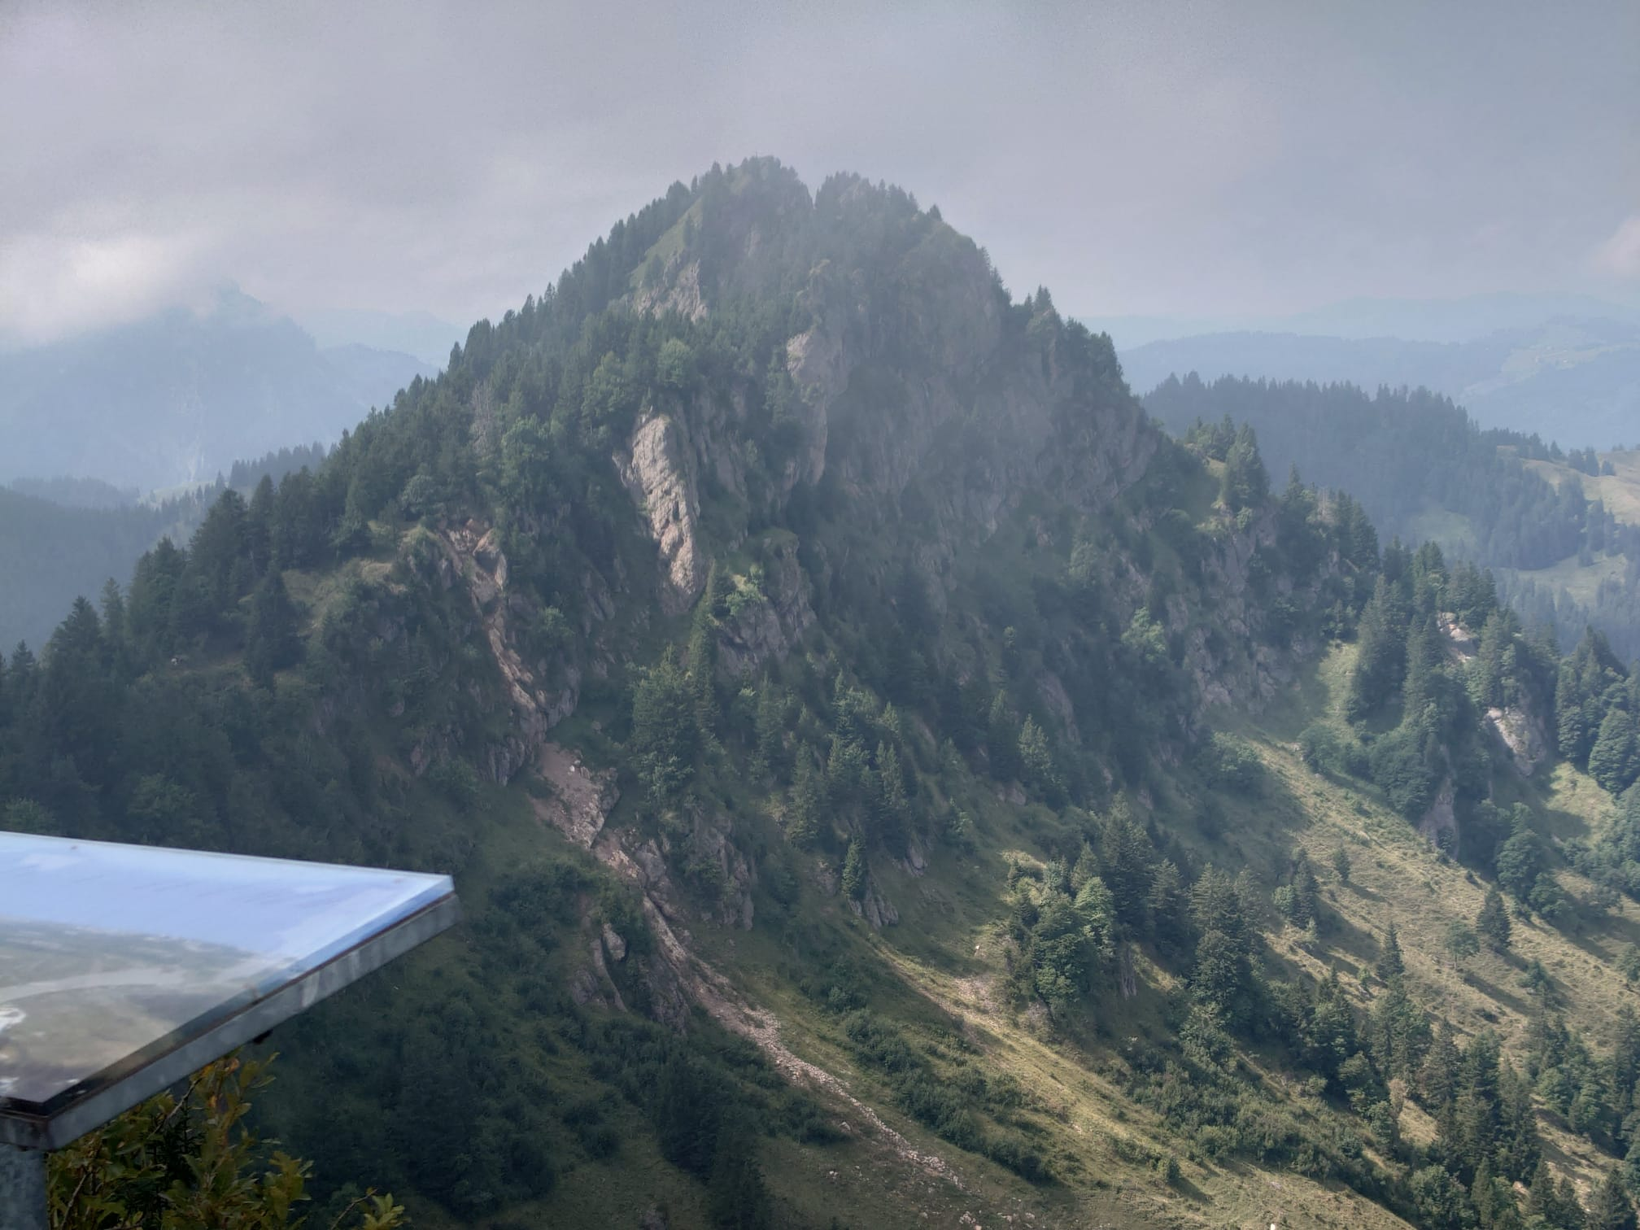
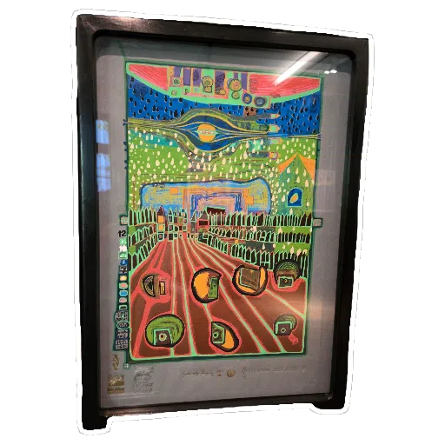
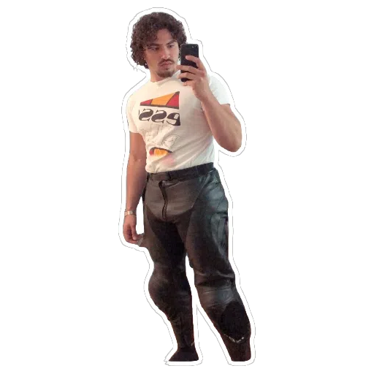


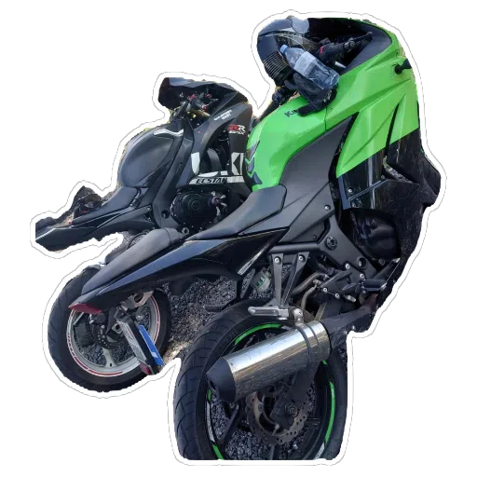
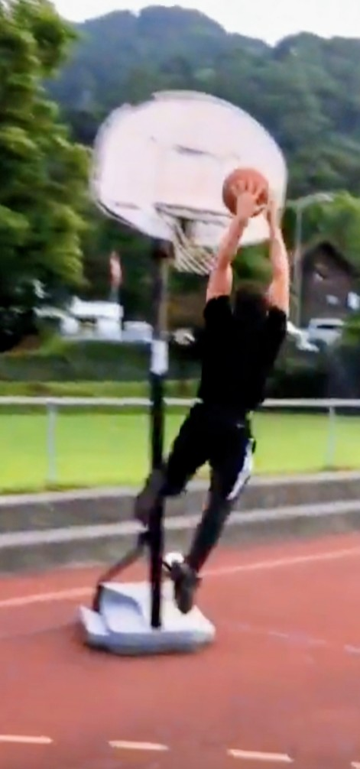

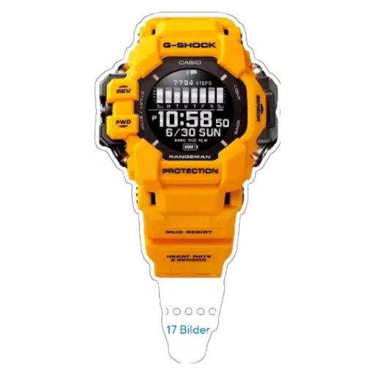
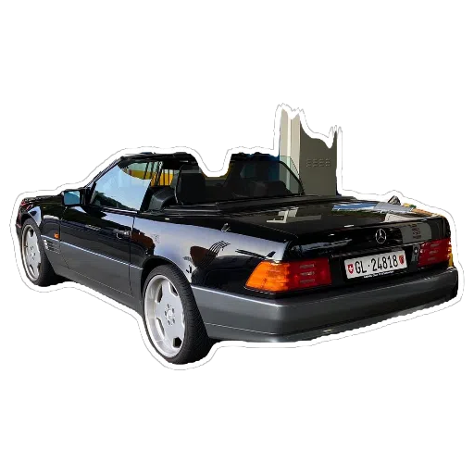
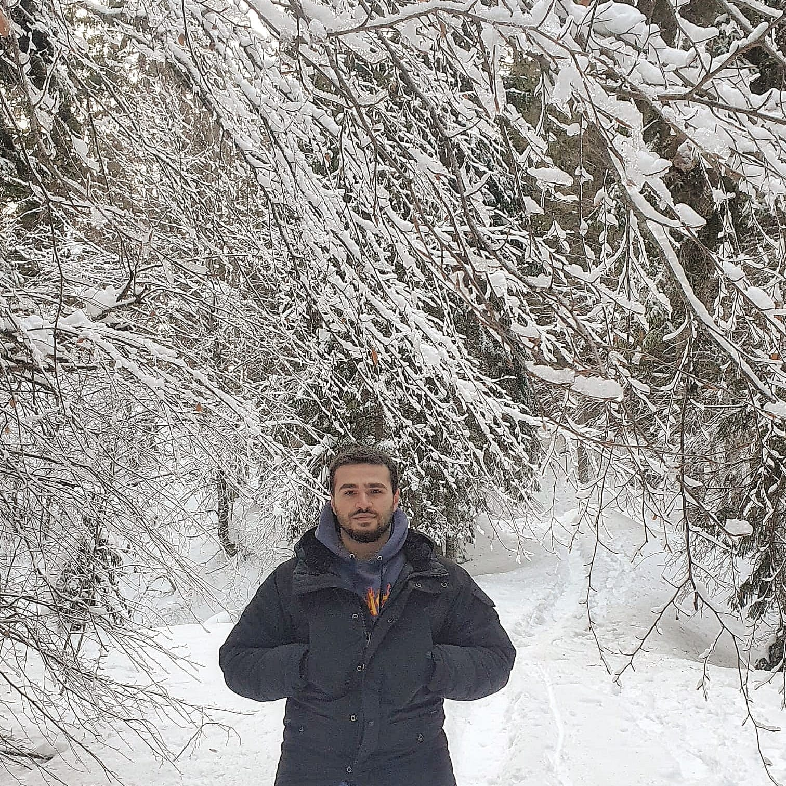
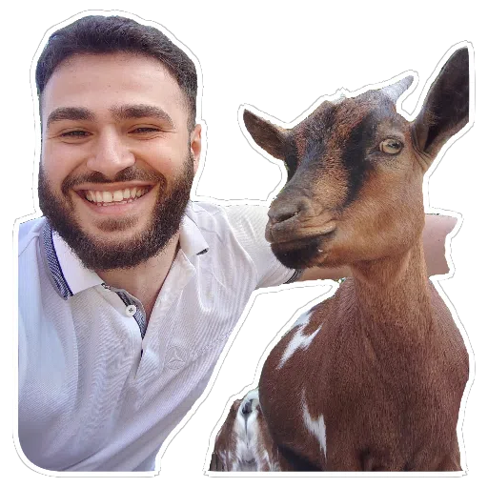
Egzon Osmani
University: Eastern Switzerland University of Applied Sciences
Study program: BSc Mechanical Engineering | Innovation
Year of study: 2024–2027
City: Glarus, Switzerland
Motto for life: Be nice, eat nice and play nice
Hobbies I gave up for Engineering: Basketball, European Football,
Boxing, Fitness.
Your expectations from the summer school:
Learn about sustainability and the current challenges.

