Slide 1

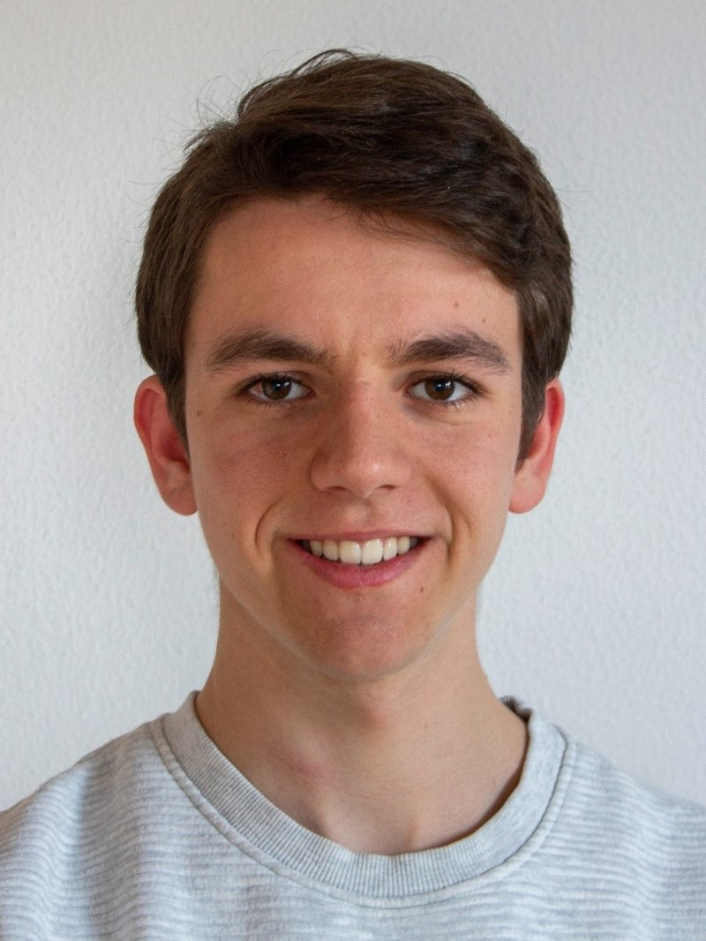
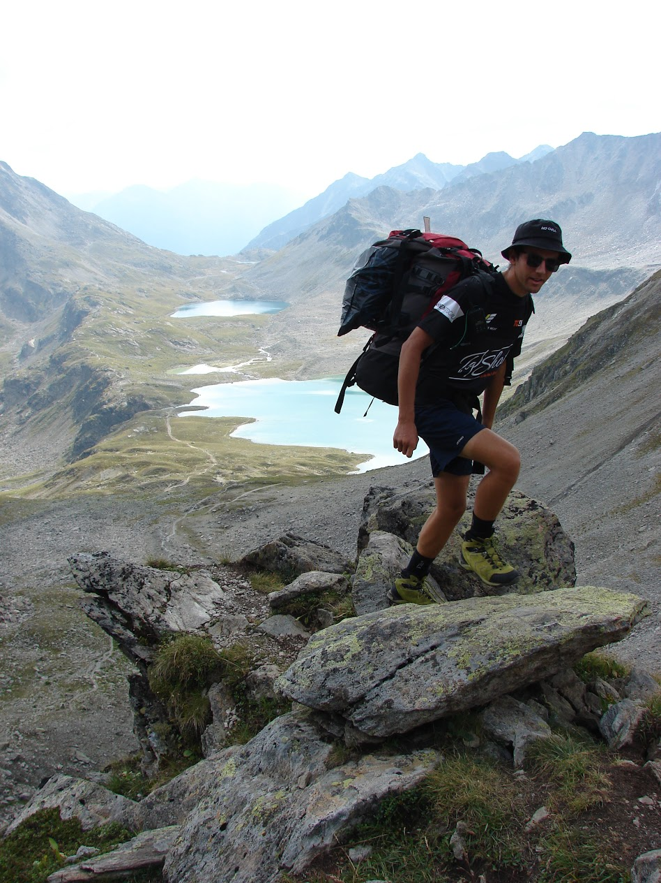
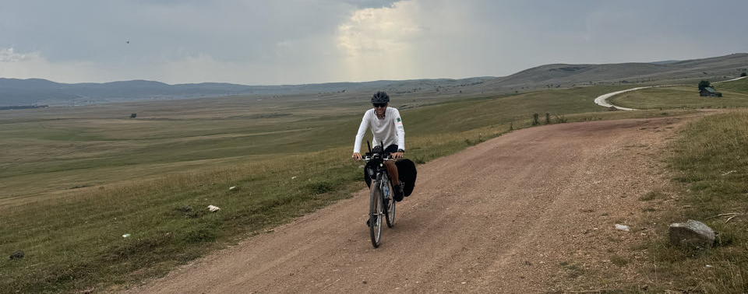
Florin Ziegler
University: Eastern Switzerland University of Applied Sciences
Study program: BSc Electrical Engineering
Year of study: 2025–2028
City: Gommiswald, Switzerland
Motto for life: enjoy life
Hobbies: Friends, Family, Paragliding, Mountaineering, Bikepacking, Travelling
Your expectations from the summer school:Talk with different people from different cultures about different topics.

