Slide 1

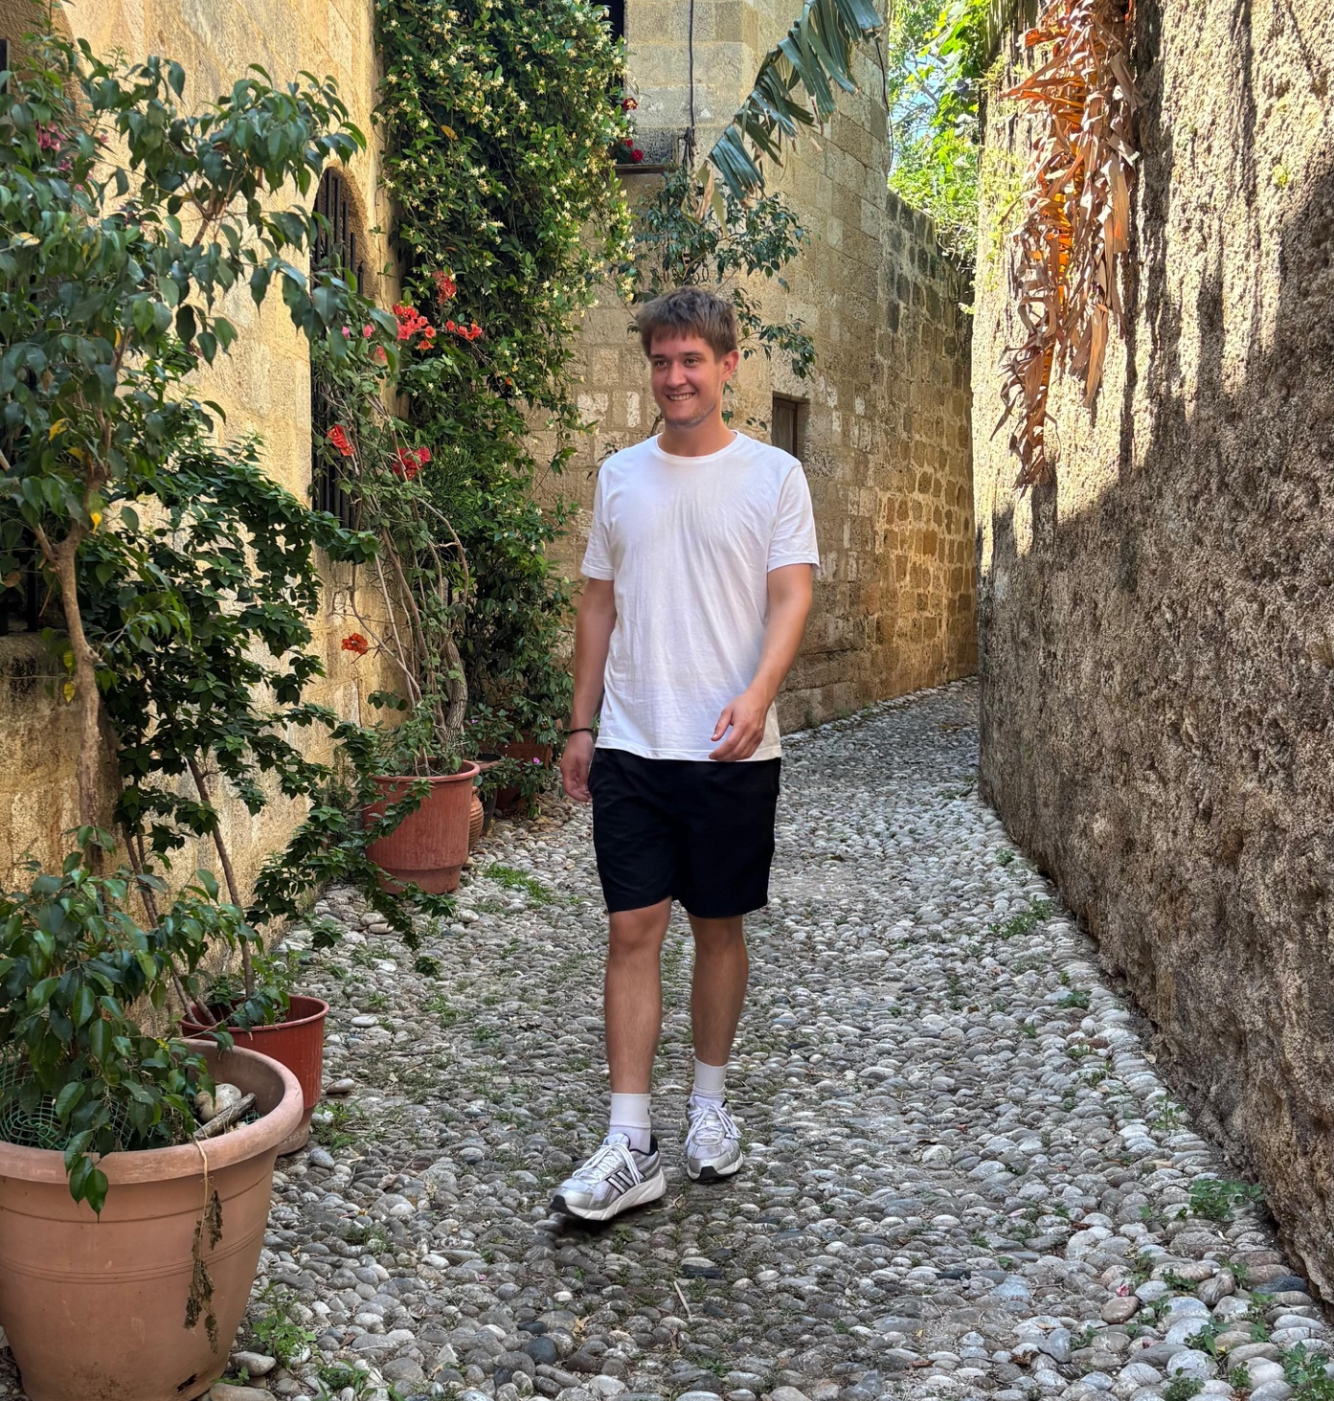




Malte Siegismund
University: Karlsruhe University of Applied Sciences
Study program: Mechanical Engineering
Year of study: 3
City: Karlsruhe, Germany
Motto for life: Good vibes only
Hobbies: Football, Tennis, Volleyball, Skiing
Your expectations from the summer school:
Having an interesting week, connecting with other people
Location where I study,
and where I live
Karlsruhe
31 August to 11 September 2026

