Slide 1


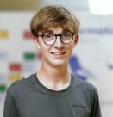




Philipp Batliner
University: Eastern Switzerland University of Applied Sciences
Study program: Spatial planning
Year of study: 4 years
City: Rapperswil, Switzerland
Motto for life: Bring your ideas to life
Hobbies: hiking, tennis, golf, skiing, spending time with family and friends
Your expectations from the summer school:
Learn how to shape this world into a better place
Where I work and live
Where I study and live
Karlsruhe
31 August to 11 September 2026

