Slide 1

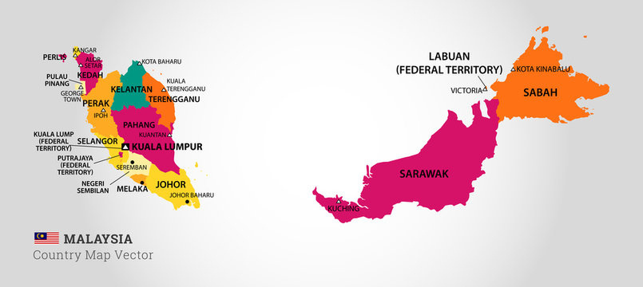
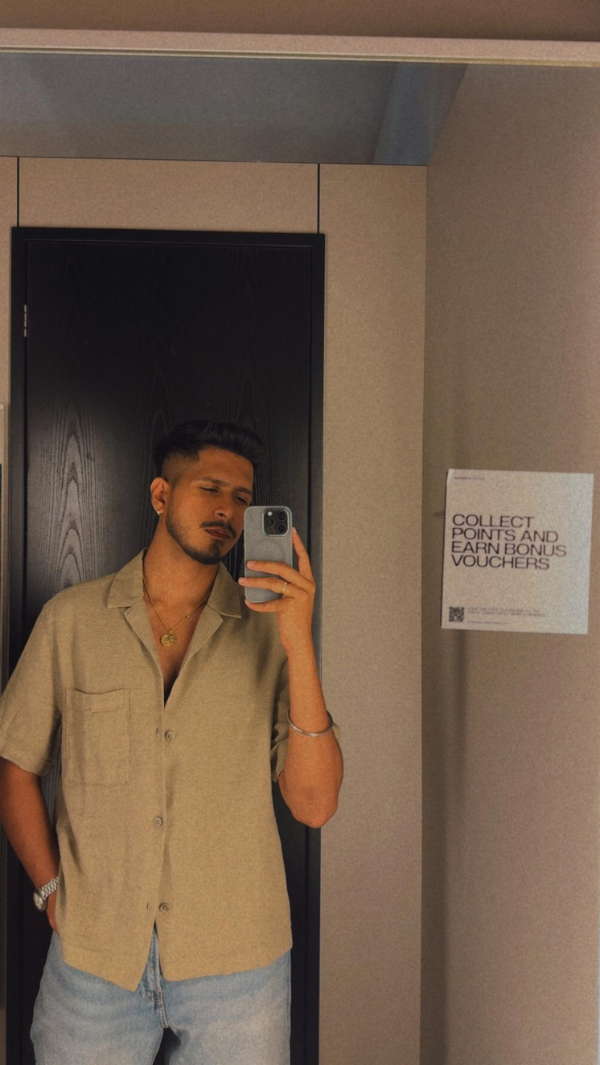






REAASIGAN A/L VISHNU PARAMATHMA
University: Universiti Malaysia Pahang Al-Sultan Abdullah
Study program: Mechatronics engineering
Year of study: 4th Year
City: Pahang, Malaysia
Motto for life: Go with the flow and never regret your decisions
Hobbies: Hiking, Camping, Fixing Legos & Gundam, Football & gaming.
Your expectations from the summer school:
To learn and create a sustainable future alongside knowing new people and cultures.
Location where I study,
and where I live
This is ME
Karlsruhe
31 August to 11 September 2026
Notes:
1

