Slide 1


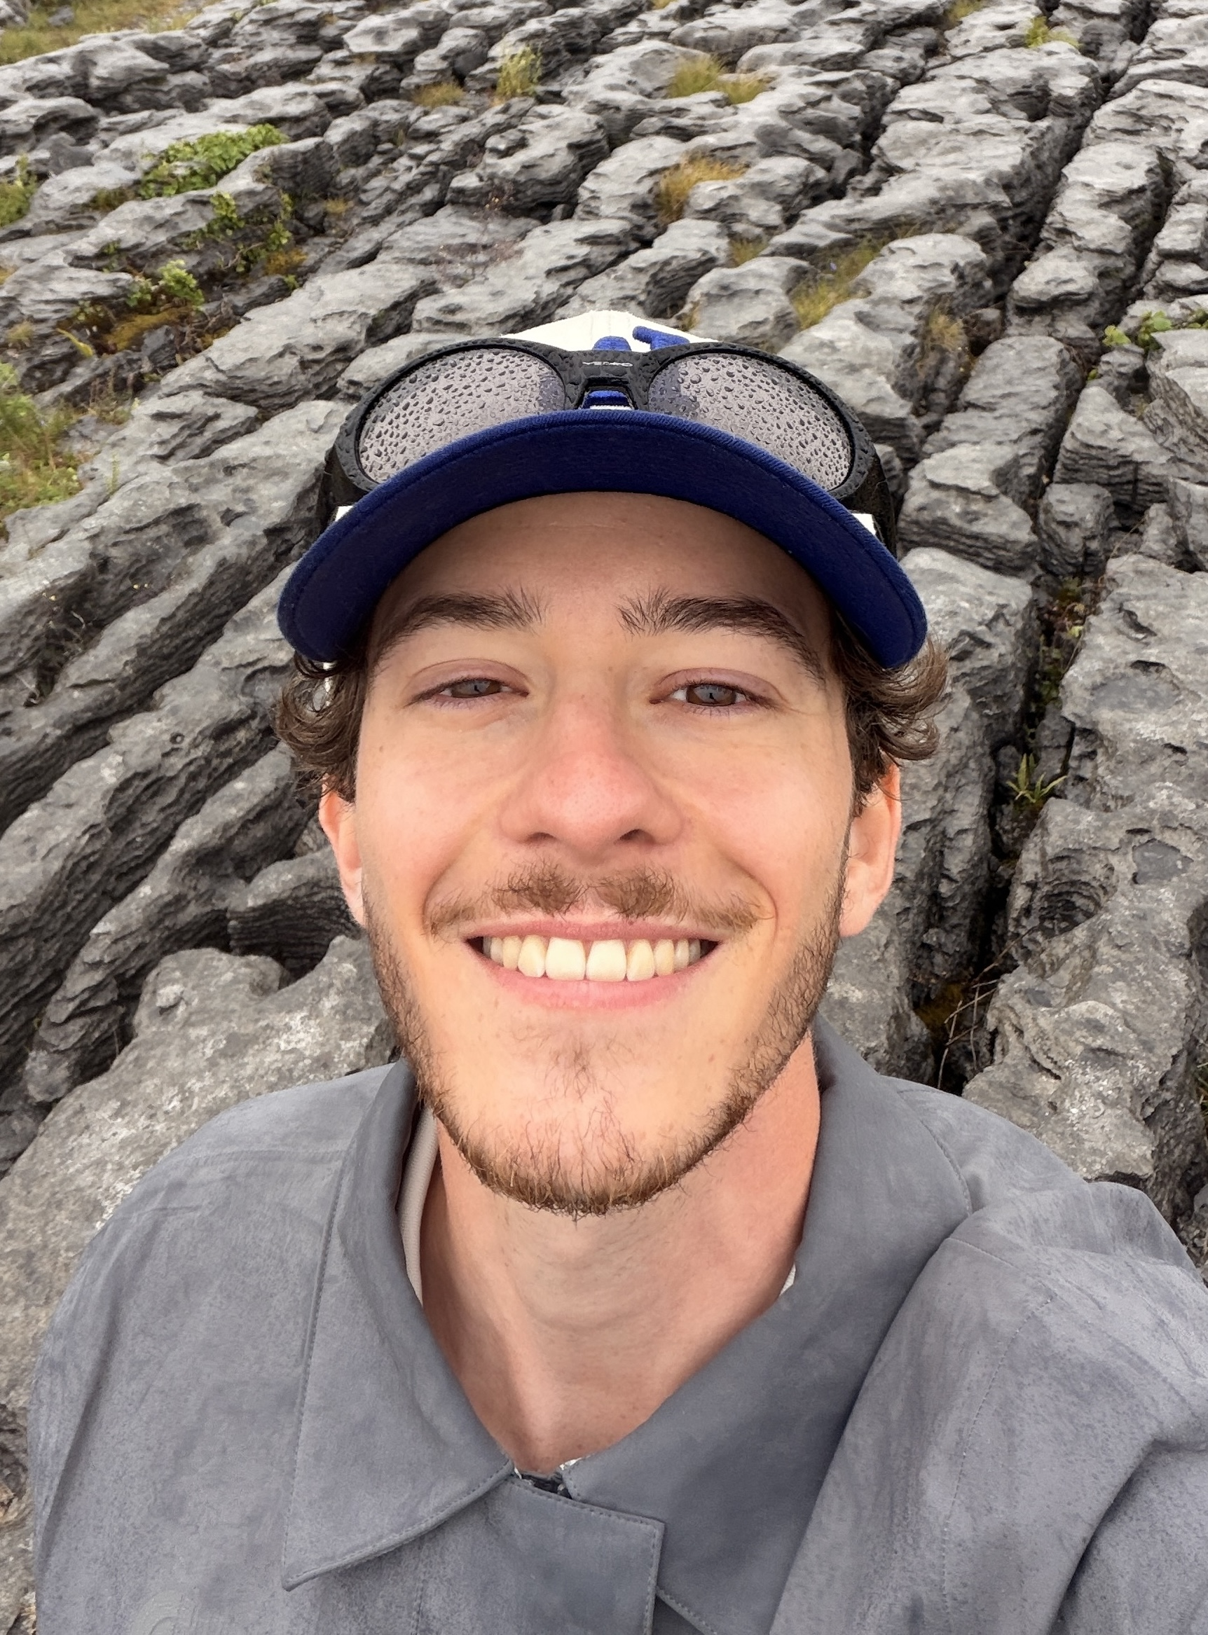




Raphaël Seiler
University: Eastern Switzerland University of Applied Sciences
Study program: Digital Design
Year of study: 4 years
City: Rapperswil, Switzerland
Motto for life: Don’t Worry Be Happy
Hobbies: fishing, hiking, biking, golf, skiing, driving, spending time with family and friends
Your expectations from the summer school:
Inspire the next generation to make this world a better place
Where I work and live
Where I study and live
Karlsruhe
31 August to 11 September 2026

