Slide 1
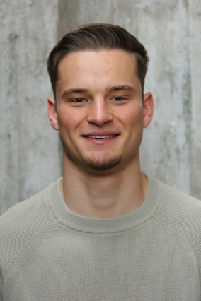
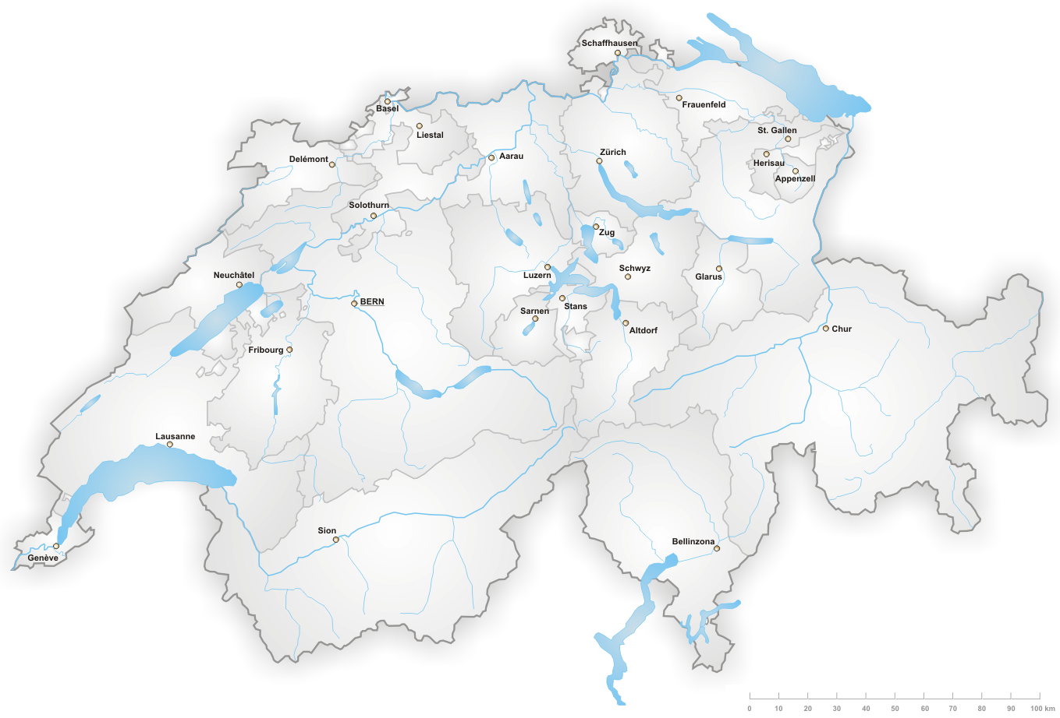
Reto Balsiger
University: Eastern Switzerland University of Applied Sciences
Study program: BSc Mechanical Engineering | Innovation
Year of study: 2024–2027
City: Uster, Switzerland
Motto for life: Stay curious, work structured, keep learning.
Hobbies: Mixed Martial Arts, fitness, skiing, travelling
Your expectations from the summer school:
Exchange ideas across disciplines, develop practical solutions and gain new perspectives for innovative engineering.
Uster, Switzerland
International Summer School • Engineering | Innovation • OST – Eastern Switzerland University of Applied Sciences

