Slide 1

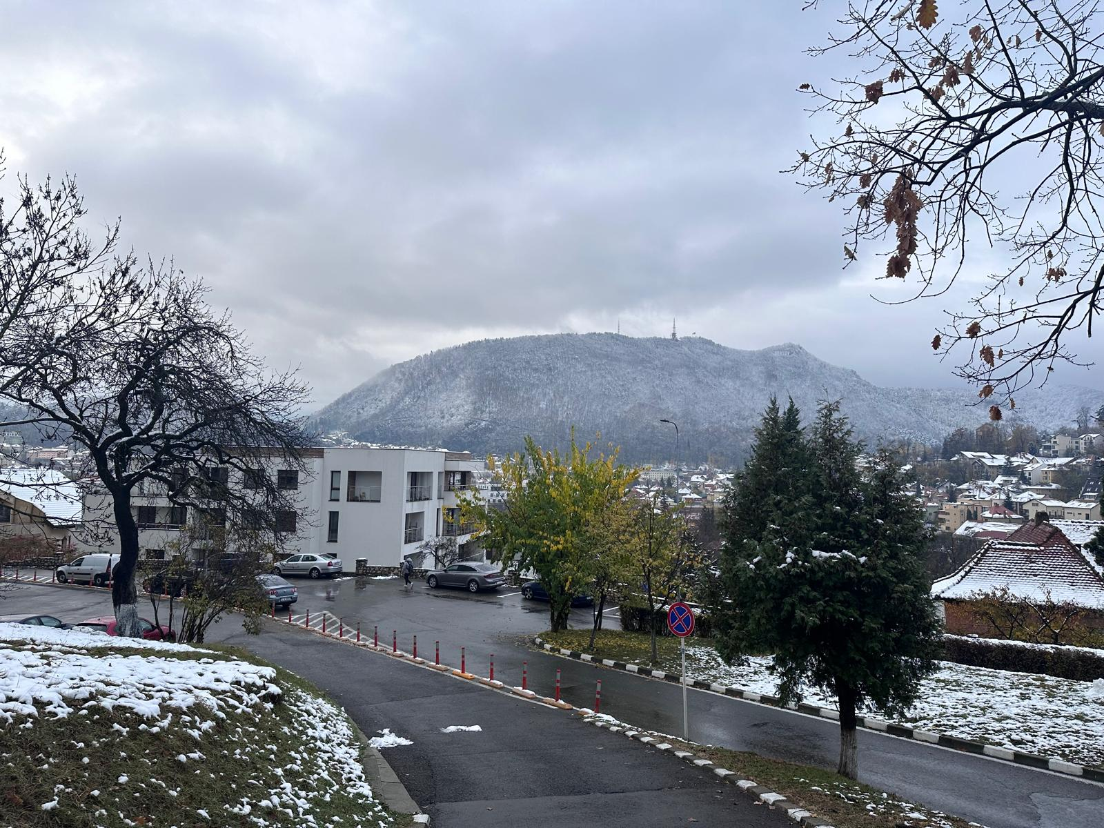
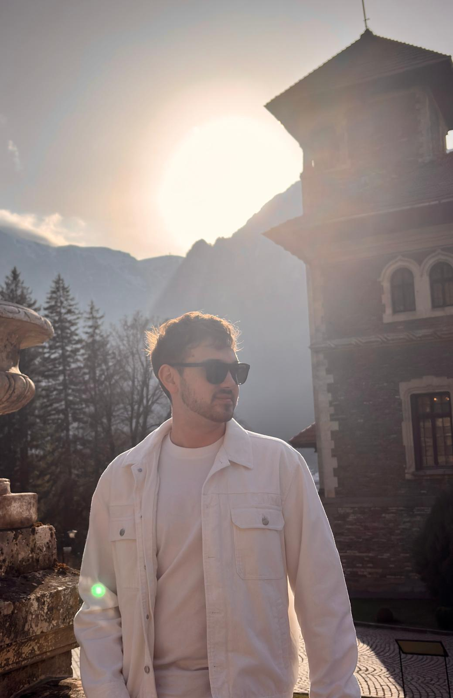
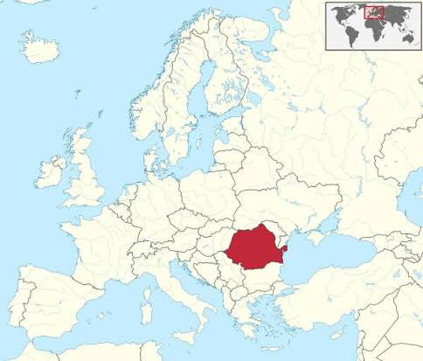

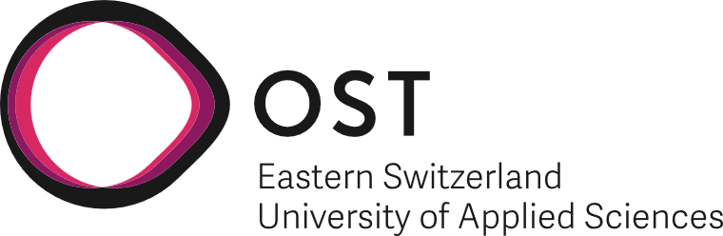


Trocea Cosmin Danut
University: Transilvania University of Brasov
Study program: Renewable Energy Systems Engineering
Year of study: 3 years / 6 semesters
City: Brasov, Romania
Motto for life: Chasing perfection
Hobbies: Motorcycles, Cars, Music, Travel, Adventure, Photography
Your expectations from the summer school:
I want to connect with new people and grow both personally and professionally, pushing myself to become the best version of who I can be.
Location where I study,
and where I live
Karlsruhe
31 August to 11 September 2026

