Slide 1
INTEL UNNATI
CODECRYPT
TEAM MEMBERS:
Aaron Thomas Blessen
Sreejith A
Midhun Sreenivas
GUIDED BY:
Er. Siju Sir

Slide 2
Problem Statement
Understanding Cryptography is Challenging
- Complex concepts make learning cryptography difficult.
- Lack of interactive, user-friendly tools for hands-on learning.
- Existing resources often fail to provide comprehensive educational content.
Solution: CodeCrypt
- An intuitive, interactive platform for exploring cryptographic techniques.
- Supports multiple data types and algorithms for encryption/decryption.
- Provides comprehensive tutorials and practical demonstrations.

Slide 3
Unique Idea Brief(Solution)
CodeCrypt: The Ultimate Cryptography Simulation Tool
- Interactive Platform: Explore and experiment with cryptographic techniques easily.
- Comprehensive Support: Encrypt and decrypt text, files, audio, images, and videos with RSA, AES, DES, and SHA.
- Educational Content: Access tutorials, demos, and practical guides.
- User-Friendly Interface: Built with Vite and React for an engaging experience.
- Key Management: Simulate key generation, exchange, and management.

Slide 4
Features Offered
- Algorithm Implementation: Experiment with RSA, AES, DES, and SHA using OpenSSL.
- Interactive Encryption/Decryption: Encrypt and decrypt text, files, audio, images, and videos.
- Key Generation and Management: Simulate cryptographic key generation, exchange, and management.
- User-Friendly Interface: Intuitive platform built with Vite and React.
- Educational Content: Access tutorials on public/private keys, symmetric/asymmetric encryption, digital signatures, and hash functions.
- User Interaction: Create and update profiles, experiment with various algorithms and data types.

Slide 5
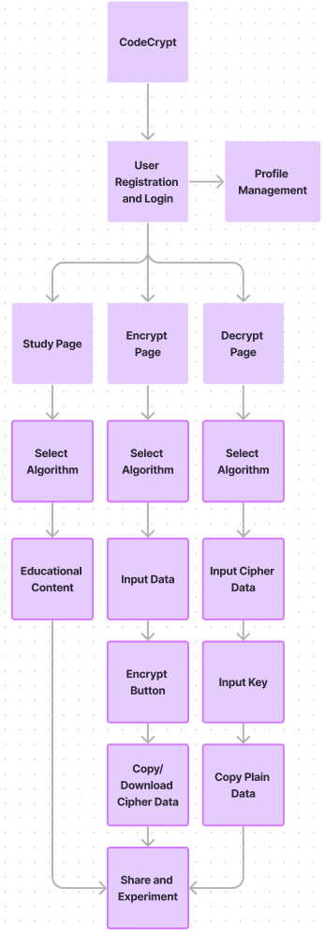
Process Flow
1. User Registration and Login - Sign up or log in on the website.
2. Select Algorithm - Choose an algorithm (RSA, AES, DES, SHA).
3. Educational Content - Access tutorials and detailed information on the selected
algorithm.
4. Input Data- Select data type (text, file, audio, image, video) and input data.
5. Generate Keys
- Generate required cryptographic keys.
6. Encrypt/Decrypt Data
- Perform encryption and decryption, view results.
7. Share and Experiment
- Share parameters for collaborative experimentation.
8. Profile Management
- Create and update user profiles.

Slide 6
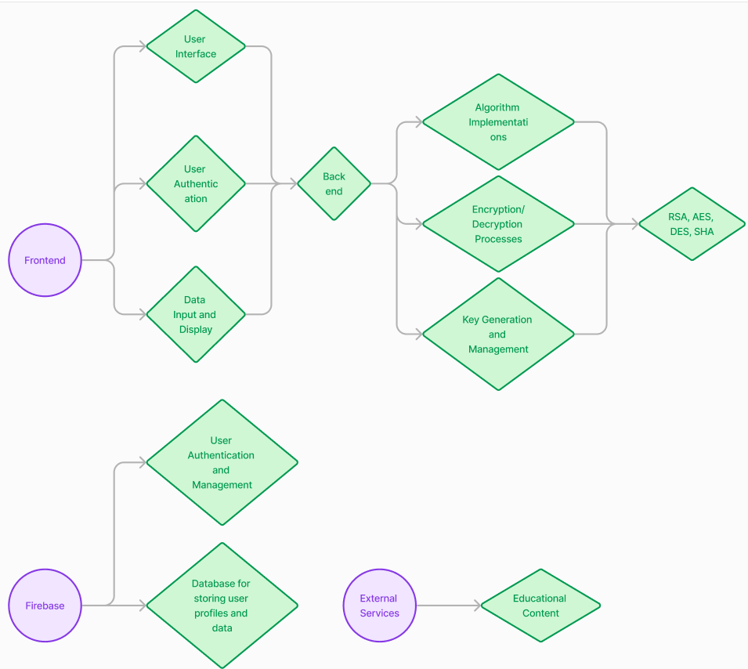
Architectural Diagram

Slide 7
Technologies Used
Frontend
- Vite - Fast and modern development build tool
- React - JavaScript library for building user interfaces
Backend
- C - Low-level programming language for implementing cryptographic algorithms
- OpenSSL - Cryptographic library for secure communications and data integrity
- Firebase - Backend as a service (BaaS) for real-time database, authentication, and storage
Cryptographic Algorithms
- RSA - Asymmetric encryption algorithm
- AES - Symmetric encryption algorithm
- DES - Symmetric encryption algorithm
- SHA - Secure Hash Algorithms for data integrity

Slide 8
Team Members and Contribution
1. Aaron Thomas Blessen
- Role: Backend Developer
- Responsibilities:
- Architecting the backend infrastructure using C and OpenSSL.
- Implementing various cryptographic algorithms such as RSA, AES, DES, and SHA.
2. Sreejith A
- Role: Frontend Developer
- Responsibilities:
- Designing and developing the user interface with Vite and React.
- Ensuring an intuitive and responsive frontend experience.
3. Midhun Sreenivas
- Role: Report Writer & Researcher
- Responsibilities:
- Conducting research on cryptographic principles and emerging techniques.
- Writing comprehensive documentation and reports for the project.

Slide 9
Conclusion
- Comprehensive Tool: Provides an intuitive and interactive platform for exploring cryptographic techniques.
- Educational Value: Ideal for students, professionals, and enthusiasts to learn about encryption, decryption, and key management.
- Versatility: Supports RSA, AES, DES, SHA, and various data types (text, file, audio, image, video).
- User-Friendly Interface: Built with Vite and React for a smooth user experience.
- Secure Backend: Implemented with C, OpenSSL, and Firebase for data security and integrity.
Continuous Improvement: Ongoing enhancements based on user feedback.
Website:- https://codecrypt-b591f.web.app/
Github:- https://github.com/Aaron-Thomas-Blessen/intelunnati_N-Coders.git

