Slide 1
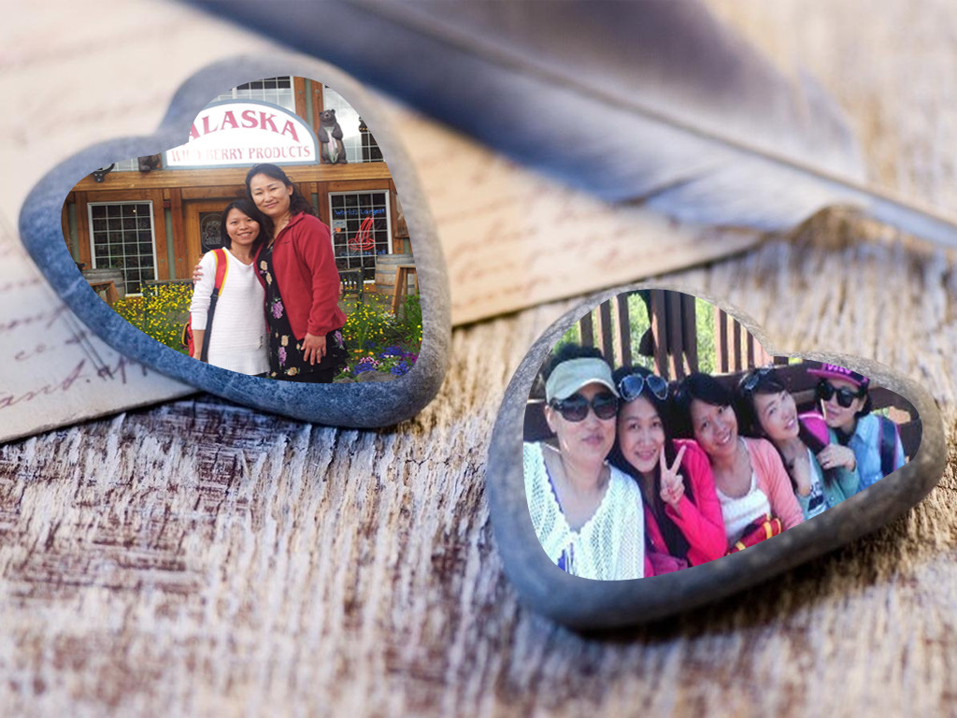
Appreciate for all the things you do to us !

Slide 2
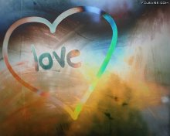
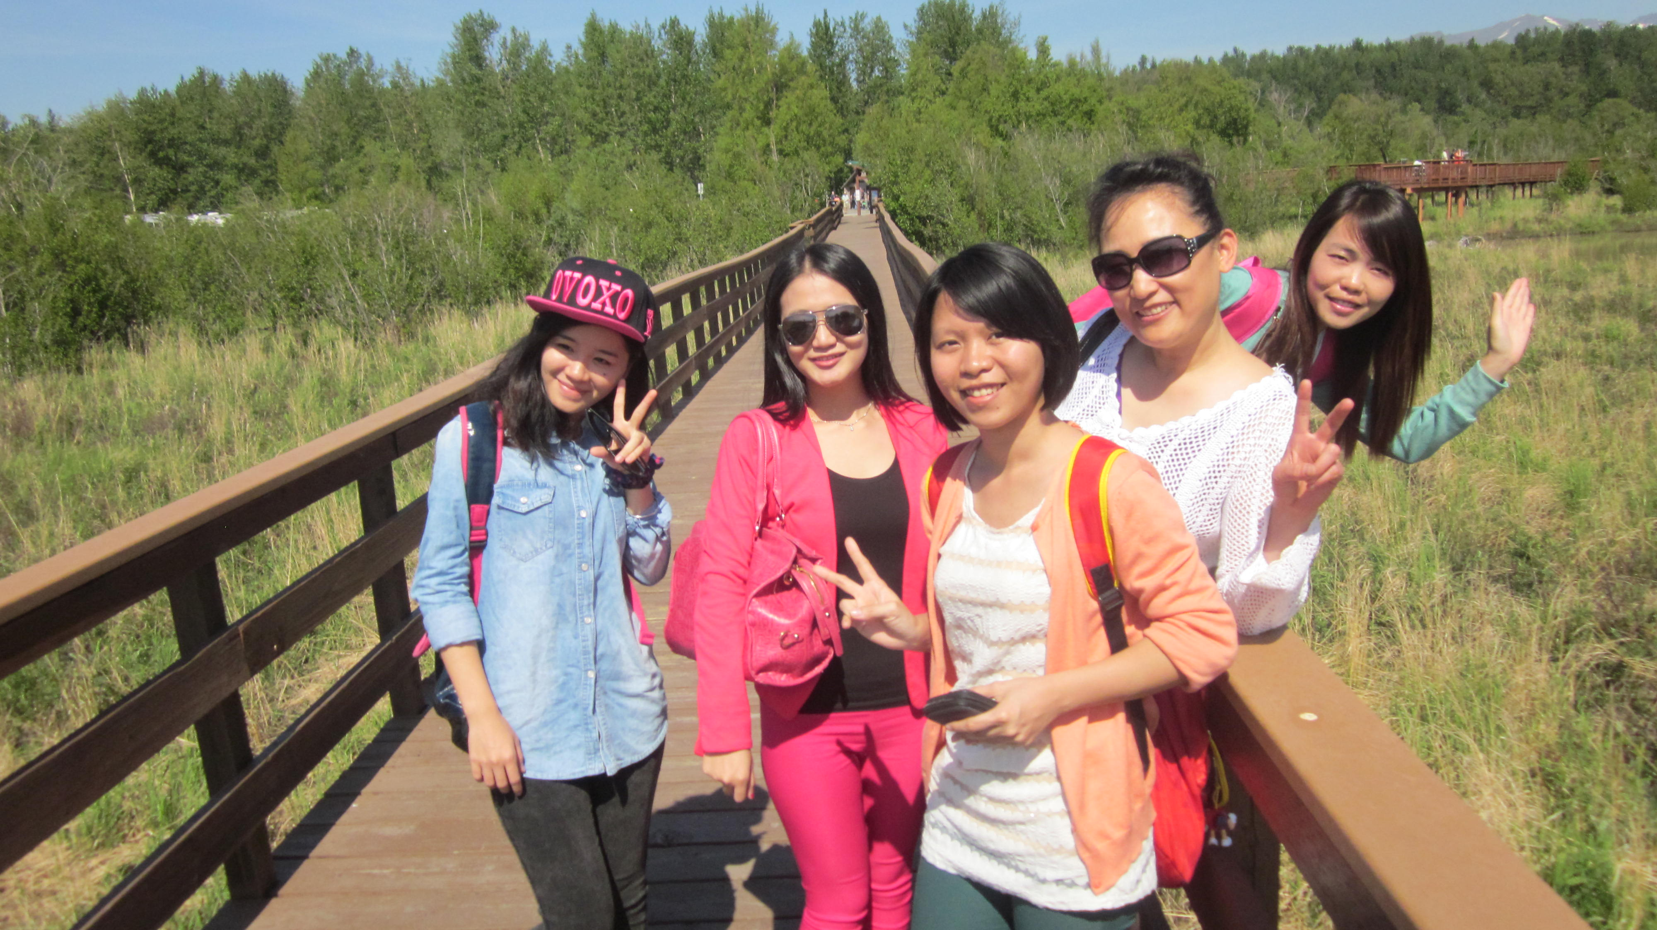
Thank You

Slide 3

You are the person
that I should ,must ,
can't wait to say thousands times of "ThankYou So Much"
in this special day.

Slide 4
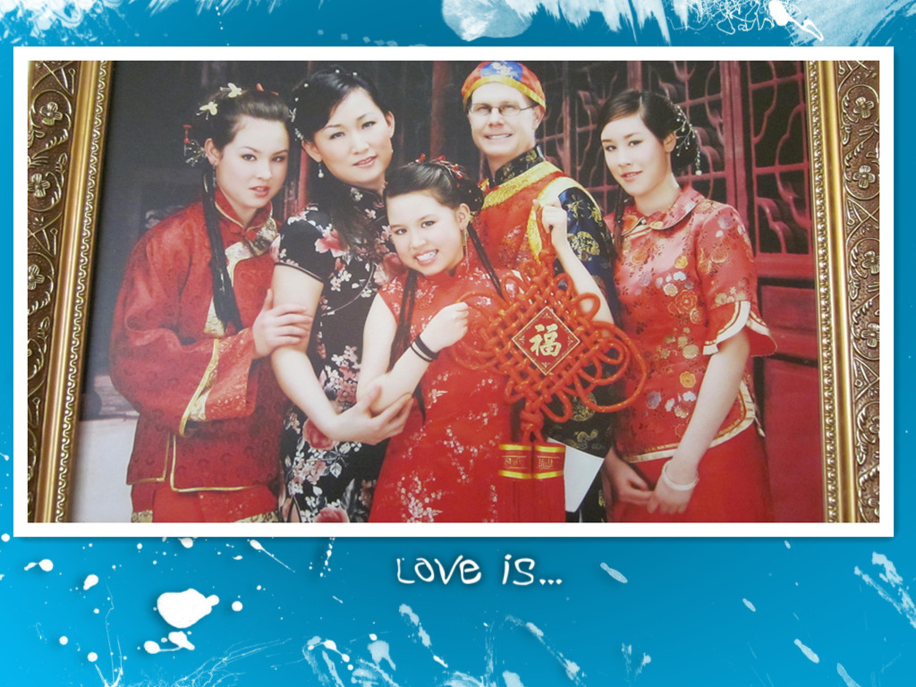

Slide 5
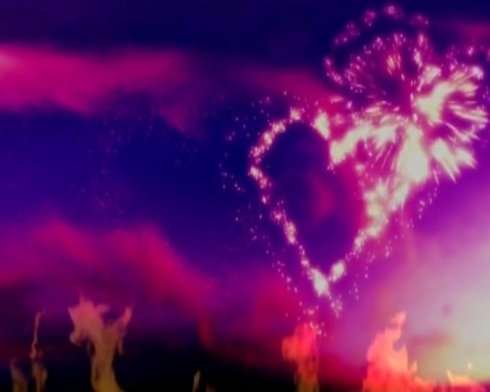
Every person has his reason to come
into this world,and I dare to
say that your
Reason to exist in this
world is to help people in need,to
spread warm and care to them,shape
them to be a person who is thankful to
everything they encounter and
also share their love and help
to others in return.

Slide 6
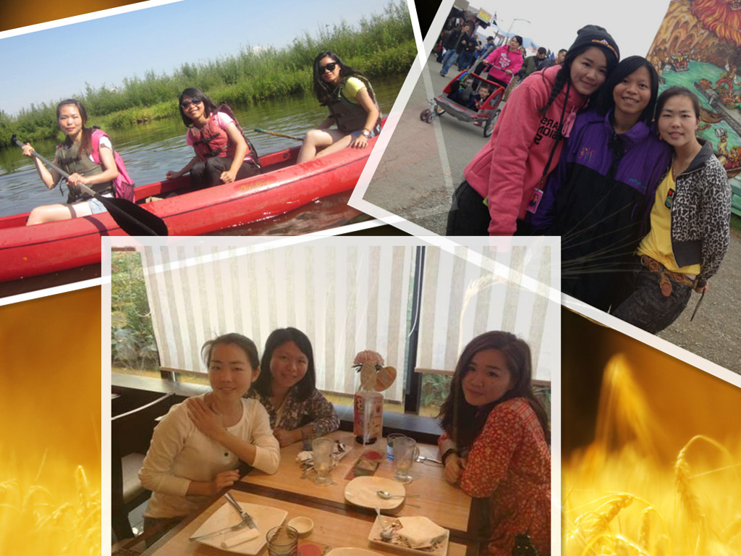

Slide 7

I am so glad that I can know you this
year and have you in my life.I am so
grateful for all the things you do for me
and all the words you say for me.

Slide 8
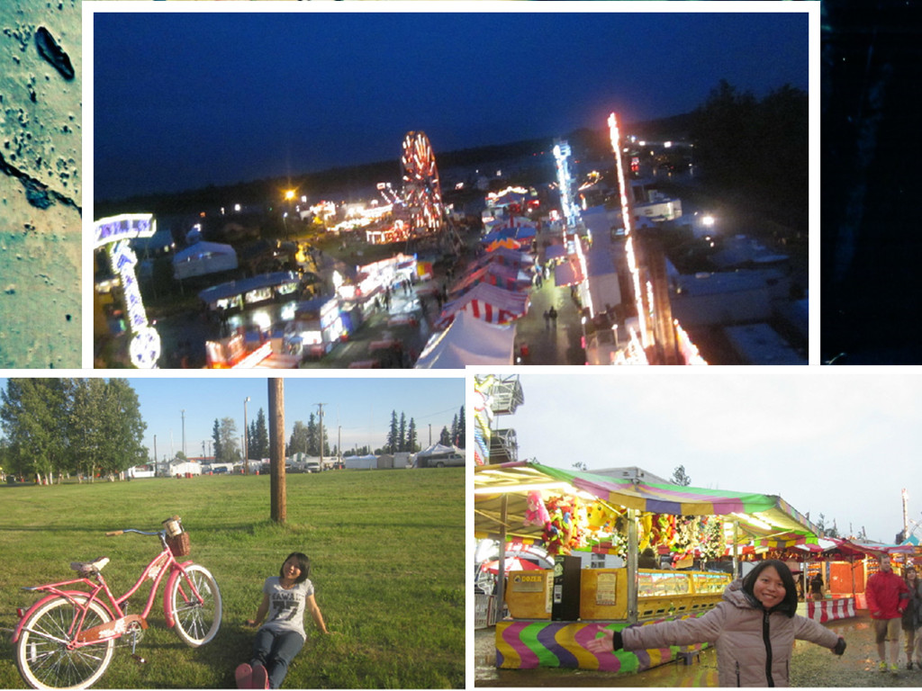

Slide 9

What I should thank you for most is that you
introduce God in my life,in
my heart,which let me
reborn again,let me
figure out that I am not
alone all this year and
always,cause I welcome
God come into my life.
I am and will always
be thankful for what I
be blessed with.

Slide 10
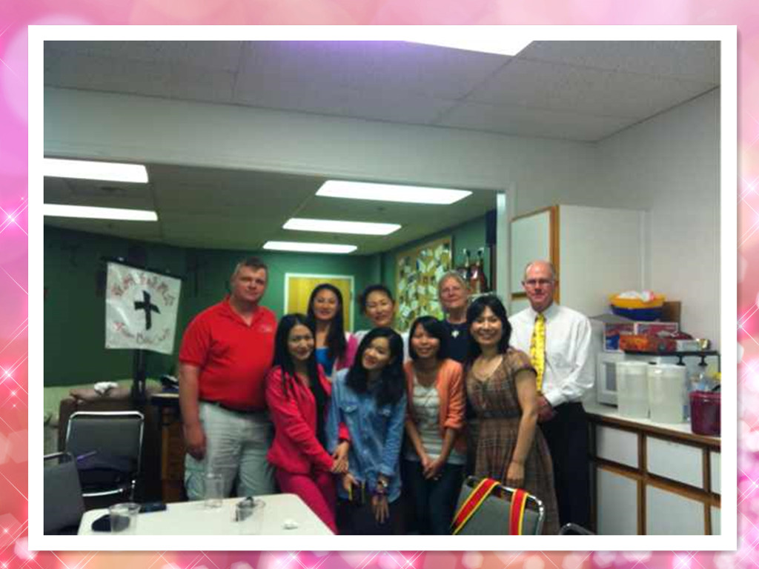

Slide 11
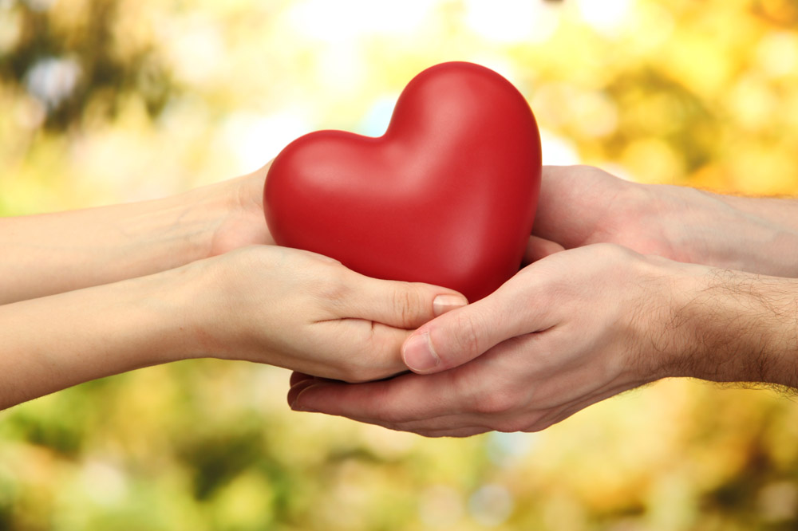

Slide 12

Have a full Thanksgiving day
Florence

