Slide 1

ToMaTo
A network experimentation tool
Dennis Schwerdel

Slide 2
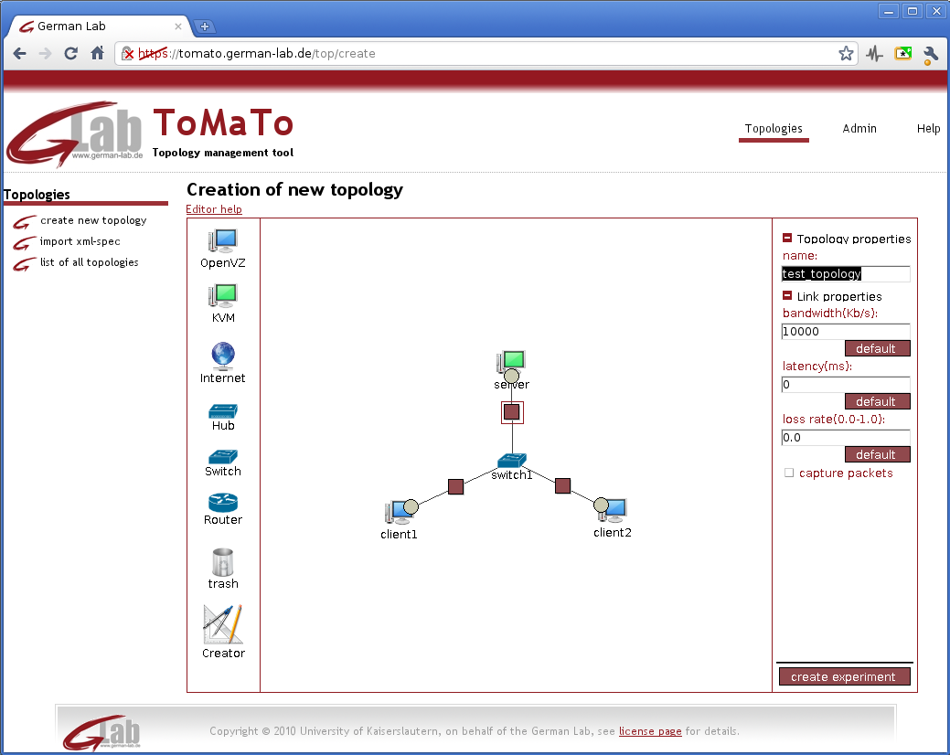
Overview
Introduction
ToMaTo
Architecture
Devices
Connectors
Features
Editor
Evaluation
Integration in German-Lab

Slide 3
Introduction
Why experimental facilities?
Helps designing, testing and improving network algorithms, applications and arcghitectures
Instrument for networking research
Existing experimental facilities
Planet-Lab
High node numbers → allows large experiments
Uses container virtualization → limited hardware and kernel access
Shared network interfaces → no network topologies
Emulab
No virtualization → full hardware and kernel access, inefficient
Realized as cluster → full control over network topology
Seattle
Very high node numbers → allows large experiments
Uses virtual python interpreter → no operating system access
Only custom python dialect → not suitable for all experiments

Slide 4
ToMaTo
Architecture
Devices
Connectors
Features
Graphical editor

Slide 5
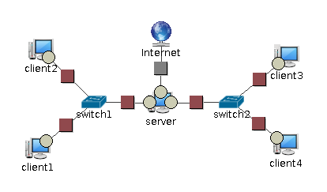
ToMaTo
ToMaTo: „Topology Managenemt Tool“
Topology contains
Devices
Connectors
Devices
Active components
E.g. computers
Produce/Consume data
Connectors
Networking components
E.g. switches, routers
Transport/Manipulate data

Slide 6
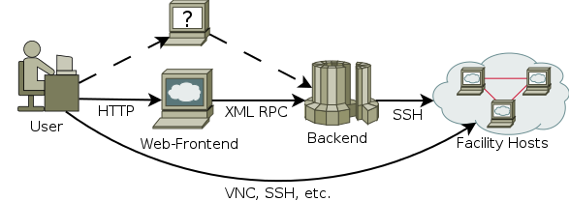
ToMaTo - Architecture
ToMaTo contains 3 parts
Host part
Based on PROXMOX VE
Offers virtualization
All additional software available as packages
Backend
Controls hosts via SSH
Centralized logic, resource management, user accounts
Offers XML RPC interface
Frontend(s)
Offer a GUI to users
Currently only a web-based interface exists
More frontends possible

Slide 7
ToMaTo - Devices
KVM
Full virtualization
Offers full access
OpenVZ
Container virtualization
Lightweight, uses less resources
Easier to access
Templates
Preinstalled device images, ready to use
Current versions of Debian and Ubuntu Linux (32 and 64 bits)
FreeBSD (only KVM)

Slide 8
ToMaTo - Connectors
Tinc VPN
Creates private networks between devices
Not encrypted → good performance
Hub, Switch or Router semantics
Special connectors
Connect devices to host bridges
Can connect devices to the Internet
Openflow integration planned
Link emulation
Only available for Tinc VPN
Can set additional QoS limitations on links
Packet loss
Bandwidth limit
Latency
Long-term statistics help users to estimate underlying link properties

Slide 9
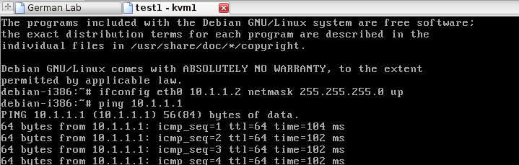
ToMaTo - Features
Administrator/Developer features
Intelligent load-balancing
Open xml-rpc interface
Administrator tools
LDAP integration
User features
Automatic network interface configuration
Changes to running topologies
Console access
Image up/download
Pcap capturing

Slide 10
ToMaTo – Graphical editor (1)

Slide 11
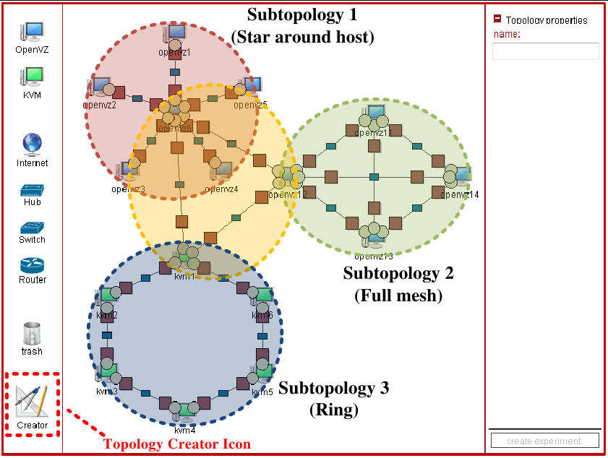
ToMaTo – Graphical editor (2)
Topology Creator
Automatically creates topologies
Ring topology
Star topology
Full mesh
Connects topologies
Configures network interfaces
IP addresses
Netmasks

Slide 12
Evaluation
Methodology
Access layer experiments
Network layer experiments
Algorithm/Protocol experiments
Legacy software experiments

Slide 13
Evaluation (1)
Methodology
Identify network experiment classes
Evaluate ToMaTo support for these classes
Access layer experiments
Consider lower layers and hardware
Example: Mobile handover
Requirements
Hardware access
Custom operating systems (Realtime)
Heterogeneous access technologies (3G, Wifi, etc.)
Complex setup, depending on hardware type
Needs specialized testbeds depending on hardware
DES Testbed, Wisebed

Slide 14
Evaluation (2)
Network layer experiments
Focus on TCP/IP suite
Example: IPv6 extensions, TCP substitutes
Requirements
Deep OS access (modified kernels, etc.)
Small but complex topologies, link emulation
ToMaTo offers
Full kernel access via KVM
Complex topologies
Link emulation
Packet capturing (for analysis)
Easy setup of topologies

Slide 15
Evaluation (3)
Algorithm/Protocol experiments
Work on top of network layer
Example: P2P-Networks
Requirements
Huge but simple topologies
Link emulation
No hardware or OS access
ToMaTo offers
Lightweight virtualization with OpenVZ (250 devices per host)
Link emulation
Ability to connect to other testbeds via Internet
Up/download of images (simplifies setup of multiple devices)

Slide 16
Evaluation (4)
Legacy software experiments
Considers legacy software
„Legacy software“ refers to any widespread software with undocumented or unpublished behavior
Example: Skype and Windows
Requirements
Special environments, custom operating systems
Access to external services
Small but complex topologies
Link emulation and external packet capturing
ToMaTo offers
Custom operating systems with KVM (even Windows and BSD run)
Acces to external service via Internet connector
Packet capturing independent of guest OS

Slide 17
Summary
ToMaTo summary
German-Lab integration

Slide 18
ToMaTo Summary
Flexible and extensible
3-tier architecture
Openflow integration being developed
Efficient
As much access as needed (KVM)
As less resource usage as possible (OpenVZ)
Easy to use
Graphical editor, topology creator
Automatic interface configuration
Supports experiments
Ready-to-use templates
Link emulation
Image download/upload
Packet capturing
Direct console access

Slide 19
German-Lab Integration
Embedded in SIG Facility
But not bound to German-Lab
20 German-Lab hosts already ToMaTo-enabled
Access via http://tomato.german-lab.de
Direct account integration via LDAP
All German-Lab users can access ToMaTo
Joint development
Host part, Backend, Frontend
University of Kaiserslautern (Dennis Schwerdel)
Topology creator (part of graphical editor)
University of Würzburg (David Hock)
Openflow integration (current development)
University of Würzburg (Student work)

Slide 20
Dipl.-Inf. Dennis Schwerdel
Phone: +49 (0)631 205-26 43
Fax: +49 (0)631 205-30 56
Email: schwerdel@informatik.uni-kl.de
Internet: http://www.icsy.de

